Slide 1
Vessel Listing & Assessment
Megan Harvey & Lori Tupper
Notes:
I am Lori Tupper and this is Megan Harvey and we are from Carteret County. First we want to thank the DOR for inviting us to speak. We hope you benefit from our presentation. We are here to talk about Vessel Listing & Assessment

Slide 2
Vessel Listing & Assessment
Motivation
Solution
Implementation
Benefit
Budget
Three Things to Remember
Notes:
The items we are going to review:
Motivation – what made us decide to make a change
Solution – what was our solution
Implementation – how did we implement our solution and some of the challenges we faced
Benefit – was it worth it?
Budget – what did it cost us?
Timeline – how long does it take?
Let us just leave you with three things to think about

Slide 3
Where we were:
Little preview:
Notes:
This is a funny video to break the ice – it is a parody of the listing process

Slide 4
MOTIVATION
Value Method
Boat Motors
Manual Update
Staff Shortage
Notes:
Motivation
Staff Shortage – in our office we have a Business Property Appraiser, Listing Supervisor, Two Customer Service Representatives. Trying to keep up with all of the boats was becoming impossible
Value Method – we were using various types of methods to value the boats. We were losing the fair and equitable concept. We had to standardize this process
Boat motors – viewing the value record in our software application, we could not tell if the motor was included in the value. In addition, we were missing a lot of the multiple motors.
Manual Update – annually we had to touch every boat value record to adjust the FMV. Time consuming and labor intensive. We could not handle this task.

Slide 5
Boats
Time
Value
Problems
Notes:
Annually, the number of our boats were decreasing. Taxpayers would list one year and not the next. We did not have the time or the resources to track all of these. In addition, our tax levy was decreasing. We had to come up with a more efficient manner to list, value and bill boats.

Slide 6
Solution
Notes:
Use the tax bill as the discovery notice and annual tax bill.

Slide 7
Bill
Import
Value
File
Notes:
How do we get to the discovery/ bill?
We needed a file……
Listed every boat in our county
Valued every boat in our county
Import directly into our tax software application
Made it to the final step our Bill/Discovery Notice

Slide 8
Vessel Valuation Services (VVS)
Provide actual "market value" instead of straight-line depreciation, reducing taxpayer complaints
Support the assessment with a nationally recognized pricing guide
Eliminate the mundane task of looking up each entry manually and recording the result
Save personnel time that is better spent on discovery and service
Increase tax levy
Notes:
Where did we get our file? We use “Vessel Valuation Services (VVS)”.

Slide 9
VVS
Flat file
Vessel Reporting System CD
Valuation Summary
Coast Guard Documented Vessels
Notes:
VVS – gives us the flat file that includes the owner and boat information located in county and values that boat
A CD that allows us to search and view the information in the file (this is handy to determine if the boat price includes the motor, if the boat has multiple motors and valuing discovered boats.
Overview of the number of boats and their value
Spreadsheet that lists the owners and boat information of documented vessels in your county.

Slide 10
One step further
Import the file

Slide 11
Import Process
Advantage:
Values and situs each boat in our county
Updates personal property records
Notes:
Values and situs the boats in our county - freeing up staff to work on discoveries
Updates personal property records- gets them ready to be billed and deletes the records of boats no longer in our county

Slide 12
Import Process (cont’d)
Challenges:
Situs
Key component to match (software and import file)
Justification issue
Boats that were not in the file

Slide 13
VVS Upload - Situs
More or less physically located
Street address, city
Multiple street addresses that cross towns
Same zip code for multiple towns
Where do I put this boat?

Slide 14
VVS Upload – Situs (cont’d)
Default situs
Communicate
Define the impact
First year is the roughest
Notes:
We had to identify a default tax district to use – just like with the VTS System.
The tax district we used was the same as the County Building.
We had several meetings with the town to let them know what we were doing. The impact was big the first year.
The first year was the roughest – taxpayers that never listed were confused

Slide 15
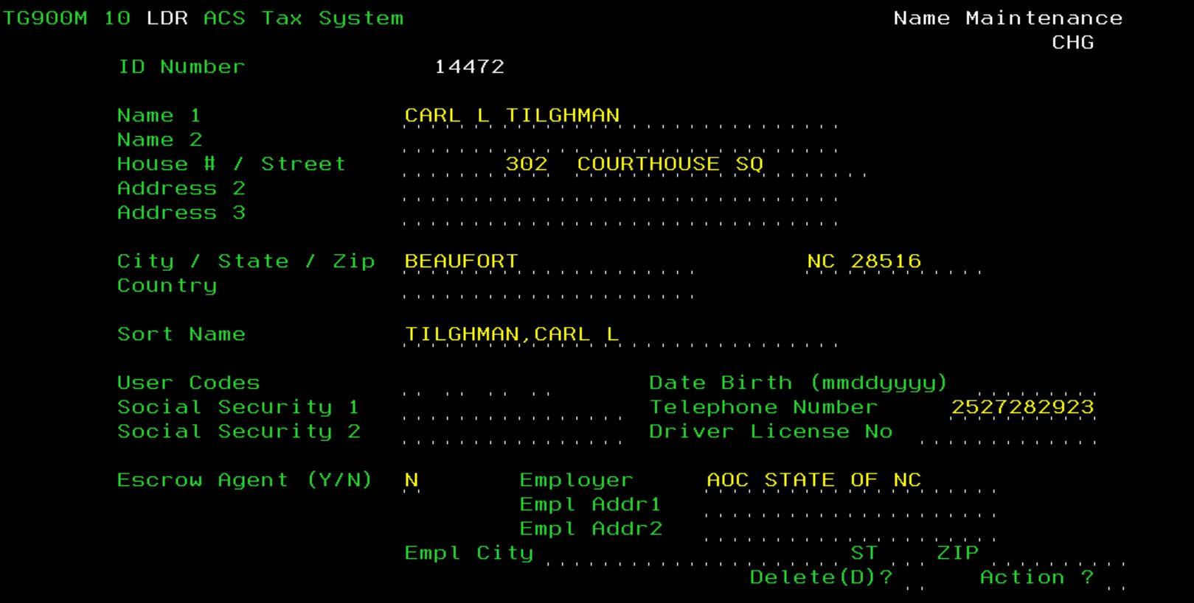

Slide 16
Key Component
Import file has name, address, boat information
Import file name Carl Tilghman
Software name Carl L Tilghman
Do we have a match?
NO

Slide 17
Key Component - Cont’d
Import file address vs. software file address:
Import file 302 Courthouse Square
Software file 302 Courthouse Sq
Do we have a match?
No

Slide 18
Key Component – Cont’d
Not matching – it would create another name record

Slide 19
Key Component – Cont’d
Need a static and reliable match
Could you use the hull id?
Maybe – but that follows the boat
Need to account for ownership changes
We use the Hull Key, Database ID, Renewal No

Slide 20
Hull Key, Database ID, Renewal No.
Notes:
This is a screen shot of ALVIN – the hull key is the renewal number

Slide 21
Notes:
This is a screens shot of the file that is on the CD. The database ID matches back to ALVIN

Slide 22
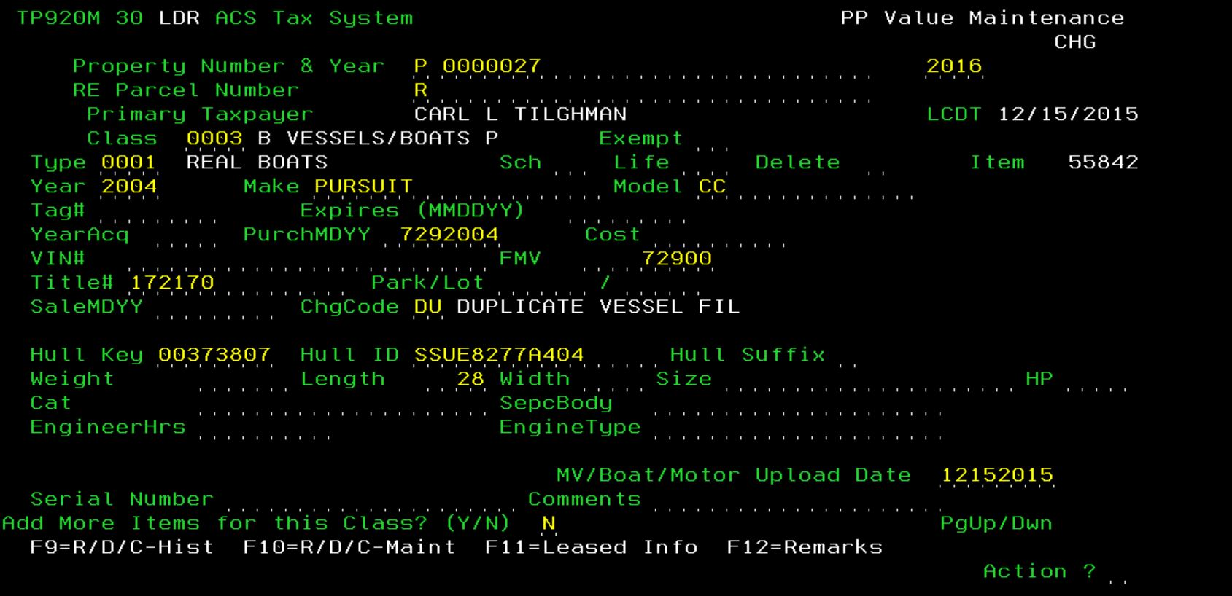
Notes:
This is a screen shot of our tax software – you can see it has a DU “Duplicate Vessel File” I know we billed them last year for this same boat

Slide 23
Notes:
This is a new record – AD – Add from Vessel File. We need to double check the situs.

Slide 24
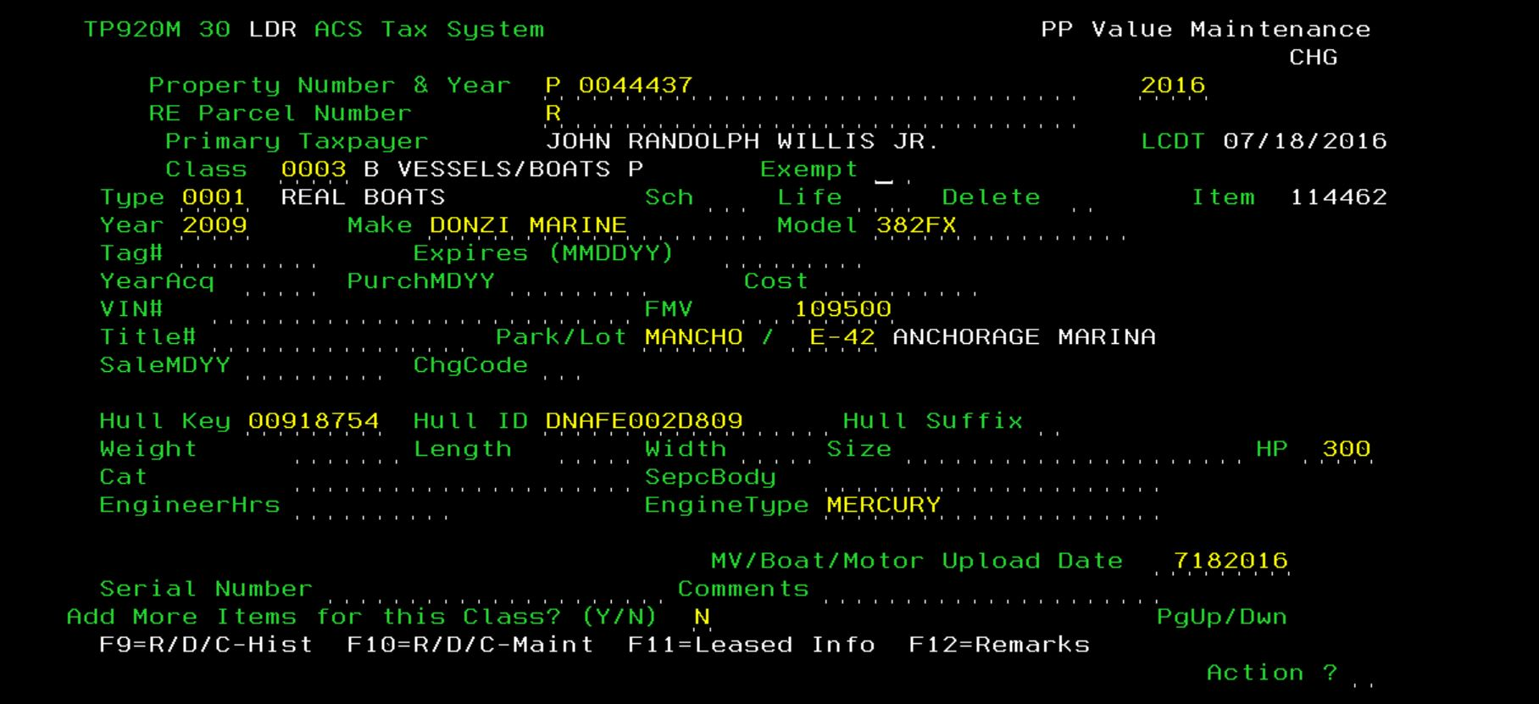
Notes:
This is one that was manually added. We always try to populate the Hull Key and Hull ID – next year a match – we don’t have to touch this record

Slide 25
Justification Issue
Boat Motor HP in Flat File
VS
Boat Motor HP in Software Application
Notes:
We had an issue the first year – HP was 150 but coming through in the import process as 1500.

Slide 26
VVS
Value discovered boats
Verify if motor is included in the price
Notes:
File on the CD allows us to quickly value discovered boats. We can search for a boat and find the value. This helps us value all the boats the same in our county. Easily determine if the motor if included in the cost of the boat.

Slide 27
VVS
Notes:
This is a screen shot of the CD File – you can click on find records to perform any search.

Slide 28
Notes:
This is a snap shot of a found record. You can see there are two motors on this boat. In addition, the boat value is included in the 61,400.

Slide 29
Benefits
 | # 0f Boats | Value
2016 | 25,062 | 308,001,481
2015 | 20,594 | 239,170,393
2014 | 9,253 | 142,455,147
Increase your levy
Fair & Equitable Value
Work on Discovery

Slide 30
Boat Comparison 2012 - 2016

Slide 31
Boat Value

Slide 32
Service
Software
Program to import file
Go Live
Import the file and bill
Vessel Valuation Services
$8,000* annually
One time fee $5,000
*based on the number of boats processed

Slide 33
Things to Remember

Slide 34
File of boats in your county with the value
Import the file
Bill serves as Discovery Notice

Slide 35
Contact Information
Megan Harvey (252) 728-8535
meganh@carteretcountync.gov
Lori Tupper (252) 728-8598
lorit@carteretcountync.gov
Dan Bradley (804) 338-3257
dan@vesselval.com

