Slide 1

The County Project
Correcting USPS addresses using the 911 database

Slide 2
Basics of sales tax reporting
Vendors are required to report to the NC Department of Revenue (DoR) sales tax by county
How vendors determines the county is up to them
Vendors use a variety of methods:
  5-digit zip code (often inaccurate)
  9-digit zip code
  USPS addressing database
Notes:
NO Control over Vendor’s Reporting
A large home good retailer in the county uses 5-digit zip

Slide 3
Five-Digit Zip Code Problem
Use of the 5-digit zip code
  Zip code boundaries do not follow county boundaries
  Incorrectly reported sales tax if vendor uses only 5-digit zip
  For example, Chatham addresses with Chapel Hill zip codes may be reported as Orange County sales
Notes:
Note: We are aware of 2 Chatham businesses charging Orange County rates
Example→ chapel hill addresses reported as orange county
Example- Governors Club→27516→ Chatham address→ Chapel Hill zip code

Slide 4
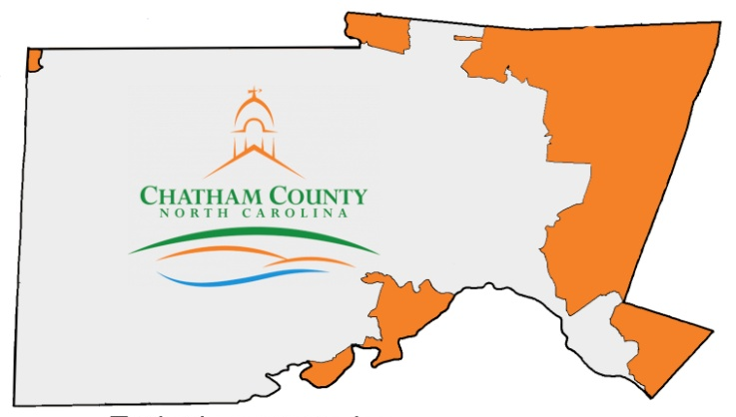
Chatham’s zip code story
Notes:
The areas in orange have 5-digit zip codes associated with other counties, such as chapel hill, apex, or cary.

Slide 5
Chatham’s Zip Code Story
In-Store Sales
  We found county vendors charging Orange’s rate (7.5%); Chatham’s rate is 6.75%
Delivered Goods Sales
  Sales tax is supposed to be charged based on the delivery address
  Items delivered to Chatham residents may incorrectly show as another county if only the 5-digit zip is used to report the sales tax
  A significant portion of building materials are delivered to the site
Notes:
An informal survey of contractors showed between 50 and 75% of building material is delivered to site

Slide 6
Chatham Zip Code
Zip Code Overlapping from
Another County
Notes:
You can see where our growth is
Vendors often use the 5-digit zip code only to track and report sales tax by county. We suspect that we are losing much sales tax because of this issue and have taken a number of steps to address it, including submitting a legislative goal to NCACC, talking with vendors, and doing an educational campaign of local businesses, contractors, and residents.

Slide 7
Chatham’s zip code story
We knew zip codes were causing us sales tax problems and had educated our residents on the issue
Then a few social medial posts showed up that a significant number of our vehicles were showing up in Orange County
We (especially our citizens) suspected our old enemy, the zip code
Notes:
A commissioner candidate brought this to my attention and she was convinced it was related to the zip code issue.
Travis: Yes, the zip code is determining the county code in most cases. When the postal worker goes to a new address if they don't put in the county code the zip code will dictate the county code.
As far as how they determined the county codes I spoke with Dawn Lambert in Greensboro after Frances Wilson contacted with the problem-- Dawn stated that a lot of time the county code is determined by where the intersection for a new road is entered (example Briar Chapel Pkwy the intersection is built from US 15-501 N if the incorrect county code was already wrong at this intersection then the road is assigned that same county code so as new roads were built off of Briar Chapel Pkwy they were issued the incorrect county code even though I was sending these new roads in to the local post office as Chatham County roads with the range and new addresses.

Slide 8
Chatham’s
County Project Story
DMV uses the USPS addresses to verify addresses for new vehicle registrations (as you tax folks know)
We have a lot of new registrations in our largest development, Briar Chapel, which has a Chapel Hill zip code
DMV’s addresses had the wrong county code for Briar Chapel; all new addresses were showing up in Orange County
Notes:
Is the zip code related to the county code?

Slide 9
Chatham’s
County Project story
Our Tax Administrator immediately notified the DoR
DoR suggested we fix the problem through the “County Project,” USPS’s method of correcting addresses
USPS is the ULTIMATE address database—used by many, not just DMV, for address verification

Slide 10
Chatham’s
County Project story
911 is the CORRECT address database; 911:
  Assigns all addresses initially (ADDRESSES COME FROM 911, NOT USPS)
  Uses Master Street Addressing Guide (MSAG) standards for uniform addressing and road names
  Not accessible to outside parties, like USPS is

Slide 11
Chatham’s
County Project Story
Enter the hero of this story: Lesa Chavis, Chatham County’s 911 Specialist
Lesa immediately worked with the Greensboro office to correct Briar Chapel (898 addresses)
Then, Lesa completed the first county project in North Carolina
Since Chatham, Rowan has also completed and Lee is in process
Notes:
From this point out, imagine Lesa as the ventriloquist and me as the dummy, which shouldn’t be too hard. I am simply sharing her work with you. She is an awesome 911 specialist, but she is reserved when it comes to bragging on herself.
Lesa had a contact in the Greensboro office.
No Rowan has done it and Lee has submitted their files. Orange, Alamance and Wake are planning on doing it. I haven't spoken with Harnett recently, but they said they were going to do it sometime in the fall.

Slide 12
The Results
Only 70% of addresses submitted match USPS exactly
11,466 addresses have been corrected
796 county codes have been corrected
179 Congressional codes have been corrected
It also returns all matched addresses in Zip+4 format
You are welcome, surrounding counties. We fixed your addresses too!
Notes:
I’m a bottom line person, so I like to know why I should pay attention to something.
Only 70% of addresses submitted match USPS exactly; this creates issues for mail, deliveries, and any other entity that uses USPS for addresses; all have been corrected (11,466)
The 11,466 now match the USPS exactly, except for some naming differences. For example, USPS spells out Mount. MSAG abbreviates as Mt. USPS was able to use an alias so that the abbreviated address shows as correct.
2% of addresses (796) did not match on the county code (this was after the clean up of Briar Chapel); all have been corrected. Basically, that would be 796 vehicle tax records won’t show up in the wrong county and would have to be reported and dealt with by two tax offices.
179 addresses did not have the correct Congressional code; all have been reviewed by elections and corrected
This file is very important for Congress. Any differences between the county database and the AMS database should be reviewed with the appropriate local representatives to determine the correct Congressional District.
Congressional franking (mailing) funds are based on this information, and
other government funds are often tracked against this information, so we need to make sure it is correct!

Slide 13
What is the County Project?
Effort by the USPS National Customer Support Center(NCSC) to improve the quality of addresses
Allows one comparison of data with USPS per year
Identifies local addresses that don’t match the USPS address management system (AMS) database
Resolves differences in county code and Congressional code with local addressing authorities
For Chatham, this valuable tool helps resolve both the sales tax and the vehicle tax issues

Slide 14
USPs County Project
Contact Info
Kathy Harris 800.331.5746, ext 4539 Memphis, TN
https://ribbs.usps.gov/index.cfm?page=countyproject (link forms and overview of the project)
https://ribbs.usps.gov/countyproject/documents/tech_guides/CountyProjectSOP.pdf (link to County Project SOP)

Slide 15
Not easy, but worth it
We were in a good position to send the data
The process took most of Lesa’s time over 3 ½ months
Steps:
  County addressing authority completes PS Form 5118 and then faxes to the NCSC
  NCSC confirms requester is the official local addressing authority
  NCSC processes approved application and notifies requester
Notes:
We had an addressing database we've been maintaining for years, to verify 911 downloads from the phone company.
GIS able to map (addressing points) ; this put us in the position to send them a file and cross-reference their file.
This piece took only a few days.

Slide 16
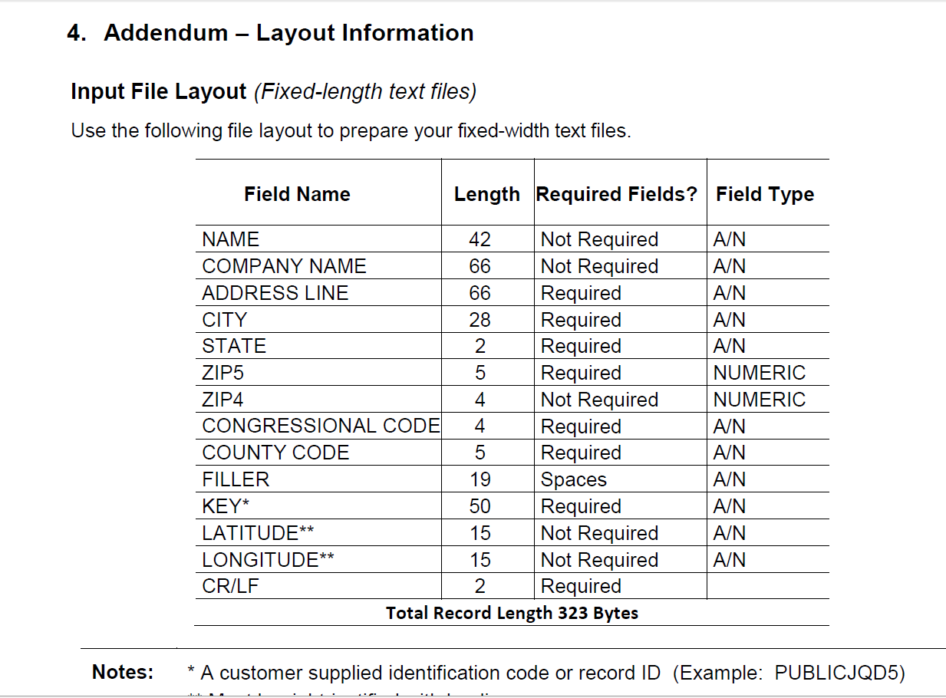
Not easy, but worth it
Steps:
  County submits file on CD/DVD media by mail or sends an encrypted file by email
Notes:
The format of the file that has to be sent is very particular. Here is a screen shot of the field requirements.
Lesa sent in Excel
Acceptable File Types:
• Excel (.xls)
• Comma Delimited (.csv)
• Fixed-length text files (.txt)*
• Access (.mdb)
• DBase (.db2)
• Extensible Markup Language (.xml)

Slide 17
Not easy, but worth it
Steps:
  NCSC sends encrypted file as an attachment
  The file provides a summary and all the detail needed to correct addresses
Notes:
Pretty quick turnaround.
Sent file in October 21. Results back by October 30.

Slide 18
Not Easy, But worth it
What we did to correct:
  Reviewed all discrepancies
  Sent in corrections to county code at one time
  Reviewed Congressional codes with Elections Director and sent in corrections at one time
  All other items were corrected in smaller “chunks”
  Lesa waited a couple of weeks and checked to make sure USPS had corrected in its database (checked every county and Congressional code, spot checks for the rest)
  If you have a lot of corrections you will need to submit them in a spreadsheet format
Notes:
This took from October 30 to January 14, 2 ½ months. The late fall and winter months are slower for addressing because of less development.

Slide 19
Ongoing maintenance
DoR encourages counties to send email of all new addresses on a weekly or monthly basis
Lesa sends in our changes daily
Tax Office vehicle transfers have been reduced by approximately 15 (33%) per month
No, you can’t hire her!
But, you can contact her!
  Lesa Chavis, 911 Specialist
  919.545.8161
  lesa.chavis@chathamnc.org
Notes:
Note that before all of this, Lesa sent our addresses to the local post office, but these apparently were not used to populated the USPS database.

