Slide 1
MOTOR VEHICLE VALUATION IN NCVTS
Linda Thomas
Cumberland County Tax Administration

Slide 2
Objectives
What Is Value?
Resources
Upload and Queue Work
Identification and Valuation

Slide 3
What Is Value?
N.C.G.S. §105-330.2
True Value in Money
Dealer Sales Price Including Accessories

Slide 4
Valuation Resources
TEC
Motor Vehicles
NADA
Antiques
Taxpayer
Trailers
Cost
Bodies

Slide 5
#1 Resource
Actual Cost
Taxpayer
Specific
Condition
Detailed
Accessories
Accurate Model

Slide 6
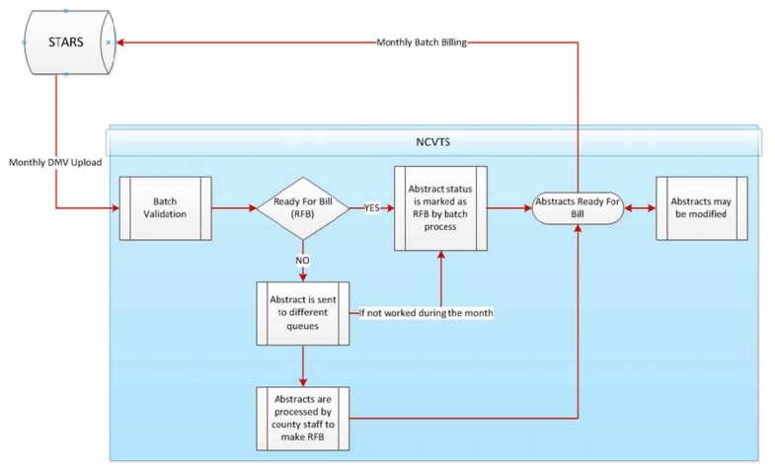
NCVTS Process

Slide 7
DMV Upload
Upcoming DMV Monthly Renewals
Value Matches Coded Ready for Bill (RFB)
Non-RFB Files in Review Queues
Remaining, Non-Reviewed Files Coded RFB in Billing Batch File Process

Slide 8
Using the Upload Report
Filter/Sort
Research
Mark/Export for Taxpayer Correspondence
Truck Bodies
Antique Vehicles
Trailers
RV/Camping Trailers
Unidentified Vehicles (Custom/Kit/Special)
VIN Research: www.vinwiz.com

Slide 9
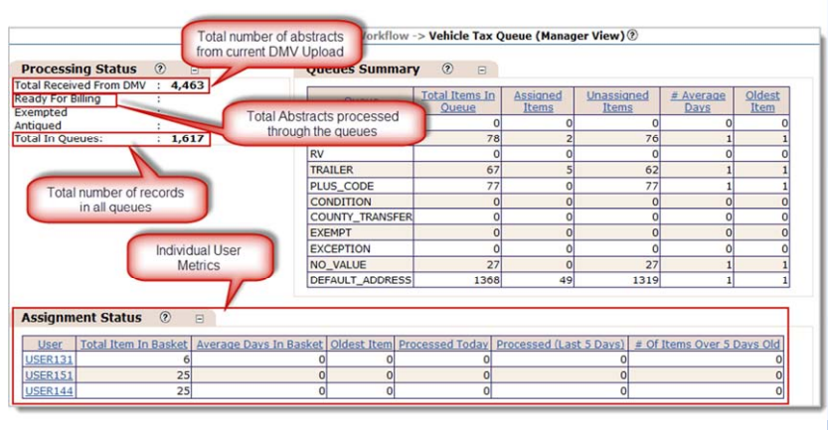
Queue Work

Slide 10
Body Styles to Review in Queue
AT - Animal Trailer
BT - Boat Trailer
TL - Trailer
UL - Utility Trailer
HR - Hearse
LM - Limousine
LS - Low Speed Vehicle
CT - Camping/Travel Trailer
HC - House Car
BU - Buses
SP - Special
TK - Trucks
WK - Wreckers
Antique Vehicles

Slide 11
Review for Truck Bodies
Freightliner
International
Kenworth
Mack
Peterbuilt
Sterling
Volvo
White
Ford VIN Identifiers
1FC, 1FD, 2FD, 2FC
Chevy/GMC VIN Identifiers
1GB, 1GD, 1GE, 2GB, 2GD
Dodge VIN Identifiers
1B6, 2B6, 3B6, 3D6

Slide 12
Why Review?
Correct Valuation Errors
Correct Models
Update Default Values
Add Truck Bodies
Correct Tax Situs
Fair and Equitable Taxation!

Slide 13
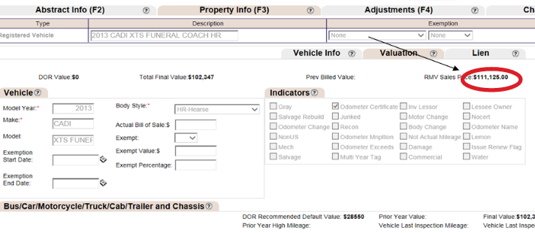
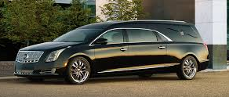
No Value Queue Example
2013 Cadillac XTS Funeral Coach HR
DOR Default: $28,550 Correct Value: $102,347

Slide 14
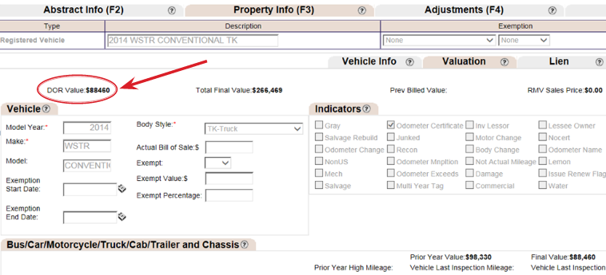
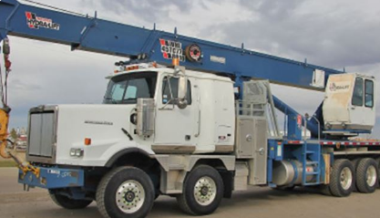
Plus Code Queue Example
2014 Western Star TK
DOR Default: $88,460 (Cab Only) Correct Value: $266,469

Slide 15
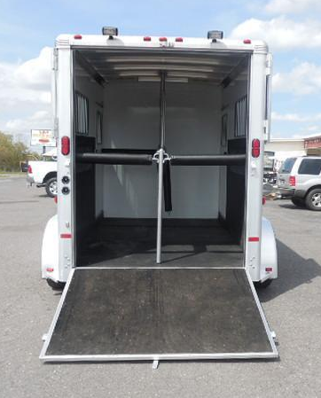
Comparing Values
2008 Sundowner Animal Trailer
RMV Sales Price $75,300 (2007)
Cost Residual Value $18,825
DOR Default Value $1,000
TEC High Livestock TL Value $9,650

Slide 16
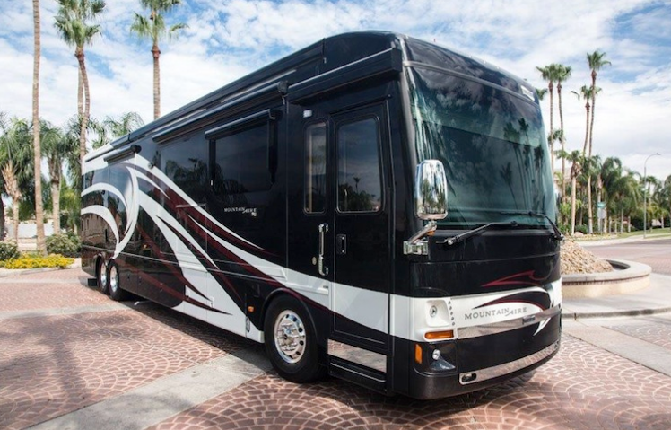
Comparing Values
2014 Newmar Mountain Aire HC
RMV Sales Price $376,672
Taxpayer Response: Model M-4369, 3 Slides, 43 ft.
Recreational NADA Value $343,150
DOR Default Value $39,950
(TEC – 32 ft.)

Slide 17
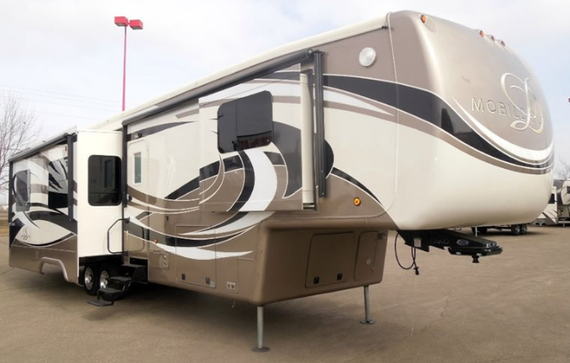
Comparing Values
2015 Mobile Suites CT
RMV Sales Price $121,885
Taxpayer Response: Model M-41-RSSB, 4 Slides, 41 ft.
Recreational NADA Value $96,750
DOR Default Value $7,000

Slide 18
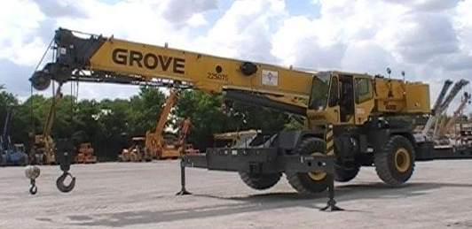
Comparing Values
2006 Grove SP
RMV Sales Price $520,000 (2015)
Value Using Trended Cost (B10) $468,000
DOR Default Value $8,100

Slide 19
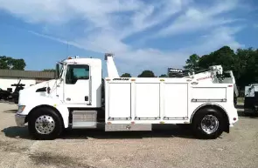
Comparing Values
2011 Kenworth Construction WK
RMV Sales Price $152,996 (2010)
RMV Sales Price – 2010 Cab Value = Body Cost
Trend Body Cost on B10
Current Body Value + Current Cab Value = Current Value
Value with Body $61,502
DOR Default Value $25,010

Slide 20
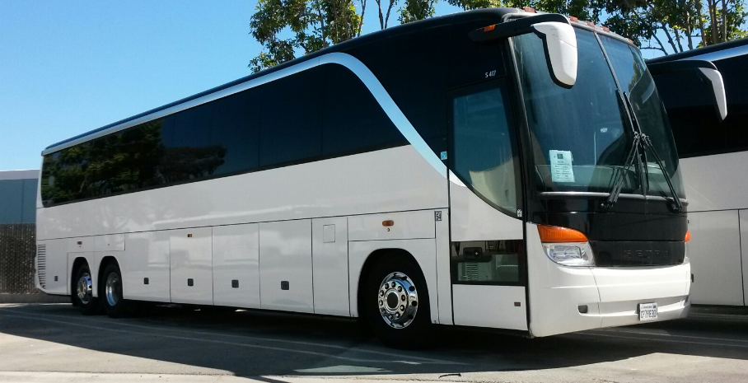
Comparing Values
2005 Setra BU
RMV Sales Price $175,000 (2014)
Taxpayer Response: Model S417
Value Using Official Bus Blue Book $150,030
DOR Default Value $1,000

Slide 21
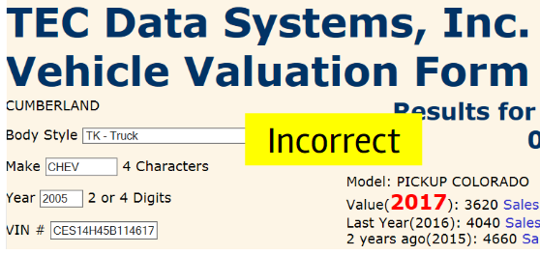
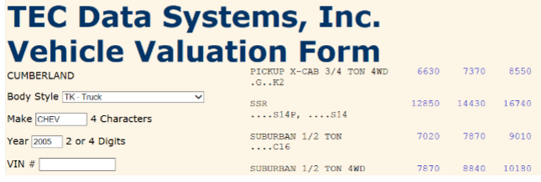
Verify Models with Similar VIN Identifiers
Chevy Avalanche
Chevy Cobalt (2007-09)
Chevy Colorado
Chevy SSR
Chevy Tahoe (2000)
Chevy Trailblazer (2006-08)
Chevy Uplander (2005)
Chevy Venture (2005)
Dodge Dakota
Dodge Durango
Dodge Ram (2009 – B18)
Note Value Difference!

Slide 22
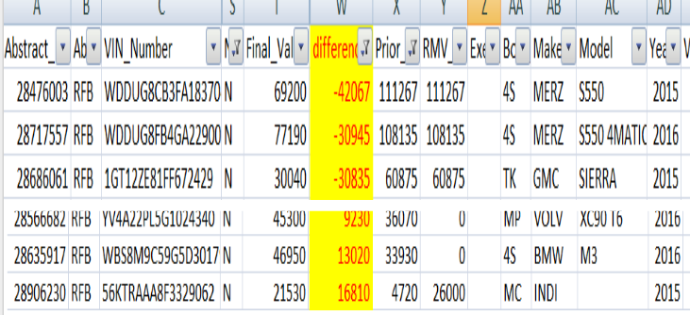
Finalizing Upload Report
Review and Edit
Verify Models with Similar VIN Identifiers
Compare Current Value to Prior Value

Slide 23
Remember!
The NCVTS queues and upload report are designed to allow counties to properly review and assess registered motor vehicles. If not used, you could be losing a lot of revenue!

Slide 24
Questions?
Linda Thomas
DMV Tax Analyst
Cumberland County
(910) 678-7501
lthomas@co.cumberland.nc.us

