Slide 1
ELECTRONIC DATA VERIFICATION PROGRAM Presented By: Jimmy Tanner Tax Director, Gaston County
Gaston County Government

Slide 2
Goals of Data Verification
Gaston County Government
Complete the property review process.
Have data as accurate as possible.
Promote customer service and public relations by demonstrating our efforts to being accurate.
Opportunity to interact with taxpayers.
Opportunity to bring awareness about reappraisal.

Slide 3
Goals of Data Verification
Gaston County Government
Provide an outlet for taxpayers to be involved in the process by “Helping us help them”.
Another tool to assist with future reappraisals
Increased confidence in our work product:
From the Public
From our Staff

Slide 4
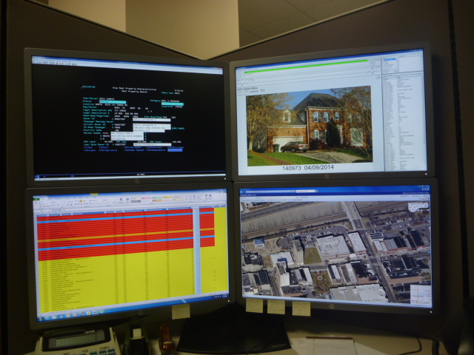
VISUAL DISPLAY OF ACCURACY
Gaston County Government

Slide 5
PROGRAM DEVELOPMENT
Gaston County Government
Developed for current and future uses.
How responses could be reviewed by staff.
Allow paper submissions or not.
Scheduled around prior year billing for significant savings on postage.
Date electronic process would end

Slide 6
PROGRAM DEVELOPMENT
Gaston County Government
Unique property owner access code required.
.NET Aspx Web application using SSRS.
Protection from spam and abuse.
Confirmation of completion.
Not allow multiple responses.

Slide 7
INTERNAL GUIDELINES FOR USE
Gaston County Government
Appraisal review from paper or electronic file.
Responses field reviewed or simply changed.
Standard procedure for reviewing responses.
Every response reviewed and processed.

Slide 8
PROGRAM DEMONSTRATION
Gaston County Government
LIVE DEMONSTRATION
https://egov.gastongov.com/TaxDataVerification/

Slide 9
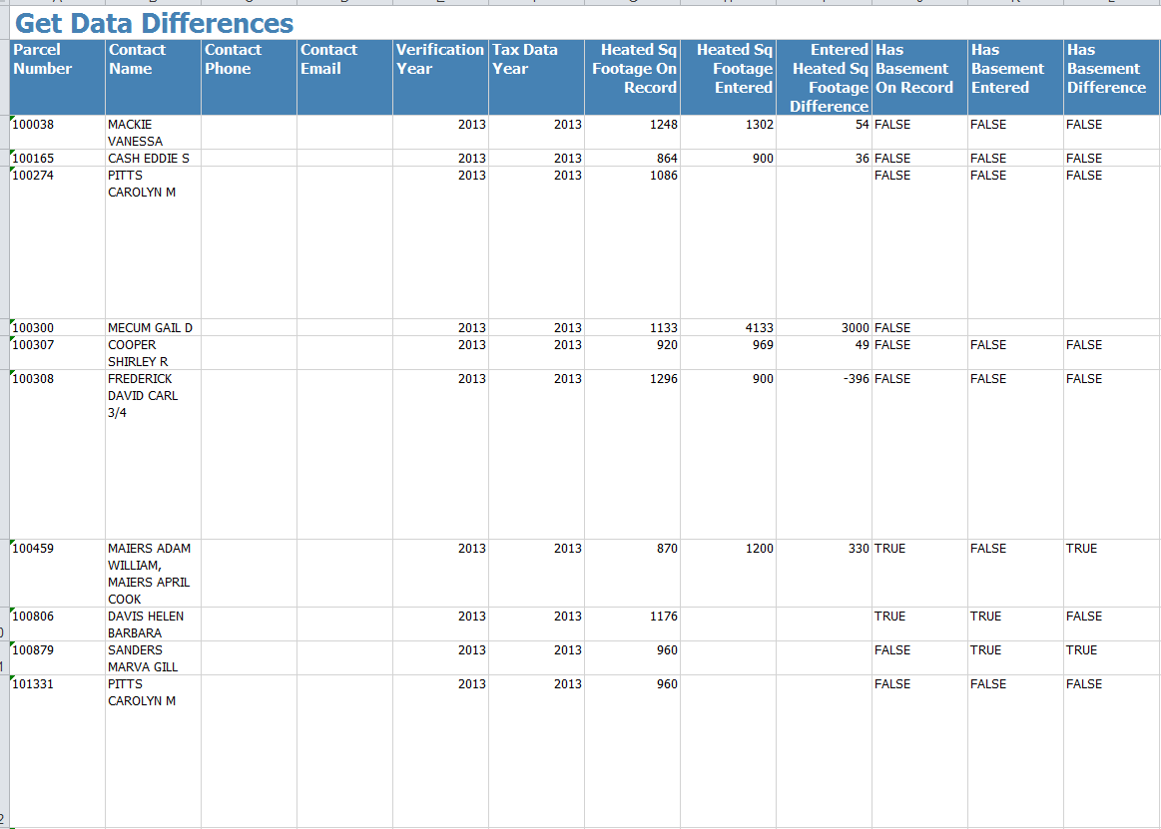
DATA DIFFERENCE REPORT
Gaston County Government

Slide 10
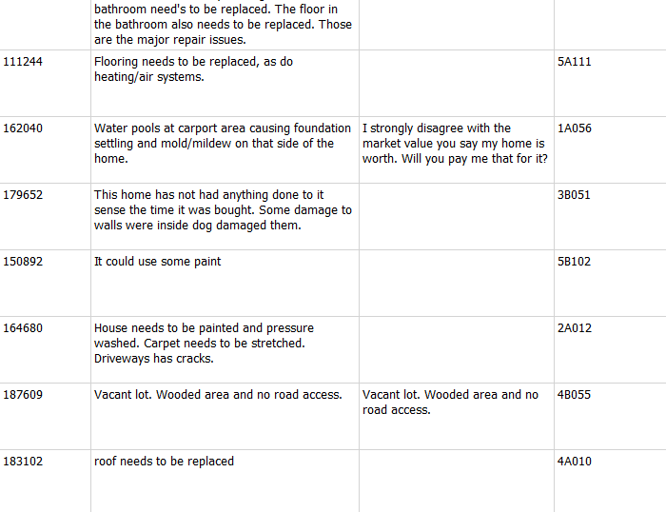
COMMENTS REPORT
Gaston County Government

Slide 11
Results
Gaston County Government
Approximately 13,000 responses
Over 8,500 Electronically
Public Perception was very favorable, especially news media.
Low percentage of false or bad responses.
Provided important information not available or visible.
Reduced volume of appeals.

Slide 12
Gaston County Government
Questions ???

Slide 13
Gaston County Government

Slide 14
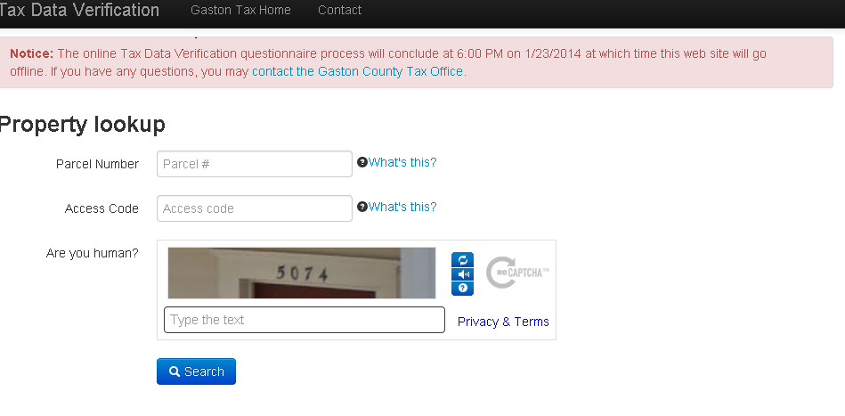
Gaston County Government

Slide 15
Gaston County Government

Slide 16
Gaston County Government

Slide 17
Gaston County Government

Slide 18
Gaston County Government

Slide 19
Gaston County Government

Slide 20
Gaston County Government

Slide 21
Gaston County Government

