Slide 1
Classic, Antique or
Just Old
NCDOR Personal Property
2016 Advanced Seminar

Slide 2
History
DOR contacted numerous times over the past several months regarding how counties are valuing the following types of vehicles:
Inquiries are from several different sources such as taxpayers, Secretary of Revenue, General Assembly Staff, General Assembly Members and the Governors Office
Recent articles featured in news papers around the state
Television News

Slide 3
Classic Vehicle
This classification can sometimes overlap with antique cars.
The definition of classic car is similar to that of antique cars.
A car must be at least 20 years old, but not more than 40 years old to be considered a classic car. It should again have been repaired and maintained in a way that keeps it true to its original design and specifications. In other words it should not be modified or altered. In addition, many add a stipulation that the vehicle should have been manufactured no earlier than 1925. For these reasons all classic cars are also antique cars, but not all antique cars are classic cars.

Slide 4
Vintage Vehicle
There is also overlap between vintage cars and antique cars.
Some vintage cars qualify as antique cars, but not all vintage cars are antique and vice versa. Different groups set different cut off points for what qualifies as a vintage car and what does not.
Generally, cars that are considered Vintage were manufactured between the years of 1919 and 1930, but some end it at 1925.
Unlike the other two classifications, having had modifications does not necessarily keep a car from being a vintage car

Slide 5
Antique Vehicle
An antique car is a classification that is often set by state law.
States often have a special type of license plate for these cars.
For that reason they set rules stating what qualifies as "antique." In most cases it is a car that's over 35 years old.
Generally the car should be maintained in a way that keeps it true to the original manufacturer specifications

Slide 6
Classic, Vintage or Antique?
Hobby?
Distinctions between the three; helps communication with the enthusiasts
Different definitions
NCDMV- 35 yrs or older ( some states 25 yrs or older)
Although there may never be complete agreement, the general consensus among the average collector and among state DMVs is that a car becomes an antique at 35 years of age.

Slide 7
Old cars become antiques when they are treasured by the owner and others alike.

Slide 8
Antique Vehicles
NCGS 105-330.9 allows antique vehicles to be appraised at no more than $500.00.
This statute was first passed in 1995 and until just recently, there have been very few problems with the application of this law. It appears that some counties have changed the way they are administrating this provision.
NCGS 105-330.9 requires that a vehicle meet the following five conditions in order to receive the special appraisal:

Slide 9
(1) It is registered with the Division of Motor Vehicles and has an historic vehicle special license plate under G.S. 20-79.4.
(2) It is maintained primarily for use in exhibitions, club activities, parades, and other public interest functions.
(3) It is used only occasionally for other purposes.
(4) It is owned by an individual.
(5) It is used by the owner for a purpose other than the production of income and is not used in connection with a business.

Slide 10
The problem we are seeing appears to be coming from how number (2) is being applied.
Number (2) above requires that a vehicle be “maintained” for use. It does not require a vehicle to be shown a certain number of times in exhibitions, club activities, parades or other public interest functions or every year in one of these events. It only requires the vehicle to be “maintained” not actually used for one of the purposes listed in number (2).
AV 66 Application should be used for taxpayers applying for the special appraisal of antique vehicles

Slide 12
Compliance Review
Part of 1/8 review
Questionnaire to verify mileage
The number of events cannot be a determining factor for approval

Slide 13
Classic Vehicle
Older Vehicles
Value increased due to turning one year older
Is the value increase justifiable ?
Can this be explained to the taxpayer?

Slide 14
Example Value Increase
Vehicle is 24 years old valued at $1,200
Vehicles is 25 years old valued increases to $12,500
How was the increase determined?
Was the value correct at $1,200?

Slide 15
Is my car vintage, classic or just old?
Most cars that are 25 years old or older are not considered collector cars by most auto enthusiasts
Classic that are normally categorized as “fine” “unusual” or “distinctive”
Most cars defined as classics are 1948 and earlier
Milestone Cars- had a significant influence into the market at the time they were introduced
Many of these vehicles are not maintained or restored
Exceptions would be:
  Cars that had a very low production run (produced in limited quantities)
  Initially had a high value (typically expensive to begin with)
  Sporty Cars ( 2006 Ford GT homage to ‘60’s GT sporty race car or 04-06 Porsche Carrera GT)

Slide 16
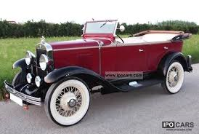
Classic, Antique or just Old? 1929 Chevrolet Convertible

Slide 17
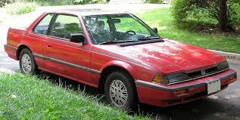
Classic, Antique or just old?
1991 Honda Accord

Slide 18
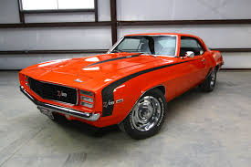
Classic, Antique or Just old?
1969 Camaro

Slide 19
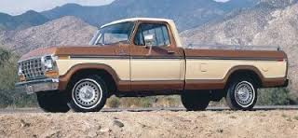
Classic, Antique or just old?
1979 Ford Truck

Slide 20
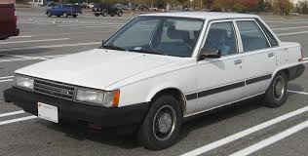
Classic, Antique or just old?
1980 Toyota Camery

Slide 21
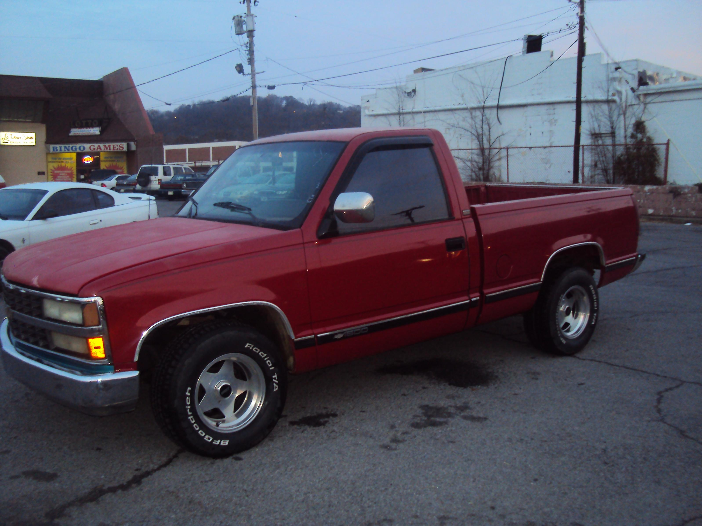
Classic, Antique or just old?
1991 Chevy Silverado

Slide 22
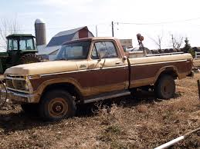
Classic, Antique or just old?
Farm Truck

Slide 23
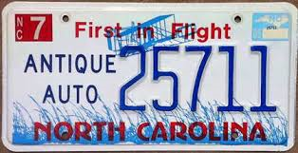
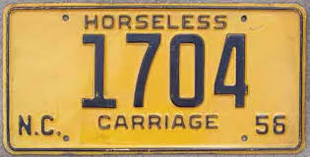
Classic, Antique or just old?

Slide 24
DOR Recommendations (Issued to Counties July 27, 2016)
We recommend that counties NOT automatically increase the value of older model vehicles just because it turned a year older.
Determine if the vehicle may meet certain criteria to be considered a classic vehicle.
Review Value
Contact Taxpayer/Mail Questionnaire get more detail about the vehicle such as condition, mileage, etc.

Slide 25


Classic, Antique or just Old?

Slide 26
Summary
We recognize some problems with the valuation on older vehicles
DOR Established Vehicle Appraisal Committee of county staff and DOR Staff to address vehicle valuation issues
Our Goal is to have a recommendation out by the first of the year
DOR strongly recommends all counties comply with these recommendations

