Slide 1
Tablets in the Field
DOR Real Property Seminar
September 14, 2016
Presented By: Brian Myers
Davie County Tax Administrator

Slide 2
Basic Information
Is the information live in the field?
NO but it can be (Still non mobile service areas in County)
Is the process user friendly?
Yes, the set up process and the ITS mobile (field production program) are user friendly.
Can you view production?
Supervisors can pull daily production to tract what has been completed
Does the use of the tablet improve production?
Yes since all the work goes into workflow it improves processes and reduces paper usage.
What tablet are you using?
Microsoft Surface Pro 3 Intel processor i7 64 bit operating system

Slide 3
Query Builder

Slide 4
Query Builder Results

Slide 5
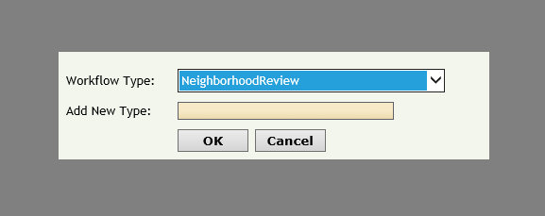
Workflow
Selecting workflow

Slide 6
Downloading Fieldwork

Slide 7
Fieldwork Map

Slide 8
Parcel Selection

Slide 9
Reviewed Parcel

Slide 10
Aerial View

Slide 11
Parcel workflow view

Slide 12
Any Questions ?

