Slide 1
Vehicle Licensing Taxes
Kara Millonzi
millonzi@sog.unc.edu
September 2016

Slide 2
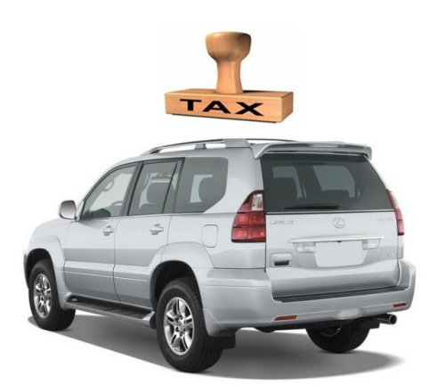
Municipal Motor Vehicle License Tax
G.S. 20-97(b)

Slide 3
Before July 1, 2016

Slide 4
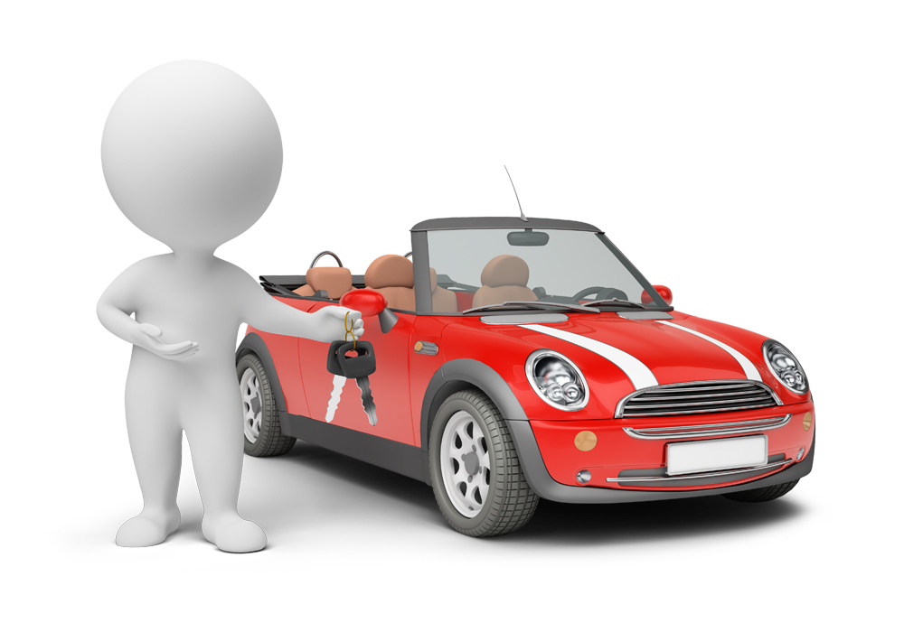
Before July 1, 2016

Slide 5
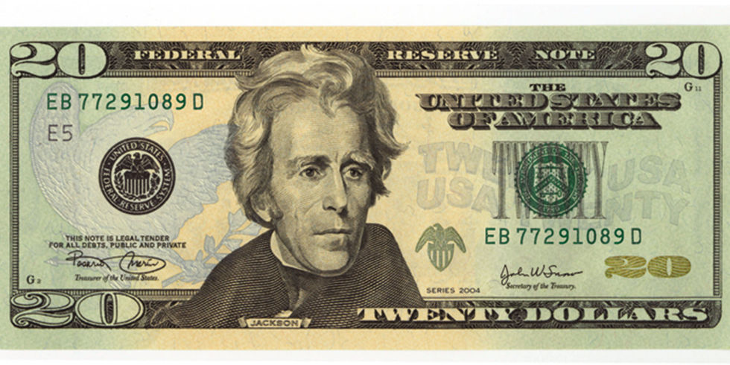
As of July 1, 2016
$30

Slide 6
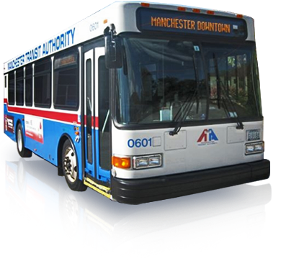
What’s the Catch?
G.S. 105-550

Slide 7
G.S. 105-550:
Public transportation system. – Any combination of real and personal property established for purposes of public transportation. The systems may include one or more of the following: structures, improvements, buildings, equipment, vehicle parking or passenger transfer facilities, railroads and railroad rights-of-way, rights-of-way, bus services, shared-ride services, high-occupancy vehicle facilities, carpool and vanpool programs, voucher programs, telecommunications and information systems, integrated fare systems, bus lanes, and busways. The term does not include, however, streets, roads, or highways except to the extent they are dedicated to public transportation vehicles or to the extent they are necessary for access to vehicle parking or passenger transfer facilities.

Slide 8
What’s the Catch?
G.S. 105-550
“maintaining, repairing, constructing, reconstructing, widening, or improving public streets in the city or town that do not form a party of the State highway system.”

Slide 9
Municipality A currently levies the $5.00 tax under general law authority. It operates a public transportation system. In its FY2017-18 budget ordinance, the municipality’s board levies a $30.00 per vehicle tax. How can it spend the $?

Slide 10
Municipality B currently levies the $5.00 tax under general law authority. It does not operate a public transportation system. Its board levies the $30.00 per vehicle tax in the FY2017-18 budget ordinance. How can it spend the $?

Slide 11
Municipality C currently levies the $5.00 tax under general law authority. It does not operate a public transportation system. Its board increases the tax levy in the FY2017-18 budget ordinance, but only to $10.00 per vehicle. How can it spend the $?

Slide 12
Municipality D currently levies the $5.00 tax under general law authority. It operates a public transportation system. The board decides to increase the tax levy, but only to $10.00 per vehicle in the FY2017-18 budget ordinance. How can it spend the $?

Slide 13
Municipality E does not currently levy the motor vehicle license tax. Its board levies a $5.00 per vehicle tax in the FY2017-18 budget ordinance. How can it spend the $?

Slide 14
Municipality F currently levies a $25 motor vehicle license tax pursuant to local act authority. How can it spend the $?

Slide 15
Why?
Privilege License Taxes
Powell Bill Funds

Slide 16
Powell Bill Fund Changes
$ subject to state appropriations
$ must be used “Primarily” for the resurfacing of streets within the corporate limits of the municipality . . . “
Unit may not accumulate more than 5 years’ worth of $ (or 10 years’ for small units), or future distributions reduced
DOT required to report to General Assembly on how units are spending $

Slide 17
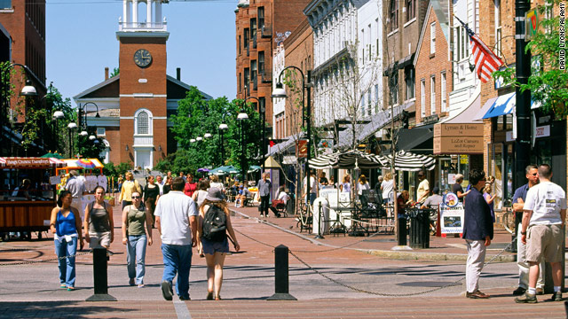
Shift in Municipal Road Funding Responsibility (??)

Slide 18
County Motor Vehicle Registration Tax
G.S. 20-97(b)

Slide 19
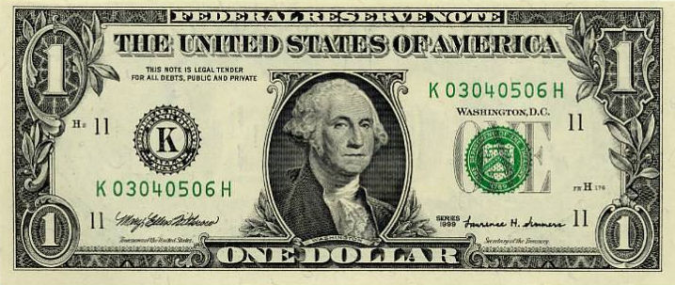
If
Then
$7

Slide 21
G.S. 105-506.1:
Public transportation system. – Any combination of real and personal property established for purposes of public transportation. The systems may include one or more of the following: structures, improvements, buildings, equipment, vehicle parking or passenger transfer facilities, railroads and railroad rights-of-way, rights-of-way, bus services, shared-ride services, high-occupancy vehicle facilities, car-pool and vanpool programs, voucher programs, telecommunications and information systems, integrated fare systems, and the interconnected bicycle and pedestrian infrastructure that supports public transportation, bus lanes, and busways. The term does not include, however, streets, roads, or highways except to the extent they are dedicated to public transportation vehicles or to the extent they are necessary for access to vehicle parking or passenger transfer facilities.

