Slide 1
Property Tax Treatment of Conservation Lands
Edgar Miller
Conservation Trust for NC
2016 Advanced Real Property Seminar
NC Department of Revenue
September 16, 2016

Slide 2
Relevant Statutes
105-317.(a)(1) – Appraisal of Real Property Include Consideration of Conservation/Preservation Agreements
105 – 277.3(d1) – Exceptions for Easements on Qualified Conservation Land in PUV
105-277.15 – Taxation of Wildlife Conservation Lands
105 - 275 (12) – Property Tax Deferrals for Conservation Land
105 – 277.4 – Modify When the Lien on Deferred PUV Taxes is Extinguished/Reduced (H 533/Session Law 2016-76)

Slide 3
Need for H 533
Elimination of NC Conservation Tax Credit - 2013
Remove Financial Disincentive for Bargain Sales of Conservation Land
Clarify Existing Statute
Reduce Cost of Land Acquisition
Improve Consistency and Compatibility B/T County Tax Departments

Slide 4
When Does H 533 Apply?
Land enrolled in PUV program purchased by nonprofit conservation organization
Qualifies for exclusion under 105-275(12) or (29)
Sold at or below PUV – no deferred taxes owed
Sold above PUV, but below true value of the property – deferred taxes prorated based on statutory formula

Slide 5
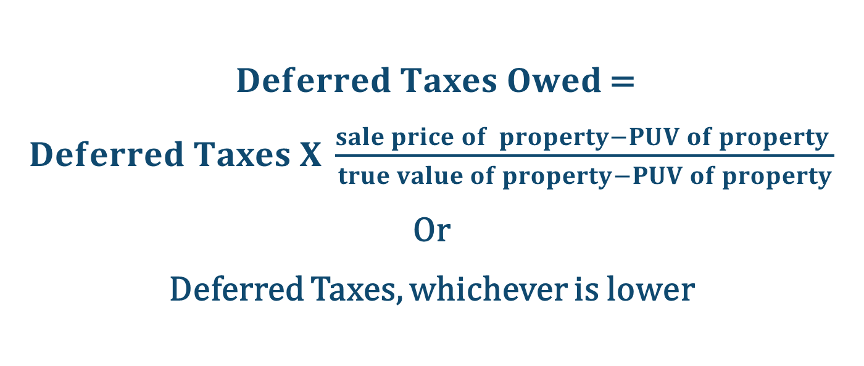
Formula for Determining Deferred Taxes Owed Under H 533
$Deferred Taxes Owed$ =
$Deferred Taxes X \frac{sale price of property−PUV of property }{true value of property−PUV of property}$
Or
Deferred Taxes, whichever is lower

Slide 6
Implementation of H 533
Determination of “True Value” vs. Assessed/Appraised
Timing/documentation of qualification under 105-275(12) or (29)
Multi-year/variable assessed values, tax rates
Worksheet for calculating percentage of deferred taxes owned

Slide 7
Qualifying Conservation Purposes Under 105-275(12)
Used for an educational or scientific purpose as a nature reserve or park
Managed under a written wildlife habitat conservation agreement
Managed under a forest stewardship plan
Used for public access to public waters or trails.
Used for protection of water quality and subject to a conservation agreement
Held by a nonprofit land conservation organization for sale or transfer to a government agency for conservation purposes.
Issues
Forest Stewardship Plans
Documentation of Conveyance
Deferment vs. Exemption

Slide 8
Emerging Issues
Nonprofit/LLC ownership models
Property tax treatment of nonprofit ag land
Income-generating properties (i.e., hunting, ecotourism, forestry)
Resources/guidance from county tax departments/Dept. of Revenue

Slide 9
Contact info:
Edgar Miller
Director of Government Relations
Conservation Trust for NC
336-688-2651
edgar@ctnc.org

