Slide 1

Mecklenburg County
BPP Canvassing Initiative

Slide 2
Mecklenburg County
BPP Canvassing Initiative
Summary
3rd Party Overture
Internal Brain Storming
Strategy
Plan of Attack
  In-house work
  Field work
Enhancements / Improvements
Canvassing Team
Dashboards
Routing Software
County Map
Door Hangers
Results

Slide 3
Mecklenburg County
BPP Canvassing Initiative
3rd Party Overture
Identify “leads” to current businesses not listing
Current county tax scroll
Comparison of databases
Fee
  $25,000 First 100 discovered businesses
  $250 > 100 discovered businesses

Slide 4
Mecklenburg County
BPP Canvassing Initiative
Internal Brain Storming
Current county tax scroll
Identify potential sources to build a comprehensive database
  Mecklenburg County BBB
  NC Secretary of State
  Chamber of Commerce
  Mecklenburg County Environmental Health
  NC Alcoholic Beverage Controls
  Sales Genie
  Leasing Companies

Slide 5
Mecklenburg County
BPP Canvassing Initiative
Strategy
Approached it like a “discovery”
Instead of “$ values”, we used “taxpayer names” and “business addresses”
Source Data = “Actuals”
Tax Scroll = “Reported”
Variances = “Potential Discovered Business”

Slide 6
Mecklenburg County
BPP Canvassing Initiative
Plan of Attack
Collect company information from various sources
Format different information into a standard format
Data mining using Excel:
  “Vlookups” - Exact matches
  “Fuzzy Lookups” - Similar matches
Field work
  Organized by zip codes
  Site visits for validation

Slide 7
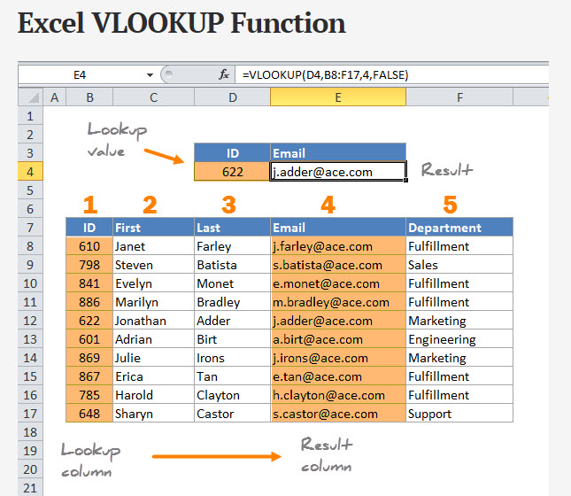
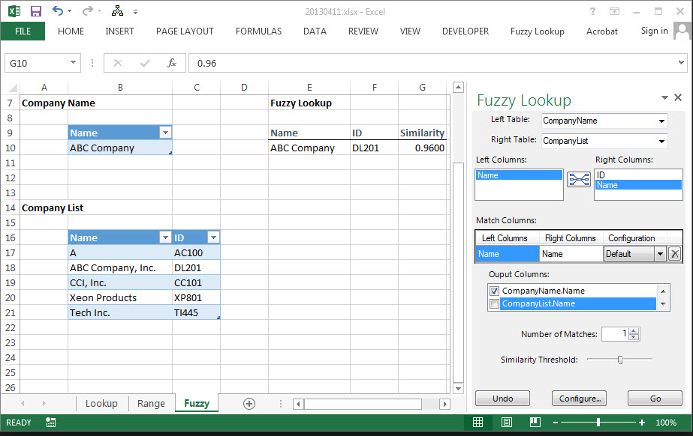
Mecklenburg County
BPP Canvassing Initiative
Excel Functions

Slide 8
Mecklenburg County
BPP Canvassing Initiative
Enhancements & Improvements
RESOURCES
Two vehicles
Cool Tracking Dashboard
Computers and Cell phones
Route Planning Software
Custom 8x8 Map
Printed bilingual door-hangers

Slide 9
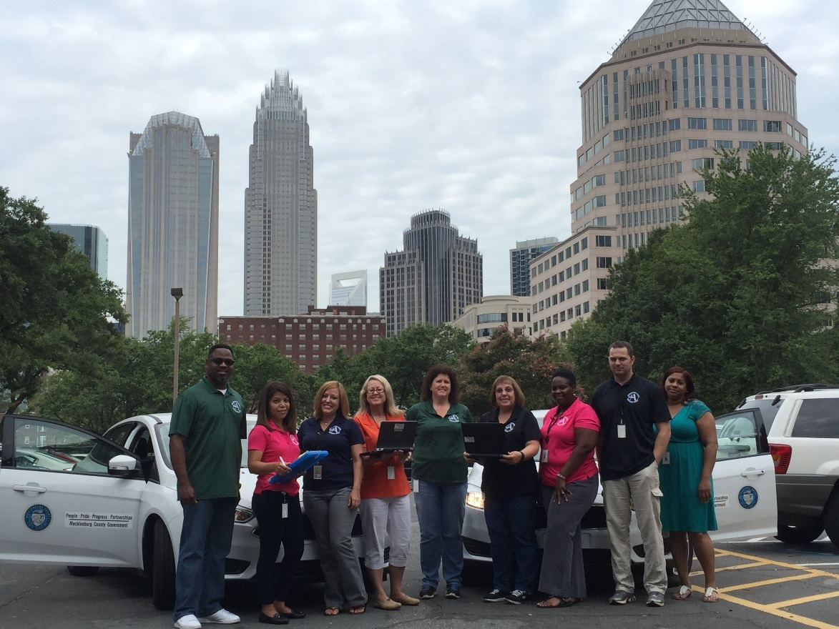
Mecklenburg County
BPP Canvassing Initiative
The Canvassing Team

Slide 10
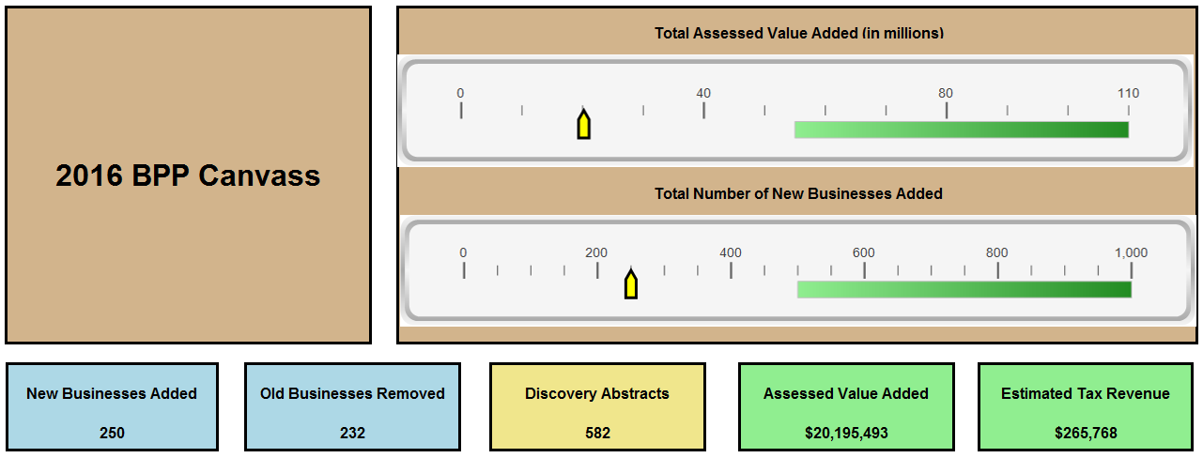
Mecklenburg County
BPP Canvassing Initiative
Dashboards

Slide 11
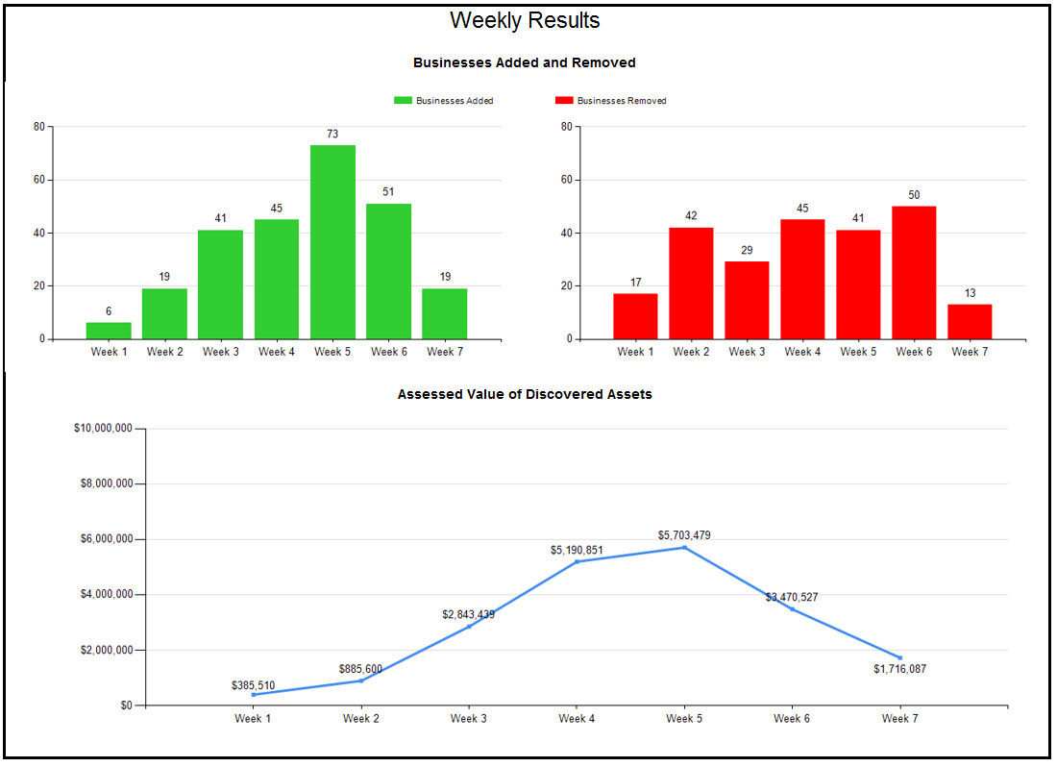
Mecklenburg County
BPP Canvassing Initiative
Dashboards

Slide 12
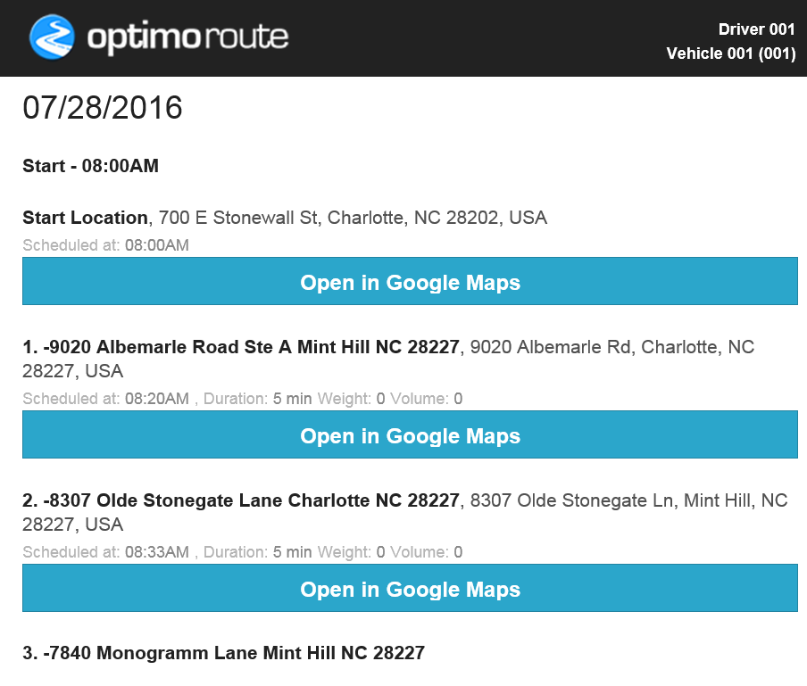
Mecklenburg County
BPP Canvassing Initiative
Routing Software

Slide 13
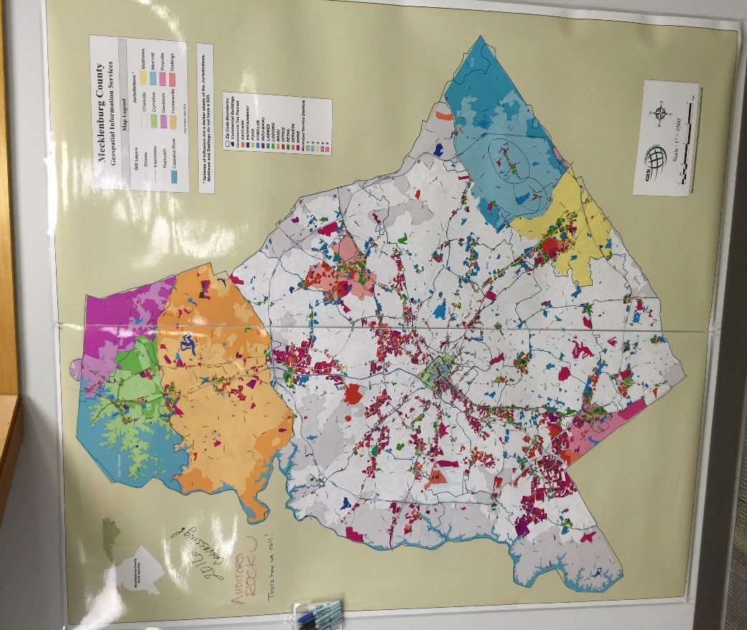
Mecklenburg County
BPP Canvassing Initiative
County Map

Slide 14
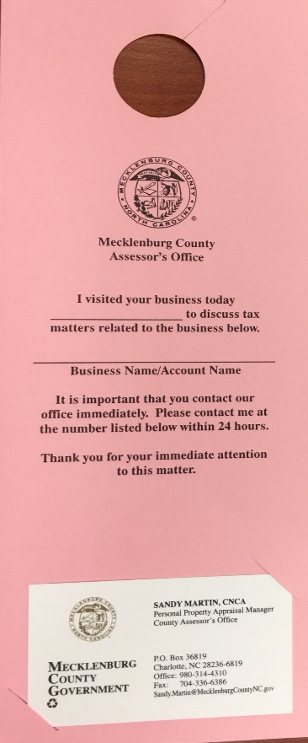
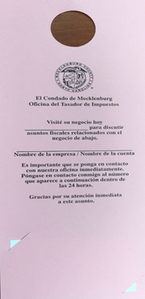
Mecklenburg County
BPP Canvassing Initiative
Door Hangers
English
Spanish

Slide 15
Mecklenburg County
BPP Canvassing Initiative
Results
CURRENT
“Win / Win” situation
  $42.8M discovered value
  479 new businesses discovered
  $350K estimated additional tax revenue
  Saved $120K in external fees
FUTURE
  479 new businesses added to tax scroll

