Slide 1
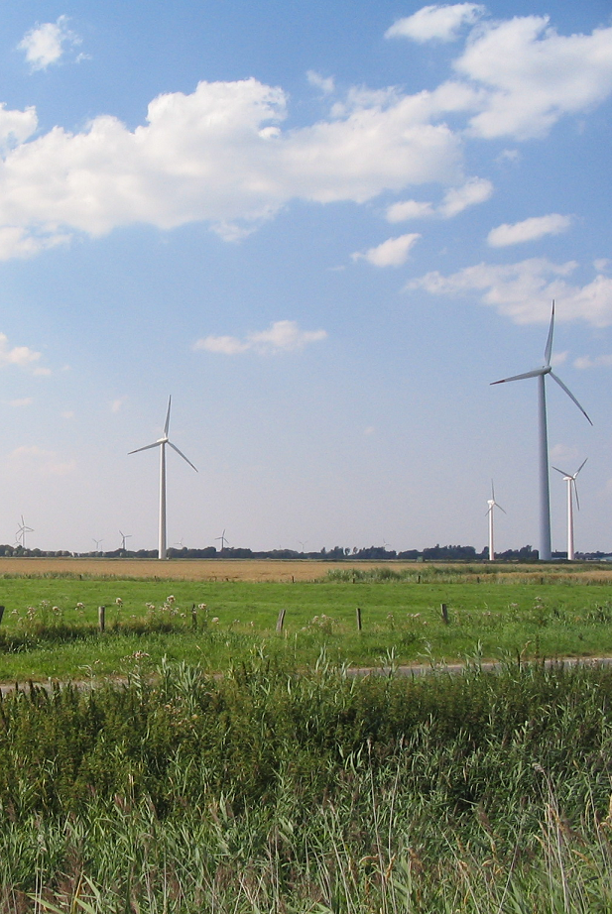
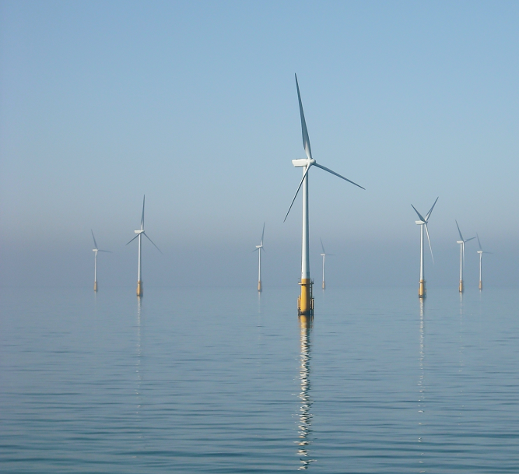
Wind Energy Potential in NC
and the Southeast
North Carolina Department of Revenue
Advanced Seminar
Greensboro, NC | September 12, 2016
Katharine Kollins
President
Southeastern Wind Coalition

Slide 2
Agenda
SEWC and Wind Deployment Overview
Cost of wind power
Southeast wind resource and technology advancements
Land-Based opportunities in NC
Offshore opportunities in NC

Slide 3
SEWC Overview
SEWC focuses on outreach and education to advance the wind industry in the Southeast. We take an objective, data-driven, and business focused approach to understanding and communicating the economic case for wind energy in the Southeast
We promote collaboration, information sharing, working together to make wind a more viable option
Resistance to wind can be strong – SEWC plays an important role in education

Slide 4
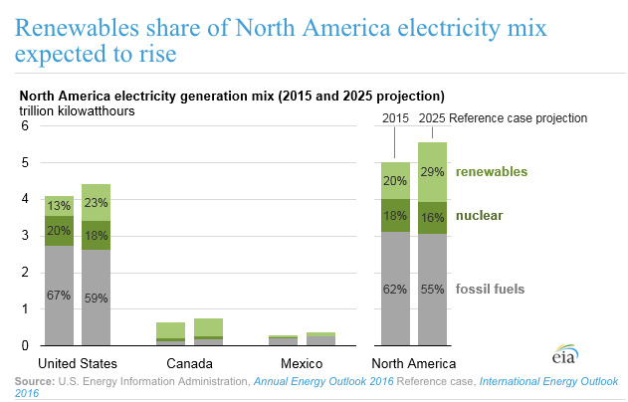
This Is the Future

Slide 5
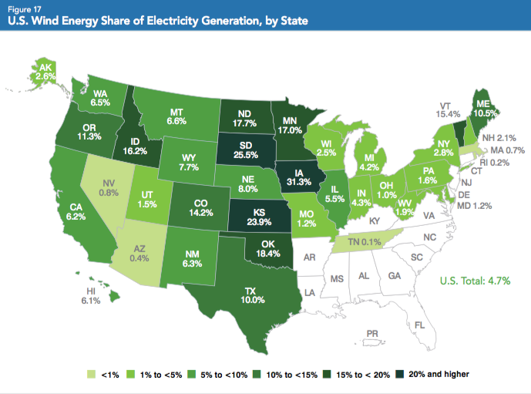
Wind Deployment
Source: AWEA 2015 Annual Market Report

Slide 6
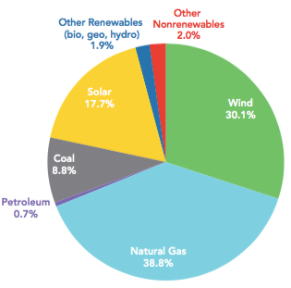
U.S. Power Capacity Additions 5-year average
Only
Natural Gas has rivaled
Wind
in new capacity additions.
Solar
coming up fast.
Source: 2015 AWEA Market Report

Slide 7
Cost of wind power

Slide 8
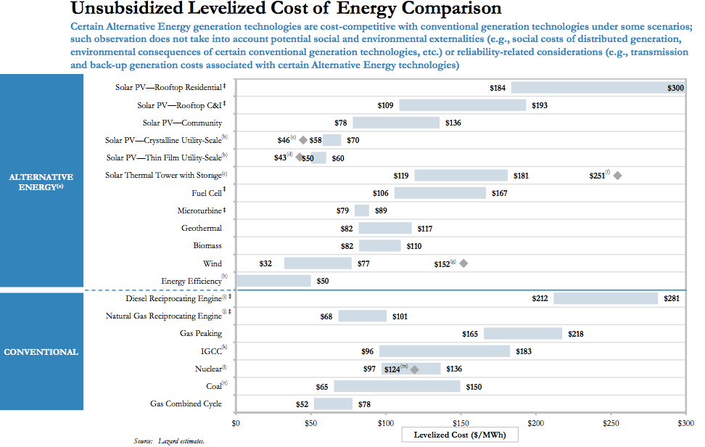

Slide 9
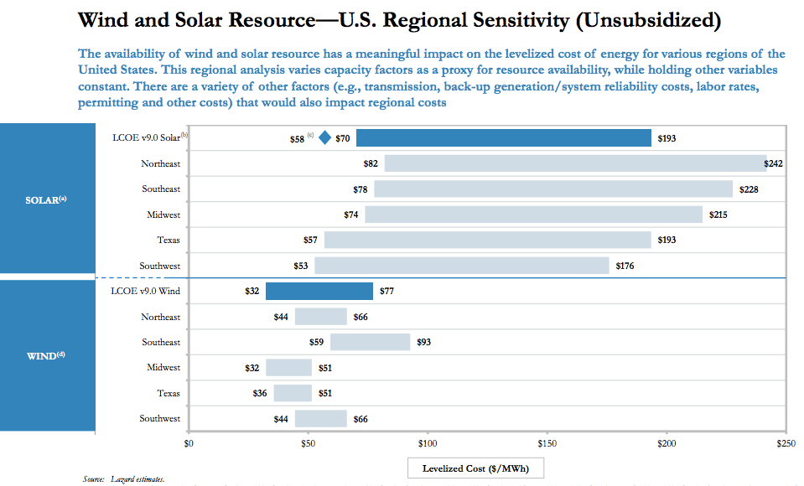

Slide 10
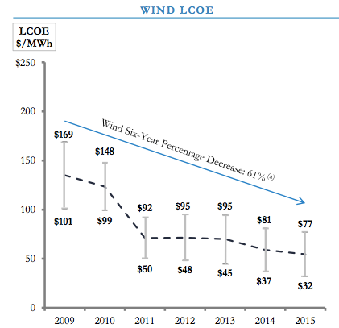

Slide 11
Wind resource and technology advancements

Slide 12
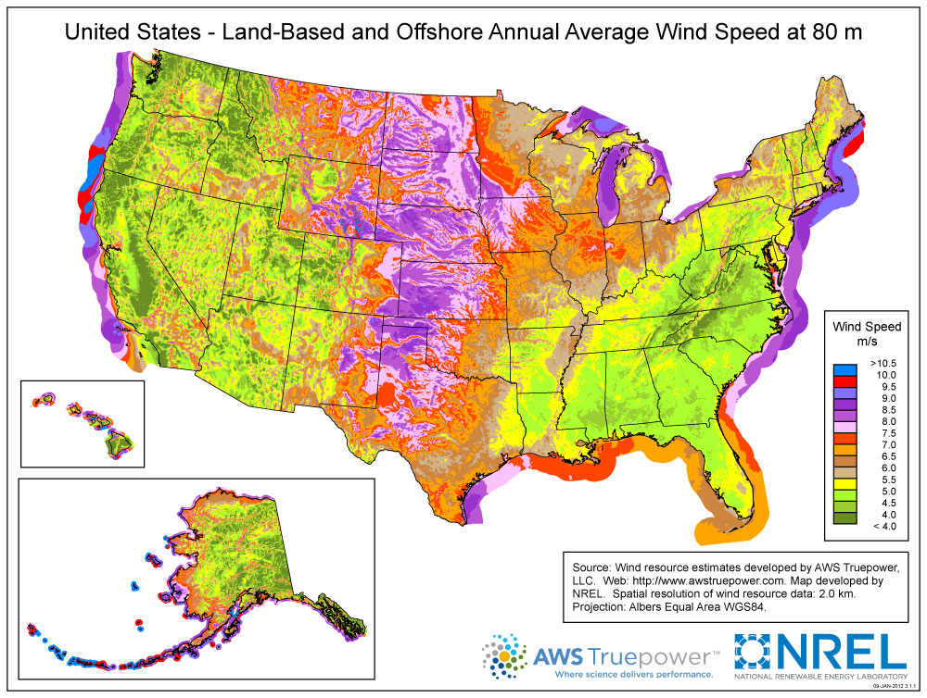

Slide 13
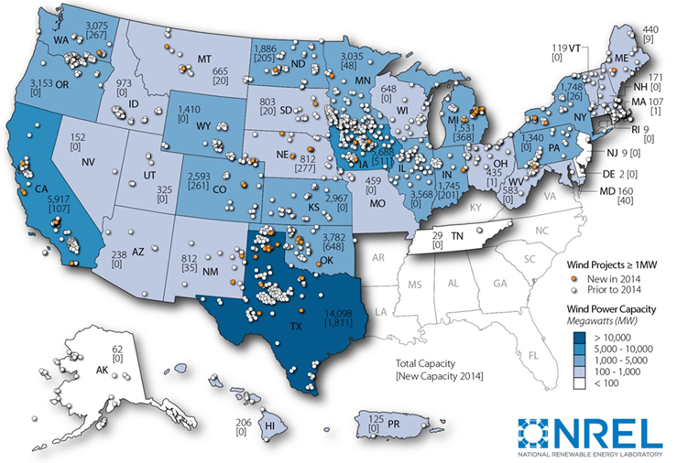
U.S. Wind Power, 2014
?

Slide 14
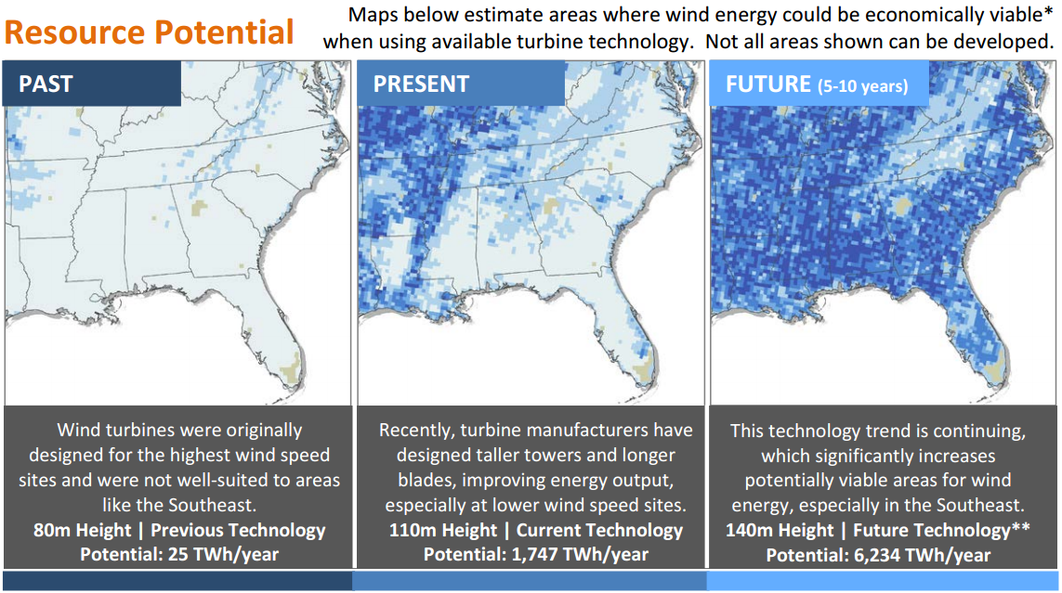
Wind Technology Changes
Open Up the Southeast

Slide 15
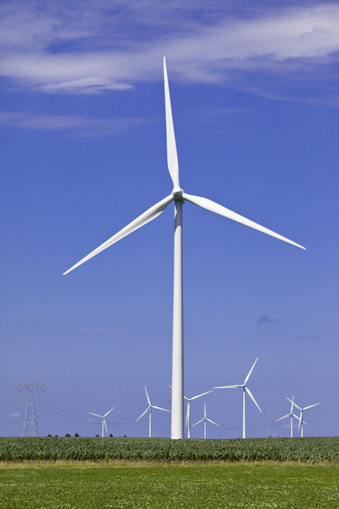
Longer Blades
Area = πr²
If r(↑) then
area(↑ ↑)
+
Taller Towers
higher up,
stronger wind
=
Higher Capacity Factors
and lower
energy costs

Slide 16
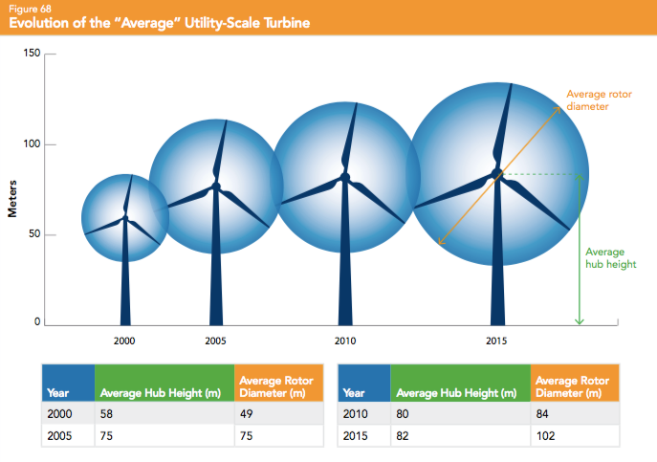
Source: AWEA 2015 Annual Market Report

Slide 17
Land based wind in nc

Slide 18
Land-Based Wind in NC
Avangrid – Amazon Wind Farm US East (208MW) under construction in Perquimans/Pasquotank
Apex Clean Energy – Timbermill (80MW) in permitting stages in Chowan/Perquimans
RES Americas – Little Alligator under development in Tyrrell
Invenergy - Hales Lake (150 MW) under development in Camden/Currituck
All projects are in coastal areas. Mountain wind has received less political support.

Slide 19
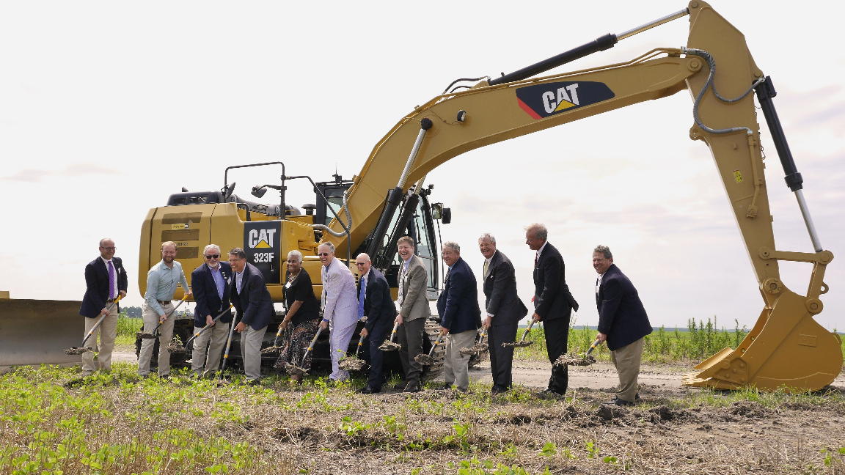
“Desert Wind”
July 14, 2015 – Ground-Breaking
Elizabeth City, NC

Slide 20
Amazon Wind Farm US East Powered by Iberdrola Renewables at Desert Wind
$400,000,000 investment in 208MW first phase
208MW capacity = Energy used by ~61,000 homes
104 Wind Turbines – Gamesa G114 on 93m towers
Project footprint of ~22,000 acres / ~34 sq mi
~ 200 acres occupied by facilities (wind turbines, roads, subs, O&M)
>60 landowners

Slide 21
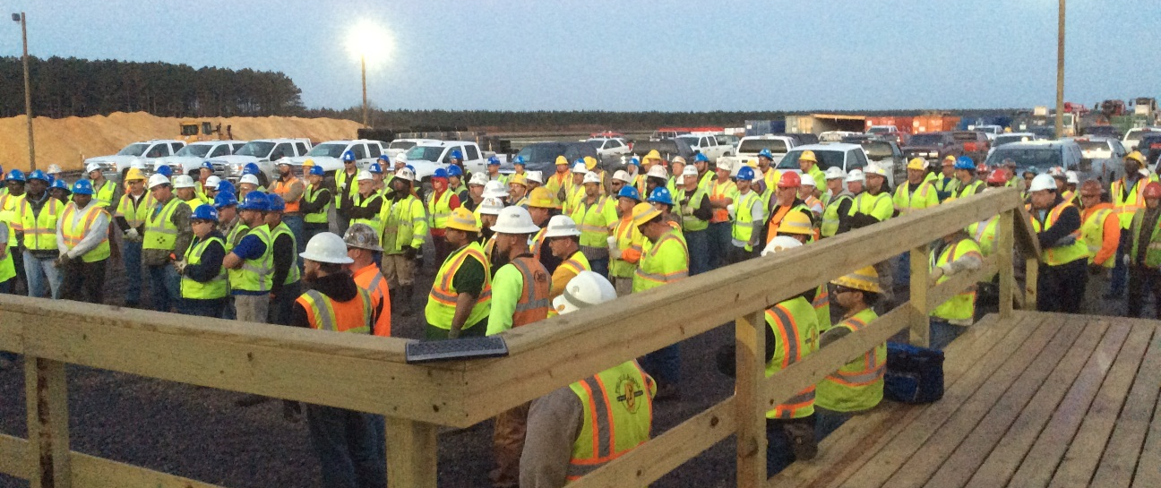
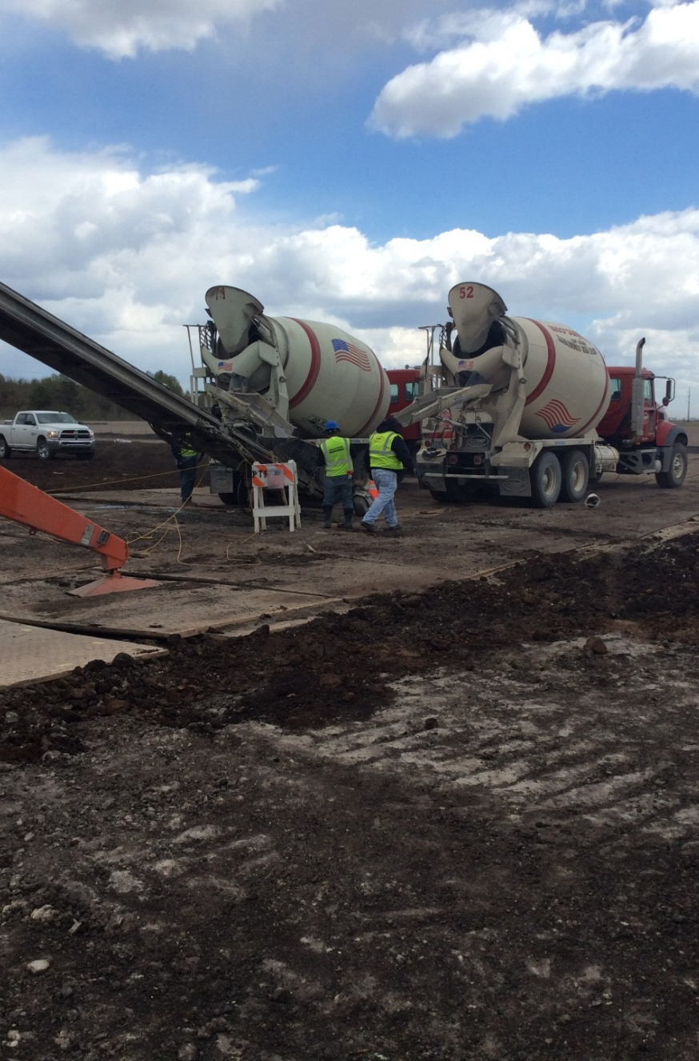
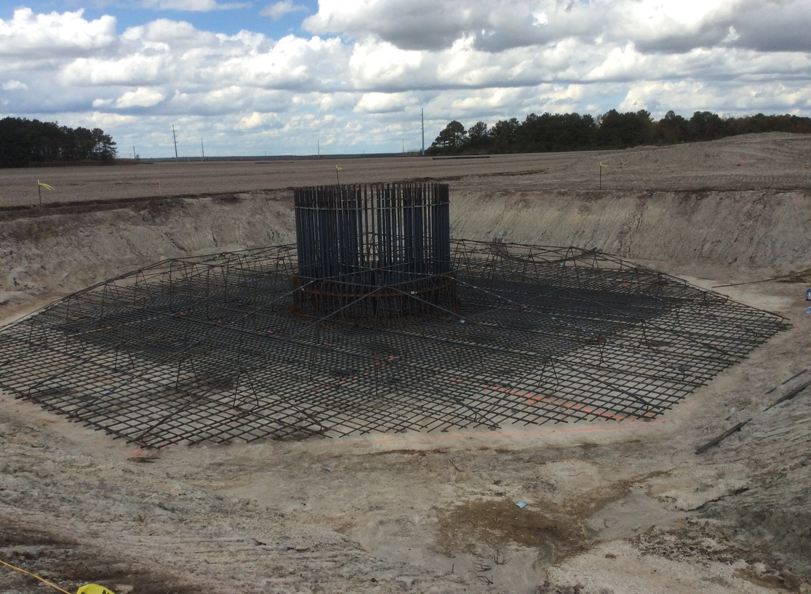
Construction is Underway

Slide 22
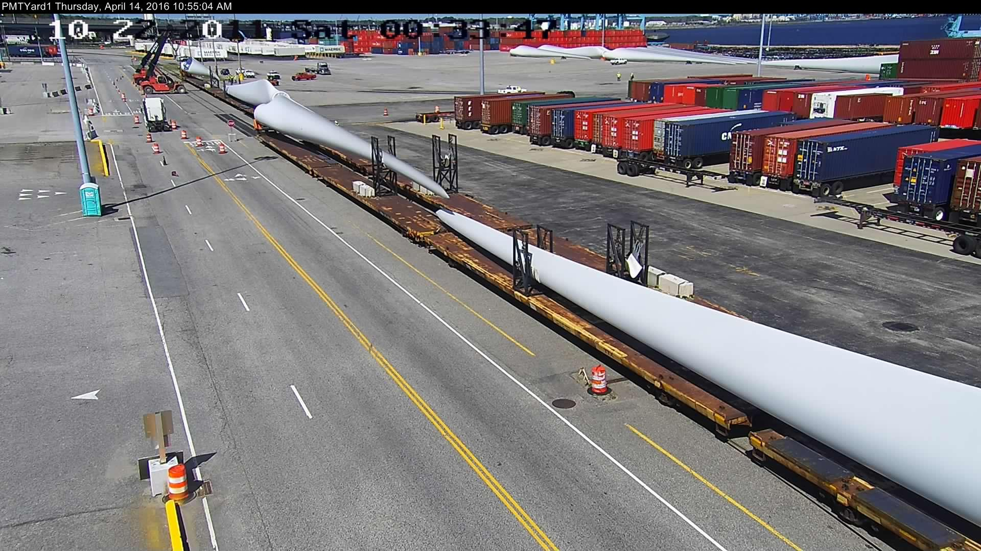
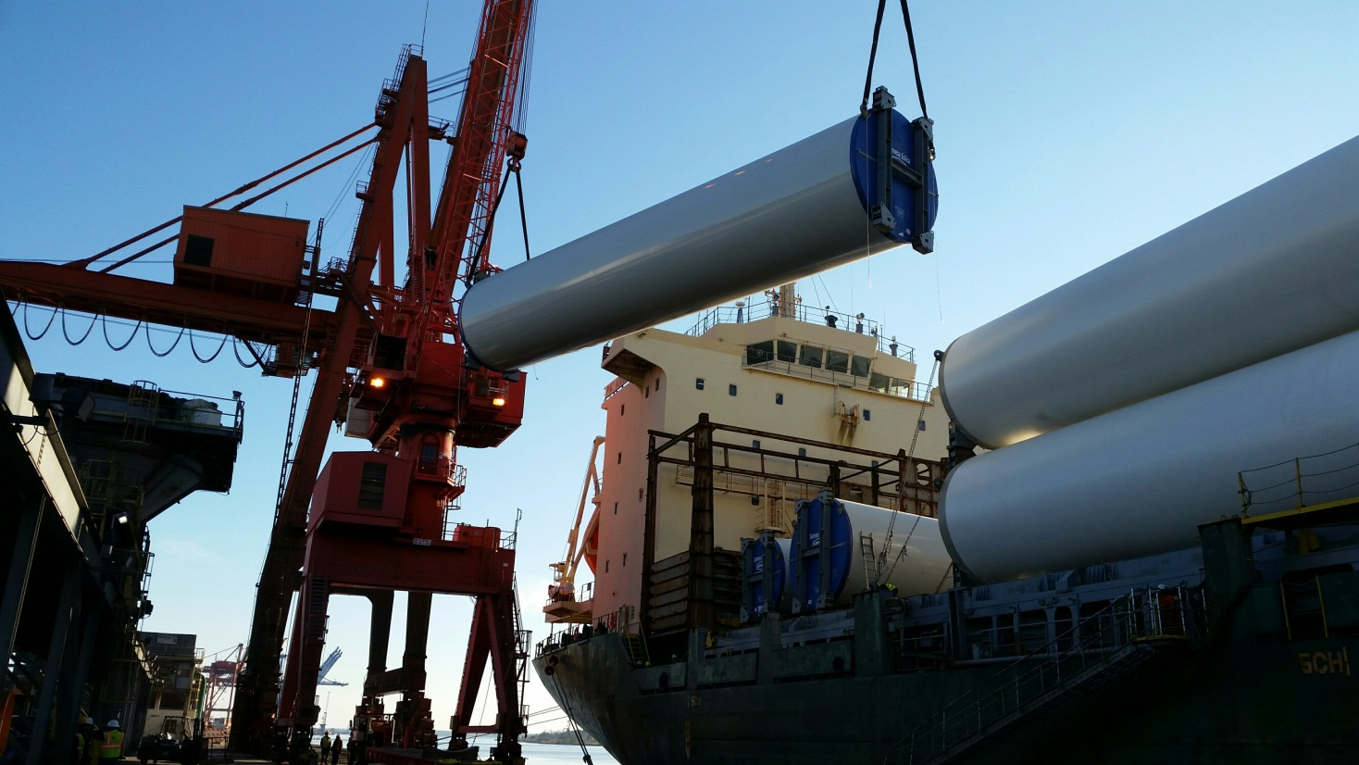
Components in Transport

Slide 23
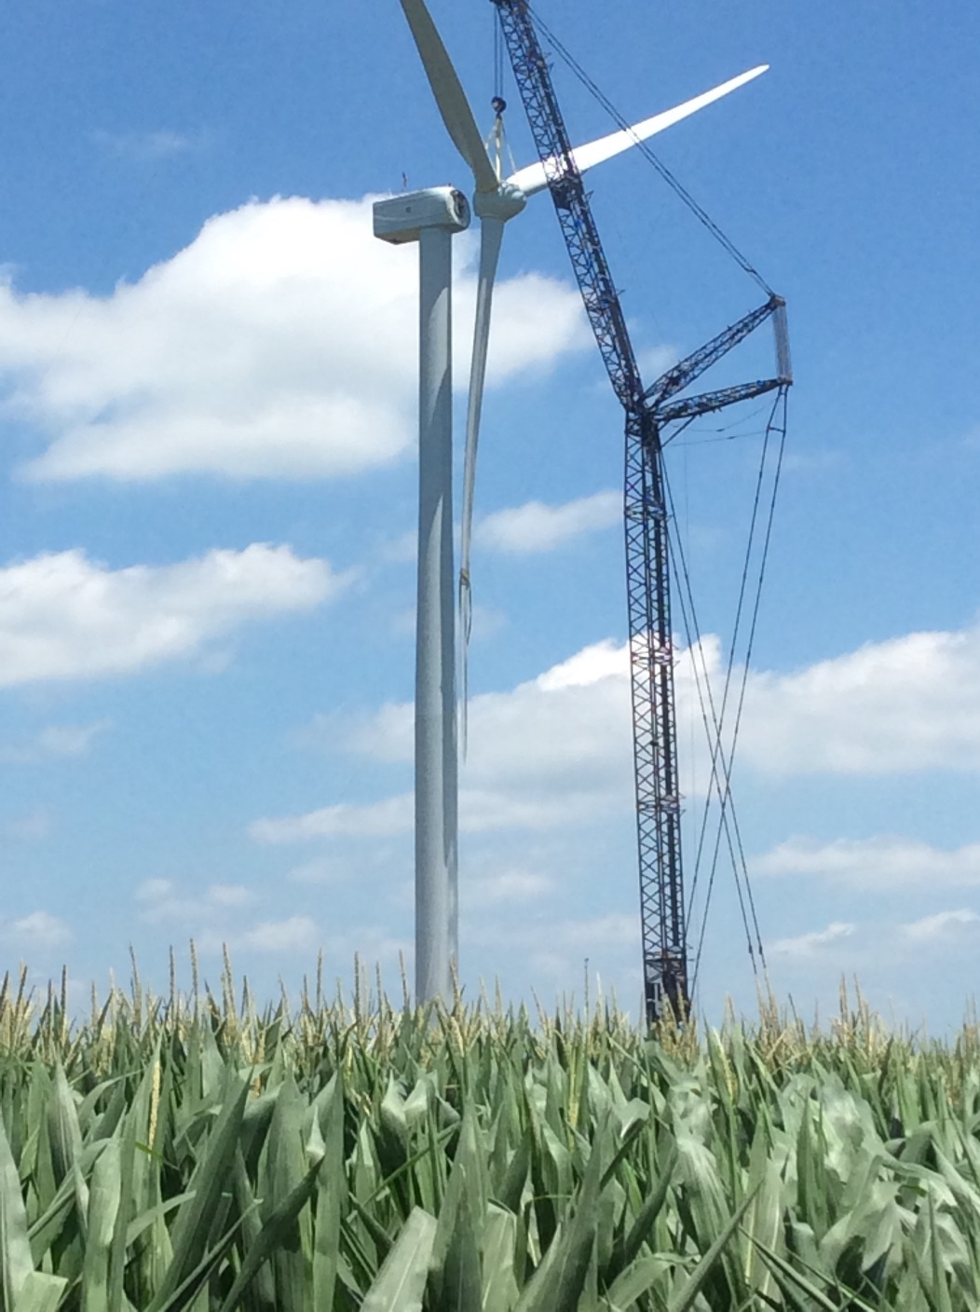
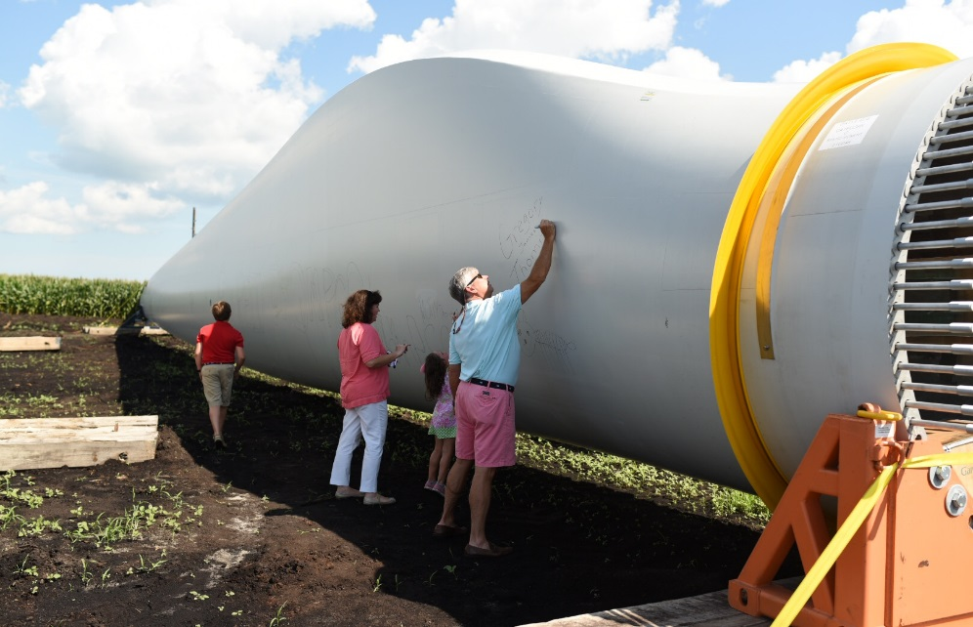
Blade Signing and Erecting the Turbines

Slide 24
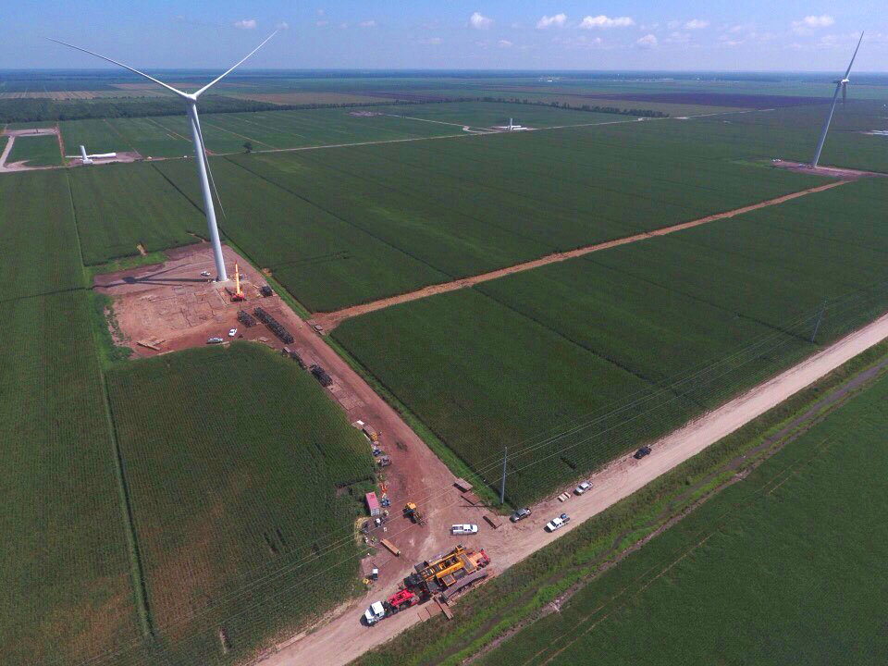
Amazon US East in Action

Slide 25
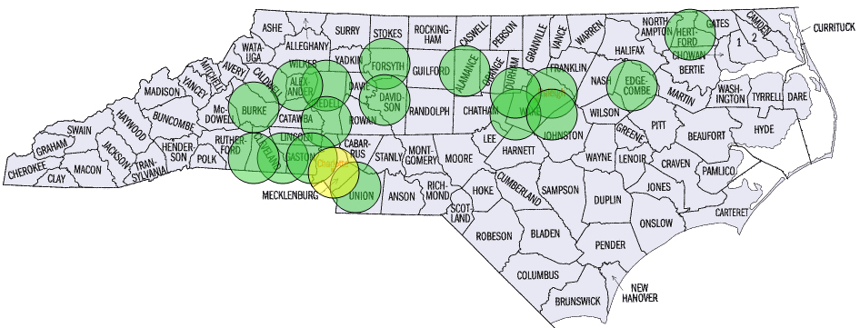
North Carolina Manufacturing
North Carolina
2000-3000 direct and indirect jobs
31 manufacturing facilities
US
500 facilities in US supply chain
Over 30,000 U.S. jobs in wind manufacturing
Domestic Content increasing:
25% in 2005
50% in 2009
>60% in 2012
Source: AWEA
Notes:
Manufacturing Company 3A/Baltek Inc ABB Inc. ABB Inc. ABB Inc. ABB Inc. AKG American Roller Bearing Company American Roller Bearing Company Armacell ATEC Baldor Electric Bijur Delimon International Bijur Delimon International Comer Industries, Inc CommScope CommScope HAWE Hydraulics Leeco Steel Leeco Steel Ming Yang Wind Power Group Ltd Nucor Steel Pioneer Motor Bearings PPG Industries PPG Industries Saertex Sandvik Southwire Company Spanset Inc. The Timken Company Tyco Electronics United Chemi-Con

Slide 26
Offshore wind

Slide 27
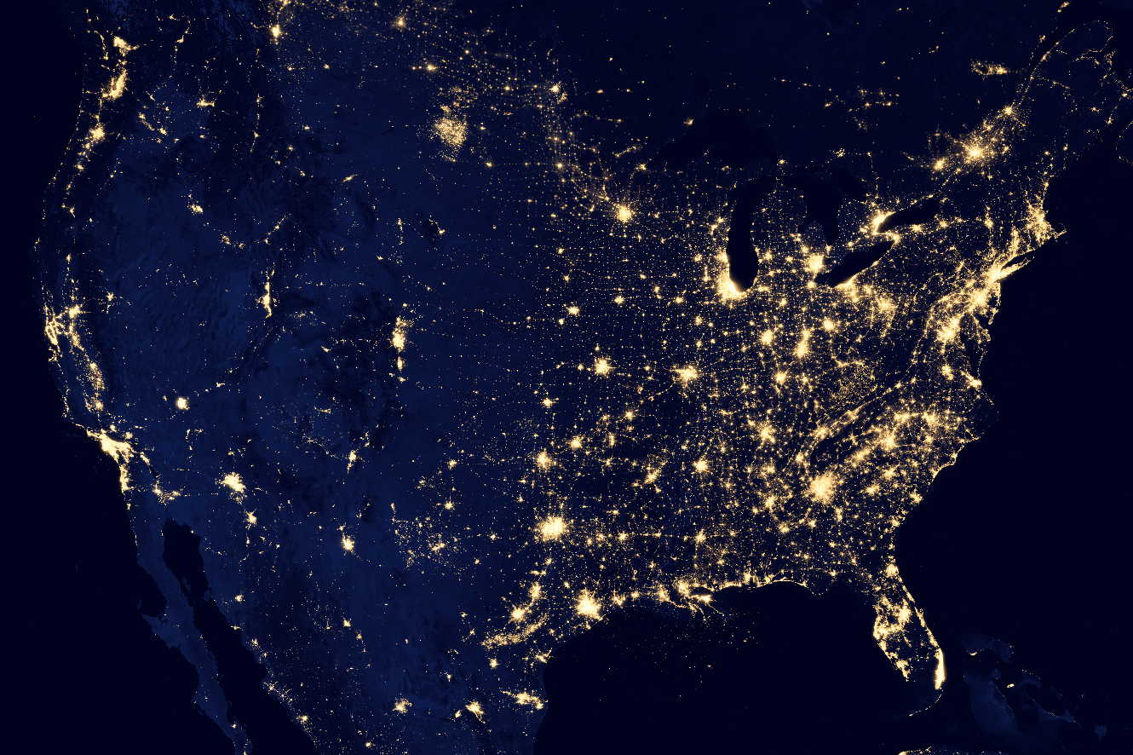

Slide 28
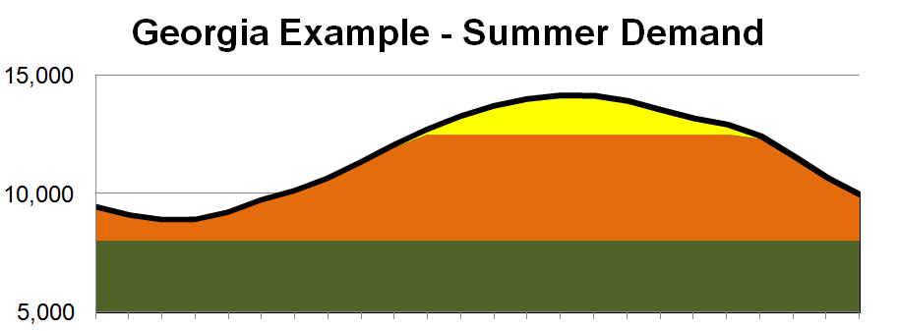
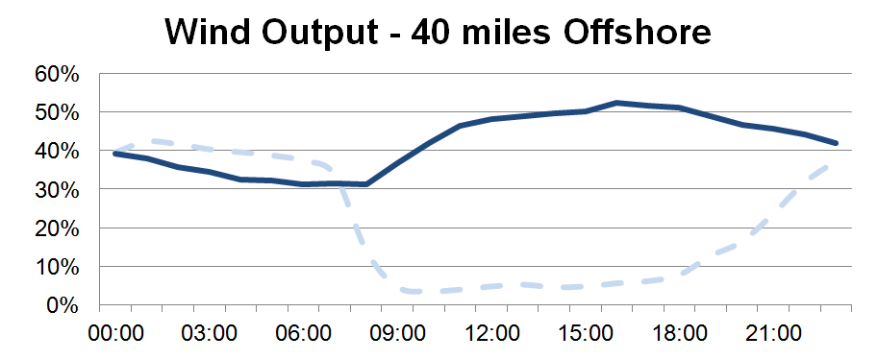
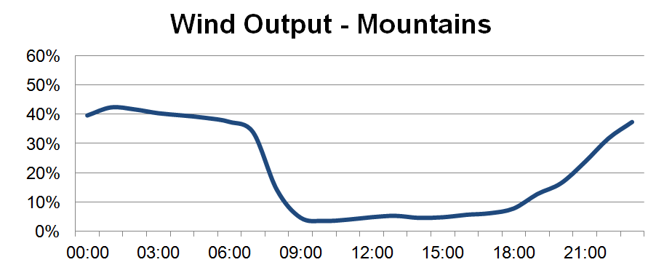
Offshore
Source:
Mountain

Slide 29
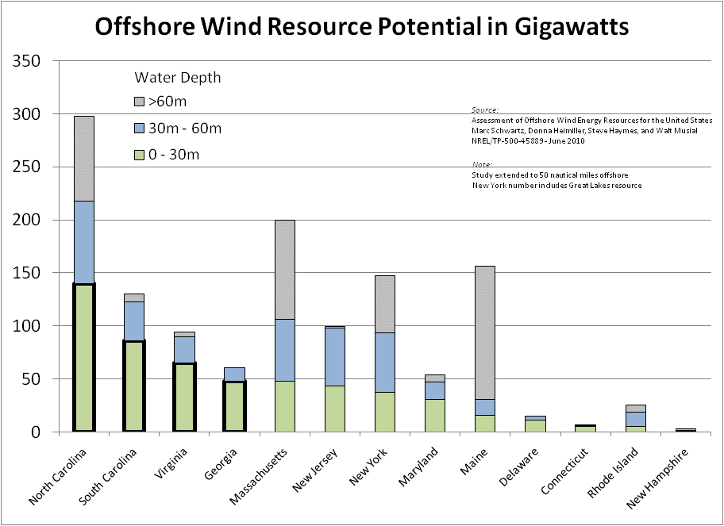
Equivalent to 100% of
NC electricity demand

Slide 30
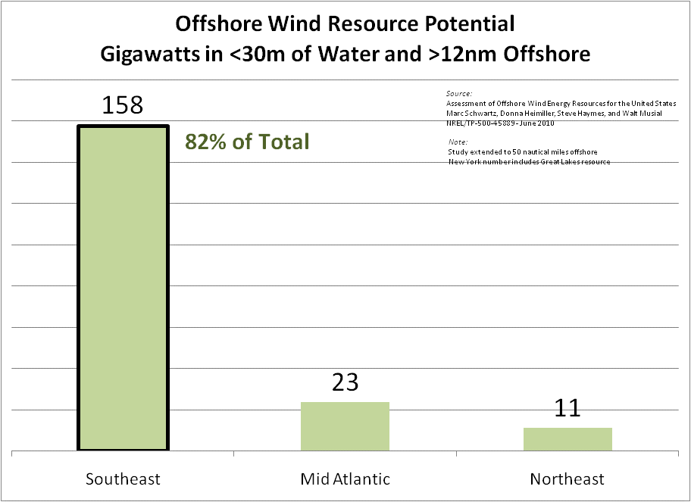
0 GW
55 GW
Source: NREL

Slide 31
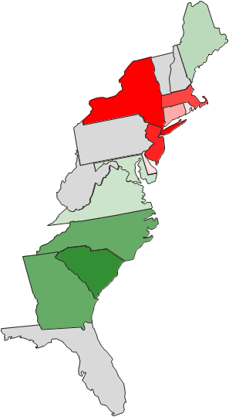
Southeast Competitive Advantages
Offshore Wind Estimated Construction Cost
Ranked:
Lowest to Highest
SC | -11.1%
NC | -8.3%
GA | -8.1%
VA | -6.8%
ME | -3.8%
MD | -2.8%
[EIA Benchmark] | 0.0%
DC | 1.9%
RI | 2.4%
DE | 2.9%
CT | 5.2%
MA | 11.6%
NJ | 13.3%
NY | 28.1%
Four lowest cost states are in the Southeast
15% Higher Cost
15% Lower Cost
Source: EIA, "Updated Capital Cost Estimates for Utility Scale Electricity Generating Plants", April 2013.
http://www.eia.gov/forecasts/capitalcost/pdf/updated_capcost.pdf

Slide 32
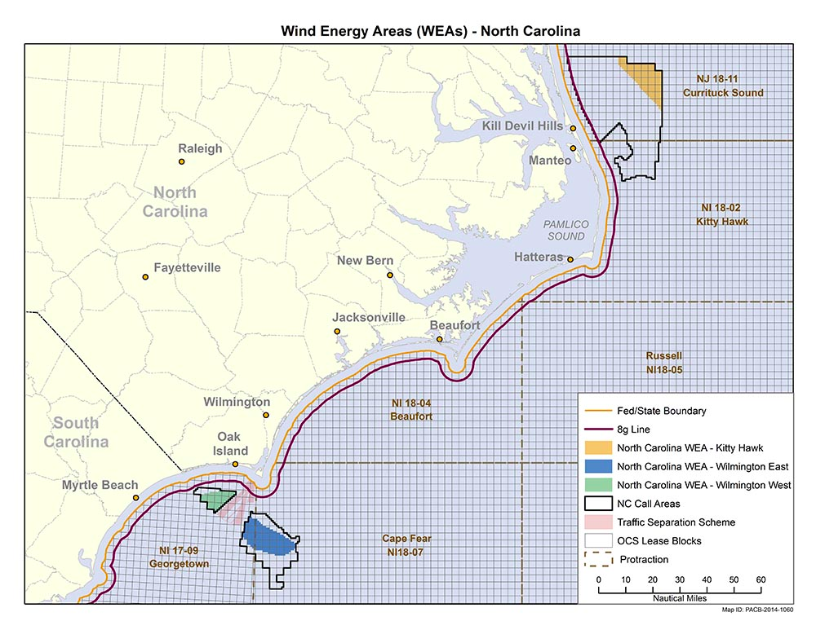
Offshore Wind in NC

Slide 33
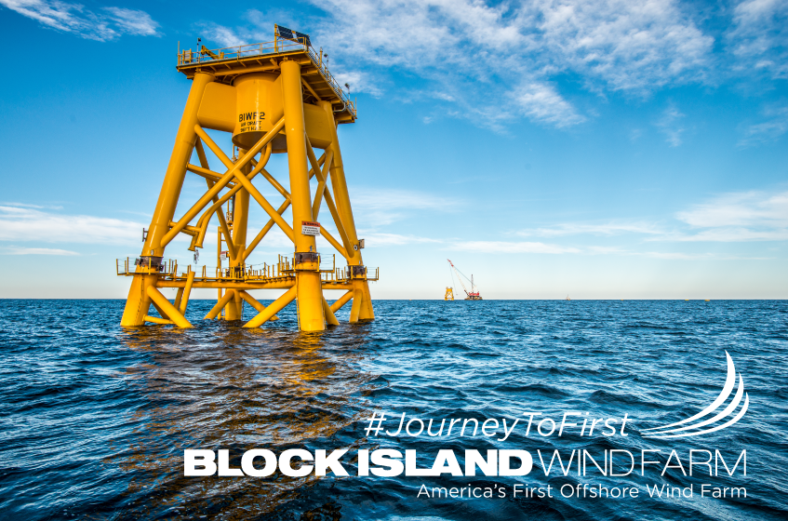
Block Island Wind Farm
First offshore wind farm in the U.S
5 Turbines
30 – MW Capacity
Built in state waters off the coast of Rhode Island
Notes:
Controversial permitting process with Rhode Island PUC rejecting initial permit
Eventually approved permits once Gov. and General Assembly changed law regarding commercial reasonability of contract pricing

Slide 34
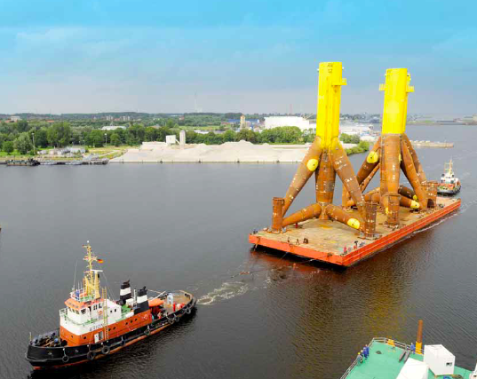
Cuxhaven Port Transport of Offshore Foundations
950 ton Tripods
Source: European Wind Energy Association (EWEA)

Slide 35
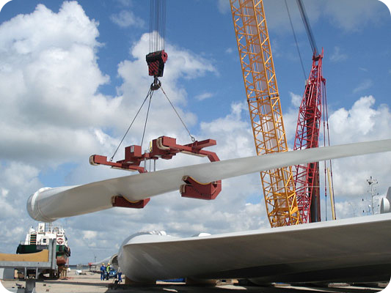
Gigantic Power Blades GmbH for Offshore Wind
5 MW Turbine Blades
200-ft long length
16-tons weight each
$120,000 of resin
Lightning Protection
1 Blade/Day = 80 people
Source: Global Wind Network (GLWN) USA

Slide 36
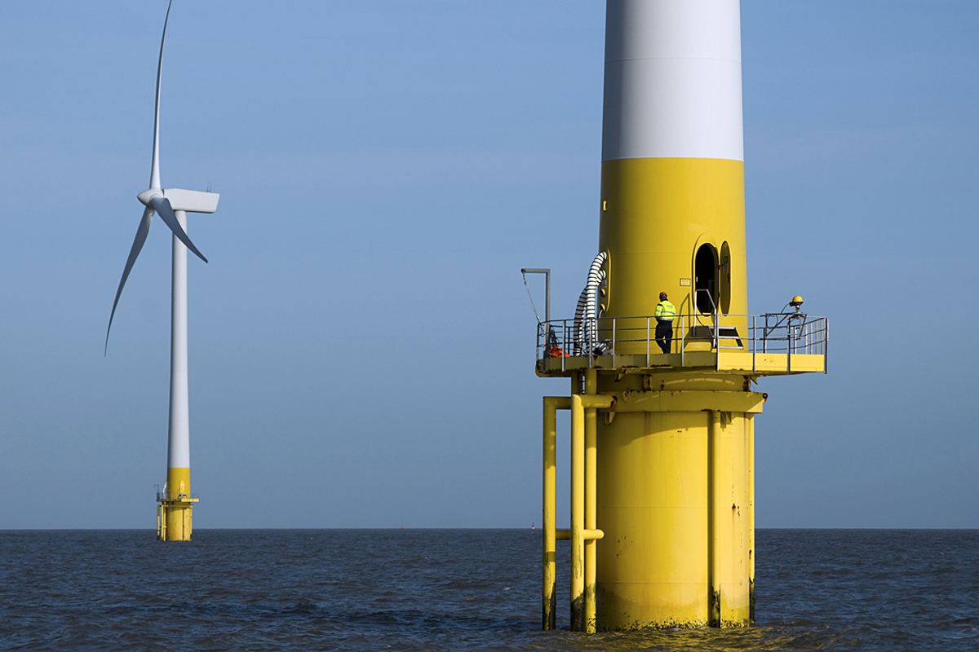
What could the future hold ?

Slide 37
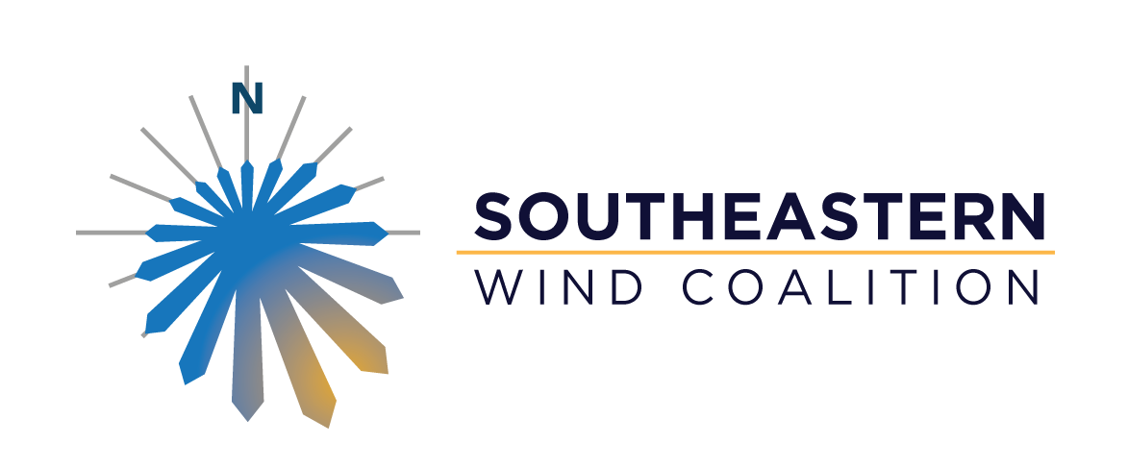
Thank You.
Katharine Kollins
katharinek@sewind.org

Slide 38
“Doing well is the result of doing good. That's what capitalism is all about.”
- Ralph Waldo Emerson

