Slide 1
Assessor/Appraiser Educational Improvements
Doug Huffman
NC Department of Revenue
Local Government Division

Slide 2
Background
100 Counties in North Carolina.
Required to reappraise all real property in the county at least every eight years.
North Department of Revenue.
  To exercise general and specific supervision over the valuation and taxation of property by taxing units throughout the State.
  Provide a certification and education program for local tax assessors and appraisers.

Slide 3
History
Issues with Mecklenburg County’s 2011 reappraisal.
Perfect Storm:
  Eight year reappraisal
  Down turn in the market
  Political
In 2013 the North Carolina General Assembly passed Senate Bill 159 which required the county to redo its 2011 reappraisal.
Discussion about Property Tax Reform started.

Slide 4
Action Taken
NC Department of Revenue formed a reappraisal committee made up of County Assessors and County Appraisers and DOR staff to take a look at the issues being raised by the General Assembly.

Slide 5
Additional Actions
Subcommittees Formed
  Reappraisal
    Create Reappraisal Standards for all 100 counties
  Board of Equalization and Review (Appeals)
    Study the appeal’s process and revise the Appeal’s Manual
  Forms and Notices
    Develop and review standard forms and notices for use by all counties
  Education
    Study the educational requirements and processes

Slide 6
Reappraisal Committee
Two Questions:
What are the changes that require Legislative action?
What changes can be made that do not require Legislative action?

Slide 7
Education Committee
Consisted of DOR and County staff
Goals
  More education courses
  More opportunities at more locations
  Reduce the costs of education
  Expand the certification program
  Encourage Professional Designations
New certification levels were developed

Slide 8
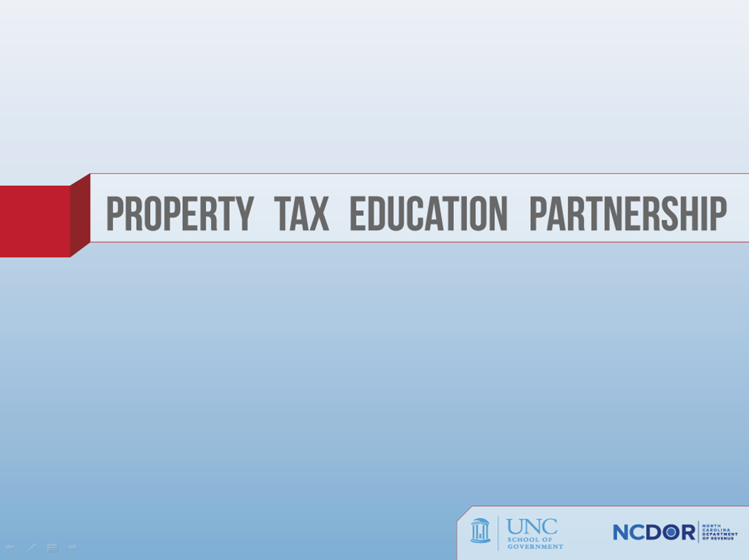

Slide 11
Course Cost Reduction
More locations
  Less overnight travel
NCDOR
  Administrative Cost
  More IAAO Instructors

Slide 12
Old Certification Program
By law all assessors and appraisers have to be certified by Department of Revenue.
30 hours of continuing education required every two years.
Old program had just two levels:
  Assessor
  Appraisers (Real and Personal)

Slide 13
Expansion of Certifications
Assessor
  Tax Administration in NC takes the place of IAAO 400.
Real and Personal Property Appraisers
  Appraiser I
  Appraiser II
  Appraiser III

Slide 14
Assessors
Property Tax Listing and Assessing in N.C.
  UNCSOG and NCDOR
IAAO Course 101 – The Fundamentals of Real Property Appraisal
Personal Property Appraisal and Assessment Course
  NCDOR
Tax Administration in N.C.
  NCDOR and UNCSOG
Achieve a passing grade in a comprehensive examination conducted by the NCDOR

Slide 15
New Certification Program
As of July 1, 2015 the new program has three levels for both real property and personal property appraisers.
  Appraiser I
  Appraiser II
  Appraiser III

Slide 16
Appraiser I Requirements
Property Tax Listing and Assessing in NC, and
Real Property
  Attend and pass IAAO 101, or IAAO 102, or
  Pass comprehensive exam administered by NCDOR
Personal Property
  Attend and pass NCDOR Personal Property Appraisal and Assessment

Slide 17
Real Property Appraiser II Requirements
IAAO-101
IAAO-102
IAAO-151 (Or Comparable Appraisal Foundation course)
Completion of two additional approved courses
Completion of two additional approved workshops or two additional courses.

Slide 18
Personal Property Appraiser II Requirements
IAAO-101
IAAO-102
IAAO-151 (Or Comparable Appraisal Foundation course)
IAAO-500
IAAO-551
IAAO-552

Slide 19
Appraiser III Requirements
Real or Personal Property
  Meet appraiser II requirements
  Completion of two additional approved courses.
  Completion of three additional approved workshops or three additional courses.
  Attend and pass USPAP 191 course

Slide 20
Exceptions to Requirements
Real Property Appraiser II
  Holding the IAAO designation as RES
  Holding the IAAO designation as AAS
Personal Property Appraiser II
  Holding the IAAO designation as PPS
Real or Personal Property Appraiser III
  Holding the IAAO designation as CAE

Slide 21
Continuing Education
All Appraisers and Assessors
  Minimum requirement is 30 hours
  Every two years beginning on July 1st of the most recent odd numbered year until June 30th of the next upcoming odd numbered year

Slide 22
Continuing Education
For NCDOR Classification as a Real or Personal Property Appraiser II and Appraiser III
  complete the IAAO Workshop 191 Uniform Standards of Professional Appraisal Practice Update within the 2 year cycle.
  IAAO 191 can be taken in addition to or in conjunction with 30 hour minimum.
If continuing education credit hour requirements are not completed, certification or classification will be suspended.

Slide 23
New Certification Program
IAAO Courses are approved
In State developed courses by NCDOR and School of Government at UNC-Chapel Hill are also approved.

Slide 24
Approved Courses/Workshops
      Course 101 — Fundamentals of Real Property Appraisal
      Course 102 — Income Approach to Valuation
      Course 112 — Income Approach to Valuation II
      Course 201 — Appraisal of Land
      Course 300 — Fundamentals of Mass Appraisal
      Course 311 — Residential Modeling Concepts
      Course 312 — Commercial/Industrial Modeling Concepts
      Course 331 — Mass Appraisal Practices and Procedures
      Course 400 — Assessment Administration
      Course 402 — Property Tax Policy
      Course 500 — Assessment of Personal Property
      Course 600 — Principles and Techniques of Cadastral Mapping
      Course 601 — Cadastral Mapping - Methods & Applications

Slide 25
Approved Courses/Workshops
      Workshop 100 – Understanding Real Property Appraisal
      Workshop 150 – Mathematics for Assessors
      Workshop 151 -- Uniform Standards of Professional Appraisal Practice (National)
      Workshop 155 – Depreciation Analysis
      Workshop 157 – The Appraisal Uses of Excel Software
      Workshop 158 – Highest and Best Use
      Workshop 162 – Marshall & Swift Cost Approach (Residential)
      Workshop 163 – Marshall & Swift Cost Approach (Commercial)
      Workshop 171 – IAAO Standards of Professional Practice & Ethics

Slide 26
Approved Courses/Workshops
      Workshop 171 – IAAO Standards of Practice & Professional Ethics Supplement (Online Application)
      Workshop 191 – Uniform Standards of Professional Appraisal Practice Update (National)
      Workshop 252 – Valuing Property Affected by Environmental Contamination
      Workshop 257 – Fundamentals of Industrial Valuation
      Workshop 260 – Valuation of Agricultural Land
      Workshop 354 – Multiple Regression Analysis for Real Property Valuation
      Workshop 403 – Property Tax Policy Alternatives and Modules
      Workshop 452 – Fundamentals of Assessment Ratio Studies
      Workshop 551 – Valuation of Machinery and Equipment

Slide 27
Approved Courses/Workshops
      Workshop 552 – Basic Personal Property Auditing
      Workshop 553 – Advanced Personal Property Auditing
      Workshop 650 – Cadastral Mapping
      Workshop 651 – Geographic Information Systems for Assessors
      Workshop 710 – Valuation of Golf Courses
NCDOR COURSES & SEMINARS:
1. Personal Property Appraisal & Assessment Course
2. Tax Administration in N.C.
SOG at UNC-Chapel Hill
1. Property Listing and Assessing

Slide 28
Application
Upon completion of Requirements, the appraiser must apply for certification as Appraiser II or III.

Slide 29
Websites
FAQs
  http://www.dornc.com/publications/qanda_certprogram.pdf
Certification/CE Manual and Supplement
  http://www.dornc.com/publications/cert_reg_manual.pdf
  http://www.dornc.com/publications/cert_levels_1_2_3_supplement.pdf
Application
  http://www.dornc.com/publications/appraiser_application_levels_2_3.pdf

