Slide 1
Exporting Data from NCVTS to Create Mail Merge Documents
By: Betsy Cummings
Robeson County Personal Property Division Manager

Slide 2
What is Exporting Data from NCVTS?
The Exporting function allows you to send information on an abstract into a spreadsheet (excel document). This functionality was created so the user can create a mail merge document based on additional information needed to assess the value of a motor vehicle.

Slide 3
Steps to Marking Abstract for Exporting in NCVTS.
The first step you must select the abstract or abstracts that you want to send a letter to requesting additional information that will help you determine the true market value.
There are several ways to mark an abstract or abstracts for exporting by selecting a single abstract or multiple abstracts all at once.

Slide 4
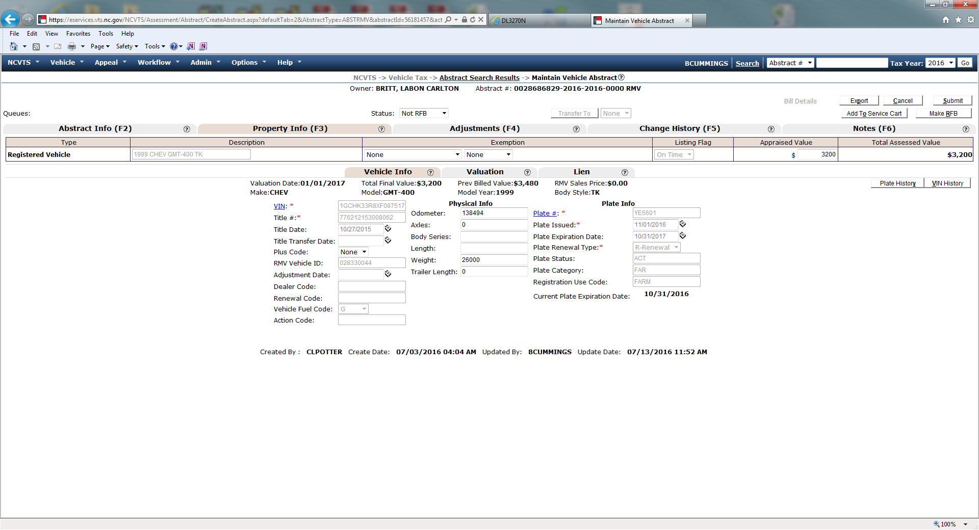
Step 1. To select a single abstract while working in the Maintain Vehicle Abstract Screen, click the “EXPORT” button located in the upper right corner of the screen.

Slide 5
Step 2. To select multiple abstracts, while working in the queue place a check inside the boxes located beside “Assigned To” that you want to send a letter and then click the “EXPORT” button located in the upper right corner of the screen.

Slide 6
Step 3. A dialog box will pop-up. Inside the dialog box you will see “LETTERS/CORRESPONDENCE”.

Slide 7
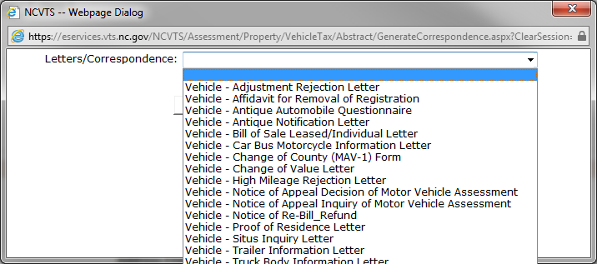
Step 4. Click on the drop down arrow ( ) and then select the type of letter you want to send that corresponds to the motor vehicle’s body type.

Slide 8
Step 5. Then click on “MARK FOR EXPORT” button. This marks the abstract(s) so you can export the needed information into your correspondence letter.

Slide 9
Step 5. Write your note and then Press the “SUBMIT” button. The abstract will show marked “ EXPORT LATER” and will display the type of letter that you sent.

Slide 10
Exporting Process
* Once you have finished marking all the abstracts that you need to send a correspondence letter to then its time for you to export the data into a file through the EXPORTING PROCESS.

Slide 11
Step 1. Under “WORKFLOW” tab on the menu bar, select “EXPORT DOCUMENTS”.

Slide 12
Step 2. Dialog Box will pop-up called “ABSTRACT DOCUMENTS”. Place your curser on the drop down arrow ( ) labeled “DOCUMENT TYPE” and then select the letter.

Slide 13
Step 3. You are now on the “Export Documents” screen. Underneath the Abstract Documents Tab you can pull the data “MARKED FOR EXPORT” by completing the following steps.
Select the date you want to export the letters by changing the date in the box labeled “DATE MARKED for EXPORT”.
Select user’s name in the box “MARKED for EXPORT BY”.
For “DOCUMENT STATUS” leave at “Not Yet Exported”.
4. Click on the button “EXPORT” .

Slide 14
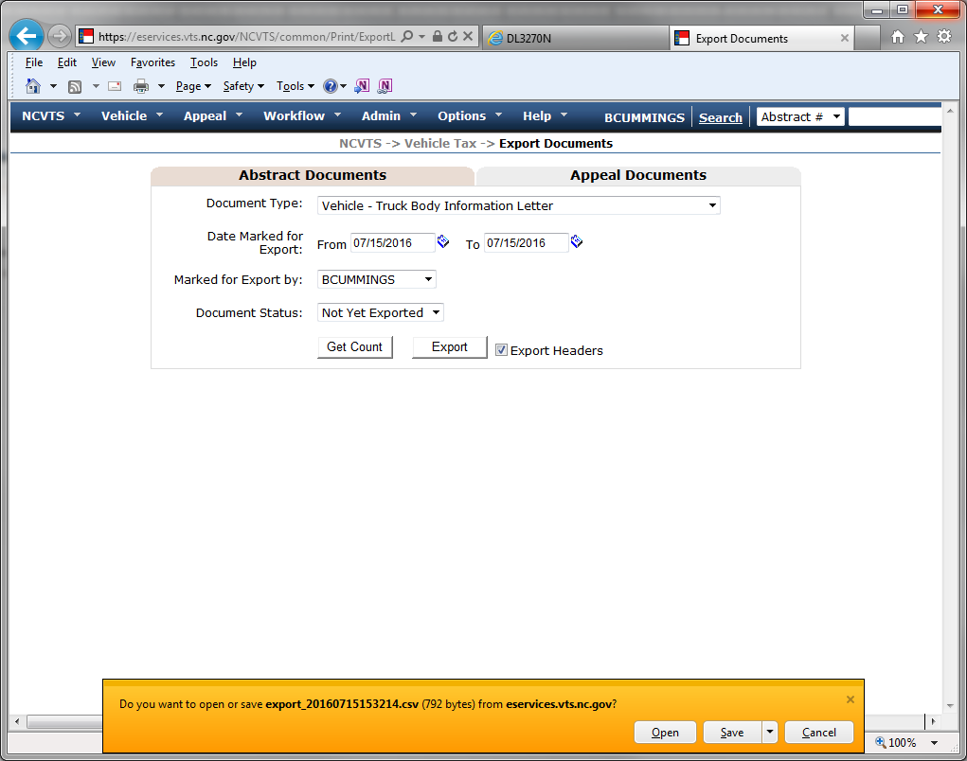
Step 4. A dialog box will pop-up asking “Do you want to open or save export from eservices.vts.nc.gov?” Click the “OPEN” button.

Slide 15
When the file opens this is what the excel file will look like.

Slide 16
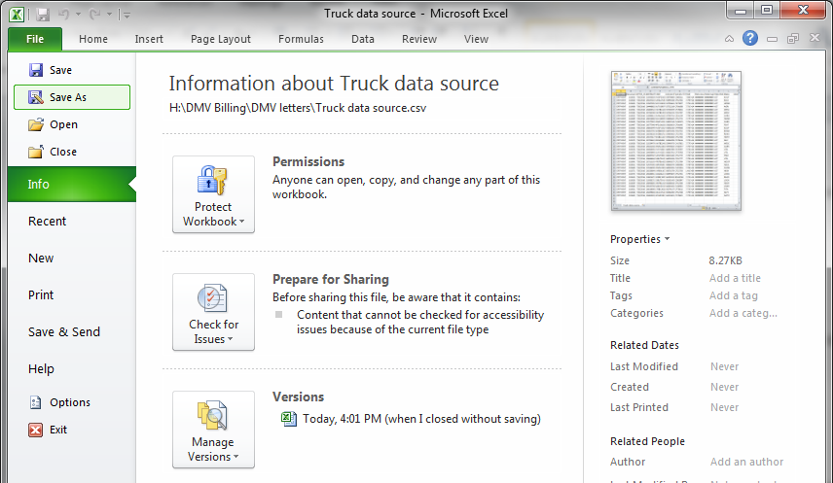
Step 5. Click the “FILE” tab located in the upper left hand corner of your screen, then click “SAVE AS”. Now name the data file as “TRUCK DATA SOURCE” file.

Slide 17
Now this completes the process that creates my data source file. The reason why I labeled the file as “Truck Data Source” is because all four of my DMV Letters is linked to this one data source. So each time I have to access my letters I only have to change my data source file just by clicking “SAVE AS” and then select “TRUCK DATA SOURCE” which is already linked to the DMV letters. When you open your next export file you will complete the following steps.

Slide 18
Step 6. Click on the data source file labeled “TRUCK DATA SOURCE”. You will notice the File Name should change to the same name as your data source file.

Slide 19
Step 7. Click “SAVE” button. A dialog box Confirm Save As will pop-up stating “Data Source .csv already exists. Do you want to replace it ? Click the “YES” button.

Slide 20
Step 8 . A dialog box will pop-up stating “ Data Source.csv may contain features that are not compatible with CSV. Do you want to keep the workbook in this format?” Click the “YES” button.

Slide 21
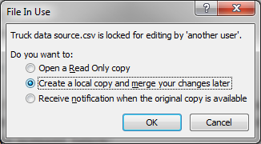
Sept 9. A dialog box will pop-up “FILE IN USE” stating “Data Source.csv is locked for editing by another user. Do you want to: select the option “CREATE A LOCAL COPY AND MERGE YOUR CHANGES LATER” and then Click the “OK” button. The file is now saved as a data source file that is linked to your DMV letters. You can now create the letters using mail merge.

Slide 22
Why should I export data into Microsoft Mail Merge?
Microsoft Word has a mail merge feature that allows you to use a form letter or document to insert names, addresses, or other related information into the letter or form automatically by inserting record fields from a data source.
You can mail out multiple DMV letters without having to physically touch each individual letter reducing employee work load.

Slide 23
How to create a Mail Merge using and existing document?
Before starting the Mail Merge process you must first create the form letter by inserting the record fields from the data source into your existing DMV letter.

Slide 24
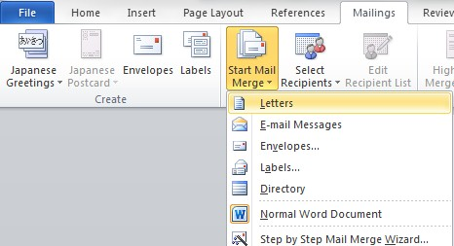
Step 1. Open Microsoft word and then select the DMV letter. Click on the “Mailings” tab.
Step 2. Find the “Start Mail Merge” tab under the Mailings tab and
click the arrow beside it. Choose the first option, “Letters”.

Slide 25
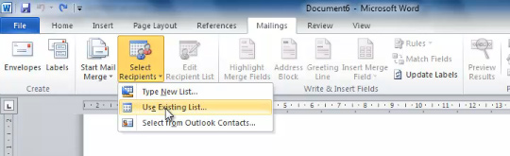
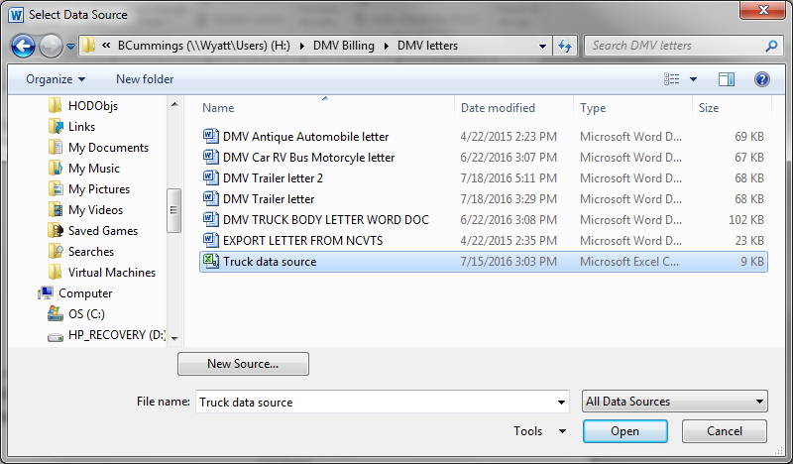
Step 3. Click “Select Recipients”. Then choose 2nd option “Use Existing List”
Step 4. The “Select Data Source” dialog box will pop-up. Locate and select the
“Truck Data Source”. This is the file you saved that was exported out of
NCVTS.

Slide 26
Inserting the Record Fields into a letter.
Your DMV letter is now linked to the excel spreadsheet which contains the owner and vehicle information needed to create your letter. It’s time to insert the record fields from the “Truck Data Source” file into the DMV letter. Make sure your curser is located where you want to insert the “Record Field” from your data source. Example: If you want to insert a date first make sure the curser is located beside DATE.

Slide 27
Step 5. Click on the “ Insert Merge Field”. You will see a list of the record fields from the “Truck Date Source” that you have to insert into the DMV Letter.

Slide 28
Step 6. To insert a “Record Field”, place your curser beside DATE and click on “Letter Create Date Time”. The record field «LETTER_CREATE_DATETIME» will appear in letter.

Slide 29
Step 7. Insert into the letter abstract # by making sure the curser is located by “Abstract #:” and then click “Insert Merger Field” select “ABSTRACT_NUM”. The record field «ABSTRACT_NUM» will appear in the letter.

Slide 30
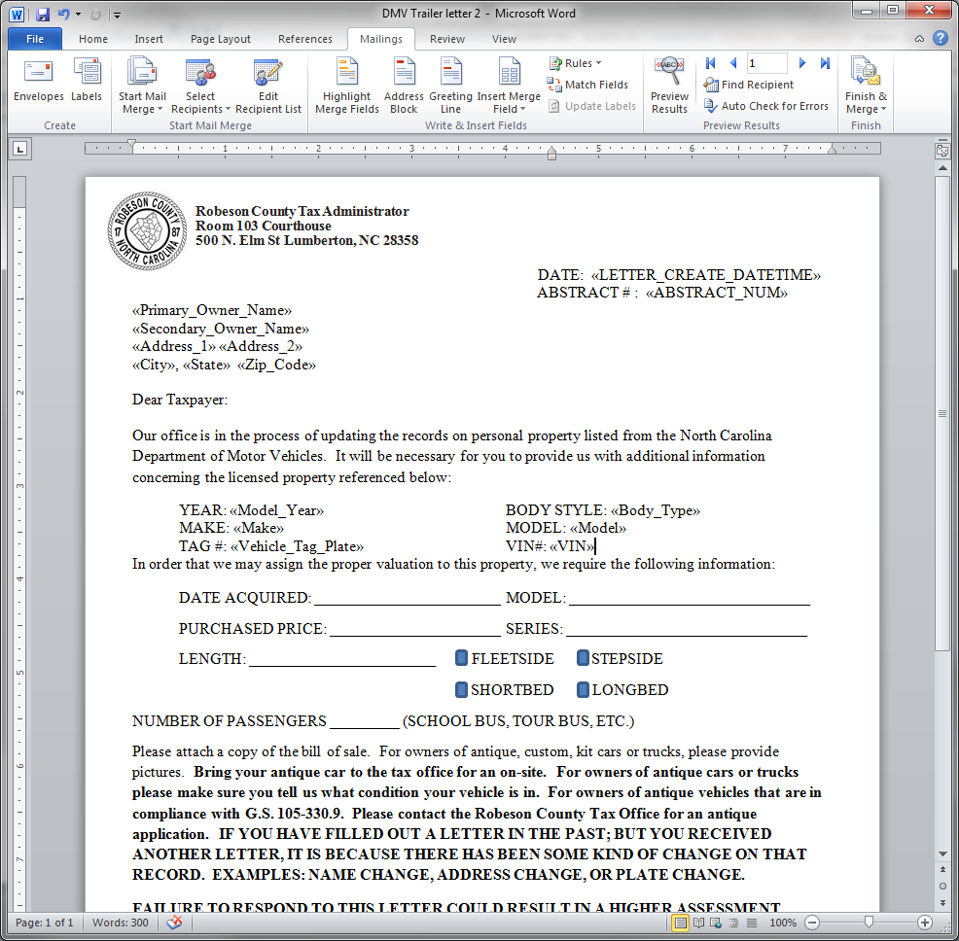
Step 7. You can insert taxpayer’s name, address, and the vehicle information into the letter using the same following steps: make sure curser is located where you want to insert the record field and click on “Insert Merge Field”, then select the which record field you want to insert. The record field(s) will appear in the letter.

Slide 31
Mail Merge
Now it is time to merge your data source file with the DMV letter that corresponds to the data source file that was exported and saved to your computer.
Select the letter that corresponds to the Motor Vehicle Body Type or condition. Such as the following:
1. Antique MV Letter
2. Truck Body Letter
3. Trailer Letter
4. Bus & RV Letter

Slide 32
Step 1. Now you can start the mail merge process by opening Word and selecting the appreciate letter that corresponds to the motor vehicle body.

Slide 33
Step 2. A dialog box will open stating “Opening the document will run the following SQL Command. Data from your database will be placed in the document. Do you want to continue?” Click the “YES” button.

Slide 34
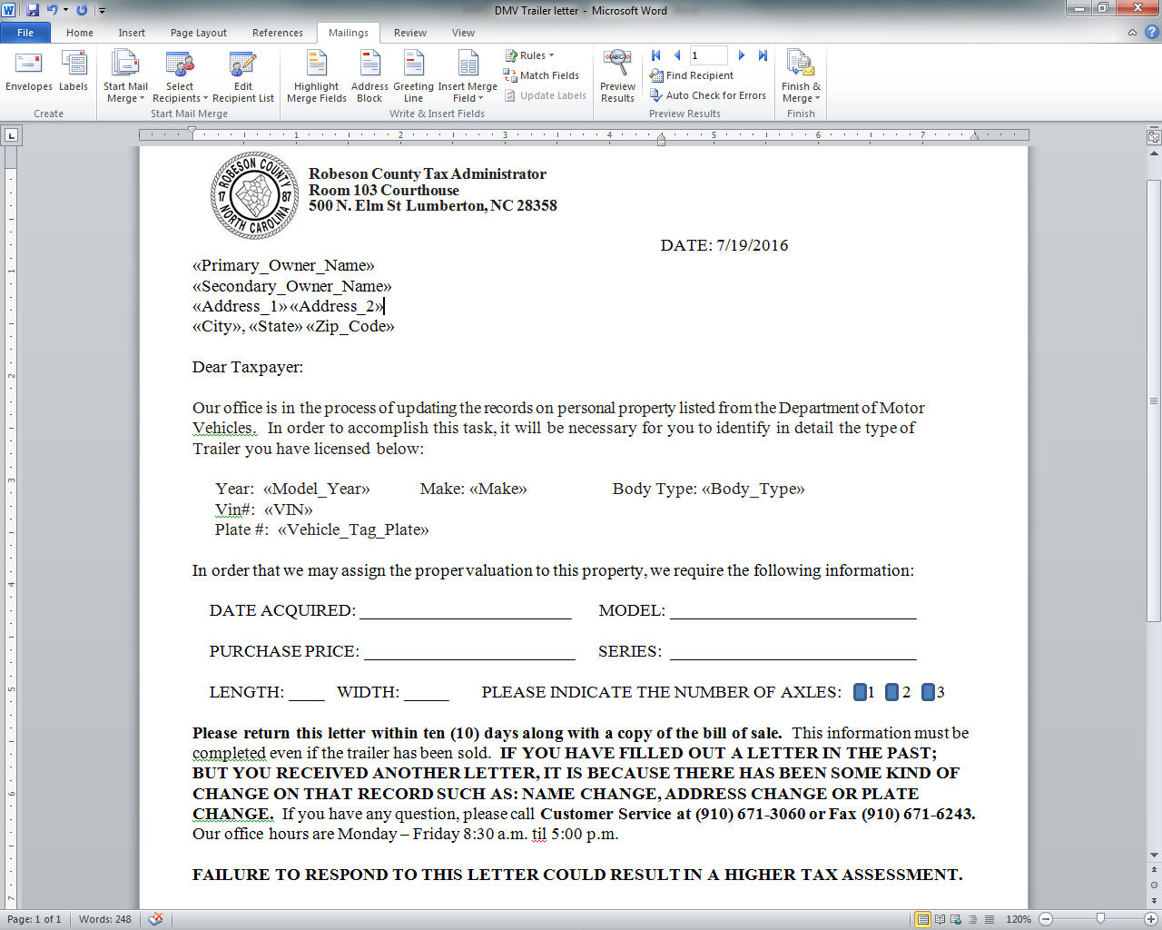
Your correspondence letter that was created for the mail merge should pop-up.

Slide 35
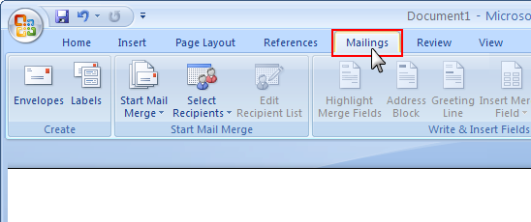
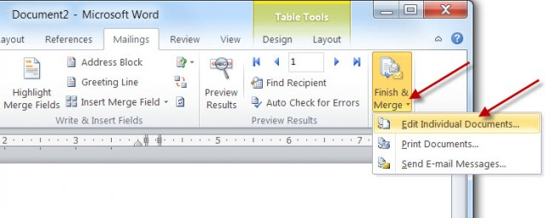
Step 3. On the Menu Bar click the “MAILINGS” tab.
Step 4. Then click on “FINISH & MERGE” tab. A box will open, select “EDIT INDIVIDUAL DOCUMENTS” tab.

Slide 36
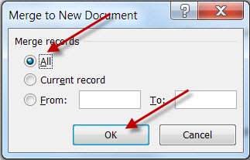
Step 5. A dialog box “Merge to New Document” will pop-up. Merge records will appear make sure “ALL” is selected and then click the “OK” button.

Slide 37
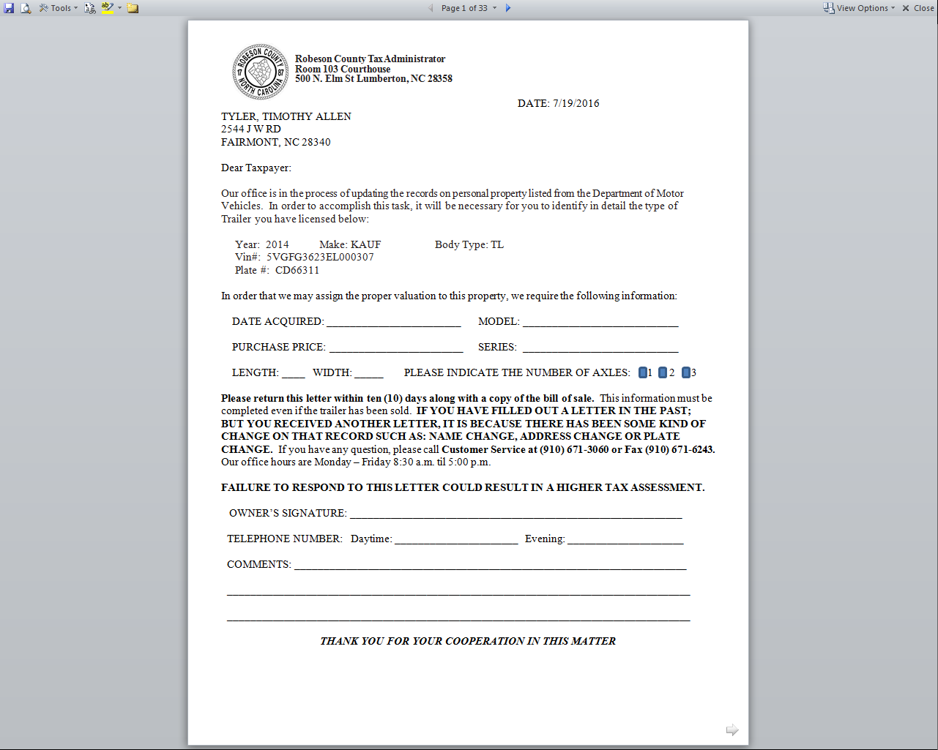
Now the mail merge is completed. You may print and mail the correspondence letters.

Slide 38
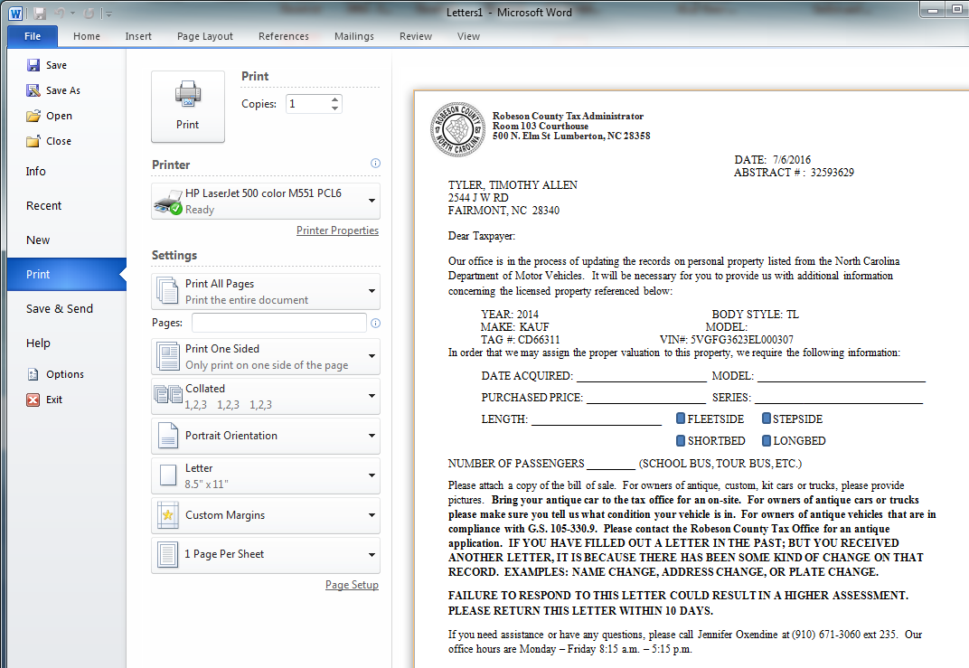
Step 6. To print your correspondence letter click on the “File” tab located in the upper right hand corner of your screen the select “Print”.

Slide 39
Step 7. After you have printed your letters. You may close the documents file by completing the following steps.
B. A dialog box will pop-up stating “Do you want to save changes you made to Letters?” Click the “Don’t Save” button.
A. Click on the in the upper right hand corner of your screen.

Slide 40
QUESTIONS?

