Slide 1
Effective Customer Interactions
2016

Slide 2
Agenda
Introduction
Define Blue Chip Service
Managing Customer Interactions

Slide 3
Blue Chip

Slide 4
Blue Chip Definition
blue chip
n 1. (Gambling, except Cards) a gambling chip with the highest value
2. (Banking & Finance) finance a. a stock considered reliable with respect to both dividend income and capital value
b. (as modifier): a blue-chip company.
3. (modifier) denoting something considered to be a valuable asset
Collins English Dictionary – Complete and Unabridged, 12th Edition 2014 © HarperCollins Publishers 1991, 1994, 1998, 2000, 2003, 2006, 2007, 2009, 2011, 2014

Slide 5
Blue Chip Service Characteristics
No Worries
Never Heard No
No Waiting
Anticipated Needs
Customized Choices
Personalized
Knowledgeable Friendly Staff

Slide 6
Managing Customer Interactions
Build Trust
Show Empathy by Acknowledge Customer’s Concern, if needed
Offer to Help Statement
Get to Heart of Call
Ask Identifying, Open, and Confirming Questions
The Solution
Provide the Solution with Choices
Gain Cooperation
Conclusion
Recap and Provide What’s Next
Ask “Is there anything else?”

Slide 7
Managing Customer Interactions
Build Trust
Show Empathy by Acknowledge Customer’s Concern, if needed
Offer to Help Statement
Get to Heart of Call
Ask Identifying, Open, and Confirming Questions
The Solution
Provide the Solution with Choices
Gain Cooperation
Conclusion
Recap and Provide What’s Next
Ask “Is there anything else?”

Slide 8
Build trust
Standard Opening
Good Afternoon, this is the North Carolina Department of Revenue, my name is Beth Collins, how may I assist you today?
Show Empathy
Listen to customer
Reflect understanding

Slide 9
Show Empathy by Acknowledging Concern
To build trust with a customer, show empathy by acknowledging his or her concern, if needed. It tells the customer you understand how he/she has been impacted by the situation. Because they don't care how much you know, until they know how much you care. https://youtu.be/dMqGr4A_0E0

Slide 10
Build Trust
Offer Statement to Help
Summarize the problem: Okay, so the Department sent you a bill showing that you owe a large tax liability. You don’t think that you owe it. Even if you did, you can’t afford to pay it.
Yes, I can assist you with that!

Slide 11
Offer to Help Statement
Use an Offer to Help statement at the beginning of each call to let the customer know that you will take accountability to help him/her.

Slide 12
Managing Customer Interactions
Build Trust
Show Empathy by Acknowledge Taxpayer’s Concern, if needed
Offer to Help Statement
Get to Heart of Call
Ask Identifying, Open, and Confirming Questions
The Solution
Provide the Solution with Choices
Gain Cooperation
Conclusion
Recap and Provide What’s Next
Ask “Is there anything else?”

Slide 13
Identifying, Open, and Confirming
?
To Get to the Heart of the Call, it is important to give the customer the explanation for your questions first (the benefit), then ask Identifying, Open, and Confirming questions.

Slide 14
Heart of The Call
Ask Identifying, Open, and Confirming Questions
To validate your identity and protect your privacy I need to ask you a few questions
Can you provide me with your name, address and SSN?
To determine if the liability is due, I must ask a few questions …
When did you acquire the property?
When did you receive the notice of tax due?
Has your address changed?
https://www.youtube.com/watch?v=ZIOogEaO3Hc

Slide 15
Heart of the Call
Confirming questions
Okay so you acquired the lot before 2013
You don’t believe you received our notice
But you haven’t change your address in 20 years

Slide 16
Managing Customer Interactions
Build Trust
Show Empathy by Acknowledge Taxpayer’s Concern, if needed
Offer to Help Statement
Get to Heart of Call
Ask Identifying, Open, and Confirming Questions
The Solution
Provide the Solution with Choices
Gain Cooperation
Conclusion
Recap and Provide What’s Next
Ask “Is there anything else?”

Slide 17
PROVIDE SOLUTION with Choices
Providing a Solution with Choices allows the Customer to feel in control and makes the solution a little more acceptable.

Slide 18
The Solution
Provide the Solutions with Choices
Since you acquired the property prior to 2014, the tax is due
Based on the dates of the notices and the fact you haven’t changed your address, the billing has become final
You may pay in our office with cash, by mail with a check or over the phone or website with a Visa or MasterCard … How would you prefer to handle this?
https://www.youtube.com/watch?v=EUm-vAOmV1o

Slide 19
The Solution
Gain cooperation
Great, so you would like to pay with credit card over the phone …
Oh no, I can’t afford this at all…
Sometimes you may have to move back a step

Slide 20
Managing Customer Interactions
Build Trust
Show Empathy by Acknowledge Taxpayer’s Concern, if needed
Offer to Help Statement
Get to Heart of Call
Ask Identifying, Open, and Confirming Questions
The Solution
Provide the Solution with Choices
Gain Cooperation
Conclusion
Recap and Provide What’s Next
Ask “Is there anything else?”

Slide 21
Heart of the Call
So, you don’t have the ability to pay in full today …
Always assume payment-in-full
Provide payment options
Do you have a major credit card?
Are you a member of a credit union?
If you can’t pay in full, how much are you short?
Better than “how much can you pay”
Assumes payment in full
Allows you to retain control of the negotiation
Depending on policies, offer options such as penalty waiver, payment plans or settlement agreements
so

Slide 22
Managing Customer Interactions
Build Trust
Show Empathy by Acknowledge Taxpayer’s Concern, if needed
Offer to Help Statement
Get to Heart of Call
Ask Identifying, Open, and Confirming Questions
The Solution
Provide the Solution with Choices
Gain Cooperation
Conclusion
Recap and Provide What’s Next
Ask “Is there anything else?”

Slide 23
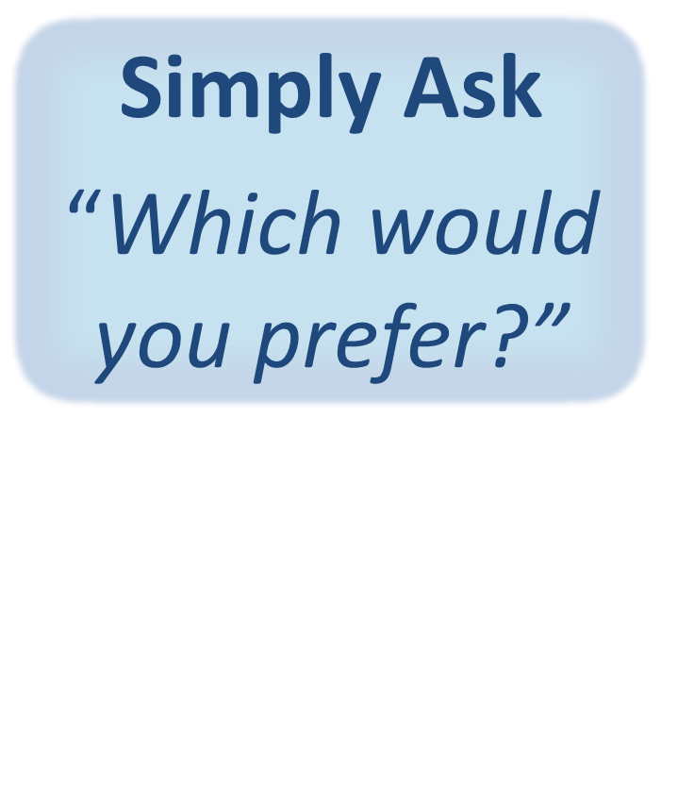
Gain Cooperation
Gaining Cooperation is asking the Customer which Choice would he/she prefer.

Slide 24
The Solutions
Options
You may pay today using cash, check or credit card … which would you prefer?
If you decide not pay today, penalty and interest will continue to accrue and your assets, such as your wages and bank accounts may be attached and garnished and liens issued against your property
Hey, it is a choice and should be presented as a choice
Gain cooperation
Okay, so you’ve decided to visit our Kiosk at Wal-Mart to pay via credit card.
https://youtu.be/4T2GmGSNvaM

Slide 25
Managing Customer Interactions
Build Trust
Show Empathy by Acknowledge Taxpayer’s Concern, if needed
Offer to Help Statement
Get to Heart of Call
Ask Identifying, Open, and Confirming Questions
The Solution
Provide the Solution with Choices
Gain Cooperation
Conclusion
Recap and Provide What’s Next
Ask “Is there anything else?”

Slide 26
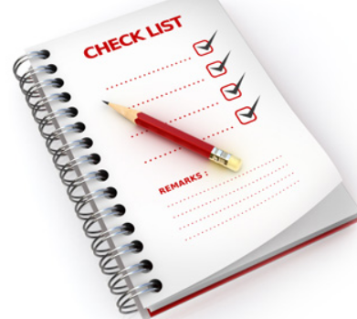
Recap and Provide What’s Next
Recapping and Providing What’s Next is reconfirming what has been discussed and states to the customer the expected outcome and what will happen next regarding the actions he/she will need to take.

Slide 27
Conclusion
Recap and Provide What’s Next
Thank you for agreeing to pay using your MasterCard at the Wal-Mart kiosk
It is located at the front of the store between Great Clips and the EyeWear store
You must pay $1,021.56 prior to May 1, 2016 to avoid additional penalty, interest and potential forced collection actions
The lien against your property will be released with the Wake Co. Clerk of Court upon posting of payment in full and you will receive a copy of the release

Slide 28
Ask, “Is There Anything Else?”
Asking, “Is There Anything Else?” ends the interaction on a positive and professional note and ensures the customer’s questions and concerns have been addressed.

Slide 29
Conclusion
Ask if there is anything else
Is there anything else I can assist you with today?
End call
Thank you for your call and please contact us again anytime we can be of service
Normally, the customer ends the call before the call agent disconnects

Slide 30
General Contact Handling Tips

Slide 31
Protect Internal Processes
Protecting Internal Processes is building a sense of trust and confidence with Customers by not revealing county’s procedures, processes, and issues to Customers.

Slide 32
Handling Abusive Customers
Offer to Help: you are a professional that is here to help, but they need to act professional as well.
Consequences of Their Behavior: if he/she continues to swear at you and act unprofessional, you will need to end the call.
Hang Up The Call: you are ending the call now and he/she is welcome to call back at a better time.
Public Servant
Public Doormat

Slide 33
State Information Positively
Stating Information Positively helps build the Customer’s confidence in your knowledge and abilities. It puts the situation or issue in a positive light.

Slide 34
Add Value
Add Value to the customer experience at every opportunity during the interaction. It conveys to the customer we are focused on their needs, we are here to help, and their tax dollars are hard at work!

Slide 35
Perception = Reality
Vocal Tone, Jargon & Acronyms

Slide 36
Activity
Listen to two customer service videos and jot down what you like and dislike about each customer service interaction.
Video 1 https://www.youtube.com/watch?v=y5UVy-uCUzs
Video 2 https://www.youtube.com/watch?v=qKv2HGsuaUs

Slide 37
https://www.youtube.com/watch?v=2v0RhvZ3lvY

Slide 38
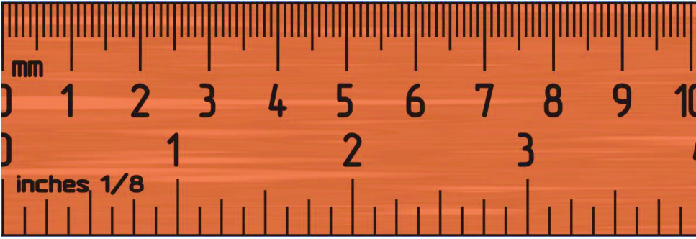
Scorecarding – Attain Standards
Standards are the minimum level of acceptable performance. These are the objective measurements on the evaluation scorecard.

Slide 39
Summary
Protect Internal Processes
Attain Standards
Achieve Blue Chip
Manage Customer Interactions
Personalize the Solution with Options
State Information Positively
Add Value
View this movie. Enjoy!

Slide 40
Questions

Slide 41
Business Card
Beth Collins, Assistant Director
Taxpayer Assistance Division
NC Department of Revenue
Beth.collins@ncdor.gov
919-896-4596

