Slide 1
Want a Reduction in BPP Value? I Have a Few Questions for You!
By Kirk Boone
RWPOLL.COM Session ID: 265496

Slide 2
Which description fits you best?
I am an assessor.
I am with a private company.
I am a BPP appraiser.
I am a Real P appraiser

Slide 3
I have five questions for you
Is the data correct?
Is the inutility penalty calculation used correctly?
What is expected in years ahead?
Has it been considered how much depreciation is being calculated by the use of age/life?
Has the required testing for recoverability under FASB 144 been done?

Slide 4
Question #1 “Is your data correct?”

Slide 5
What is this formula?
V = LV+(CN – D)
Value = Land Value + (Cost New - Depreciation)
For machinery and equipment BPP
Value = Cost New – Depreciation

Slide 6
What is the result if the incorrect cost new is used in the formula?
The value will always be too high.
The value will likely be too low.
Absolute Chaos
GIGO

Slide 7
Garbage In Garbage Out
May refer to failures in human decision making due to using a correct formula, but faulty, incomplete, or imprecise data.

Slide 8
Make sure the data is correct
Ask what would be done in real property.
My house is measured wrong.
Those comps are not similar to my house.
Income is too high, expenses, cap rate too low.
Verify random sample of data before revaluation.

Slide 9
How to make sure
The big picture – on site inspection
Supplies, spare parts, fuels, random sample M&E.
Develop Cost manuals ($/sq. ft)
Closer look - a review of financials.
Request asset list used to file BPP return – tie it.
Request financials trial balance, depreciation schedule, income statement, chart of accounts.
Note if any BPP is in real property accts.
Spare parts, supplies, and fuels. CIP, Section 179 property, Cap. Interest, allocated costs.

Slide 10
Consider a request for 50% economic obsolescence.
Beginning value is $120 million based on 40% good of $300 million historical cost.
$120 million x 50% = $60 million requested.
On site and cost reconciliation finds $60 million cost not reported.
If economic obsolescence exists:
$144 million x 50% = $72 million requested now?

Slide 11
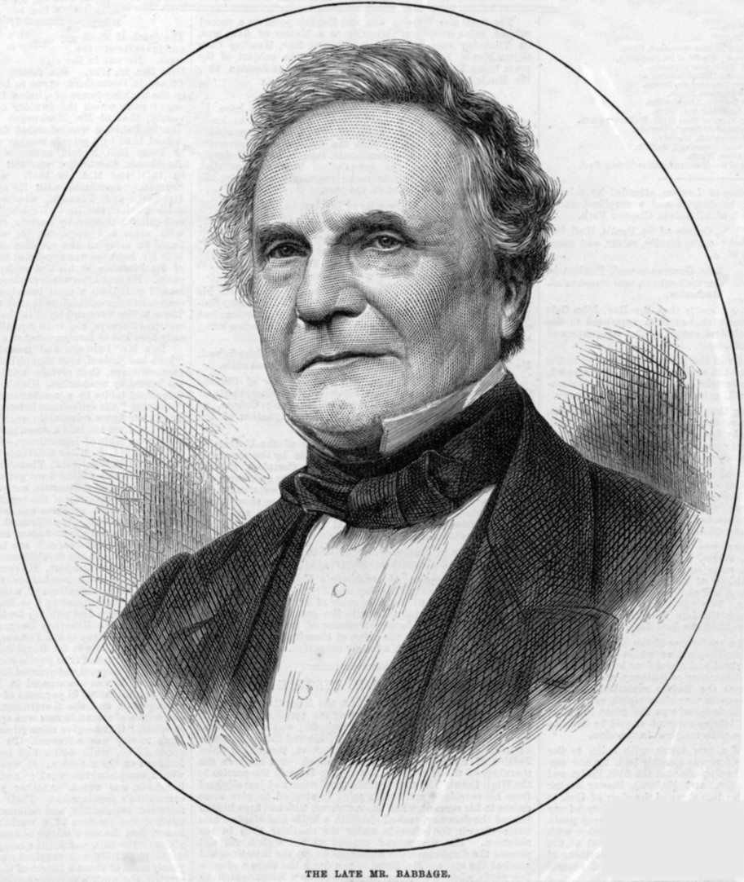
Charles Babbage
"Pray, Mr. Babbage, if you put into the machine wrong figures, will the right answers come out?" ... I am not able rightly to apprehend the kind of confusion of ideas that could provoke such a question.
—Charles Babbage, Passages from the Life of a Philosopher

Slide 12
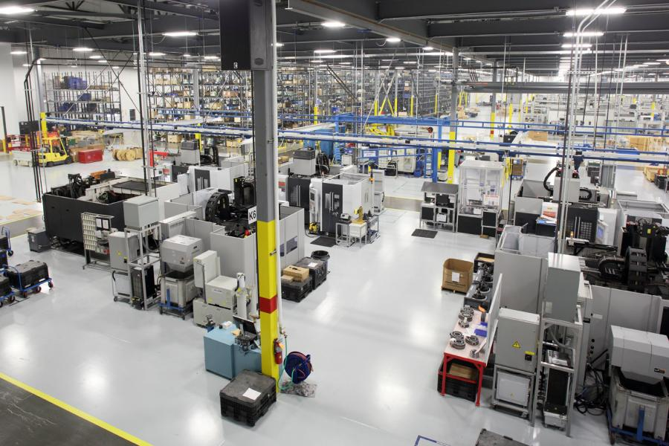
Question #2 – “Is the inutility penalty being used correctly?”
A manufacturing facility has a designed capacity of 1,000 units per day. However, it is producing 400 units per day.

Slide 13
Inutility as a percent Formula
Where Capacity A = Rated or design capacity
Capacity B = Actual Production
X = Exponent or scale factor
Valuing Machinery and Equipment The fundamentals of Appraising Machinery and Technical Assets, Third Ed., ASA

Slide 14
Inutility as a percent is calculated using a .7 scale factor at 47%
There is some economic obsolescence (EO).
There is approximately 47% EO.
There is no EO.
We don’t have enough information.

Slide 15
More information
The facility has experienced a decrease in production over the past 3 years.
The general economy has shown signs of a recession in the past 3 years.

Slide 16
Inutility as a percent is calculated using a .7 scale factor at 47%
There is some economic obsolescence (EO).
There is approximately 47% EO.
There is no EO.
We don’t have enough information.

Slide 17
More Information
Normal production levels follow a cyclical market. The industry is well aware of this.
It is impossible to achieve 100% production.
The best production year ever was 90%. Engineers indicate more was demanded.
40% production is not abnormal in the cycle.
Permits approved to expand capacity by 50%.
$30 million spent last year to increase capacity by 10%. Value of entire plant - $60 million.
Forecasts indicate demand to increase sharply.
Competition and the market is following.

Slide 18
Inutility as a percent is calculated using a .7 scale factor at 47%
There is some economic obsolescence (EO).
There is approximately 47% EO.
There is no EO.
We don’t have enough information.

Slide 19
The formula is a method, not a decision maker.
Does measuring the area of a triangle determine whether the triangle exists?
Can a formula alone determine whether economic obsolescence exists?
“The appraiser should determine the facts and circumstances and apply them as appropriate.” Valuing machinery and equipment: The fundamentals of appraising machinery and technical assets (3nd ed., p. 78). (2011). Washington, D.C.: American Society of Appraisers.

Slide 20
Determine the facts and circumstances, apply as appropriate.
“A plant operating at close to its full capacity doesn’t necessarily indicate that economic obsolescence is zero.” ibid
“A plant operating at near zero capacity doesn’t necessarily indicate that economic obsolescence is high.” Kirk Boone, PPS

Slide 21
What is the “Scale factor”?
Engineering cost to capacity formula
Assumes as capacities increase not all costs vary with size in a straight line.
A 1,000 gallon tank doesn’t cost twice as much as a 500 gallon tank. Relationship is not linear
A machine that manufacturers 1,000 units per day doesn’t cost twice as much as one that makes 500.
And the non-linear relationship with machines is different than the one with tanks.

Slide 22
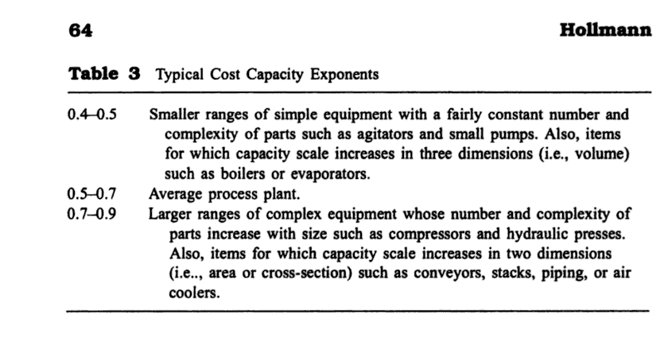
The Engineer's Cost Handbook: Tools for Managing Project Costs By Richard E. Westney

Slide 23
Question #3 “What is expected in the future?”
A machine or plant is for sale. Capacity is 1,000 units per day. Production is 400 units per day.
Which of the following would be most important in determining the current value?

Slide 24
Which has the MOST impact on the current probable arms-length selling price?
That production is currently 40% of capacity.
Being 100% sure of what has happened in the market over the past 3 years.
Being relatively certain of what will happen in the market in the next 3 years.

Slide 25
Which has the MOST impact on an individual arms-length selling price going up or down..next week?
Sale prices in a neighborhood are down to 1/3 of their prices 3 years ago.
Having a 3 year sales history with all related data.
A forecast arriving tomorrow indicates demand is going to sharply increase in the neighborhood in the next 3 years.

Slide 26
12 Principles of Value
Evolved from economic doctrine.
Interrelated, rarely considered in isolation.
Substitution
Supply and Demand
Anticipation

Slide 27
What do these actions indicate about principles of value?
Increasing capacity while production is low.
Trade associations forecast increased demand.
Competitors are building and expanding.
Few competitors are closing.
Cost of the product is stable.
Cost per capacity of expansion is greater than cost per capacity of subject, existing facilities, and new facilities.

Slide 28
Ask….
How is the market reacting to expectations?
“Value is the present worth of all the anticipated future benefits to be derived from a property….Prior sales and prior income streams are important only when they parallel the current actions of buyers, thus providing an indication of what may be expected in the future.” Property assessment valuation (3rd ed., p. 16). (2010). Kansas City, Missouri: International Association of Assessing Officers.

Slide 29
Question #4 “How much depreciation is already being calculated?”
Remember: GIGO
Remember: Value = Cost New – Depreciation

Slide 30
Age/Life Analysis
Can economic obsolescence be included in this?
A life of 20 years is the correct life for a plant.
Marshall and Swift and State/County depreciation tables agree.
M&S, “External…is not directly included in the tables”
If local governments claim all forms of NORMAL depreciation is included, how can both be correct?

Slide 31
Age/Life
Most mass appraisal tables do consider all forms of normal obsolescence.
Many industries follow normal production cycles of peaks and valleys.
A plant with a 20-yr. life can be virtually new with primary components 50 yrs. old.
Marshall and Swift is still correct.
Extended Life Expectancy – like us….

Slide 32
Extended Life Expectancy
“is the increased life expectancy due to seasoning and proven ability to exist. Just as a person will have a total normal life expectancy at birth which increases as he/she grows older, so it is with structures and equipment.” –Marshall Valuation Service, Section 97 page 1, March 2009
So what? Let’s look at an example….

Slide 33
Which do we do in mass appraisal?
Same plant, 20 year life,15 years actual age on assessment date, $1 million cost
Plant is 15 years old.
5 years remaining economic life
5/20 = 1/4 remaining value
With index factor of 1.33
Trended $1,330,000
Value = $332,500
Plant is 15 years old.
Remaining life is recalculated each year.
It has 15 years remaining.
15/20 = .75 good
Trended $1,330,000
Value is $997,500

Slide 34
Using age/life formula but actual age rather than effective age results in:
Less Depreciation calculated, higher value.
Higher depreciation calculated, lower value.
Actual age is same as effective age.
I have a higher effective age after this presentation.

Slide 35
Question #5 “Has there been a test for a FASB 144 write down?”
FASB establishes standards of financial accounting that govern the preparation of financial reports by nongovernmental entities.
Recognized as authoritative by the Securities and Exchange Commission (SEC) and the American Institute of Certified Public Accountants.
http://www.fasb.org/facts/

Slide 36
The value for property tax purposes is different than the value tested under FASB 144.
True
False
I’m lost.
Don’t know but I’ve found a couple of useful things in this presentation.

Slide 37
Value in FASB 144
FASB 144 speaks to “fair value”
“The fair value of an asset is the amount at which that asset could be bought or sold in a current transaction between willing parties, that is, other than in a forced or liquidation sale.”
Accounting for the impairment or disposal of long-lived assets (p.12). (2001). Norwalk, CT: Financial Accounting Standards Board of the Financial Accounting Foundation.

Slide 38
FASB 144
For assets to be held and used:
Impairment exists when the carrying amount (book value) exceeds fair value.
The carrying amount of a long-lived asset (asset group) is not recoverable if it exceeds the sum of the undiscounted cash flows expected to result from the use and eventual disposition of the asset (asset group).

Slide 39
When testing for recoverability is required
A long-lived asset (asset group) shall be tested for recoverability whenever events or changes in circumstances indicate that its carrying amount may not be recoverable. The following are examples of such events or changes in circumstances:
Accounting for the impairment or disposal of long-lived assets (p. 9). (2001). Norwalk, CT: Financial Accounting Standards Board of the Financial Accounting Foundation.

Slide 40
Listed examples
a. A significant decrease in the market price of a long-lived asset (asset group)
b. A significant adverse change in the extent or manner in which a long-lived asset (asset group) is being used or in its physical condition
c. A significant adverse change in legal factors or in the business climate that could affect the value of a long-lived asset (asset group), including an adverse action or assessment by a regulator.
ibid

Slide 41
Listed Examples
e. A current-period operating or cash flow loss combined with a history of operating or cash flow losses or a projection or forecast that demonstrates continuing losses associated with the use of a long-lived asset (asset group)
f. A current expectation that, more likely than not, a long-lived asset (asset group) will be sold or otherwise disposed of significantly before the end of its previously estimated useful life.
ibid

Slide 42
In Conclusion
Some questions are interrelated.
FASB 144 test requirements and what is expected.
If economic obsolescence exists, is 50% economic obsolescence warranted if the depreciation amount compensates?
Look at the bigger picture to see if it just makes sense.
Remember GIGO.

Slide 43
MA_ _E_ A_A_YS_ _
MARKET ANALYSIS
RKT PLUS
LPN RNTS
PPD SMED
RKT NLIS

Slide 44
Thank you!
Kirk F. Boone, PPS
Lecturer,
UNC School of Government
919.962.7434
boone@sog.unc.edu

