Slide 1

LEASHOLD IMPROVEMENTS
Lessons learned
NC Dept of Revenue
Tina stone, PPS
Travis Isaacs
David Baker, PPS

Slide 2
Leasehold Improvements
Real Estate improvements to leased property contracted for, installed by, and paid for by the lessee; and which may or may not remain with the real estate, there by becoming an integral part of the leased real estate upon expiration or termination of the current lease, but which are the property of, and should be charged to, the current lessee.

Slide 3
Two Big Questions
Are the improvements:
    Real property, or Personal property?
Who is the owner of the property?

Slide 4
Real Property Defined
G.S. 105-273
(13) Real property, real estate, or land. – Any of the following:
  a. The land itself.
  b. Buildings, structures, improvements, or permanent fixtures on land.
  c. All rights and privileges belonging or in any way appertaining to the property.

Slide 5
Personal Property Defined
G.S. 105-273
(14) Tangible personal property. – All personal property that is not intangible and that is not permanently affixed to real property.

Slide 6
Property Must be Taxed to Owner
G.S. 105-302
(a) Taxable real property shall be listed in the name of the owner, and it shall be the owner's duty to list it unless the board of county commissioners shall have adopted a permanent listing system as provided in G.S. 105‑303(b).

Slide 7
Property Must be Taxed to Owner
G.S. 105-306
(a) Taxable personal property shall be listed in the name of the owner on the day as of which property is to be listed for taxation, and it shall be the duty of the owner to list the property.

Slide 8
Who is the Owner?
Keep in mind G.S. 105-306(c)(8):
If the person in whose name personal property should be listed is unknown, or if the ownership of the property is in dispute, the property shall be listed in the name of the person in possession of the property, or if there appears to be no person in possession, in the name of "unknown owner."

Slide 9
Lessee
Assets are usually capitalized by the lessee as leasehold improvements.
Lessee receives benefits of the use of the property and the depreciation for financial and income tax purposes.

Slide 10
Personal or Real?
Webster's Real Estate Law in North Carolina, 4th Edition, 1994
2-1 “Personal Fixtures” retain their character as personalty; “real fixtures” are those items which have become in law so inseparably a part of the land as to be deemed a part of the real property. Again, the key factor in determining whether an item has become a fixture, i.e., a real fixture, is the intent of the owner of that item.

Slide 11
Personal or Real?
2-2 Nevertheless, "real fixtures" generally consist of things, originally chattels personal, which have been annexed to land, or to things permanently attached to land, by the owner of the chattels or with his assent, and with the intention to make the annexation permanent. All other annexations are "personal fixtures".

Slide 12
Personal or Real?
2-2 However, the key consideration in determining whether an item has become a “real fixture” is often not whether it has actually been annexed but is instead the intent of the item’s owner

Slide 13
Personal or Real?
2-4(a) The fact that a chattel has been attached to the land or a building in such a way that it cannot be detached therefrom without seriously tearing or injuring the soil, land or building to which it is attached is strong evidence that the annexation was intended to be permanent. Such fixtures are usually considered to be “real fixtures” and therefore nonremovable.⁹

Slide 14
Personal or Real?
2-4(b)(5)(b) "For trade purposes. With respect to trade purposes, it is the purpose of the law to encourage trade, manufacture, industry and transportation. The law allows a tenant who places chattels on leased realty to remove whatever he has affixed to the premises for trade purposes.³³ They are called "trade fixtures" and remain personal property of the tenant. ..."

Slide 15
Personal or Real?
...if one has only a temporary interest in the real property, it is reasonably presumable that he does not intend for an attachment to the realty to be more than temporary, to parallel his temporary interest in the realty, and thus to remain personalty."

Slide 16
Personal or Real?
No one single test, but a set of questions.
What is the intent of the lessee or owner of the leasehold improvements?
What is the intent of the lessor or owner of the real property?
How is the property affixed to the real property?
For what purpose is the leasehold put in place?
What has been appraised as real by the county?

Slide 17
Current State of Affairs
Counties are receiving many leasehold improvement (LHI) appeals based on a number of arguments.
Some inconsistencies in taxpayer treatment of LHI.
Some inconsistencies in county treatment of LHI.
Desire to explore options for improvement in the LHI process led to recent discussions.

Slide 18
Lesson 1- Do not Assume
Are all Leasehold Improvements taxable as
business Personal Property?
    Maybe?
    County should request detail of Leasehold Assets!
    Just because a county does not have it included in the real property does not make it automatically taxable as Business Personal Property

Slide 19
Lesson 2-Review Details
Review Asset Detail
Communicate with Taxpayer
Descriptions- if unable to determine ask for more detail
Taxpayer unable to identify assets based on descriptions

Slide 20
Lesson 3- Verify Real Property
During Review of Assets review your real property record card
Communicate with Real Property Appraiser-
Review Schedules of Values-
    What is considered real vs. personal?
    Is it clearly defined?
    What approach to value was used?

Slide 21
Lesson 4- Site Visit
Schedule Site Visit
Ask for detail- Review assets and how they are installed
Ask questions

Slide 22
Lesson 5- How is the Real Property Valued
Be familiar with how the Real Property is valued
Income Approach
      Best approach for leased property
  Market/Sales Approach

Slide 23
Lesson 6 - Read the Lease
Ask for a copy of the Lease
What type of Lease?
Understanding the type of lease may be helpful in understanding leasehold improvement and how they should be treated
  Gross Lease
  Net Lease
    Triple Net Lease ( Most Common)- Tenant pays property tax, insurance, etc

Slide 24
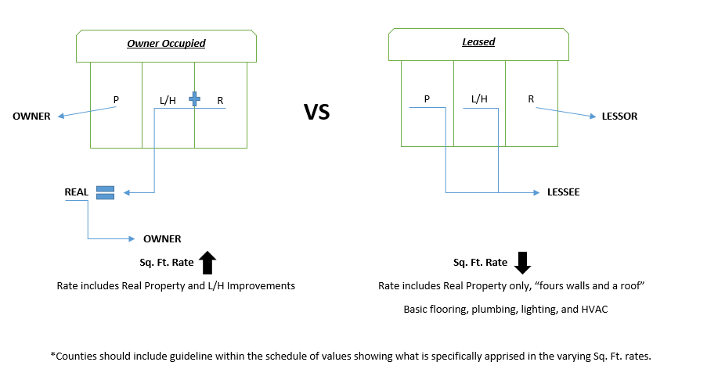
Leasehold Diagram?

Slide 25
Lesson 7- Double taxed
Most all leasehold improvements are taxable however they are only taxable as real or personal and cannot be taxed as both “ DOUBLE TAXED”
Information should be verified: Again check with your real property appraiser

Slide 26
Lesson 8- Does it add Value?
Ask yourself does it add value to real or personal?
  How does it add value?
  Real, Personal or neither?

Slide 27
Lesson 9- Use the correct Schedule
Once you have determined what assets are actually leasehold improvements and taxable as business personal property apply the correct schedule
Do not automatically use N15 or N20
This is why it is important to request a detailed asset listing of the leasehold improvements

Slide 28
Lessons Learned Summary
No absolutes in determining if an asset is real or personal
Examine Leases- Determine intent of the owner
Personal Property Appraisers should be familiar with Schedule of Values not just Real Property Appraiser

Slide 29
Lessons Learned Summary Continue
Clearly define what is considered real or personal
How is the property affixed?
Is the property there for the benefit of the process or people?
Property is only taxable once as real or personal
Be consistent

Slide 30
Lessons Learned -- Appeals
Appeals
    Be able to defend your position
    If the business is unable to identify a leasehold improvement then can you?
    No cases to the PTC on Leasehold Improvements
    Red Flag to commission –INCONSISTANCIES WITH THE COUNTIES ACROSS THE STATE
      If parking lot lighting is personal property in County A then how is it real property in County B?
      Standards

Slide 31
Lessons Learned -Inconsistencies
County Inconsistencies on Leasehold Improvements
Inconsistencies with counties across the state and how assets are categorized as real or personal
Different CAMA systems.
Difficult for multi county taxpayer to report/list BPP

Slide 32
Lessons Learned
Must Solve County Inconsistencies on Leasehold Improvements-
What is real property in one county should be the same in another. Ex: Parking Lot Lighting; Dock Levelers, Walk-in Freezer, Roll Up Doors
Reappraisal Cycles

Slide 33
Three Goals
All real and personal property is taxed correctly
No property is doubled taxed
Property is assessed to the correct owner.

Slide 34
Example for discussion
Two stores that are the same size, same age, same construction with the same personal property and retail up fit.
Land values are not in question in this example. Land is owned by the owner of the building in both cases.
First store is owner occupied and the personal property is owned by the owner of the land and building.
Second store is leased to the retail operator of the store. Personal property and leasehold improvements are owned by the operator of the store or lessee.

Slide 35
Owner Occupied Store
Personal
Property
Real
Property
Real and Personal Property owned by land owner

Slide 36
Leased Store
Personal
Property
Real
Property
Leasehold
Improvements
Personal Property and Leaseholds owned by the Lessee
Real Property owned by the land owner

Slide 37
Question
How would your county appraise these two buildings the year of the reappraisal?
  Use the cost approach with the same base rate per sq. foot on both stores or different base rates on the two stores?
  Use the income on the leased store and the cost on the owner occupied.

Slide 38
Cost Example: Owner Occupied Store
Cost of each store for all property (real and personal) is $120.00 per square foot.
County appraises real property at $80.00 per square foot for the real property.
The owner lists $40.00 per square foot of personal property.
County has all the property appraised and taxed.

Slide 39
Cost Example: Leased Store
Cost of each store for all property (real and personal) is $120.00 per square foot.
County appraises real property at $80.00 per square foot for the real property.
The owner lists $40.00 per square foot of personal property and no leaseholds.
County has all the property appraised and taxed but is taxing the owner of the real for property owned by the lessee.

Slide 40
Cost Example: Owner Occupied Store
Cost of each store for all property (real and personal) is $120.00 per square foot.
County appraises real property at $50.00 per square foot for the real property.
The owner lists $40.00 per square foot of personal property.
County has under appraised the real property.

Slide 41
Cost Example: Leased Store
Cost of each store for all property (real and personal) is $120.00 per square foot.
County appraises real property at $50.00 per square foot for the real property.
The owner lists $40.00 per square foot of personal property and $40.00 per square foot for leaseholds.
County has taxed the full value of personal property and the leaseholds but has appraised the leased store for more than the owner occupied store. $130.00 vs. $90.00 per square foot.

Slide 42
Issues with using the Same base rate per sq. foot
  The leasehold improvements are doubled taxed.
  The property is not taxed to the correct owner
  All the property is not being taxed.
  Leased store is taxed for more than the owner occupied store

Slide 43
Some of you are thinking this is an interesting discussion but this could not really happen in the real world!

Slide 44
Some real numbers
Total cost Bldg only = $2,396,769
Square Footage of store = 28,574.00
Cost per sq st = $84.00
Total cost of personal property = $1,249,443
Total cost = $3,646,211.66
Total cost per sq ft = $128.00

Slide 45
Recent Review

Slide 46
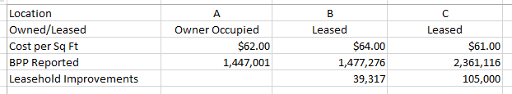
Are the Leasehold being Double Taxed?

Slide 47
Question
  What if you use the income approach on the leased store and cost approach on the owner occupied store?

Slide 48
Cost Example: Owner Occupied Store
Cost of each store for all property (real and personal) is $120.00 per square foot.
County appraises real property at $80.00 per square foot for the real property.
The owner lists $40.00 per square foot of personal property.
County has all the property appraised and taxed.

Slide 49
Income Example: Leased Store
Cost of each store for all property (real and personal) is $120.00 per square foot.
County appraises real property using the income approach as a shell of a building.
The owner lists $40.00 per square foot of personal property $40.00 per square foot of leasehold improvements.
County has all the property appraised and taxed to the correct owner.

Slide 50
Cost vs. Income
Issues:
  Is the value of these two stores now different or close enough?
  The leaseholds are going to depreciate in value each year while the owner operator’s property is not going to do likewise.

Slide 51
Income approach
The key is knowing what is leased.
  What is there when lease is signed?
  Lessor ownes what is leased.
  What the lessor owns is what should be taxed as real property.
  What is placed there by the lessee after that is chattel personal fixtures and taxable to the lessee.

Slide 52
Possible Solution
Use the same correct base rate for the owner occupied store and the leased store and have the lessee not list any leasehold improvements.
  This makes sure all the property is taxed but not double taxed.
  Taxes the leaseholds to the incorrect owner
  What other the issues do you see with this approach?

Slide 53
Possible Solution
Use a different base rate for the owner occupied store and the leased store and have the lessee list all leasehold improvements.
  This makes sure all the property is taxed but not double taxed.
  This would allow the leaseholds and personal property to be taxed to the correct owner, the lessee.
  What are the issues you see with this approach?

Slide 54
Possible Solution
Use the same base rate for the owner occupied store and the leased store and have the lessee list all leasehold improvements, and adjust the real property value of the leased store for the listed leaseholds.
  This makes sure all the property is taxed and not doubled taxed
  Taxes the leaseholds to the correct owner
  Should leaseholds be taxed as real or personal?
  What other the issues do you see with this approach?

Slide 55
Possible Solution
Use the cost approach on the owner operated store and the income approach on the leased store. Require the lessee to list the leaseholds not included in the rent.
  This makes sure all the property is taxed and not doubled taxes
  Taxes the leaseholds to the correct owner
  Have to know what was there when the lease was signed.
  What other the issues do you see with this approach?

Slide 56
Possible Recommendation
Use the income approach on leased property and have lessee list leasehold improvements.
Use cost approach and make adjustment to the real property value of the leased property to reflect the leasehold improvements listed and taxed to the lessee.

Slide 57

Questions??

