Slide 1
Assessor/Appraiser Educational Improvements
David B. Baker, MPA, PPS
Director
Local Government Division
NC Department of Revenue

Slide 2
Welcome
Local Government Division
  Property Tax Section
    Personal Property Unit
    Real Property Unit
    Public Service Property Unit
  Distribution Unit
    Distribution
    Audit
    Debt Setoff

Slide 3
Services Provide
Property Tax
Tag and Tax
Appraise Public Service Companies
Deed Excise Tax
Sales and Use Tax Distribution
Utilities Franchise Distribution
Video Programming Distribution
Peg Channel Certifications
Alcoholic Beverage Tax Distribution
Medicaid Hold Harmless
Article 44 Harmless Distribution
White Goods Disposal Tax Distribution
Scrap Tire Disposal Tax Distribution
Solid Waste Disposal Distribution
TR-1 Reports and other information data requests
TVA Distribution
Debt Setoff

Slide 4
NCGS 105-289(d)
(1) A continuing program of education and training for local tax officials in the conduct of their duties;
(2) A program for testing the qualifications of an assessor and other persons engaged in the appraisal of property for a county or municipality;
(3) A certification program for an assessor and other persons engaged in the appraisal of property for a county or municipality;

Slide 5
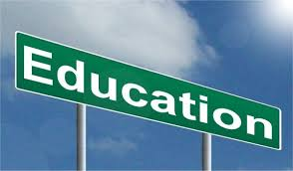
What is it?

Slide 6


Slide 7


Slide 8


Slide 9


Slide 10

This is why we are here this week.

Slide 11
NC Department of Revenue formed a reappraisal committee made up of County Assessors and County Appraisers and DOR staff to take a look at the issues being raised by the General Assembly.

Slide 12
Subcommittees Formed
  Reappraisal
    Create Reappraisal Standards for all 100 counties
  Board of Equalization and Review (Appeals)
    Study the appeal’s process and revise the Appeal’s Manual
  Forms and Notices
    Develop and review Standard forms and notices for use by all counties
  Education
    Study the educational requirements and processes

Slide 13
Education Committee
Consisted of DOR, UNCSOG and County staff
Goals
  More education courses
  More opportunities at more locations
  Reduce the costs of education
  Expand the certification program
  Encourage Professional Designations

Slide 14
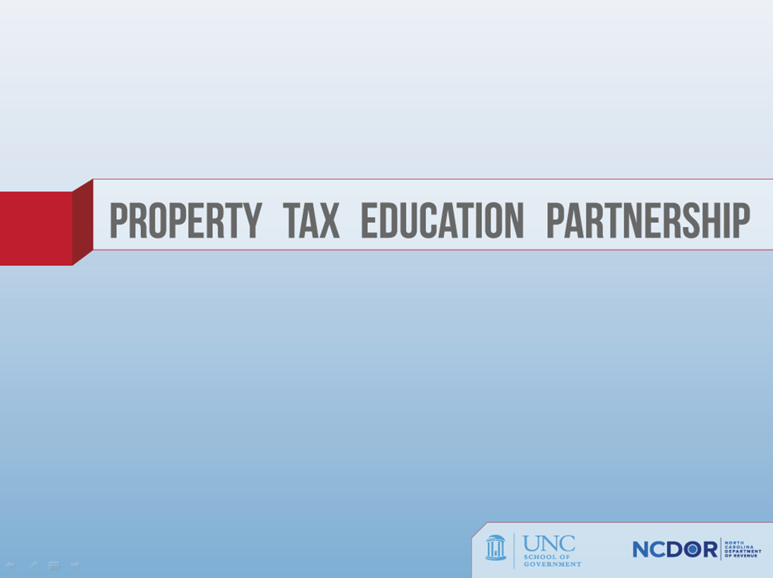

Slide 17
Course Cost Reduction
More locations
  Less overnight travel
NCDOR
  Administrative Cost
  More IAAO Instructors

Slide 18
Old Certification Program
By law all assessors and appraisers have to be certified by Department of Revenue.
30 hours of continuing education required every two years.
Old program had just two levels:
  Assessor
  Appraisers (Real and Personal)

Slide 19
Assessors
Property Tax Listing and Assessing in N.C.
  UNCSOG and NCDOR
IAAO Course 101 – The Fundamentals of Real Property Appraisal
Personal Property Appraisal and Assessment Course
  NCDOR
Tax Administration in N.C. (takes the place of IAAO 400)
  NCDOR and UNCSOG
Achieve a passing grade in a comprehensive examination conducted by the NCDOR
  It is recommended that all Assessors take USPAP and the USPAP update as required.

Slide 20
New Certification Program
Starting July 1, 2015 the new program has three levels for both real property and personal property appraisers.
  Appraiser I
  Appraiser II
  Appraiser III

Slide 21
Real Property Appraiser I – 326
Real Property Appraiser II – 29
Real Property Appraiser III – 9
Personal Property Appraiser I – 257
Personal Property Appraiser II – 1
Personal Property Appraiser III – 0
Both Real and Personal I – 116
Both Real and Personal II – 1
Both Real and Personal III – 0

Slide 22
Appraiser I Requirements
Property Tax Listing and Assessing in NC, and
Real Property
  Attend and pass IAAO 101, or IAAO 102, or
  Pass comprehensive exam administered by NCDOR
Personal Property
  Attend and pass NCDOR Personal Property Appraisal and Assessment

Slide 23
Real Property Appraiser II Requirements
IAAO-101
IAAO-102
IAAO-151 (Or Comparable Appraisal Foundation course)
Completion of two additional approved courses
Completion of two additional approved workshops or two additional courses.

Slide 24
Personal Property Appraiser II Requirements
IAAO-101
IAAO-102
IAAO-151 (Or Comparable Appraisal Foundation course)
IAAO-500
IAAO-551
IAAO-552

Slide 25
Appraiser III Requirements
Real or Personal Property
  Meet appraiser II requirements
  Completion of two additional approved courses.
  Completion of three additional approved workshops or three additional courses.
  Attend and pass USPAP 191 course

Slide 26
Exceptions to Requirements
Real Property Appraiser II
  Holding the IAAO designation as RES
  Holding the IAAO designation as AAS
Personal Property Appraiser II
  Holding the IAAO designation as PPS
Real or Personal Property Appraiser III
  Holding the IAAO designation as CAE

Slide 27
Continuing Education
All Appraisers and Assessors
  Minimum requirement is 30 hours
  Every two years beginning on July 1st of the most recent odd numbered year until June 30th of the next upcoming odd numbered year

Slide 28
Continuing Education
For NCDOR Classification as a Real or Personal Property Appraiser II and Appraiser III
  complete the IAAO Workshop 191 Uniform Standards of Professional Appraisal Practice Update within the 2 year cycle.
  IAAO 191 can be taken in addition to or in conjunction with 30 hour minimum.
If continuing education credit hour requirements are not completed, certification or classification will be suspended.

Slide 29
Continuing Education
All IAAO Courses are approved
In State developed courses by NCDOR and School of Government at UNC-Chapel Hill are also approved.

Slide 30
Approved Courses/Workshops
      Course 101 — Fundamentals of Real Property Appraisal
      Course 102 — Income Approach to Valuation
      Course 112 — Income Approach to Valuation II
      Course 201 — Appraisal of Land
      Course 300 — Fundamentals of Mass Appraisal
      Course 311 — Residential Modeling Concepts
      Course 312 — Commercial/Industrial Modeling Concepts
      Course 331 — Mass Appraisal Practices and Procedures
      Course 400 — Assessment Administration
      Course 402 — Property Tax Policy
      Course 500 — Assessment of Personal Property
      Course 600 — Principles and Techniques of Cadastral Mapping
      Course 601 — Cadastral Mapping - Methods & Applications

Slide 31
Approved Courses/Workshops
      Workshop 100 – Understanding Real Property Appraisal
      Workshop 150 – Mathematics for Assessors
      Workshop 151 -- Uniform Standards of Professional Appraisal Practice (National)
      Workshop 155 – Depreciation Analysis
      Workshop 157 – The Appraisal Uses of Excel Software
      Workshop 158 – Highest and Best Use
      Workshop 162 – Marshall & Swift Cost Approach (Residential)
      Workshop 163 – Marshall & Swift Cost Approach (Commercial)
      Workshop 171 – IAAO Standards of Professional Practice & Ethics

Slide 32
Approved Courses/Workshops
      Workshop 171 – IAAO Standards of Practice & Professional Ethics Supplement (Online Application)
      Workshop 191 – Uniform Standards of Professional Appraisal Practice Update (National)
      Workshop 252 – Valuing Property Affected by Environmental Contamination
      Workshop 257 – Fundamentals of Industrial Valuation
      Workshop 260 – Valuation of Agricultural Land
      Workshop 354 – Multiple Regression Analysis for Real Property Valuation
      Workshop 403 – Property Tax Policy Alternatives and Modules
      Workshop 452 – Fundamentals of Assessment Ratio Studies
      Workshop 551 – Valuation of Machinery and Equipment

Slide 33
Approved Courses/Workshops
      Workshop 552 – Basic Personal Property Auditing
      Workshop 553 – Advanced Personal Property Auditing
      Workshop 650 – Cadastral Mapping
      Workshop 651 – Geographic Information Systems for Assessors
      Workshop 710 – Valuation of Golf Courses
NCDOR COURSES & SEMINARS:
1. Personal Property Appraisal & Assessment Course
2. Tax Administration in N.C.
SOG at UNC-Chapel Hill
1. Property Listing and Assessing

Slide 34
Application
Upon completion of Requirements, the appraiser must apply for certification as Appraiser II or III.

Slide 35
Websites
FAQs
  http://www.dornc.com/publications/qanda_certprogram.pdf
Certification/CE Manual and Supplement
  http://www.dornc.com/publications/cert_reg_manual.pdf
  http://www.dornc.com/publications/cert_levels_1_2_3_supplement.pdf
Application
  http://www.dornc.com/publications/appraiser_application_levels_2_3.pdf

Slide 37
IAAO
IAAO is the internationally recognized leader and preeminent source for innovation, education and research in property appraisal, assessment administration and property tax policy.
http://www.iaao.org

Slide 38
Professional Designations
Mass Appraisal Specialist (MAS)
Cadastral Mapping Specialist (CMS)
Personal Property Specialist (PPS)
Assessment Administration Specialist (AAS)
Residential Evaluation Specialist (RES)
Certified Assessment Evaluator (CAE)

Slide 39
