Slide 1
Technological Changes When Moving From Paper To Electronic Records
Harry Smith
Onslow County Tax Administrator
Advanced Personal and Real Seminars
September 28, 2015

Slide 2
How long has the need existed?
Onslow began discussions of Microfilm a long, long time ago
In early 80’s, only 30,000 parcels in the county
Budget cuts and retrieval concerns prevented project approval
Over next 15 years there were numerous demos of ever changing technology options
During late 1990’s, scanning requests finally received budget approval, for only one scanner

Slide 3
Issues to be Considered
Indexing
How many fields are going to be entered?
Is it worth time & effort to index multiple fields?
GIGO- retrieval is only as good as accuracy of indexing
Verification of image quality and indexing is very important
Verification performed by different employee

Slide 4
Issues to be Considered
Document preparation
Multiple staples take time to remove and damage documents
Poor quality originals- “dog ears”, dot matrix printers, light-small-poor penmanship, small margins
Issues with paper colors not scanning-originals on white or yellow paper are better

Slide 5
Land Records Scanning
PRC’s scanned from 2000-2015, including revaluations in 2000, 2006, 2010, and 2014
Currently working on PUV and exemptions
Annexations have been scanned
Finally disposed of PRC’s from 1992-1999 which were stored in file cabinets

Slide 6
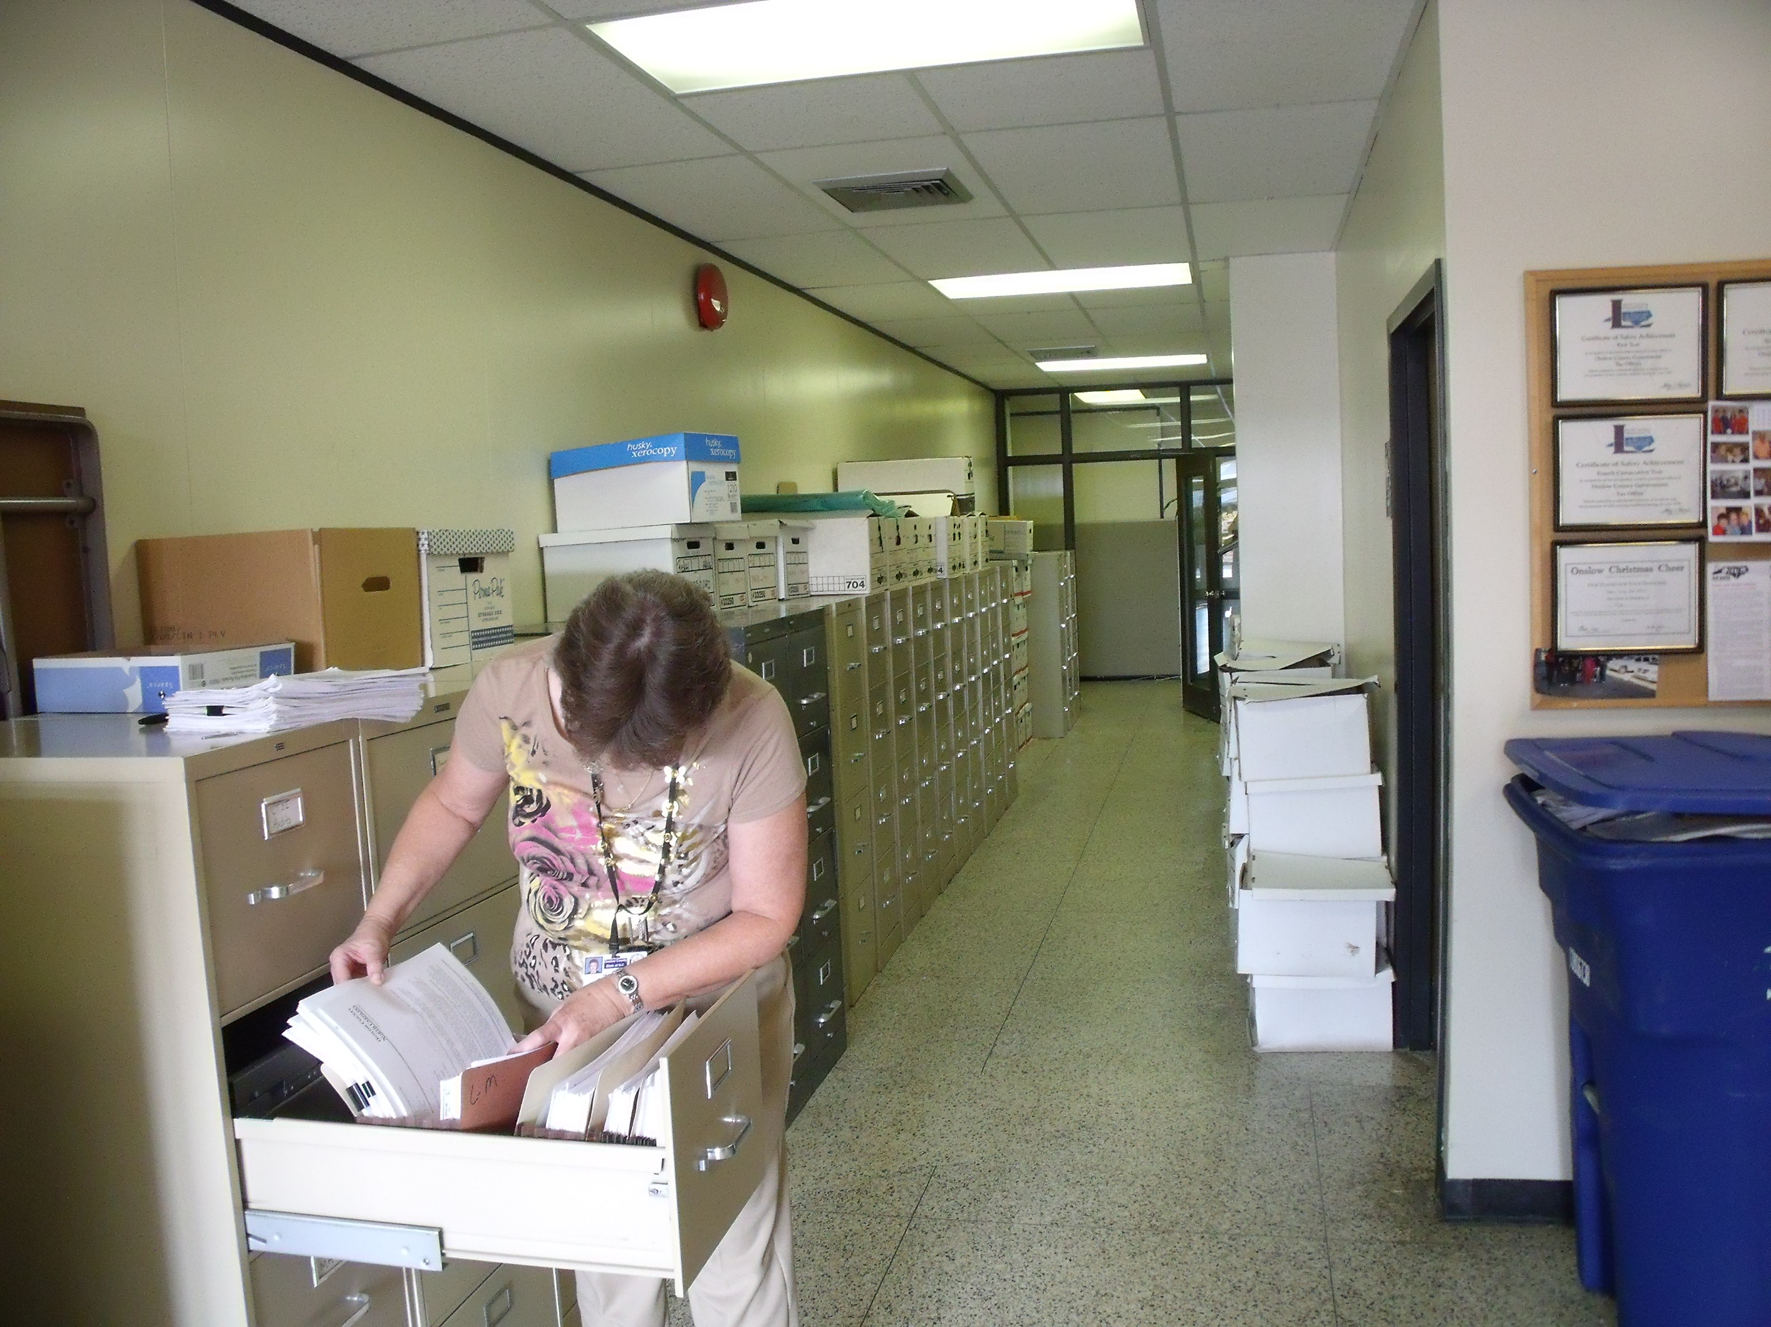

Slide 7
New Opportunity due to Change in Technology
As a result of computer system conversion, personal property abstracts moved to 8 ½ x 11
In 2012, began outsourcing scanning of abstracts and working them electronically
Provided envelope to mail form directly to vendor
Abstracts returned to office were shipped to vendor for scanning

Slide 8
When Opportunity Becomes Directive
In 2012, BOC approved construction of Onslow County Government Center
Construction began early 2013
All departments relocating to the Government Center were directed to transition toward paperless office
New building designed to maximize open work space and drastically reduce number of file cabinets

Slide 9
How Do We Meet This Objective?
County provided resources through contract with JHS Document Solutions, Wilmington
Tax office identified documents that needed to be kept due to retention requirements
Also identified documents that could be disposed of through recycling or shredding

Slide 10
Listing- Business Personal Listings

Slide 11
Listings – Vault – 10 years of Personal Listings- 437 odd shaped books

Slide 12
Collections-bankruptcy & foreclosure files

Slide 13
Land Records – PUV/Exemptions

Slide 14
Appraisal - PRC’s

Slide 15
Administration- Old Personnel Files

Slide 16
By the Numbers
Identified the following records for imaging project:
PRC’s – appx. 25 file cabinets
PUV/Exemptions – 5 file cabinets/9 file boxes
Listing abstracts-437 books-30 file cabinets
Tax releases – 69 storage boxes
Tax Refunds - 4 file cabinets
BPP audits – 3 file cabinets
Collections – 5 file cabinets

Slide 17
What if it wasn’t scanned?
During summer 2014, three large recycling cans were full every week, in addition to large trash bags full of shredded documents
Vendor provided shred truck
City of Jacksonville provided recycling dump truck

Slide 20
Additional option
Vendor offered long term storage solution
Older files rarely accessed
Long term storage less costly than scanning
Turnaround time of < 24 hours for retrieval of stored records
Storage file boxes indexed- must provide box # and name on document for retrieval

Slide 21
Process Changes as a Result
Staff trained on how to retrieve scanned docs
Staff trained on how to scan and index new docs
Business practices have changed-many employees now have desktop scanners
Many more employees now engaged in scanning on routine basis

Slide 24
Future Changes Anticipated
Listings plans to implement in-house scanning of abstracts in coming year
Appraisal division will assist Land Records by scanning and indexing PRC’s with changes
Staff has embraced scanning as part of daily routine, and prefers electronic process over paper

Slide 26
Scanners Now Deployed Throughout Office

Slide 30
Other Opportunities for Technology
Moving to new Government Center caused concern for local professionals
Old office location was one block from courthouse and Register of Deeds
Attorney staff were frequent visitors to obtain deed tax stamp certifications

Slide 31
Other Opportunities for Technology
Old office was located close to local license plate agency
Active duty military generate a great deal of traffic for MV tax releases
New office is nearly 6 ½ miles from LPA office

Slide 35
Issue
Once BOC approved moving Tax Office out of downtown area, local attorneys voiced their opposition and concern
Main issue was anticipated travel time, expense, and inconvenience of traveling to new facility for tax deed stamps

Slide 36
Other Opportunities for Technology
Met with ROD and staff to discuss issue and possible solutions
In 2012, met with local Bar Association and presented an idea for developing an electronic deed tax stamp certification process
Local attorneys tested the process and approved
Process was implemented in spring 2013, or 1 ½ years before moving to the new Government Center

Slide 37
Deed Stamp Process
Developed and provided forms for attorneys to use when submitting tax stamp requests
Deed Recording Checklist
Tax Certification Request Form
Tax Certification Form
Waiver forms for Bankruptcy and Tax Foreclosures
Attorneys office submits request form by fax or e-mail
Tax collections staff reviews and responds with signed certification by fax or e-mail

Slide 41
Other Opportunities for Technology
Transition to VTS caused an increase in processing Military Exemptions
In June 2014, met with LPA owner and staff to discuss customer service issues due to distance to new office at Government Center
County IT and Tax worked with LPA to install a PC at the LPA-military allowed to access and submit LES electronically to Tax Office
Process was up and running in July 2014

Slide 42
Easy Instructions for Submitting LES

Slide 43
Military Exemption Process
Service member accesses LES at LPA computer and e-mails LES to Tax Office
Listings staff reviews LES, accessed VTS and processes exemption
Staff member then contacts LPA to advise that exemption has been processed
Service member completes transaction at LPA

Slide 44
Questions??

