Slide 1
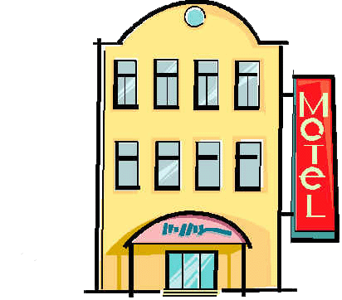
2015 Advanced Personal and Real Property Seminar
The Gross Receipts Taxes
Prepared Food and Beverage
Lodging / Room Occupancy
Rental Vehicle
Heavy Equipment Rental
Presented by:
Marshall Reid, Business Auditor
Wake County Revenue Department
(919) 856-2721 marshall.reid@wakegov.com

Slide 2
Contents of Presentation
Overview- Law, Levy, Rates, References
What is Gross Receipts tax?
Legal Authority
Prepared Food and Beverage Tax (PFB)
Lodging / Room Occupancy Tax
Short Term Vehicle Rental Tax
Heavy Equipment Rental Tax
Business License Tax
State Collected Gross Receipts Tax
Reference: Sales Tax Rates by Jurisdiction

Slide 3
1-1 Overview: Law
Prepared Food and Beverage (only by Local Bill)
Administration / Application of Penalties:
- County Authority: cited in Session Law / G.S. 153A-154.1
- Municipal Authority: cited in Session law / G.S. 160A-214.1
Lodging / Room Occupancy (only by Local Bill)
Administration of the Tax:
- County Authority: cited in Session Law / G.S.153A-155
- Municipal Authority: cited in Session Law / G.S.160A-215
Short-Term Rental Vehicle (sub for Property Tax)
- County Authority: G.S. 153A-156
- Municipal Authority: G.S. 160A-215.1
Heavy Equipment Rental (sub for Property Tax)
- County Authority: G.S. 153A-156.1
- Municipal Authority: G.S.160A-215.2

Slide 4
1-2 Overview: Levy
Prepared Food and Beverage
- 4 Counties
- 1 Municipality
Lodging / Room Occupancy
- 78 Counties
- 5 Special County Districts
- 108 Municipalities
- 2 Special Municipal Districts
Short-Term Rental Vehicle
- Unknown # of Counties
- Unknown # of Municipalities
- 1 State
- 3 Transit Authorities
Heavy Equipment Rental
- Unknown # of Counties
- Unknown # of Municipalities

Slide 5
1-3 Overview: Rates
Prepared Food and Beverage
- County Rate: 1%
- Municipal Rate: 1%
Lodging / Room Occupancy
- County Rate: Capped at 6% (Mecklenburg Co Capped at 8%)
(Brunswick Co Capped at 1%)
- Municipal Rate: Depends on County Rate- Municipal + County
Rate capped at 6%
Short-Term Rental Vehicle
- County Rate: 1.5%
- Municipal Rate: 1.5%
- State Rate: 8%
- Transit Authority Rate: 5%
Heavy Equipment Rental
- County Rate: 1.2%
- Municipal Rate: 0.8%

Slide 6
1-4 Overview: More
Want more statistics?
Collections by jurisdiction and other valuable statistical information can be found here:
http://www.dor.state.nc.us/publications/abstract/2013/part5.html
http://www.dornc.com/localgovt/

Slide 7
Pop Quiz- Gross Receipts Tax is a tax on:
2-1: What is a Gross Receipts Tax Anyway?
Things that are REALLY Gross so we have to pay public employees to get rid of them
Alien Artifacts (these can be really gross so avoid them whenever possible)
Gifts (or Anything You Receive) that you don’t want (because they are GROSS)
The Gross Receipts of a Business

Slide 8
2-2: What is a Gross Receipts Tax Anyway?
Wikipedia: A gross receipts tax or gross excise tax is a tax on the total gross revenues of a company, regardless of source.
Most other sources have a similar definition of Gross Receipts Tax, but is it accurate?
Answer: It is accurate for most states that impose a Gross Receipts Tax; however, what North Carolina calls “Gross Receipts Tax” is a bit different.

Slide 9
2-3: What is a Gross Receipts Tax Anyway?
In North Carolina, Gross Receipts Tax is an Excise Tax.
Excise Tax is defined by the Internal Revenue Service as “taxes paid when purchases are made on a specific good”.
A “specific good” can be:
A prepared food, or a prepared beverage
A rental room
A rental vehicle
A rented piece of heavy equipment

Slide 10
2-4: What is a Gross Receipts Tax Anyway?
In Other States, Gross Receipts Tax may be:
New Mexico: imposed on businesses based on
ALL income from ALL sources. (Note: NM does
not have a sales & use tax)
Michigan: levied on the gross receipts of all
business. (Note: the tax was repealed and
replaced with a flat corporate income tax)
Nevada: levied on the gross receipts of businesses
with at least $4 million in revenue in Nevada.
(Note: Nevada calls it a “Commerce Tax”)

Slide 11
2-5: What is a Gross Receipts Tax Anyway?
In Other States, Gross Receipts Tax is:
Delaware: a tax on the total gross revenues of a
business, regardless of source. This tax is
levied on the business, rather than on the
consumer.
Ohio: a tax imposed on the privilege of doing
business in Ohio measured by gross receipts
from business activities in Ohio (called a
“Commercial Activity Tax”, or “CAT”)

Slide 12
2-6: What is a Gross Receipts Tax Anyway?
In Other States, Gross Receipts Tax is:
Virginia: a 200-year-old business, professional
and occupational license tax. The tax is levied on
all businesses as a percentage of gross receipts,
and the rate varies with type of industry.
Washington: a tax on the value of products, gross
proceeds of sale, or gross income of the business.
(Note: Washington State does not have an
income tax)

Slide 13
2-7: What is a Gross Receipts Tax Anyway?
In summary, the Gross Receipts Tax is typically defined as a tax levied on the gross receipts (total revenue) of a business. The tax is levied on all of a firm’s sales, including sales to other firms (intermediate goods) and to consumers (final goods).
This differs from a tax which is applied only on sales to a consumer. It also differs from a tax that is directly born by the consumer.

Slide 14
2-8: What is a Gross Receipts Tax Anyway?
Common Elements of Gross Receipts Tax in Other States:
Imposed on the business.
If passed to the ultimate consumer, it is done so
by the business, not the government.
Can result in the condition known as “Tax
Pyramiding”: the payment of taxes by different
companies on the same goods or services. Occurs
when goods or services of one company are inputs
for another's production and/or sales. Thus, a tax is
paid multiple times on a product as it moves through
the production chain.

Slide 15
2-9: What is a Gross Receipts Tax Anyway?
In other states, Gross Receipts Tax is like a shot gun blast. In North Carolina, it is much more selective- targeted at particular activities for particular purposes.
In North Carolina at the State Level, Gross Receipts Tax has almost entirely been transitioned to Sales & Use Tax. For Example:
Amusement Tax (gross receipts tax repealed 2014)
Electricity (franchise tax repealed 2014)
Piped Natural Gas (excise tax repealed 2014)

Slide 16
2-10: What is a Gross Receipts Tax Anyway?
In North Carolina at the Local Government level, Gross Receipts Tax is applied very much like the Sales & Use tax and often on the same specific products / services:
Room Occupancy Tax
Prepared Food and Beverage Tax
Short Term Motor Vehicle Rental
Heavy Equipment Rental

Slide 17
2-11: What is a Gross Receipts Tax Anyway?
In North Carolina at the State and Local Government levels, the tax is not assessed against the business on its receipts; the tax is assessed against the ultimate consumer based on purchases and is collected by the business from the consumer. The tax is deemed to be held by the retailer in trust, to be paid to the government on a due date (usually the 20th day of each month). The retailer is put in the position of being an agent of the government for the collection of the tax.

Slide 18
2-12: What is a Gross Receipts Tax Anyway?
Summary
To answer the question “What is Gross Receipts Tax”:
In other states, generally, Gross Receipts Tax
is a tax on all receipts of all businesses. It is
applied broadly with few exemptions.
In North Carolina, Gross Receipts Tax is
much more selective- targeted at particular
activities for particular purposes.

Slide 19
3-1: North Carolina Law Taxes That May Be Imposed by a County
North Carolina General Statutes
Chapter 153A
Article 7
Taxation
G.S. 153A-146
A COUNTY may impose taxes ONLY as specifically authorized by act of the General Assembly

Slide 20
3-2: North Carolina Law Taxes That May Be Imposed by a City or Town
North Carolina General Statutes
Chapter 160A
Article 9
Taxation
G.S. 160A-206
A CITY may impose taxes ONLY as specifically authorized by act of the General Assembly

Slide 21
3-3: North Carolina Law Can a County or Municipality Tax Any Kind of Gross Receipts Any Time It Wants To?
Answer: NO
A County or Municipality can only impose a Gross Receipts Tax if it has been given the legal standing to do so by the General Assembly.
What are the TWO most difficult to levy Gross Receipts Taxes??

Slide 22
3-4: North Carolina Law
The most difficult Gross Receipts Taxes to Levy are:
The Prepared Food and Beverage Tax
The Room Occupancy Tax
How Come??

Slide 23
3-5: North Carolina Law
For the Prepared Food and Beverage Tax and the Room Occupancy Tax, the authority to tax Gross Receipts must be established by a local bill enacted into law by the North Carolina General Assembly.
Ouch!!!
The bill establishes the rate of tax and how the tax will be Administered / Distributed / Used, with some authority defined by the General Statutes.

Slide 24
3-6: North Carolina Law
Room Occupancy Tax and Prepared Food and Beverage Tax Example:
Session Law 1991-594 established Wake County’s authority to levy a Gross Receipts Tax on Room Occupancy and Prepared Food and Beverage.
Do you know what law establishes your local government’s authority to levy these taxes?

Slide 25
3-7: North Carolina Law
Pop Quiz: so, which is tougher to get, the Room Occupancy Tax or the Prepared Food and Beverage Tax?:
Answer: the Prepared Food and Beverage Tax, of course!
Why? Because it requires not only the passage of a local bill, but passage of a referendum as well. A referendum is a general vote by the electorate.
The Room Occupancy tax requires the passage of a local bill but does not require a referendum. It can be finalized by a resolution and a public hearing.

Slide 26
3-8: North Carolina Law
The “Easier” Gross Receipts Taxes to Levy:
G.S. 153A-156 and G.S.160A-215.1were enacted to establish a Gross Receipts Tax on Short-Term Leases or Rentals of Vehicles. The law provides a substitute for property tax which is excluded on this type of property by G.S. 105-275(42). A local government may enact this tax.
G.S. 153A-156.1 and G.S.160A-215.2 were enacted to establish a Gross Receipts Tax on the Short Term Lease or Rental of Heavy Equipment in lieu of property tax. May be imposed by Resolution.

Slide 27
4-1: Prepared Food and Beverage (PFB) The “Meals” Tax
Must be enacted by the North Carolina General Assembly by local bill for EACH taxing jurisdiction!
The tax must also be passed by the residents of the taxing jurisdiction (Referendum).
The tax is applicable to all prepared food and beverages sold at retail for consumption, on or off the premises, by any retailer with sales that are subject to sales tax imposed by the State under G.S. 105-164.4(a)(1).
The tax is collected by the merchant, in addition to NC State Sales Tax, and is remitted to the county on a monthly basis.
Trivia: What makes a “local bill” different from other bills?
A: a local bill does not require the signature of the Governor and it cannot be vetoed

Slide 28
4-2: Prepared Food and Beverage (PFB)
Tax is levied on any food or beverage which has been altered by preparing, combining, dividing, heating, or serving, in order to make the food or beverage available for immediate human consumption.
Taxpayers include: restaurants, sandwich shops, delicatessens, taverns.
The tax also applies to any establishment which dispenses any beverage or prepares any type food such as popcorn, cotton candy, etc. Example: specialty shops like gourmet popcorn, cupcakes, frozen yogurt.

Slide 29
4-3: Prepared Food and Beverage (PFB)
Exemptions:
Sales through vending machines.
Retail sales exempt from taxation under G.S. 105-164.13 (Exemptions and Exclusions) on January 1993.
Sales prepared by someone other than the retailer for immediate consumption and merely placed on display for sale purposes. Examples include prewrapped sandwiches, packaged crackers, prepacked ice cream, etc. (grocery stores, etc)
Prepared food and beverages served by any establishment subject to the County's Occupancy Tax if the charge for the food or beverage is included in a single, non-itemized sales price, together with the charge for room rental, lodging, or accommodations furnished by the taxable establishment. (Free breakfast)
Prepared food and beverages furnished without charge by an employer to any employee.
Prepared food and beverages served to residents in boarding houses on a periodic basis, which are included with the rental of any sleeping room or lodging.

Slide 30
4-4: Prepared Food and Beverage (PFB)
The General Assembly has only authorized FIVE local governments to levy a meals tax:
Four counties
- Wake (Session Law 1991-594)
- Mecklenburg (Session Law 1989-821)
(Use of the funds was amended under Session
Law 2001-402 and Session Law 2013-26)
- Cumberland (Session Law 1993-413)
- Dare (Session Law 1991-177)
One Municipality:
- Town of Hillsborough (Session Law
1993-449)

Slide 31
4-5: Prepared Food and Beverage (PFB)
The legislature has not granted any jurisdiction similar authority in the last 20 years except:
City of Monroe; however, a subsequent
referendum was defeated in 2007.
City of Durham; however, a subsequent
referendum was defeated in 2007.
Most recently (2014- Senate Bill 876), a 1.5% PFB tax proposed for Brevard failed in the General Assembly.

Slide 32
4-6: Prepared Food and Beverage (PFB)
Penalties
§ 153A-154.1. Uniform penalties for local meals taxes.
(a) Penalties. - Notwithstanding any other provision of law, the civil and criminal penalties that apply to State sales and use taxes under Chapter 105 of the General Statutes apply to local meals taxes.
§ 160A-214.1. Uniform penalties for local meals taxes.
(a) Penalties. - Notwithstanding any other provision of law, the civil and criminal penalties that apply to State sales and use taxes under Chapter 105 of the General Statutes apply to local meals taxes.

Slide 33
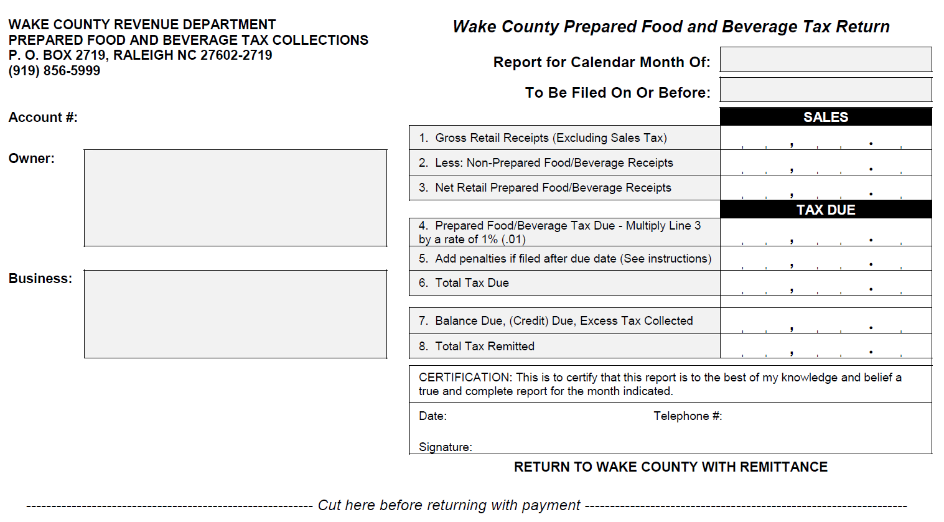
4-7: The PFB Tax Return for Wake County
(looks a lot like a Sales & Use Tax Return)
Pop Quiz: the payment must be remitted on or before the 20th day of the month. Why do you suppose the 20th day of the month was picked as the due date?

Slide 34
5-1: Lodging / Room Occupancy Tax
A local government may levy the tax only after receiving authorization from the General Assembly via a local bill.
After successfully enacting the law, the local government must pass a resolution formally levying the tax. There must be a public hearing on the occupancy tax resolution.
Use – At least two-thirds of the proceeds must be used to promote travel and tourism and the remainder must be used for tourism-related expenditures, which may include beach nourishment.
The tax is derived from the rental of any room, lodging or accommodation furnished by a hotel, motel, inn or similar business.

Slide 35
5-2: Lodging / Room Occupancy Tax
Rate – The county tax rate is capped at 6% (with ONE exception- see Mecklenburg) and the city tax rate, when combined with the county rate, cannot exceed 6%.
Brunswick County’s rate is capped at 1%.
The Mecklenburg County/Charlotte occupancy tax rate has a cap of 8%. It was 6% until 2005 when an extra 2% was authorized to help finance the NASCAR Hall of Fame (SL 2005-68)
Many local governments started with 3% rate limits and later obtained authorization to raise their rates to 6%.

Slide 36
5-3: Lodging / Room Occupancy Tax
The tax does not apply to accommodations furnished by nonprofit charitable, educational, benevolent or religious organizations when furnished to further their nonprofit purpose.
The tax does not apply to accommodations furnished to the same person for at least ninety (90) consecutive days.
If you want to know more, see “Occupancy Tax 101” (Christopher McLaughlin) on the UNC SOG blog titled “Coats’ Canons”.

Slide 37
5-4: Lodging / Room Occupancy Tax
This is a Very Well-Utilized Tax: Google this: “Occupancy Tax Overview Table 2014”
Through the 2014 legislative session, the tax
was levied by:
78 Counties
5 Special County Districts
108 Municipalities
2 Special Municipal Districts

Slide 38
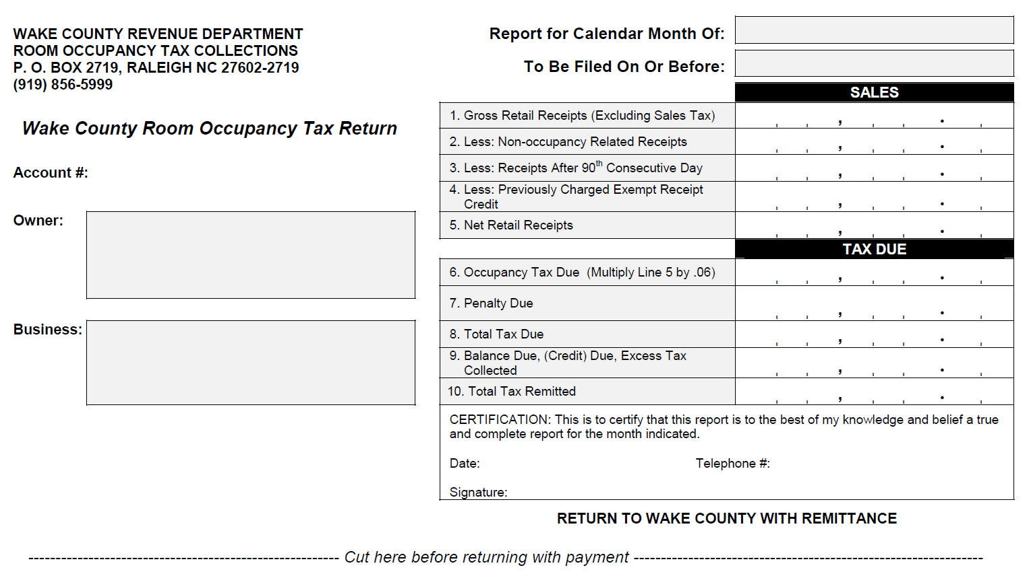
5-5: The Room Occupancy Tax Return for Wake County
(looks a lot like a Sales & Use Tax Return)
The payment must be remitted on or before the 20th day of the month to conform to the due date for remitting sales & use tax.

Slide 39
6-1: Rental Vehicle Tax
Under G.S. 153A-156, A County May Enact this Tax.
This gross receipts tax is a substitute for the property tax on a short-term leased or rental vehicle which is excluded by G.S. 105-275(42)
Applies to a rental vehicle that is offered at retail for short-term lease or rental and is owned or leased by an entity engaged in the business of leasing or renting vehicles to the general public.
The tax rate shall not exceed one and one-half percent (1.5%) of the gross receipts from such short-term leases or rentals

Slide 40
6-2: Rental Vehicle Tax
Under G.S. 160A-215.1, A City May Enact this Tax.
This gross receipts tax is a substitute for the property tax on a short-term leased or rental vehicle which is excluded by G.S. 105-275(42)
Applies to a rental vehicle that is offered at retail for short-term lease or rental and is owned or leased by an entity engaged in the business of leasing or renting vehicles to the general public.
The tax rate shall not exceed one and one-half percent (1.5%) of the gross receipts from such short-term leases or rentals

Slide 41
6-3: Rental Vehicle Tax
Law excluding this type of property from Ad Valorem Tax:
G.S. 105-275. Property classified and excluded from the tax base.
The following classes of property are designated special classes under Article V, Sec. 2(2), of the North Carolina Constitution and are excluded from tax:
(42) A vehicle that is offered at retail for short-term lease or rental and is owned or leased by an entity engaged in the business of leasing or renting vehicles to the general public for short-term lease or rental.
A gross receipts tax as set forth by G.S. 153A-156 and G.S. 160A-215.1 is substituted for and replaces the ad valorem tax previously levied on these vehicles.

Slide 42
6-4: Rental Vehicle Tax
Definition of a Rental Vehicle under:
G.S. 153A-156(e) and G.S. 160A-215.1 (e):
A motor vehicle of the private passenger type, including a passenger van, mini-van, sport utility or recreational vehicle
A motor vehicle of the cargo type, including a cargo van, pickup truck or truck with a gross vehicle weight of 26,000 pounds or less used predominately in the transportation of property for other than commercial freight and that does not require the operator to possess a commercial driver's license
A trailer or semi-trailer with a gross vehicle weight of 6,000 pounds or less.

Slide 43
6-5: Rental Vehicle Tax
Definition of “Short Term”:
G.S. 105-187.1
The following definitions and the definitions in G.S. 105-164.3 apply to this Article:
(3) Long-term lease or rental. - A lease or rental made under a written agreement to lease or rent property to the same person for a period of at least 365 continuous days.
(7) Short-term lease or rental. - A lease or rental that is not a long-term lease or rental.

Slide 44
6-6: Rental Vehicle Tax
The county gross receipts tax on rental vehicles is independent of rental vehicle taxes administered by:
A Transit Authority
Triangle Transit Authority (TTA) (Chapter 160A,
Article 26): Wake, Durham, Orange Counties- 5%
Piedmont Authority for Regional Transportation
(PART) (Chapter 160A, Article 27): Guilford, Forsyth,
Davidson, Davie, Stokes, Surry- 5%
Mecklenburg County (Chapter 150, Article 50)- 5%
The NC Department of Revenue.
(see following slide regarding the State Levy)

Slide 45
6-7: Rental Vehicle Tax State Levy (something you should be aware of)
(Chapter 105, Article 5A- N.C. Highway Use Tax)
8% tax on short-term lease or rental. See 105-187.5
3% on long-term rental (note: the 3% tax is levied on long-term lease payments and is the same as the highway use tax levied on the sale of motor vehicles). See G.S. 105-187.5
G.S. 105-187.9. Disposition of tax proceeds (a) Distribution. - Taxes collected at the rate of eight percent (8%) shall be credited to the General Fund. Taxes collected at the rate of three percent (3%) shall be credited to the Highway Trust Fund.
See NCDOR MVLR Tax: Form E-500F

Slide 46
6-8: Rental Vehicle Tax
If you rent a car in some jurisdictions, this is what your receipts will show:
City Gross Receipt Tax 1.5%
County Gross Receipt Tax 1.5%
North Carolina Gross Receipt Tax 8.0%
(may call it NC Highway Use Tax)
Transit Authority Tax 5.0%
Total Tax Percentage: 16.0%

Slide 47
6-9: Rental Vehicle Tax
ONE MORE TIME
Why did the General Assembly allow local governments the legal standing to impose this tax?
Because the General Assembly excluded the ad valorem tax in exchange.
G.S. 105-275(42) excludes the ad valorem tax on this type of property:
A gross receipts tax as set forth by G.S. 153A-156 and G.S. 160A-215.1 is substituted for and replaces the ad valorem tax previously levied on these vehicles.

Slide 48
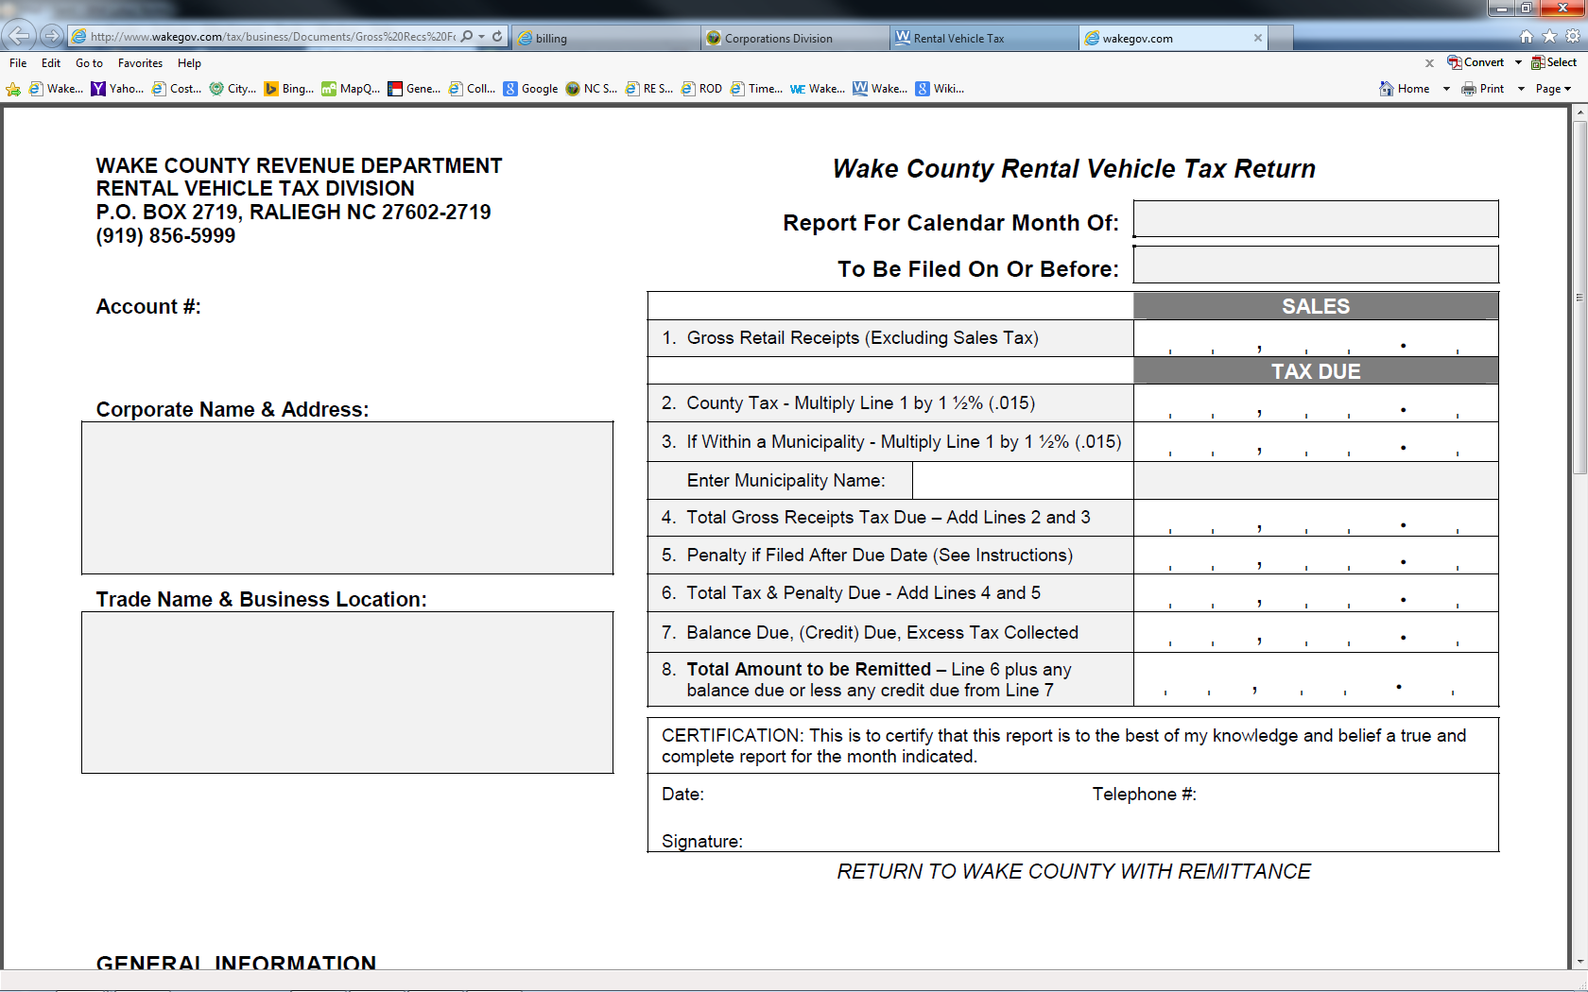
6-10: The Rental Vehicle Tax Return for Wake County
(looks a lot like a Sales & Use Tax Return)
The payment must be remitted on or before the 20th day of the month to conform to the due date for remitting sales & use tax.

Slide 49
7-1: Heavy Equipment Rental Tax
Under G.S. 153A-156.1, A County may impose the tax by resolution.
The tax is applied to heavy equipment that is offered at retail for short-term lease or rental and is owned or leased by a person (company) engaged in the business of leasing or renting heavy equipment to the general public.
The COUNTY rate is 1.2% of the gross receipts from rental of the equipment.

Slide 50
7-2: Heavy Equipment Rental Tax
Under G.S. 160A-215.2, A City may impose the tax by resolution.
The tax is applied to heavy equipment that is offered at retail for short-term lease or rental and is owned or leased by a person (company) engaged in the business of leasing or renting heavy equipment to the general public.
The CITY rate is 0.8% of the gross receipts from rental of the equipment.

Slide 51
7-3: Heavy Equipment Rental Tax
G.S. 153A-156.1 defines Heavy Equipment subject to the tax as earthmoving, construction, or industrial equipment that is
Mobile
Weighs at least 1,500 pounds
A self-propelled vehicle not designed to be driven on a highway
If industrial, it is industrial lift equipment, industrial material handling equipment, industrial electrical generation equipment, or a similar piece of industrial equipment.
It is a short-term lease or rental as defined in G.S. 105-187.1.
The term includes an attachment for heavy equipment, regardless of the weight of the attachment.
G.S. 160A-215.2 refers to G.S. 153A-156.1 for definitions

Slide 52
7-4: Heavy Equipment Rental Tax
The Law excludes this type of property from Ad Valorem Tax:
G.S. 105-275. Property classified and excluded from the tax base.
The following classes of property are designated special classes under Article V, Sec. 2(2), of the North Carolina Constitution and are excluded from tax:
(42a) Heavy equipment on which a gross receipts tax may be imposed under G.S. 153A-156.1 and G.S. 160A-215.2.

Slide 53
7-5: Heavy Equipment Rental Tax
ONE MORE TIME
Why did the General Assembly allow local governments the legal standing to impose this tax?
Because the General Assembly excluded the ad valorem tax in exchange for the gross receipts tax. G.S. 105-275(42a) excludes the ad valorem tax on this type of property:
Heavy equipment on which a gross receipts tax may be imposed under G.S. 153A-156.1 and G.S. 160A-215.2.

Slide 54
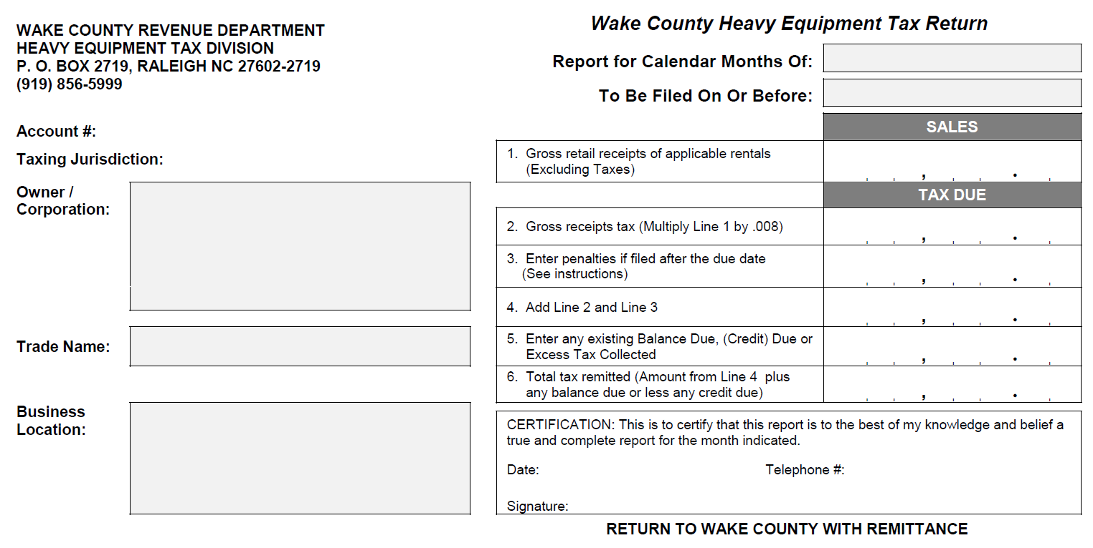
7-6: The Heavy Equipment Tax Return for Wake County (looks a lot like a Sales & Use Tax Return)
Wake County Form. Wake County does not levy this tax but collects the tax for the municipalities. Pop Quiz: how can you tell there is no county levy?
The tax is payable quarterly and is due by the last day of the month following the end of the quarter (Jan 31, April 30, July 31, Oct 31)

Slide 55
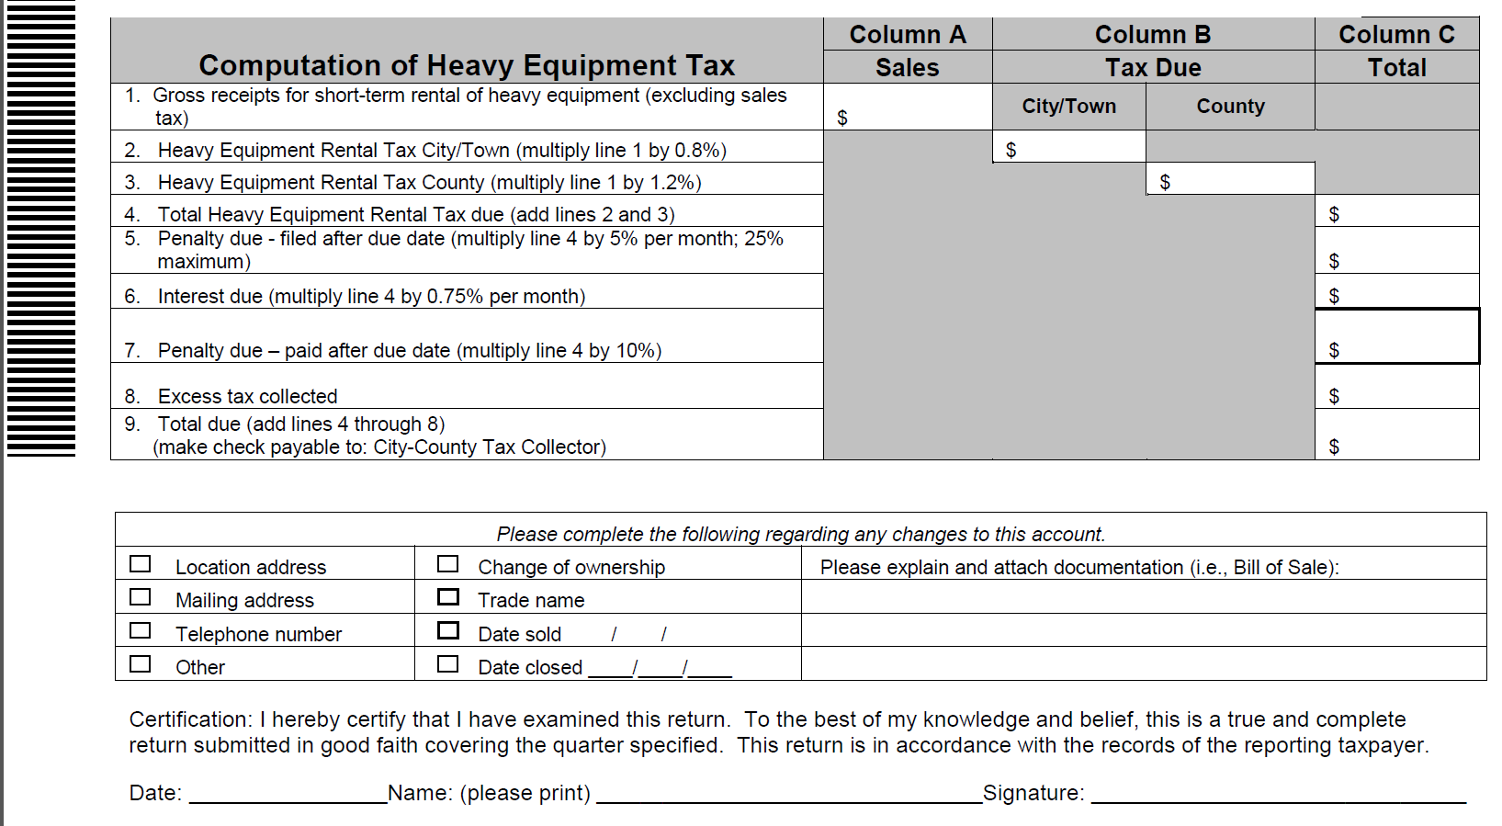
7-7: The Heavy Equipment Tax Return for Wake County (looks a lot like a Sales & Use Tax Return)
Mecklenburg County Form. Mecklenburg County collects the tax for the county and for the municipalities
The tax is payable quarterly and is due by the last day of the month following the end of the quarter (Jan 31, April 30, July 31, Oct 31)

Slide 56
8-1: License Tax
House Bill 1050 (Session Law 2014-3)
After July 1, 2015, the city and county privilege tax statute is repealed, and localities are no longer authorized to impose privilege license taxes.
The repeal addresses the belief that privilege tax has not been applied consistently. The General Assembly has vowed to work with local governments to address the lost revenue (which is A LOT!)

Slide 57
8-2: License Tax
BEFORE House Bill 1050
License Tax could be imposed by a County or a Municipality.
License Tax could be a Flat Fee- not a gross receipts tax
License Tax could be based on Gross Receipts
Legal Basis- County: G.S. 153A-152
(repealed effective July 1, 2015)
Legal Basis- Municipality: G.S. 160A-211
(repealed effective July 1, 2015)

Slide 58
8-3: License Tax
Lost Revenue
Based on 2012 Information, all but three counties levied a business license tax. Total County Revenue (2011-2012): $10.9 million
- High: Harnett County @ $2.5 million
Cumberland @ $921.8 thousand
Based on 2012 Information, 243 out of 553 municipalities levied a business license tax. Total Muni Revenue (2011-2012): $95 million
- High: Charlotte @ $32.5 million
Raleigh @ $16.2 million

Slide 59
8-4: License Tax
So, Business License Tax was BIG for N.C. Municipalities.
Q: What’s Left?
A: Beer & Wine License Tax
Beer & Wine Tax is NOT a Gross Receipts Tax!
Legal Authority: G.S. 105-113.70
Rates Established by G.S. 105-113.78 (County) and G.S. 105-113.77 (Municipality)
The license tax is separate from the Excise Taxes collected by the NCDOR which is distributed to the local governments

Slide 60
8-5: License Tax
Beer & Wine License Tax Rates:
County
- On-premises malt beverage: $25.00
- Off-premises malt beverage: $5.00
- On-premises unfortified or fortified wine, or both: $25.00
- Off-premises unfortified or fortified wine, or both $25.00
Municipality
- On-premises malt beverage: $15.00
- Off-premises malt beverage: $5.00
- On-premises unfortified or fortified wine, or both: $15.00
- Off-premises unfortified or fortified wine, or both $10.00

Slide 61
9: State Collected Gross Receipts Taxes Distributed to Local Governments (something you should know)
Local Government Sales & Use Tax: distributed Monthly
Utilities Sales Tax (Piped Natural Gas, Electricity, Telecommunications, Video Programming): distributed Quarterly
The following taxes are not based on Gross Receipts but you should know about them anyway because they are distributed to the local governments:
Alcoholic Beverage Tax (Beer, Unfortified Wine, Fortified Wine): distributed Annually
Disposal Taxes (Scrap Tire, White Goods, Solid Waste): distributed Quarterly

Slide 62
10: Reference: Current S&U Rates by County
NOTE: Sales and Use Tax IS a Gross Receipts Tax

Slide 63
11: Thanks for Joining Us!
“I may look happy but the only receipt I get is dog food, and it is Really Gross!

