Slide 1
Golf Course Valuation NC Dept of Revenue – 2015 Advanced Personal/Real Property Seminars October 2, 2015
David Pope, MAI, SRA, SGA
Hotel & Club Associates, Inc.
3717-D West Market Street
Greensboro, NC
336-379-1400
www.hotelandclub.com

Slide 2
Golf With Friends!

Slide 3
Value Trends in Golf Courses
Source: Marcus & Millichap – Leisure Investment Properties Group

Slide 4
How Does the Market Value Golf Properties ?
Multiples of Gross Revenue
Multiples of EBITDA
Overall Capitalization Rates

Slide 5
Not Particularly Relevant
Replacement Cost
What is golf land value?
High Levels of External Obsolescence
Price per Acre
Price per Round
Price per Member

Slide 6
Sources of Valuation Data
Sales of Comparable Properties
Investor Surveys
Society of Golf Appraisers
www.golfappraisers.org
Golf Broker Specialists

Slide 7
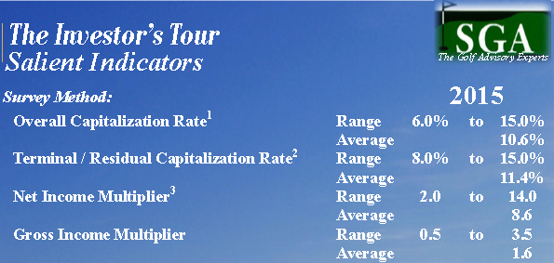
Society of Golf Apprasiers
www.golfappraisers.org

Slide 8
Types of Golf Properties
Municipal
Daily Fee
Semi-Private
Private Country Club

Slide 9
Challenges in Valuation
High Fixed Expenses
Golf Course Maintenance - $250,000 to > $1.0 million per year
Low Operating Margins Compared to Other Types of Real Estate
Limited Availability of Debt Financing
Higher Risk = Higher Capitalization Rates

Slide 10
Assessment Challenges
Access to Reliable Revenue/Expense Data
Can not rely on advertised fees x annual rounds
Private clubs have multiple revenue sources

Slide 11
Trends in Private Clubs
Declining membership #’s
Aging Facilities – Capital Needs
Struggling to Remain Relevant
Existing Debt Burdens
Assessment Fatigue
Private Club Governance
Some Clubs Choosing to Sell

Slide 12
Big Deal Country Club - Example

Slide 13
Big Deal Club Example
$2.0 million outstanding loan from new tennis/fitness center in 2005
Members still paying $100/mo capital assessment in addition to $500/mo dues
Membership 800 in 2006 to 600 today
Gross Revenues Declined from $5.5 million in 2006 to $4.0 million today
Clubhouse resembles funeral parlor – losing its appeal
Club Needs to Improve Facilities to attract younger members to replace those that are aging out of the club

Slide 14
Aging Members

Slide 15
Big Deal Board Meeting

Slide 16
Big Deal Club continued
Club Options
1. Do Nothing – Hope for the Best
2. Borrow and Renovate = Assess members and potentially lose more
3. Sell to a Private Investment Group
4. There is a Market For Select Clubs

Slide 17
Big Deal Club Continued
Members Vote to Sell After Reviewing Proposals from 3 Investment Groups
Deed Recorded Transferring Ownership to new Entity
Deed Stamps $4,000
Buyer Agrees to:
$300,000 to Acquire Stock Certificates
$1.5 Million on Clubhouse Improvements in Year 1
$1.0 Million on Golf Course Renovations in Year 2
Spend $200,000/yr Cap Ex. for 5 years after that
Buyer Agrees to No Dues Increase for 3 years and No Capital or Operating Assessments
Is This is a Market Sale ?
What is the Price ?

Slide 18
Typical Private Club Transaction
Club solicits offers from private investment
Buyer pays off existing debts at closing
Buyer undertakes capital improvements
Existing members allowed continue
No Dues Increase for Set Period
No Capital/Operating Assessments
Deed Recorded based on Existing Debt

Slide 19
Private Country Club Valuation
Sources of Revenue
Initiation Fees
Membership Dues
Green Fees
Cart Fees
Proshop Revenues
Food & Beverage Revenues
Swim & Tennis Revenues

Slide 20
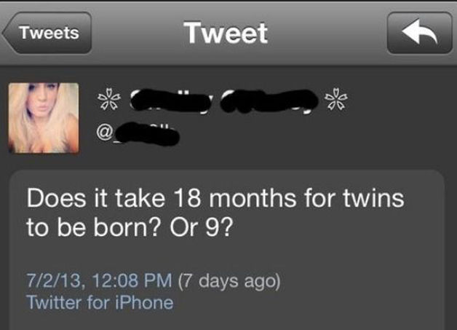
Questions

