Slide 1
LINCOLN County 2015 revaluation and integration of technology

Slide 2
What did we use software & technology for?
Data Cleansing
Identifying Patterns and Trends
Regression Analysis
Comp Selection
Comp Based Valuation
Ratio Analysis
Post Analysis (Looking for properties with high risk of appeal)

Slide 3
Software interface

Slide 4
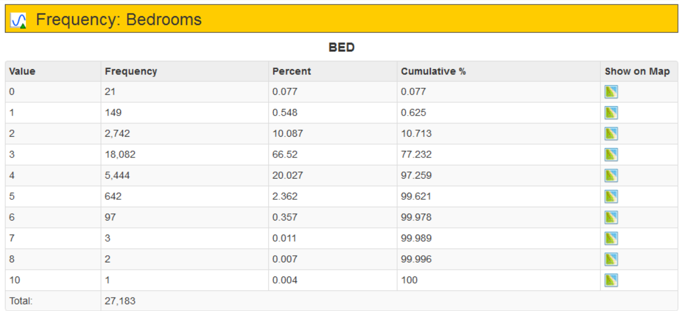
Data cleansing/ Exploratory analysis example

Slide 5
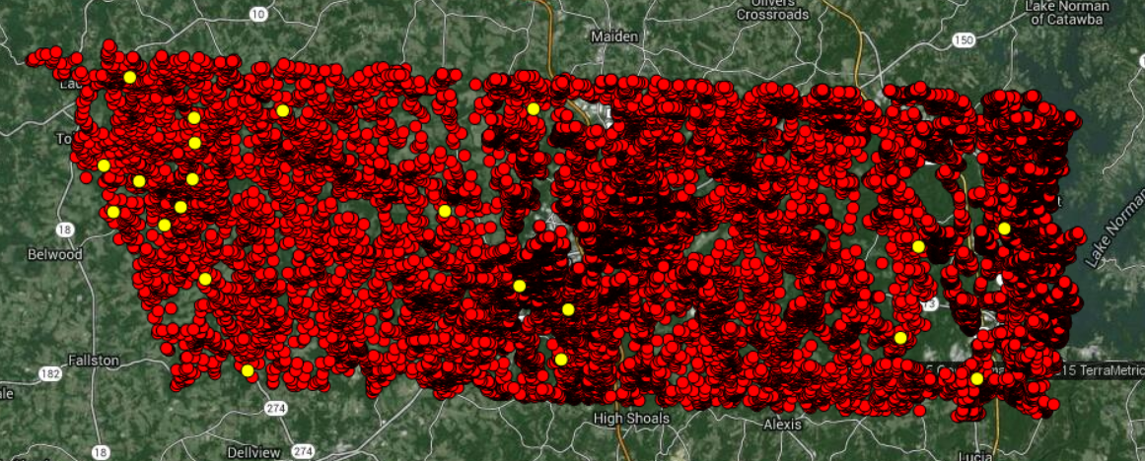
Location of potentially erroneous data

Slide 6
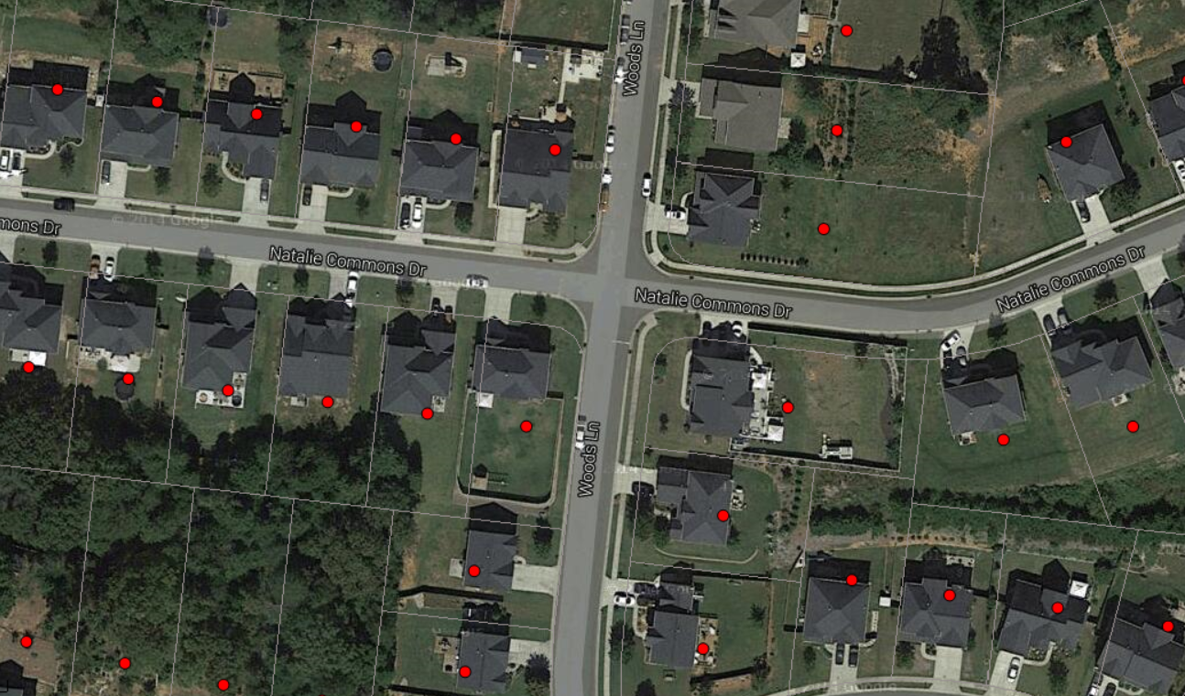
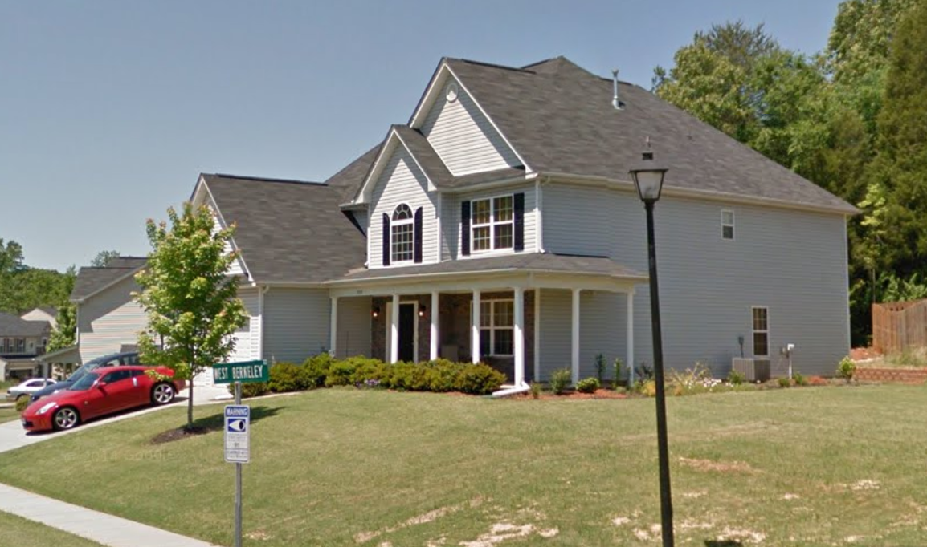
VIEW PROPERTIES IN GOOGLE MAPS

Slide 7
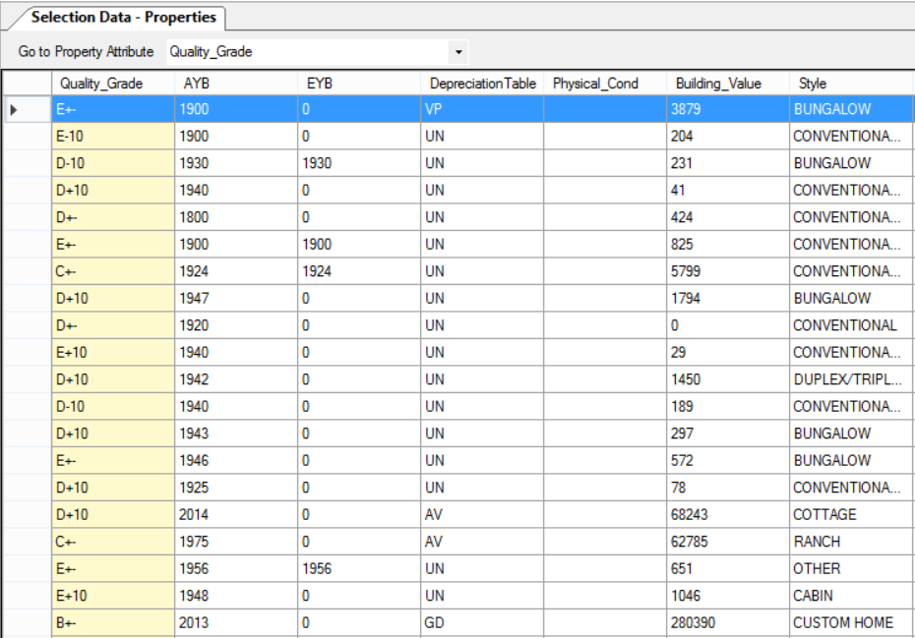
Property characteristics of 0 bed properties

Slide 8
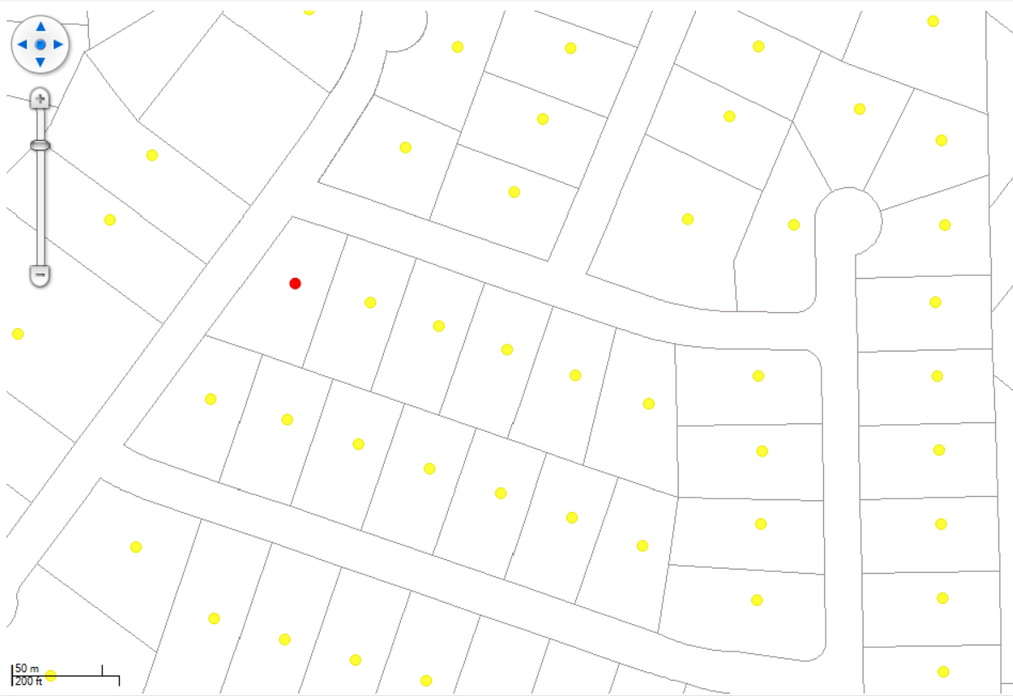
Thematic map ‘Quality Grade’

Slide 9
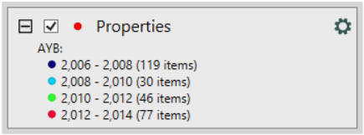
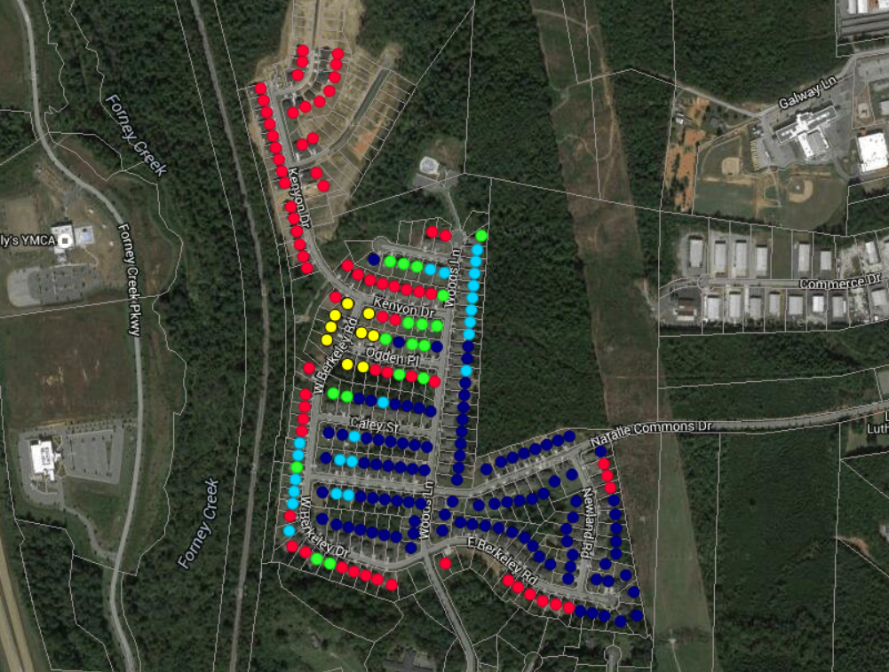
Thematic Map By Year Built group

Slide 10
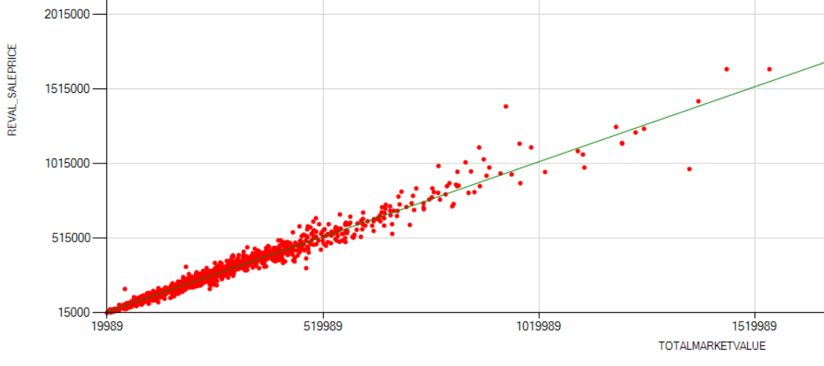
Generate simple statistics
GENERATE GRAPHS

Slide 11
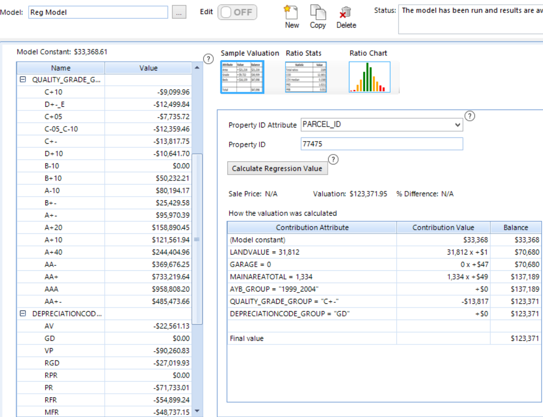
REGRESSION ANALYSIS

Slide 12
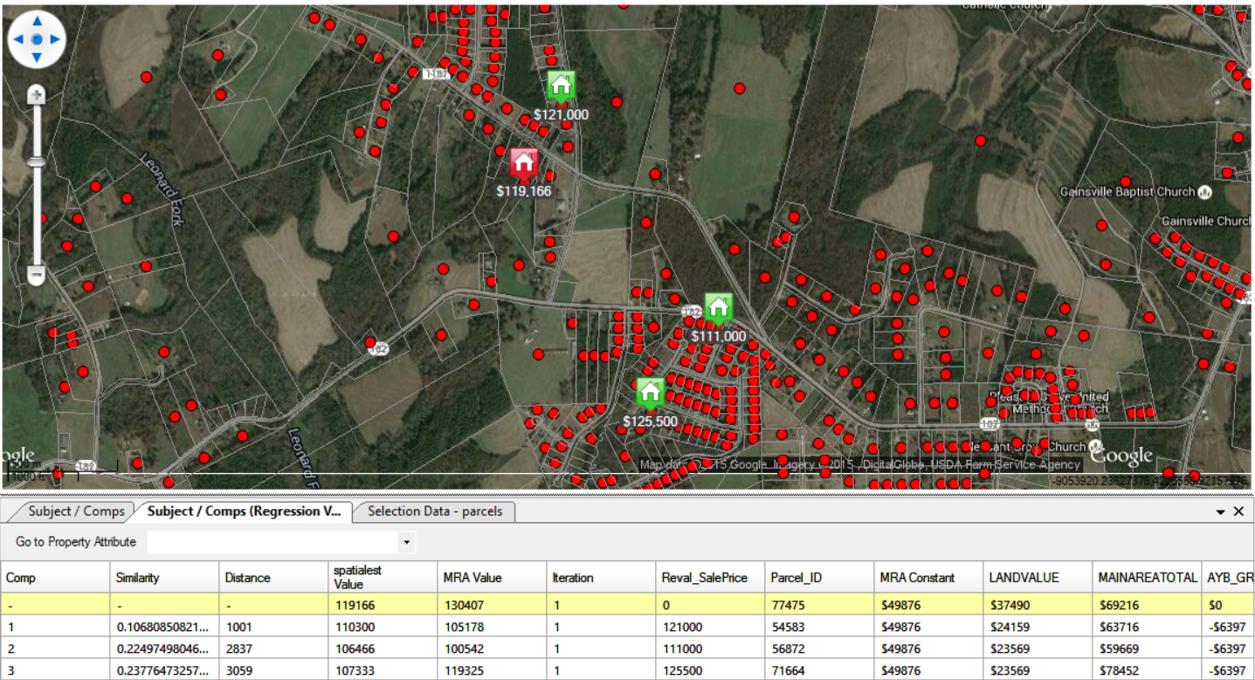
COMPARABLE SALES MODEL

Slide 13
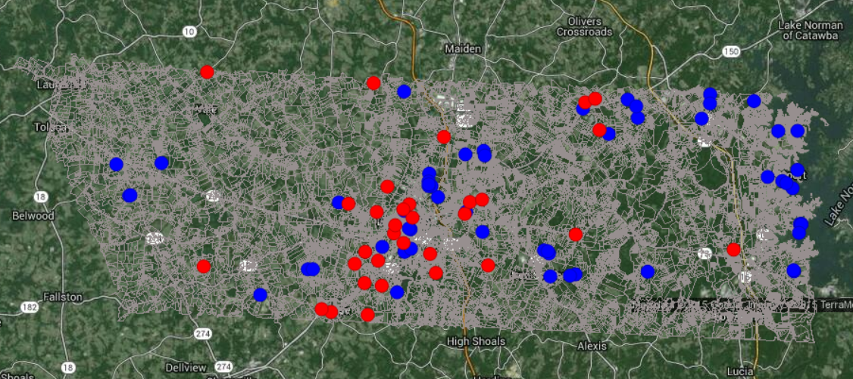
Three Methods of Valuation
Modified Cost / Schedule of Values
Regression Predicted
Comparable Sales Predicted

Slide 14
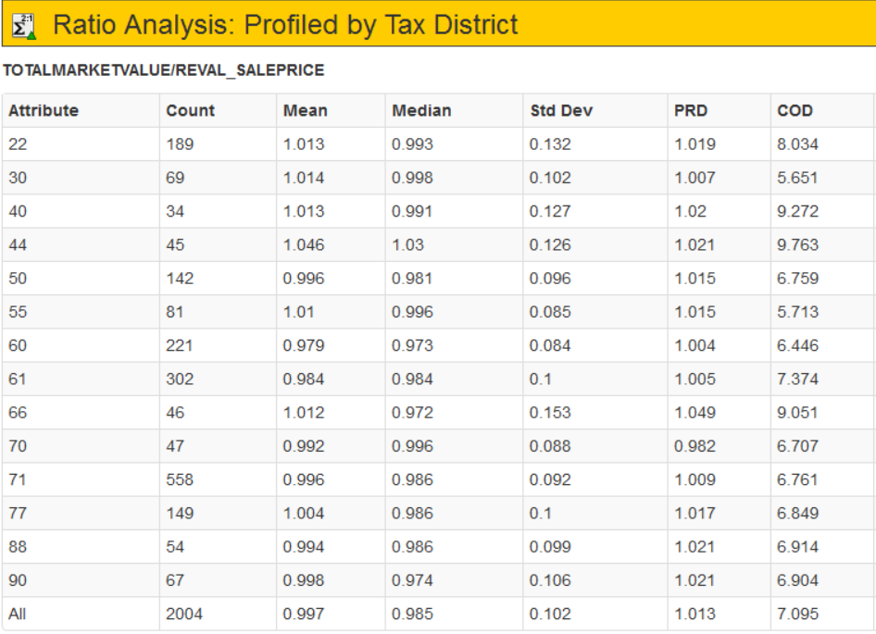

Slide 15
GOALS
MOTIVATIONS
RESULTS

