Slide 1
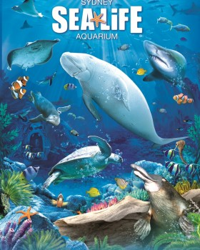
Sea Life Aquarium, Concord Mills Mall and Taxability Issues: An Overview

Slide 2
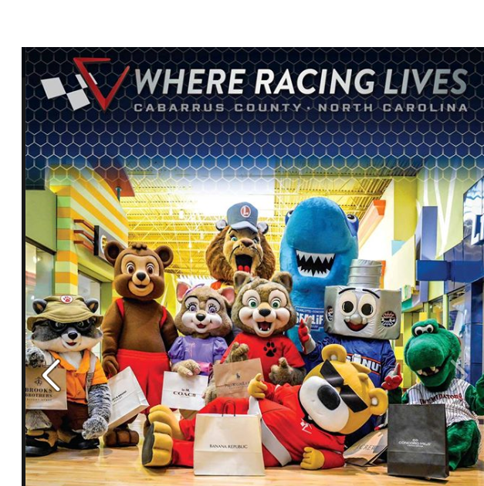
Cabarrus County Tourism
You could say that racing in Cabarrus County started with the original gold rush caused by the first documented discovery of gold in North America in 1799.
Nascar now dominates our racing but tourist attractions are diverse.

Slide 3
Economic Benefits
2,700 hotel rooms
632,000 room night stays
$4.8 million in room tax revenue
3,900+ tourism jobs
$80 million+ in payroll
$6.5 million in local tax revenues which save each household $424 per year in taxes
Ranked 12th in travel impact among North Carolina’s 100 counties

Slide 4
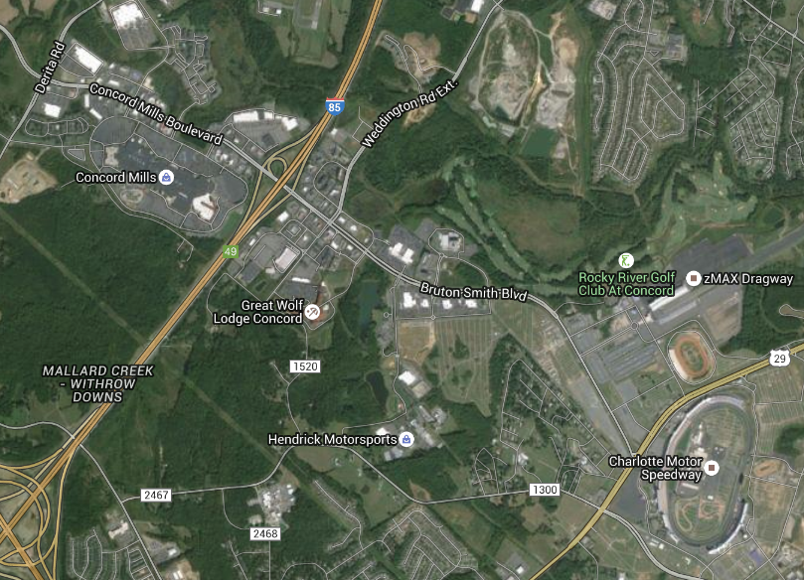
Destination: I-85 Exit 49
All within 2 mile radius

Slide 5
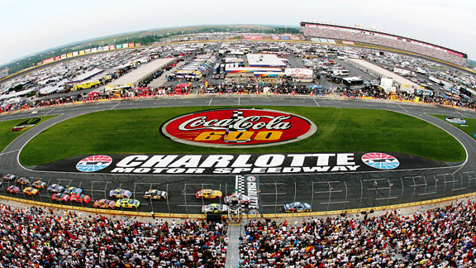
Charlotte Motor Speedway
Preceded Exit 49 and the related development. Who says a large stadium does not act as an impetus for additional development?

Slide 6
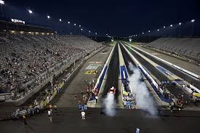
Z-Max Dragway
The first NHRA 4 lane drag strip

Slide 7
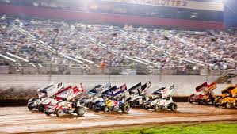
The Dirt Track at Charlotte
Fourth-tenths mile dirt oval race track features:
World of Outlaws STP Sprint Cup & Late Model Series
Super DIRTcar series Big-Block Modifieds

Slide 8
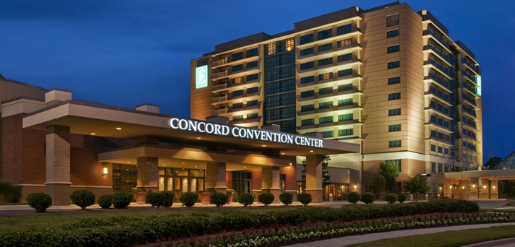
Embassy Suites
Convention Center
Golf Resort &
Spa

Slide 9
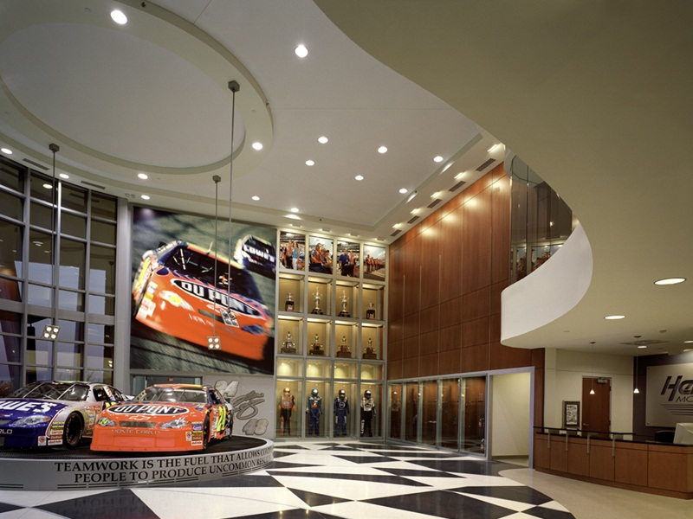
Hendrick Motorsports
Race Shops
Museum &
Team Store

Slide 10
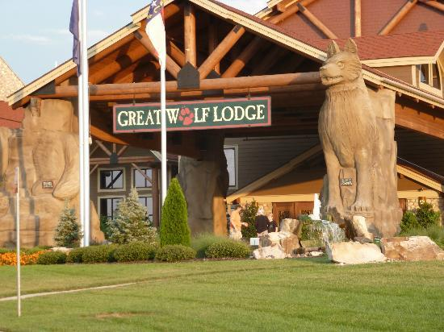
Great Wolf Lodge
Includes a full service resort hotel
The largest indoor waterpark in the Carolinas, reportedly 400k+ gallons of water, various slides, wave pool and other features
Rope course, kids spa, 4D theater, restaurants, mini golf and many other attractions

Slide 11
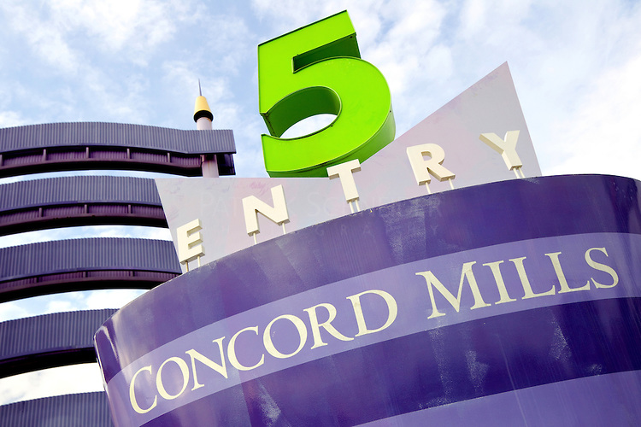
Concord Mills Mall
Operated by Simon Property Group
One of several Mills Outlet Centers across the United States
Unique combination of entertainment and shopping
Draws 17 million visitors per year and is referred to as the largest tourist attraction in North Carolina
Contains 1.4 million square feet of retail space and over 200 stores

Slide 12
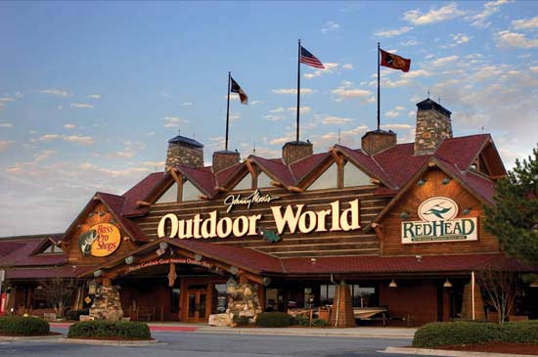
Bass Pro Shops
150k+ square feet of hunting, marine, boating and fishing supplies
23k gallon aquarium
Wildlife dioramas
Shooting arcade & snack bar

Slide 13
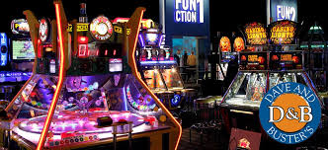
Dave & Buster’s
Sports bar / Restaurants
Arcade
Bowling Alley
Other games

Slide 14
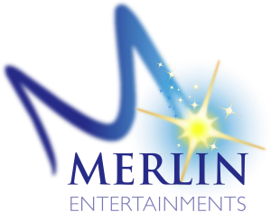
Merlin Entertainment
Europe’s most popular and the world’s second largest visitor attraction operator
Operates over 100 attractions, 9 hotels and 3 holiday villages in 23 countries across 4 continents including:
Madame Tussauds (5 in U.S.)
The Dungeons (1 in U.S.)
LEGOLAND (2 in U.S.) & LEGOLAND Discovery Centers (6 in the U.S.)
Sea Life (6 locations in the U.S.)
Among the other international attractions

Slide 15
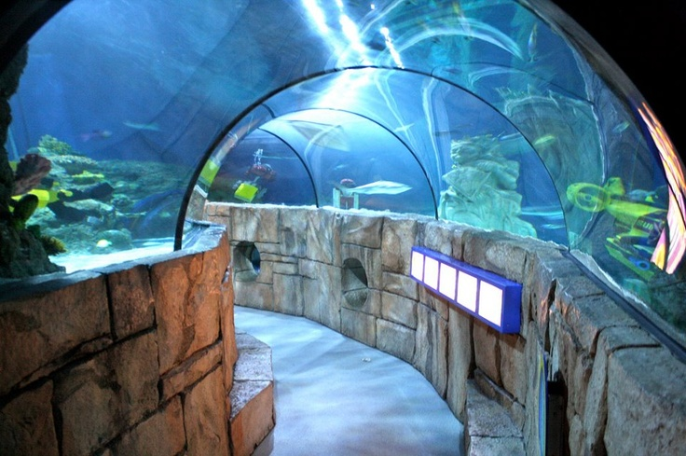
Sea Life Aquarium
Merlin Entertainment’s 100th attraction
150,000 gallons of water
Over 5,000 sea Aquatic life, including crabs, fish, sharks, octopi and stingrays
Designed to showcase river to sea ecosystem
Includes aquariums featuring unique designs that allow for both underwater views and hands on experiences

Slide 16
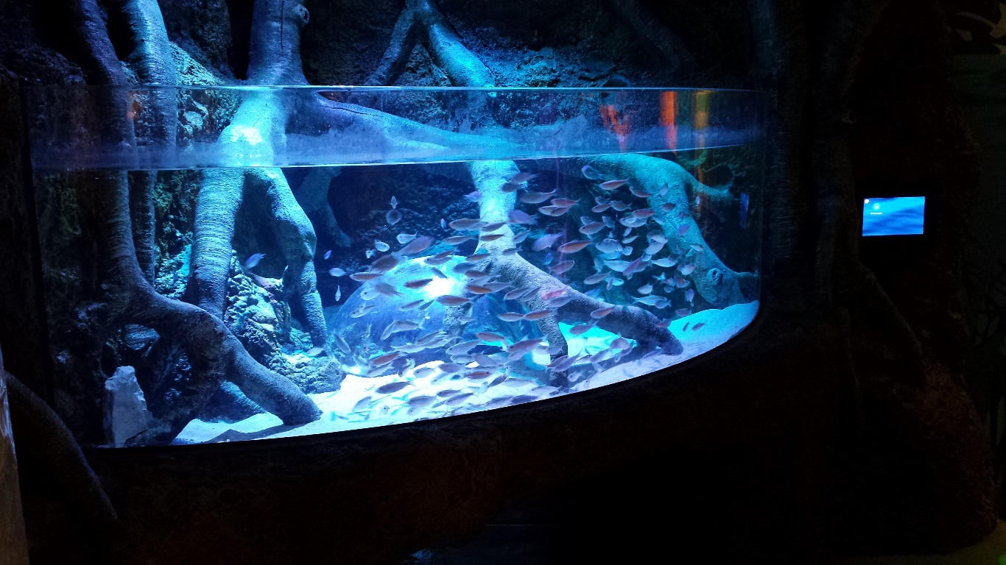
Economic Incentive Grant
Cabarrus County and the city of Concord offered economic incentive grants to entice Simon Property Group and Merlin Entertainment to construct and operate a Sea Life Aquarium in Concord Mills Mall. Specific factors include:
Estimated investment of $10 million
Both grants are for a maximum of 6 years
85% of tax paid on increase in assessment related to new investment
Maximum of $400,000 to be granted by the county and the city in total

Slide 17
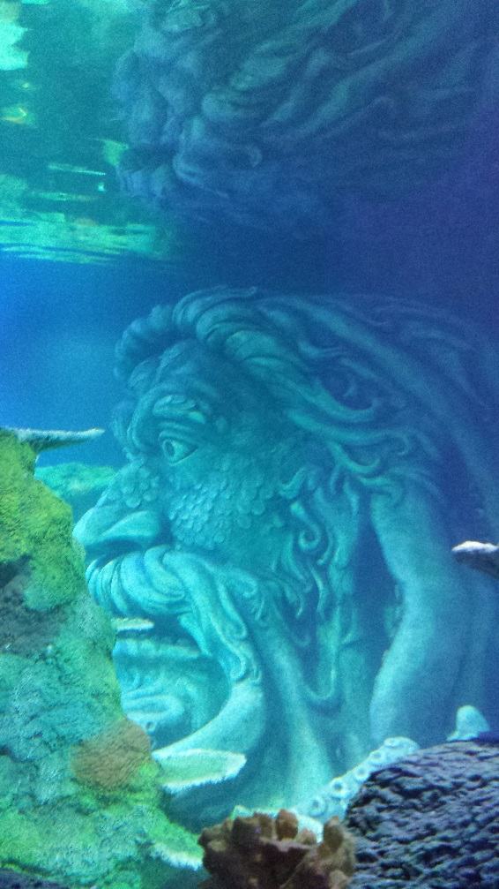
Economic Incentive Grant Legality
The NC constitution allows for the state legislature to create tax laws. It also excludes or exempts taxation Statewide
Local governments are only allowed to incur debt or expend tax revenue for the public benefit - not for a private party
The Maready case clarifies under N.C.G.S. Sec. 158-7.1 (Local Development) :
Appropriations eligible if “increase the population, taxable property, agricultural industries and business prospects”
Out of this comes the “But for” clause requirement
Incentive is required for Project to go forward, typically in a competitive situation

Slide 18
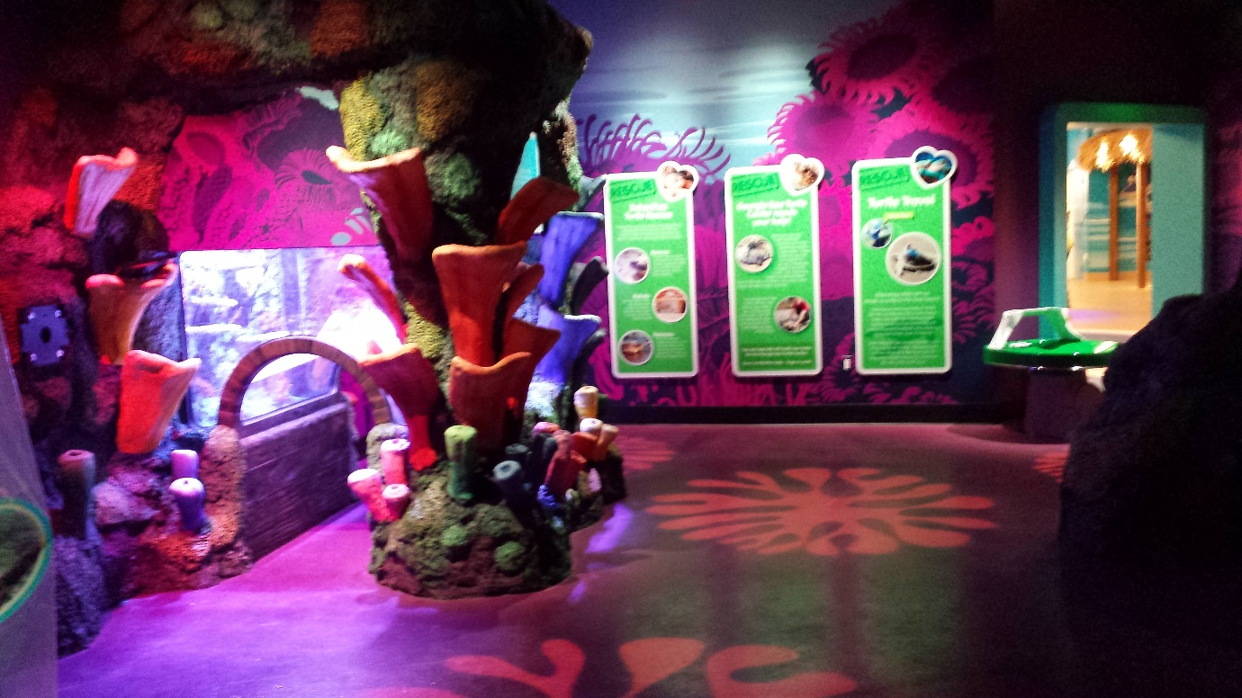
Economic Incentive Grant: Key Factors
Grants are for the new incremental change in assessment.
All investments do not necessarily result in new assessment values and may actually cause a decrease in value:
Removal of previously assessed assets cause a reduction to the otherwise grantable assessment
Replacements of HVAC or relocation of other utilities do not result in increases in assessment values
Destruction and rebuild similarly do not increase assessment values
Spending on advertising and other startup costs do not result in grantable value

Slide 19
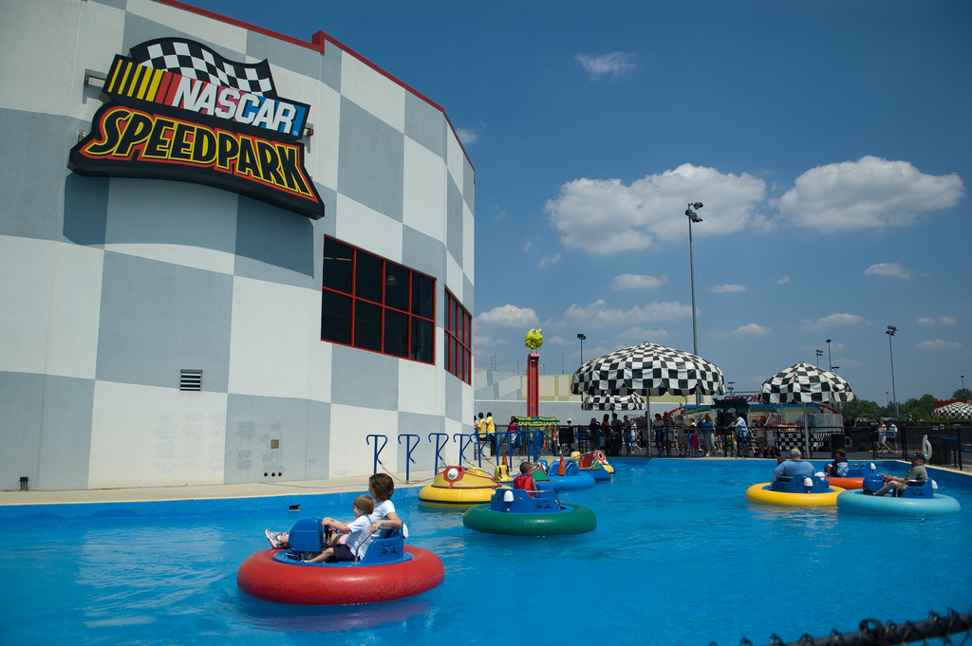
Nascar Speedpark
Occupied the retail space prior to the construction of the Sea Life Aquarium
It was primarily, a combined indoor and outdoor go-cart facility

Slide 20
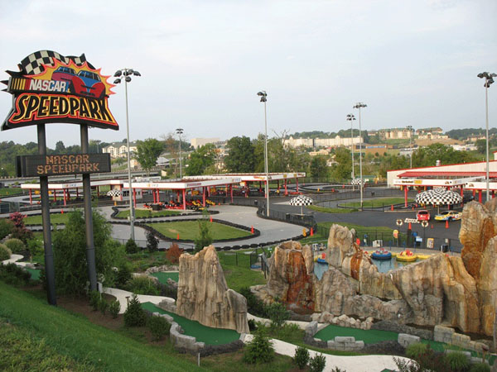
The Speedpark
The exterior go-cart and peripheral operation has since been taken over by a new company, The Speedpark, while Sea Life took over the interior space
The Speedpark has added slides, bungee jumps and other amusements to the preexisting go-cart and mini-golf attractions

Slide 21
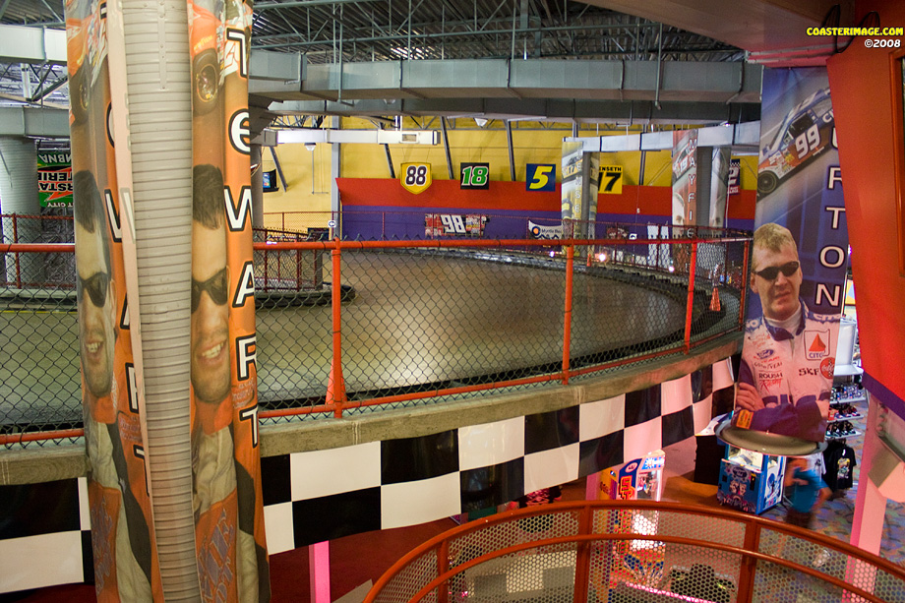
Nascar Speedpark
The interior space had a partial 2 story configuration and included part of the track - a concrete ramp from the first floor to the second floor and back
It included various arcade games, a paint ball area, snack bar and souvenir shop along with ticket sales for both indoor and outdoor operations

Slide 22
Construction
Construction started as destruction with the removal of the racetrack ramp and the movement of utilities including HVAC

Slide 23
Construction
For the establishment of aquariums, portions of the concrete floor needed to be excavated in order to put support piping into place along with filtering and other equipment

Slide 24
Construction
The tanks were mostly built to specifications, off site and then installed per plans
This picture shows the back side of a smaller tank, the deck built for access, the filtering piping and support structure
There also is special lighting installed directly above the tanks
The display side and interior of the tank contain all of the theming

Slide 25
Construction
The entire attraction is built in the interior space of the shell store - no attachment to the exterior walls

Slide 26
Construction
Much of the display area was made to look like rocks or wood but was actually built from concrete applied over wire, similar to a kids volcano project

Slide 27
Real Estate Assessment
Enclosed Shopping Mall
Typically 3 Components:
Major Anchor Stores
Small Strip Shops
Mall Concourse

Slide 28
Concord Mills
Major Mall outlet, made up of many major and minor anchor stores
Different approach – All three groups are combined together

Slide 29
White Box Approach
Building Shell ( Structure – Insulated Roof – Exterior Walls )
Interior Leased Stores (slab Floor, open ceiling, demising partitions and walls)
Interior Non-Leased ( AC and Lighted malls, courts, entry ways, public restrooms, service areas )

Slide 30
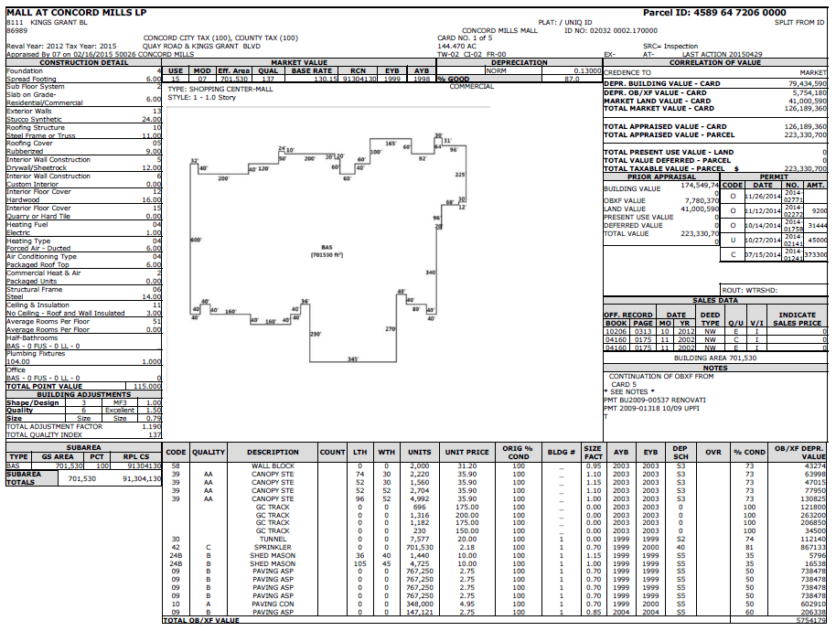
Concord Mills

Slide 31
Leasehold Improvements
All Improvements beyond White Box level are considered Leasehold Improvements

Slide 32
Personal Property and Leasehold Improvements
There are numerous personal property aspects related to this facility that are unique:
Aquatic life
Water
Displays
Process related investments
Retained assets

Slide 33
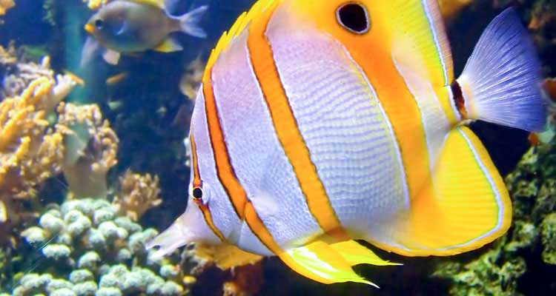
Assessment: Aquatic life
Statutes provide for the assessment of all personal property used to generate income that is not exempted or excluded
There is an exclusion for livestock but in this circumstance the aquatic life are not being raised as food or for the production of food. As a result, the sea life are not classified as livestock and are therefore taxable

Slide 34
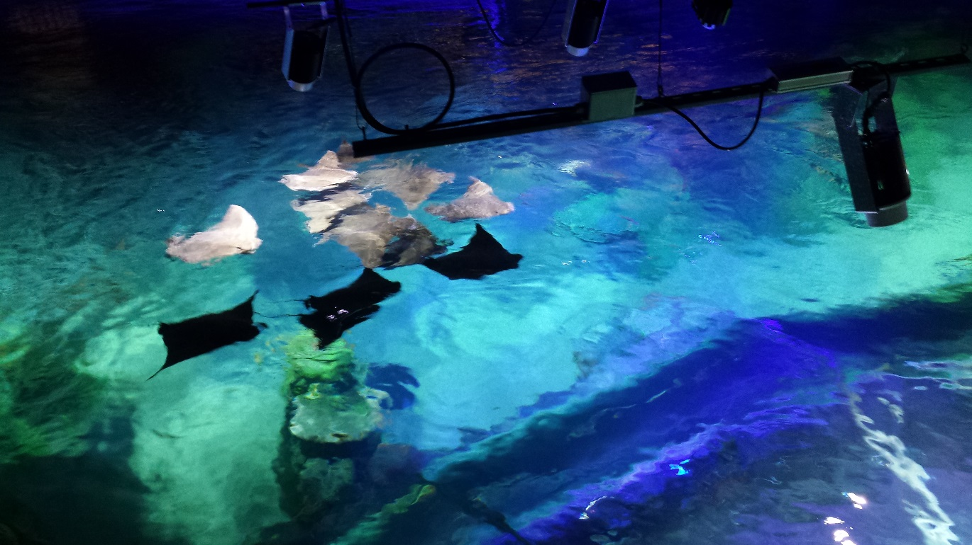
Assessment: Aquatic life
Given that the aquatic life are booked by the company at their acquisition cost prior to their full growth, have long lives and are replaced as needed they arguably appreciate in value
Based on this and our discussions with management we have decided to accept original cost ($300k) to represent the value of the Aquatic life. We expect replacement costs to be expensed going forward

Slide 35
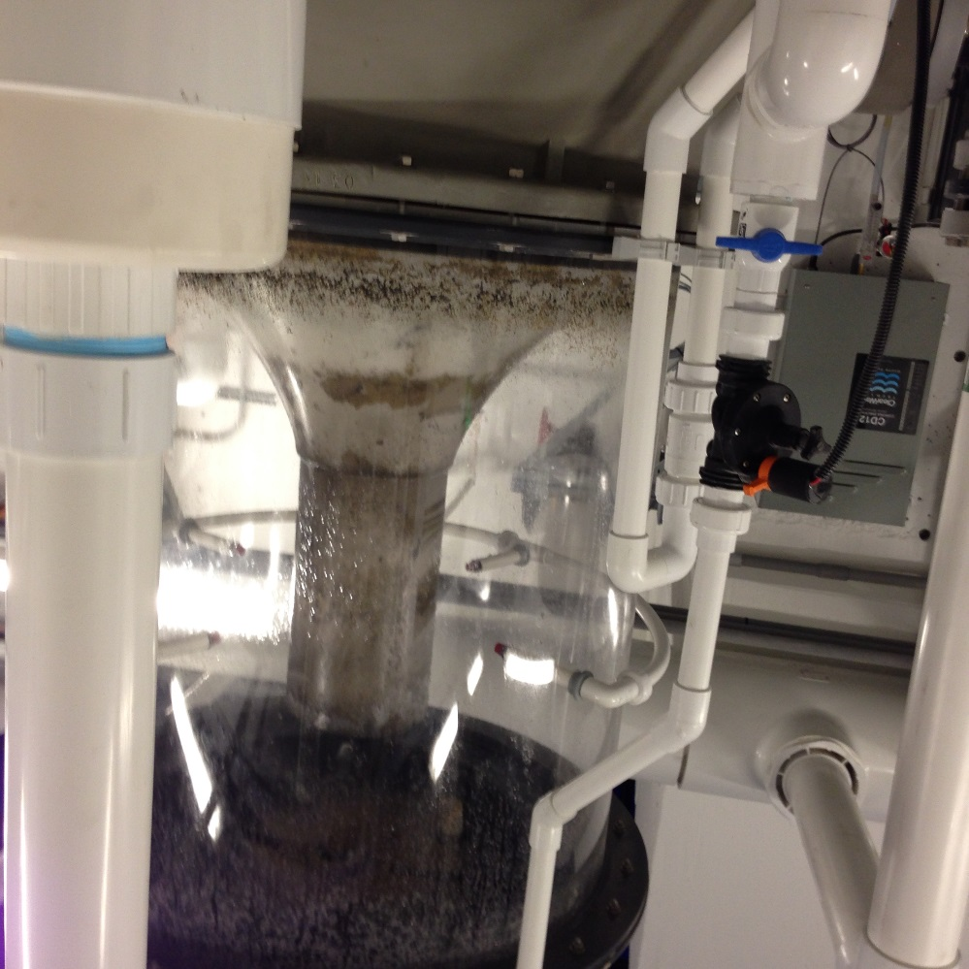
Assessment: Water
Per reports, the tanks hold 150,000 gallons of water which is filtered, purified and salinized to maintain prime aquatic conditions

Slide 36
Assessment: Displays
As described earlier, the displays are made primarily of concrete. The tanks are made of fiber glass and Plexiglas
Historically the Cabarrus County Assessors office has used a standard 10 year life for leasehold improvements since theming/branding of retail stores is regularly refreshed and/or replaced as tenants relocate

Slide 37
Assessment: Displays
In this case the theming is clearly built to last for a longer life as confirmed in discussions with management
It is expected that the theme will be kept in excellent condition with repairs and paint refreshing done on a regular basis
We therefore have decided to apply a 25 year life (N25) for the $4m of display and other leasehold improvements listed by the taxpayer

Slide 38
Assessment: Other Listed Items
The aquarium does have filtering and other related equipment, furniture and fixtures, etc. ($2.25 million) which we assigned 10 year lives (B10 – Amusement)
Furniture and fixtures (Office): $11k (K10)
Computers: $333k (U5)
Signs: $53k which Cabarrus County assigns a 15 year straight line life given the construction of the signs
Supplies: about $4k

Slide 39
Assessment: Computers
As mentioned we have initially assessed computers as listed by the taxpayer $333k (U5)
We may find that a substantial amount of the computer cost is related to interactive displays and/or attached to the water maintenance systems
If this is the case then we may reclassify the assets, during the audit process

Slide 40
Assessment: Process Related
As part of every grant Cabarrus County completes a Personal Property audit to assure that all property has been listed and properly assessed
The audit is broad in an attempt to assure that all assets and expenses are reviewed and identified as either real property, personal property or supplies as appropriate

Slide 41
Assessment: Process Related
As part of this process we will review Sea Life’s listing to identify how process related items have been accounted for like: footings, piping and electrical installations. It is possible that these items have already been included in the equipment or display costs that have been listed
Our intent depending on the asset would be to treat these items as leasehold improvements and apply a 25 year life (N25) given the expected lifespan of the improvements

Slide 42
Assessment: Supplies
The listed supplies (about $4k) appear to be low and may not include items like:
Salt
Food
Spare parts
Uniforms
Veterinarian supplies and
Various small tools that were likely expensed

Slide 43
Assessment: Supplies
Sea Life has use of a walk in cooler and appears to prepare fresh food for the aquatic life so we likely will look to identify 1 weeks worth of food (1/52nd of total cost) as supplies
Full cost of spare parts will be assessed. Small tools and uniforms if applicable, will likely be assessed over a 3 year life
Most other items will likely be assessed 1/12th of annual expense

Slide 44
Assessment: Assets of Prior Tenant
In our case we know of a large walk in cooler and possibly counter/kitchen areas that appear to be left behind and in use by the new tenant
Who should list and be assessed for these assets?

Slide 45
Assessment: Assets of Prior Tenant
Under the typical lease the landlord takes ownership of the assets once they are abandoned at the termination of the lease
Where possible we assess the new tenant directly for the retained assets that they have put into use but we would like to know how all of you handle abandoned items

Slide 46
Today
We have toured the facility and discussed with corporate management regarding the listability/assessability and lives of various types of assets
The company has since hired a representative that has sought to preemptively engage certain assets assessed as real estate and therefore assessed to the mall owners
This could impact:
Real -Personal assessments
Grants

Slide 47
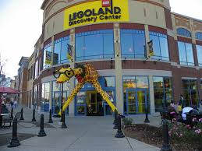
Future Plans?
Merlin has about 10k square feet of leased interior space available for expansion or location of additional amusements
The building could potentially be expanded as well
At other locations like Grapevine, TX they have complimentary Sea Life and Legoland Discovery Center attractions with each being in excess of 35k square feet
Concord Mills does currently contain a Lego retail store

Slide 48
Questions?

