Slide 1
Software and Data Conversion
2015 Advanced Seminar
Kim Horton, CAE – Durham County
&
John Burgiss, RES – Forsyth County

Slide 2
Topics
Introductions
First Considerations
Critical Steps and Decisions
Data Conversion Processes
Shared Experiences

Slide 3
Introductions
Kim & John’s background and experience
The Audience – by show of hands
> switched software components within past 5 yrs
> considering a software switch within next 5 yrs
> see benefits through software upgrade/change
The frequency of software conversions are increasing

Slide 4
First Considerations
Define your software needs
Define your software wants
Know the difference between the two
Are you looking for the best software component system?
Are you looking for the best complete assessment system?
Regardless, full integration must be achieved

Slide 5
System Integration
Will the new software integrate well with:
> GIS
> CAMA
> Tax Collections
> Finance Department software
> Addressing software
> Municipalities
*** A software system is really not complete until it can communicate its data***

Slide 6
System Integration
Each software system will have both capabilities and limitations
Need to know for the current software as well as the new
> can affect policy and procedures
> foreclosure flowchart example

Slide 7
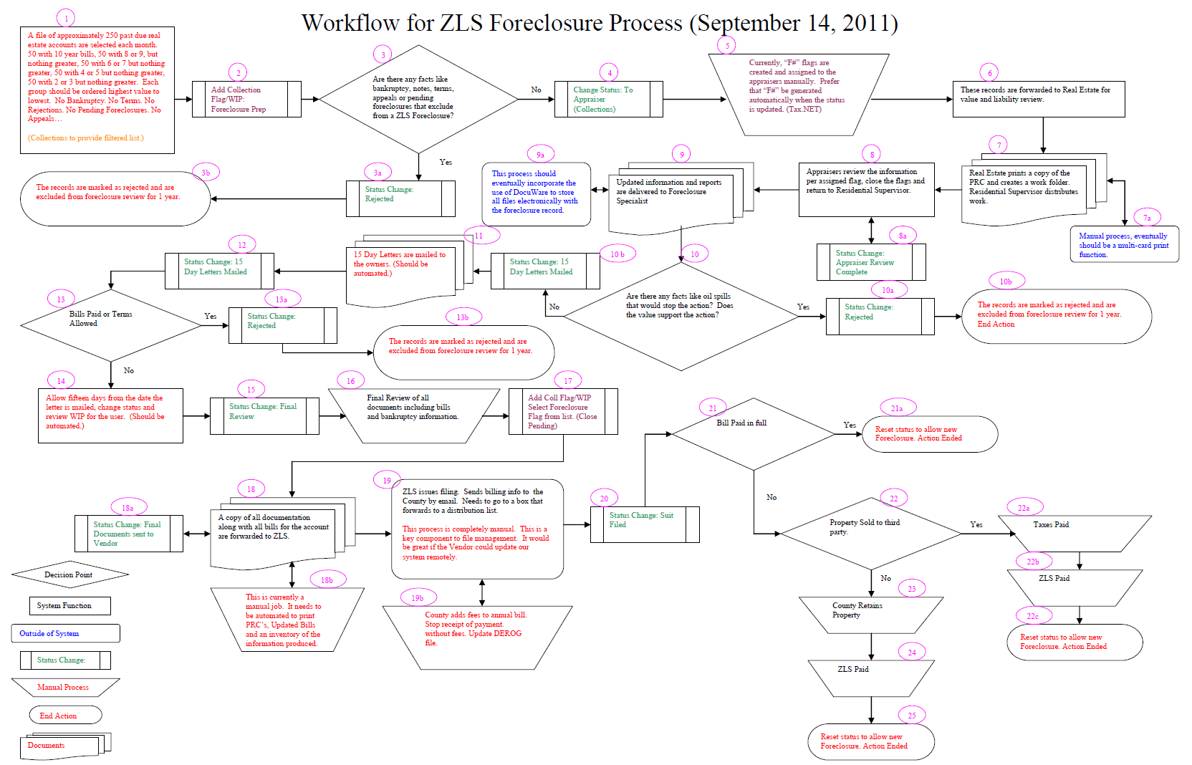

Slide 8
System Integration
Vendors are very helpful in conversions – detailed plan
> you are the expert on existing software
> detailed calculations can present issues
> staff turnover can leave you without answers
> vendor is expert on new software
“Fruitful collaboration can yield positive results”

Slide 9
Critical Steps and Decisions
Setting up the new system
> super critical – don’t overlook system settings!
> identify critical data for all processes – keep it!
> functionality trumps change (change will occur)
Verifying converted data
> do pre-conversion totals = post conversion totals
Training
> manuals or face-to-face or web???

Slide 10
Data Conversion Processes
Identify the need for conversion
Request For Proposal (RFP) and demonstrations
Gap Analysis – possible business process changes
Purchasing
Timeline
Implementation
Testing
Go Live
Refining

Slide 11
Data Conversion - RFPs
Ask for recent RFPs from other counties
Ask other counties for software enhancement ideas
RFPs identify requirements, seeks solutions
Establish performance criteria
> workflow or search timeliness
Establish acceptance criteria and process
> value calculation accuracy within certain amount

Slide 12
Data Conversion - Timeline
Plan for unforeseen difficulties and disruptions
Budgeting can be very tricky – getting started, enhancements, etc.

Slide 13
Data Conversion - Implementation
Variable to variable mapping blueprint
PIN # example:
> Is PIN the same as Parcel Number?
> Parcel Number is ‘alpha character’ in legacy
> Parcel Number is ‘numeric character’ in new

Slide 14
Data Conversion - Implementation
Traditional Tax Database vs. Modern Tax Database
> many calculations not stored in Modern database
> or, may have total columns added
Traditional >>>>> Traditional (less likely to occur)
Traditional >>>>> Modern (likely to occur)
Modern >>>>> Modern (occur now and in the future)
What bridges the gap?
> write query to compare data values
> create new script/process to compare data values

Slide 15
Data Conversion - Testing
Data Queries
Reports
Data Entry
Calculations
Unique example set of records
Complicated record comparison
Remember – we can’t violate 105-287!!

Slide 16
Data Conversion – Go Live
When?
> just before a major event/mail-out?
> just after a major event/mail-out?
How?
> One and Done
> Multiple ‘Mock Go Live’ events?
Other considerations?
> test system environment – UAT
> how long to keep legacy system operable (dependency?)
***Always suggest vendor be on site on Go Live date***

Slide 17
Data Conversion - Refining
Even when you get done with conversion…..
You are NEVER DONE!!!
(how else do things improve?)

Slide 18
Shared Experiences
Identify your true goals/needs
Define terms related to data, processes, contract, etc.
> “Entity” example

Slide 19
Shared Experiences
Fully understand hardware and software requirements
Effective communication is key
Data clean-up PRIOR to conversion
> some data may best be ‘fixed’ during conversion

Slide 20
Shared Experiences
Huge time commitment on all parties
Build new relationships (new vendor = new opportunity)
Enhance relationships with colleagues in other counties using the same software
Talk, talk, talk – without help from others you may not know what questions to ask

Slide 21
Shared Experiences
Plan on delays – they will happen!
Patience is a virtue…. and a necessity!
Postpone scheduled software upgrades around conversion
Document, document and document some more!
Check converted results parcel by parcel

Slide 22
Conclusion
Questions…..
Comments…..
Thanks!

