Slide 1
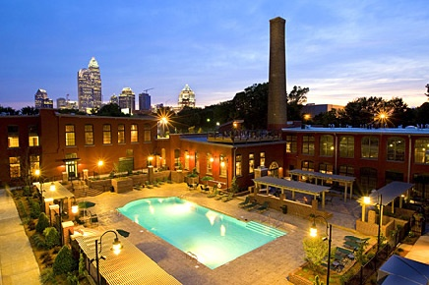
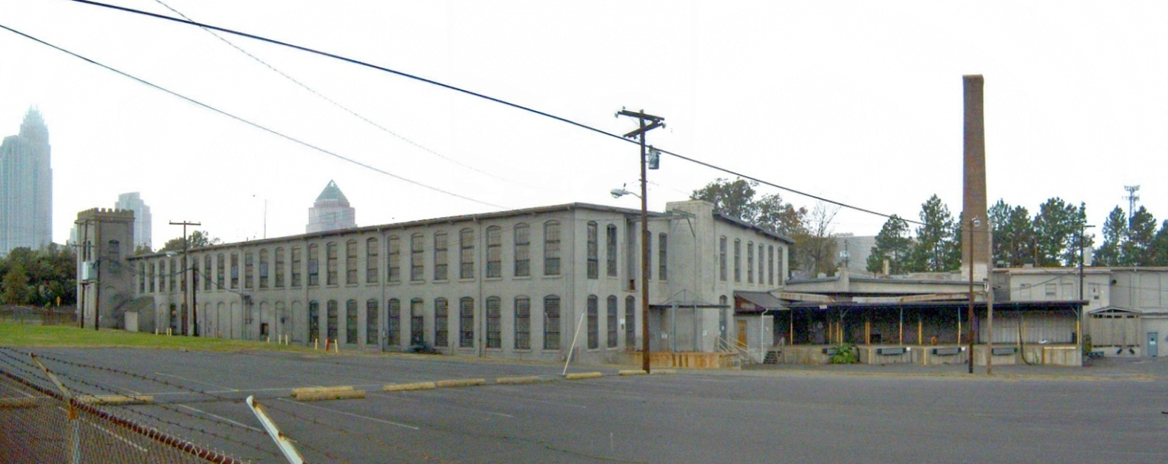
The
North Carolina
Brownfields Program
Ahead of the Curve
NCDOR
Advance Seminar
Sheraton Four Seasons
Greensboro, NC
October 1, 2015
Tony Duque, Brownfields Project Manager
NC DEQ, Division of Waste Management

Slide 2
Brownfields Property Reuse Act of 1997
Create special class of remediating parties... “Prospective Developer” of brownfields sites
First, make sure PD did not cause or contribute to the contamination, then:
  Provide PD (*and others*) with liability protection in return for measures that PD take to make the property safe (“suitable”) for reuse
  Provide PD (*and follow-on owners*) with a partial property tax exclusion to assist in costs
  Focus cleanup and mitigation efforts on risk prevention and land use restrictions

Slide 3
Brownfields Agreement
Brownfields Agreement (BFA):
  Available only to a Prospective Developer (PD) who: desires to buy or sell a brownfields property for the purpose of redeveloping the a brownfields property; and
  Did not cause or contribute to site contamination
The BFA does not affect the state’s ability to enforce against the Responsible Party (RP)

Slide 4
Brownfields Agreement
Defines the actions PD must take to make the site safe for the PD’s intended reuse… using a combination of:
  Site-specific, risk-based cleanup decisions
  Land use restrictions that run with the land
Recorded at the county Register of Deeds… thus becoming part of the Public Record
Functions as a “Covenant-Not-to-Sue,” providing PD with liability protection from state enforcement in regard to existing site contamination, subject to completion of necessary “safe-making” actions

Slide 5
_______ Roles _______
Federal Program
State Program
Funding to States
  NC Brownfields Program $630,000 last year.
Competitive Brownfields Grants to Local Governments
  $2.6 M for NC in the last two years.
Liability Protection to Prospective Developers
  Brownfields Agreement
Guidance for Safe Redevelopment
  Brownfields Agreement
  Deed Recordation
Tax Incentives to PD
  Special BF property partial tax exclusion
Notes:
Have experienced 10% cut in federal support. Expecting another
10 – 20% cut in the next federal fiscal year, and perhaps more in the future.

Slide 6
Economic Development Benefits that are facilitated by the N.C. Brownfields Program
Defined and limited environmental liability
  Covenant not-to-sue contingent on making site safe
Break Barriers to Financing
Financial/Tax Incentives
Controlled and Defined Cleanup Costs
Land Use Planning/Decisions
Addressing Public Health Concerns
Risk Communication to Public
Return on Investment

Slide 7
Goal: Something For Everyone
NCDEQ / EPA
Risk Reduction / Public Protection
Smart Growth
Sustainability
Prospective
Developer
Reduced Uncertainty
Liability Protection
Profit
Local Govt.
Economic Devel.
Jobs
Sustainability
Risk Reduction
Neighbors
Economic Benefits, Jobs
Risk Reduction
Blight Reduction
Lender
Reduced Uncertainty
Liability Protection
Profit

Slide 8
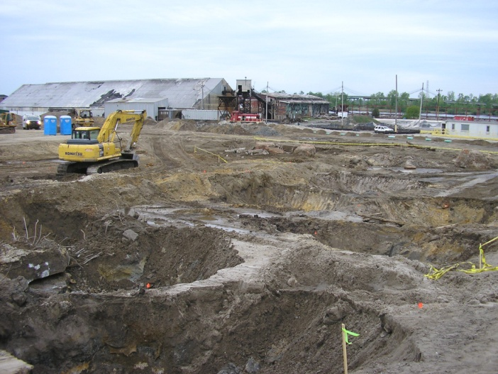
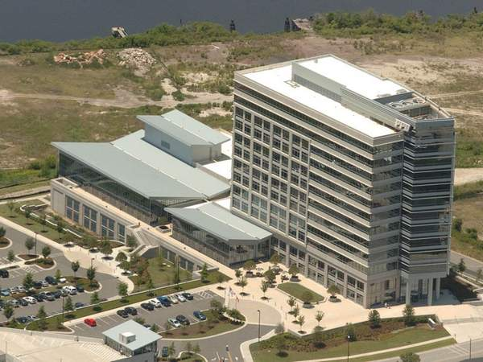
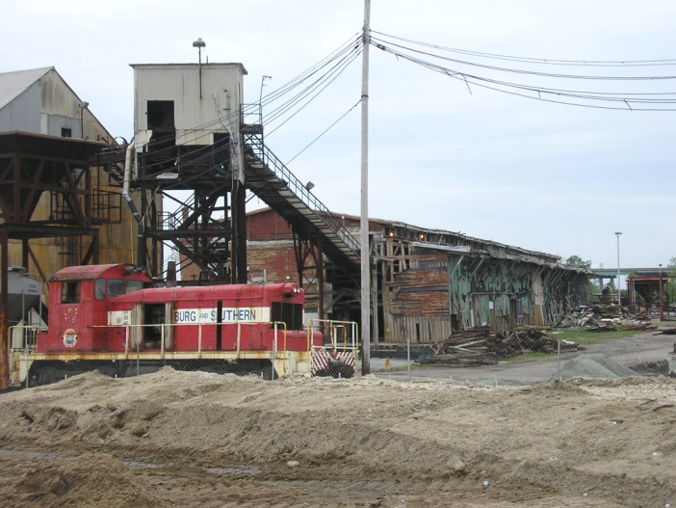
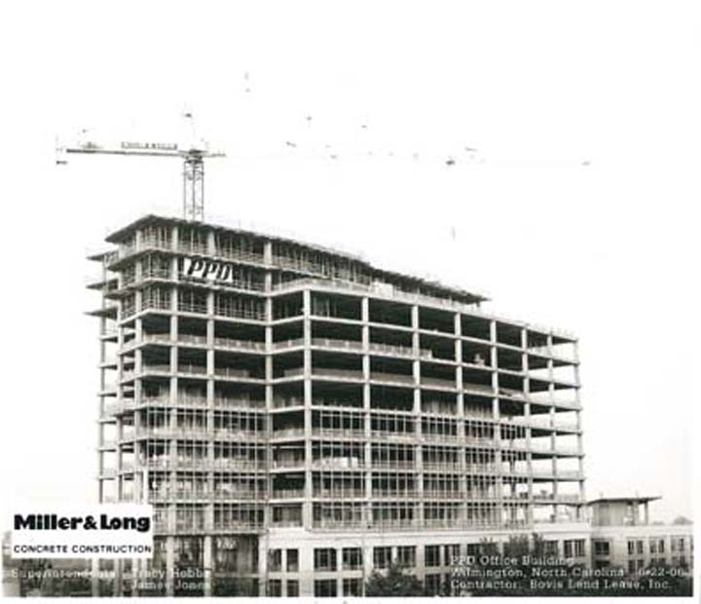
From: Former Almont Shipping Co.
To: PPD World Headquarters - Wilmington
Abandoned Fertilizer Stockyard/Shipping Facility
PPD World Headquarters in downtown Wilmington, 400,000-ft², and 1,800 workers

Slide 9
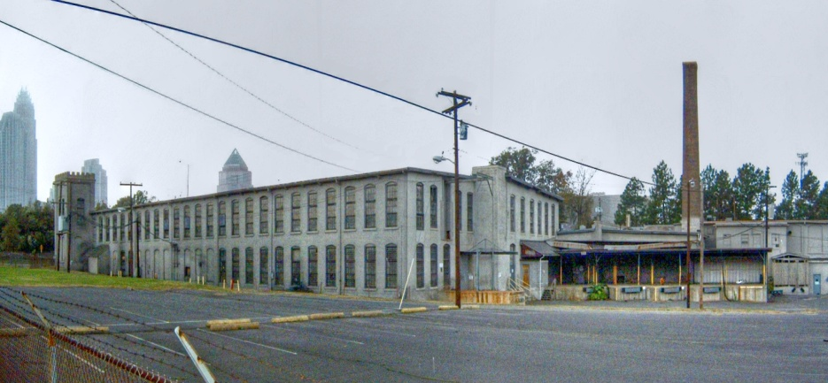
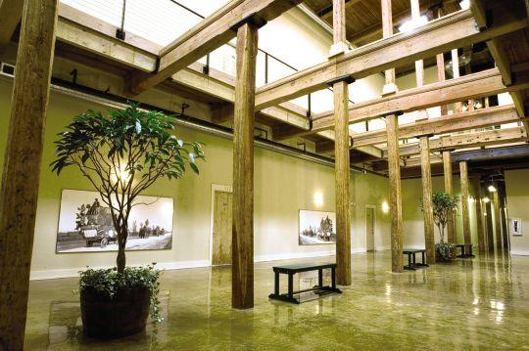
From: Former Alpha Mill
To: Alpha Mill Apartments
Abandoned Textile Mill, circa 1888 and Chromium Electroplater, circa 1955
Alpha Mill Apartments bordering uptown Charlotte
Preservation of historic architectural heritage

Slide 10
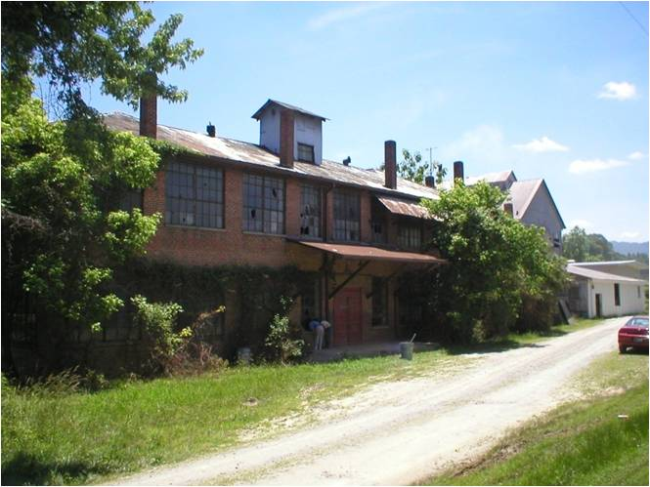
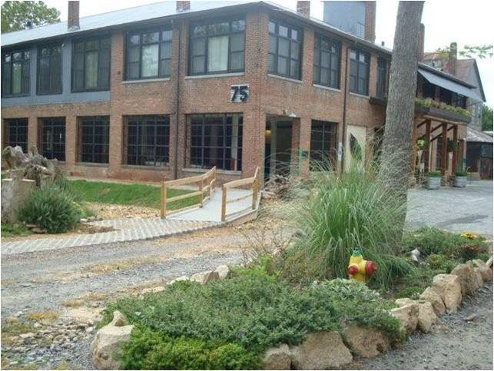
From: Former Asheville Mica Co.
To: Mica Village Lofts
Abandoned Mica Plant, circa 1905 in Biltmore Village, Asheville
Green building redevelopment as Mica Village Loft Condominiums

Slide 11
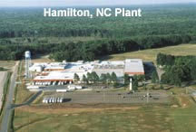
From: Alamac Textiles to Penco
To: Penco Metal Products - Hamilton
School locker manufacturer relocates two manufacturing operations to 400,000 ft² former textile mill.
Hamilton, Martin County (Rural)
300 manufacturing jobs replaced those lost when Alamac Textiles went bankrupt & ceased operations
Brownfields Agreement facilitated N.C. Dept. of Commerce recruitment of out-of-state redeveloper

Slide 12
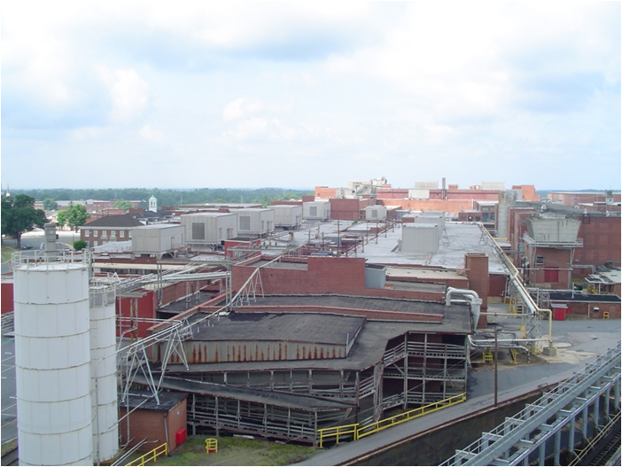
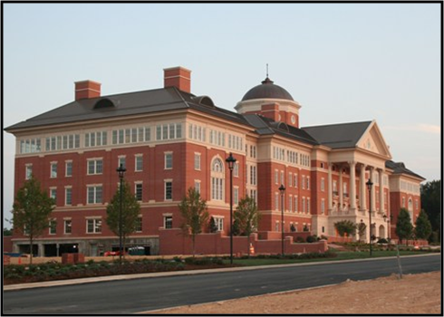
From: Pillowtex Plant 1
To: NC Research Campus - Kannapolis
North Carolina Research Campus
David Murdock/Dole/University Public-Private Venture Nutrition/Ag Research Park
$500 M – $1 B investment
Core Labs built, more to follow
Former Pillowtex and Cannon Mills on 150 acres in Kannapolis
Largest single layoff in State history (4800 jobs lost)

Slide 13
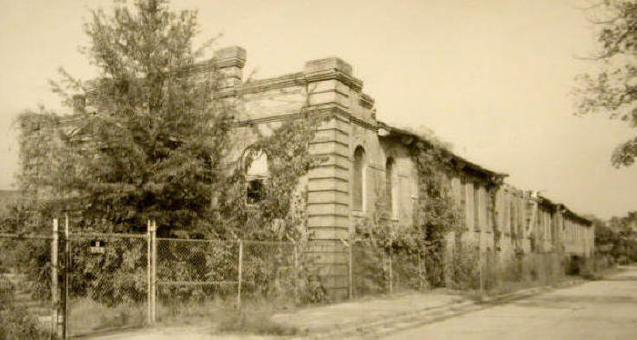
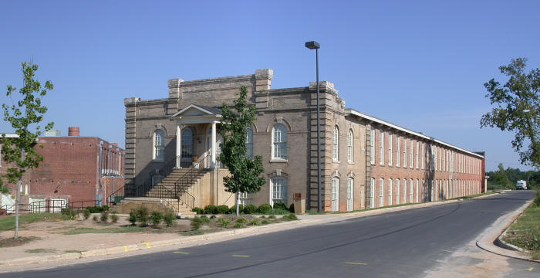
From: Former Pilot Mill
To: Pilot Mill Office Complex - Raleigh
Abandoned Turn of the Century Textile Mill Slated For Demolition
Tax Value:$200,000
Cleanup Cost:~$1 million
Fully Leased Office Complex on National Register of Historic Places
Value over $13 million
Cleanup Cost:~$100,000
Spurred Neighborhood investment of $100 million

Slide 14
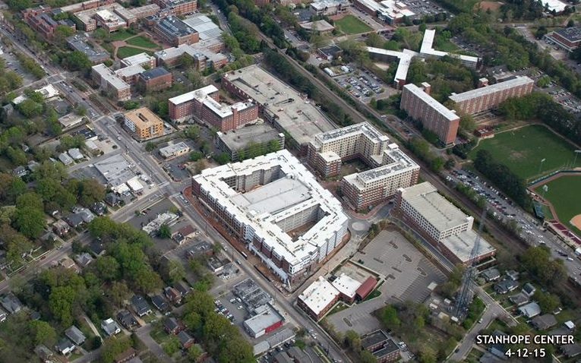
From: Former NC Equipment Co.
To: Dorm and Residential Development
Former heavy equipment sales and servicing facility and bulk oil terminal
Initial tax value:
$4.1 million
Est’d cleanup cost:
~$450,000
Value over $140 million
Actual cleanup cost:
~$50,000
Fully leased 600-unit residential complex: “Stanhope Center” and
“Valentine Commons,” provides much needed student housing for NCSU,
additional commercial retail space

Slide 15
Brownfields Program Staff www.ncbrownfields.org
Bruce.Nicholson@ncdenr.gov
Tony.Duque@ncdenr.gov
Jim Rudder@ncdenr.gov
Sharon.Eckard@ncdenr.gov
Joe.Ghiold@ncdenr.gov
Lebeed.Caty@ncdenr.gov
Geof.Little@ncdenr.gov
Administrative Assistant
Shirley.Liggins@ncdenr.gov
Raleigh 919-707-8383
Carolyn.Minnich@ncdenr.gov
Charlotte 704-661-0330
Joselyn. Harriger@ncdenr.gov
Mooresville 704-663-1699
Tracy.Wahl@ncdenr.gov
Asheville 828-337-2121
Samuel.Watson@ncdenr.gov
David.Peacock@ncdenr.gov
Wilmington 828-796-7401

