Slide 1
The North Carolina Geographic Information Coordinating Council 30 September 2015
Stan C. Duncan
Chair; N C Geographic Information Coordinating Council
Henderson County Assessor & Tax Collector

Slide 2
Late-1970’s/mid-80’s & NOW

Slide 3
A Brief History of the Council
Established initially by Executive Order 147,
issued by Gov. James G. Martin in July 1991.
Continued by Gov. James B. Hunt, Jr., via Executive Order 16 in May 1993.
Formalized by NC General Assembly in 2001 via Session Law 2001-359, “to develop policies regarding the utilization of geographic information, GIS systems, and other related technologies.”
N.C.G.S. §143-725(a)

Slide 4
Responsible by Statute For . . .
Strategic planning.
Resolution of policy and technology issues.
Coordination, direction, and oversight of State, local, and private GIS efforts.
Advising the Governor, the General Assembly, and the State Chief Information Officer as to needed directions, responsibilities, and funding regarding geographic information.
N.C.G.S. §143-725(a)

Slide 5
Statutory Direction . . .
“The purpose of this statewide geographic information coordination effort shall be to further cooperation among State, federal, and local government agencies; academic institutions; and the private sector to improve the quality, access, cost-effectiveness, and utility of North Carolina’s geographic information and to promote geographic information as a strategic resource in the State.”
N.C.G.S. §143-725(a)

Slide 7
Education
Military
Surveying &
Engineering
NextGen 911
Counties, Towns & Cities
Other Private Enterprise
Public Safety
GICC
Commerce
and
State Parks & Wildlife
CGIA
Transportation
Agriculture
Justice
Forest Services
Federal Agencies
Other State Agencies
Conservation
General Public
Notes:
GIS users and stakeholders

Slide 8
Collaboration Through the NC Geographic Information Coordinating Council
GICC User Committees Represent
Local, State, and Federal Agencies
(with number of members , not including CGIA staff)
Geographic Information Coordinating Council – GICC
(34 Members)
Management & Operations Committee
(9 members)
Local Government
Committee
(7 members)
NC OneMap Governance
(9 members)
Statewide Mapping Advisory Committee
(17 members)
Staff: Center for Geographic Information and Analysis (CGIA) in the NC Office of Information Technology Services
State Government GIS Users Committee
(16 executive and
175 general members)
Working Group for Orthophotography Planning
(12 members)
Federal Interagency Committee
(8 executive and
70 general members)
Working Group for Geospatial Data Standards
(10 members)
Working Group for Seamless Parcels
(16 members)
GIS Technical Advisory Committee –
(9 members)
GICC representation includes local, state, and federal governments, regional organizations, universities, private businesses, and nongovernmental organizations
Working Group for Roads and Transportation
(36 participants)
Metadata
ad-hoc Committee (11 members)
http://www.ncgicc.com

Slide 9
Center for Geographic Information and Analysis (CGIA)
Lead agency for GIS services and coordination for the State.
Manages and distributes digital geographic information about North Carolina through NC OneMap.
Operates the statewide data clearinghouse and provides Internet access to geographic information.
Monitors and approves state agency GIS initiatives to ensure they are not duplicative.
Staffs the GICC and its committees. N.C.G.S. §143.725(a)
Provides GIS services to public sector agencies and others for public purposes. N.C.G.S. §147-33.82(a)(10)

Slide 10
Role of the CGIA . . .
The Center for Geographic Information and Analysis (CGIA) shall staff the Council and its committees.
The CGIA shall manage and distribute digital geographic information about North Carolina maintained by numerous State and local government agencies.
CGIA shall operate a statewide data clearinghouse and provide Internet access to State geographic information.
N.C.G.S. §143-725(a)

Slide 11
Notes:
By 2009, all counties had digital orthoimagery and 95 of 100 counties had acquired imagery since 2005. A factor in the acceleration of imagery acquisition starting in 2005 was cost-share from federal and state sources. Yet, many counties had imagery four or more years old and mismatches in vintage and resolution across county boundaries were widespread.

Slide 12
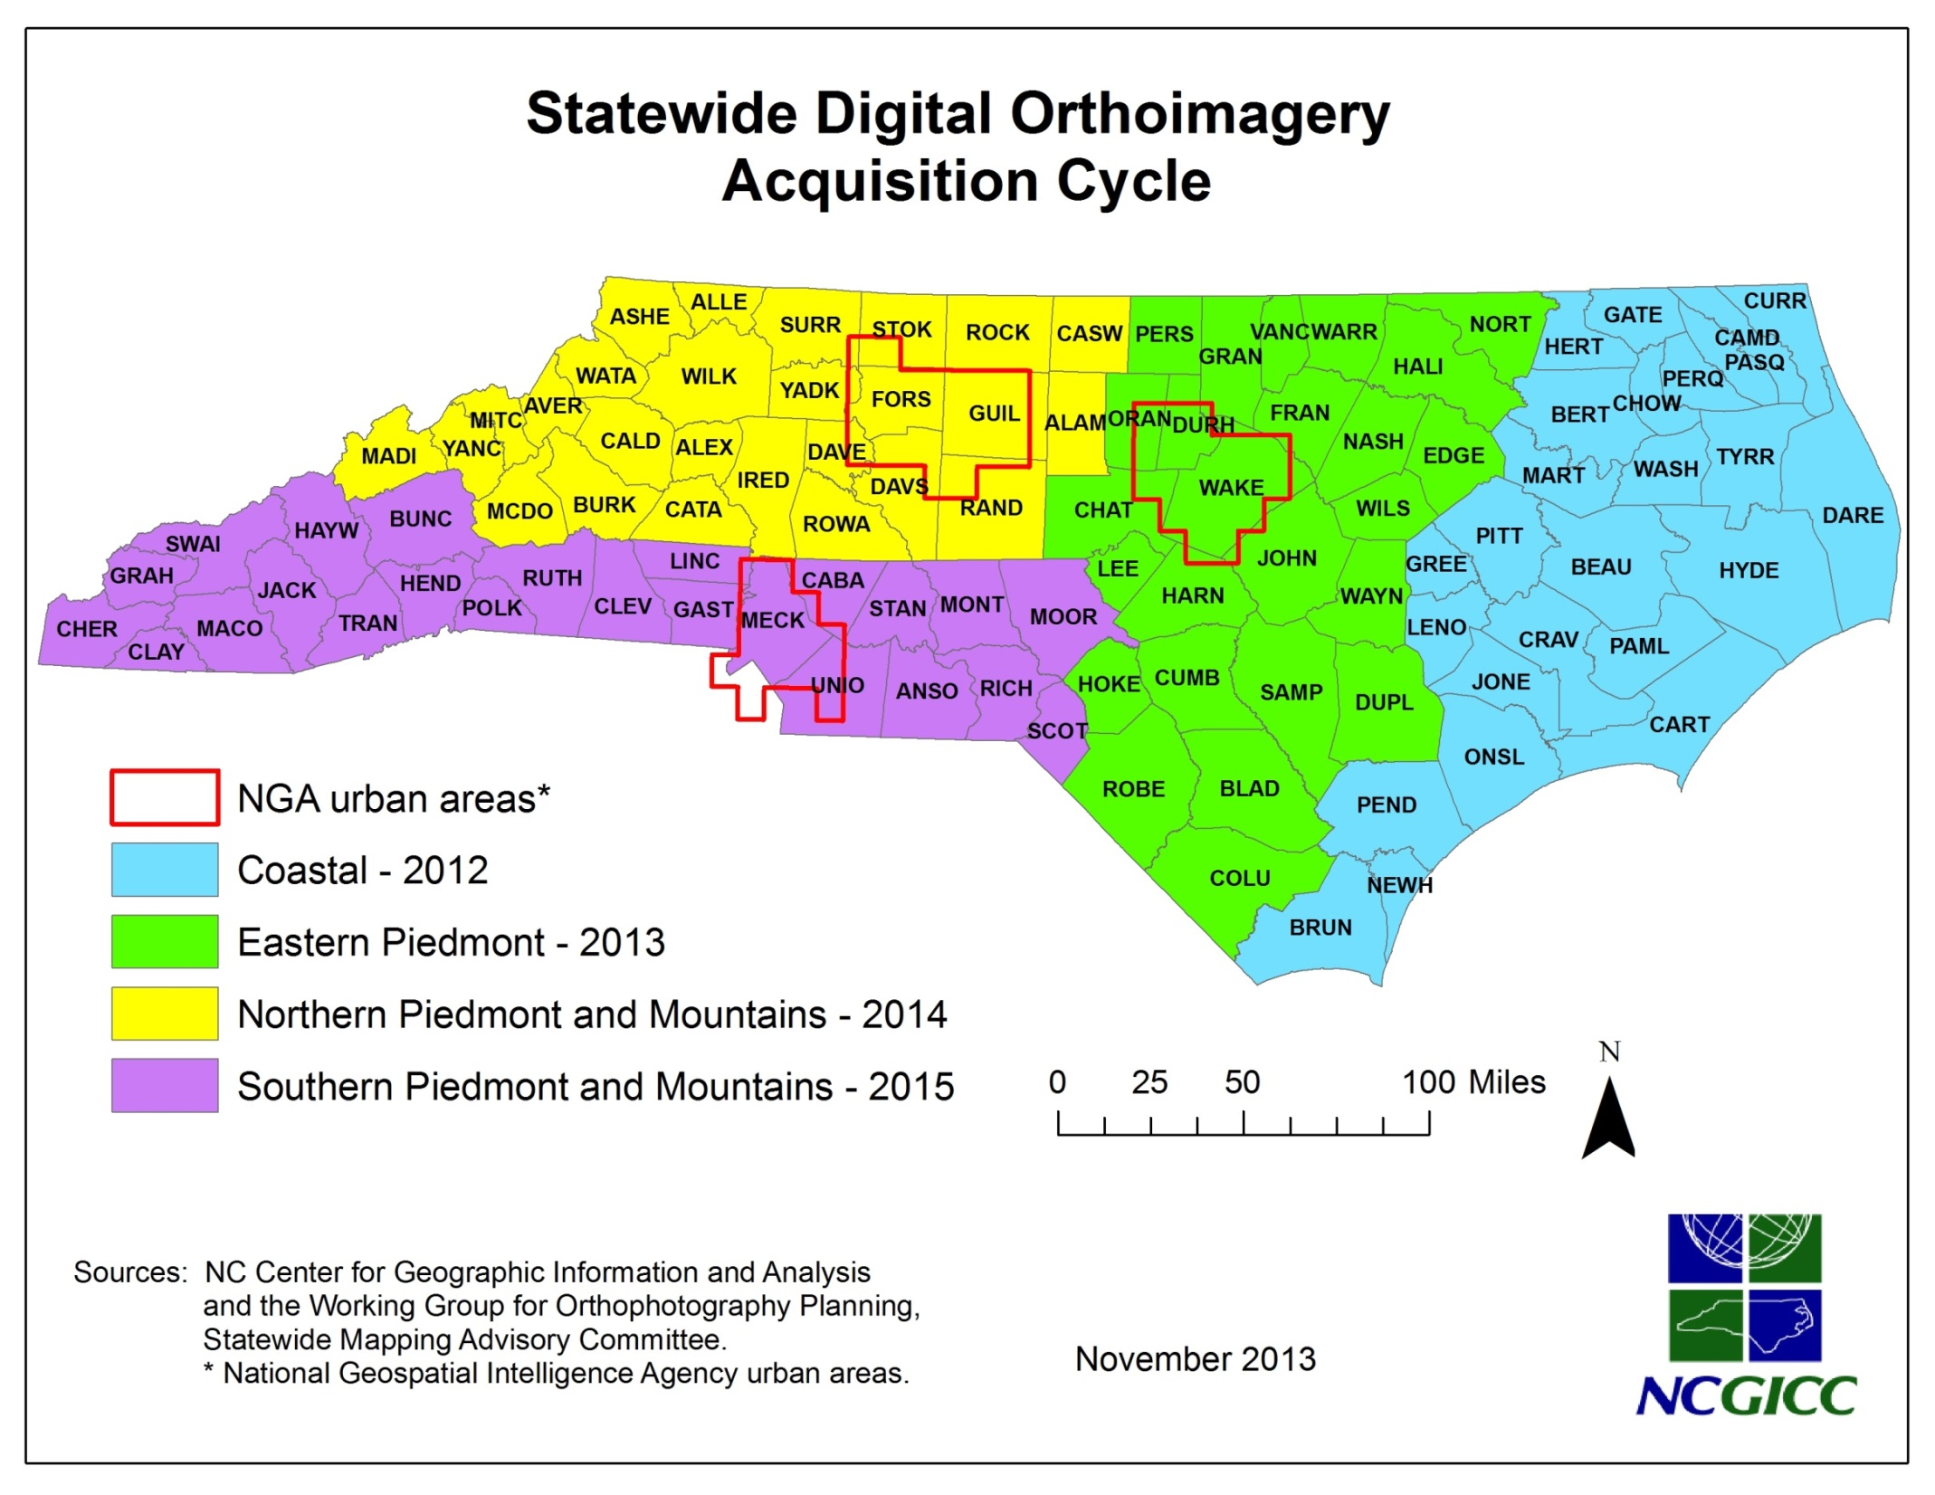

Slide 13
Accomplishments
NC OneMap (managed by CGIA staff), is a one-stop, web portal providing access to numerous geospatial data layers that are current, well-documented, complete, consistent, reliable, and practical.
Release of NC OneMap Data Explorer, a map-based application for intuitive searches for discovery and viewing of geospatial data.
http://data.nconemap.com

Slide 14
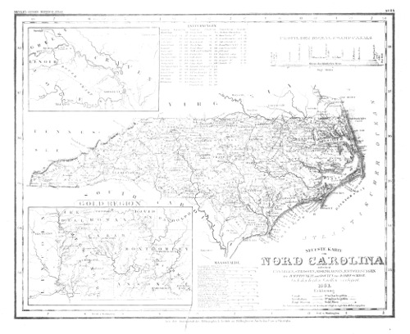

Slide 15
GIS Data Layers: The Framework
Transportation
Surface Waters
Boundaries
Elevation
Geodetic Control
Land Ownership
Orthoimagery

Slide 16
NC OneMap Growth (Visits/Year)

Slide 17
Scheduled for completion Spring 2014

Slide 18
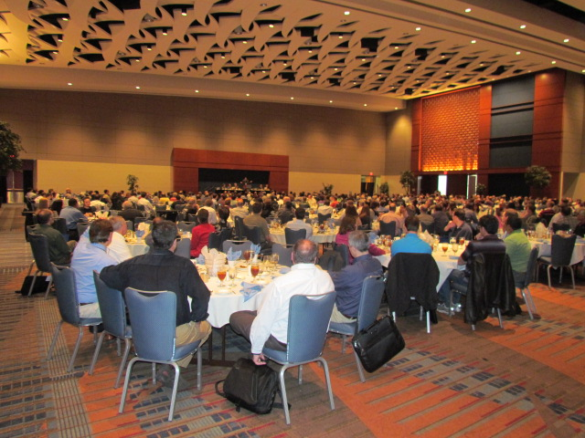
Accomplishments
2015 NC GIS Conference
14th (biannual) Conference, “Mobile and Global” held in Raleigh (February 25-27), set a new attendance record with over 1,000 registrants.

Slide 19
Standards Created & Maintained
In February 2012, the Council endorsed Technical Specifications for LiDAR Base Mapping as drafted by the Secretary of State’s Land Record Management Office, subsequently adopted by the Secretary of State in January 2013.
Development of a Metadata Standard
The who, what, when, where, why, and how
A Metadata Committee formed.
Council adopt Standard in November 2014.

Slide 20
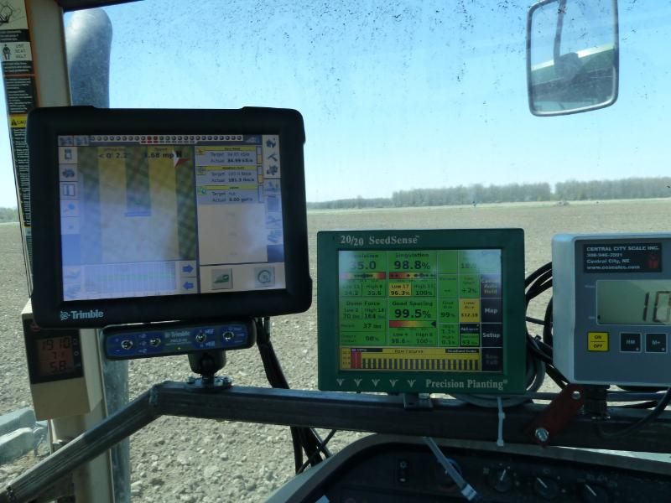
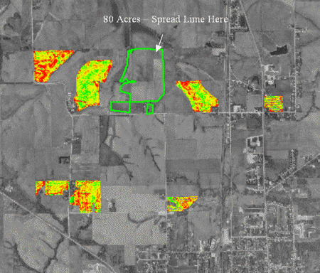
Precision Agriculture
Integration of GIS & GPS Technologies:
Improves productivity.
Reduces use of expensive
fertilizers & pesticides.
Safer and less operator fatigue.
Reduces human error.
Less field call-backs.
Greater control with
larger equipment.

Slide 21
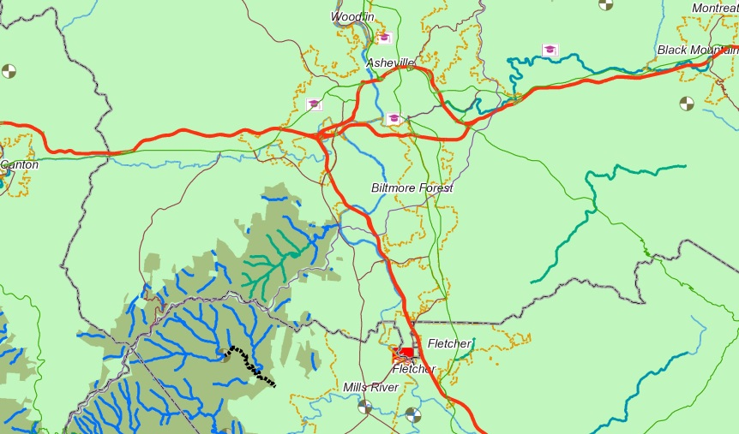
GIS for Economic Development
Sierra Nevada Brewery → Henderson County
New Belgium Brewery → Asheville
Key characteristics* for site selection:
East Coast market access
Educational opportunities
Recreational community atmosphere
Excellent water resources
* www.thrivenc.com

Slide 22
NC/SC State Boundary Line
Not a ‘new’ line;
but the re-establishment of the original line.
S575 – fate pending…
Affecting border counties of Polk, eastward…
Question: What authority does any assessor have to list, appraise, and assess property not in their jurisdiction?

Slide 23
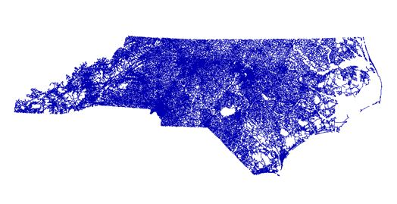
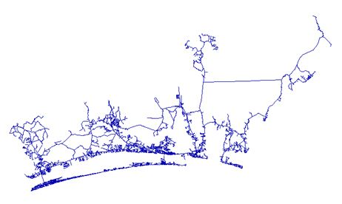
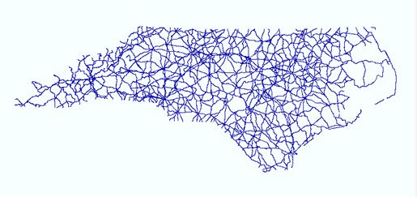
Street Centerlines
Close to completion, built from county files (100 counties).
NC DOT will integrate county roads into statewide roads for a more complete, current, and consistent dataset to support their business needs.
Expected Release: late-2015 – early 2016

Slide 24
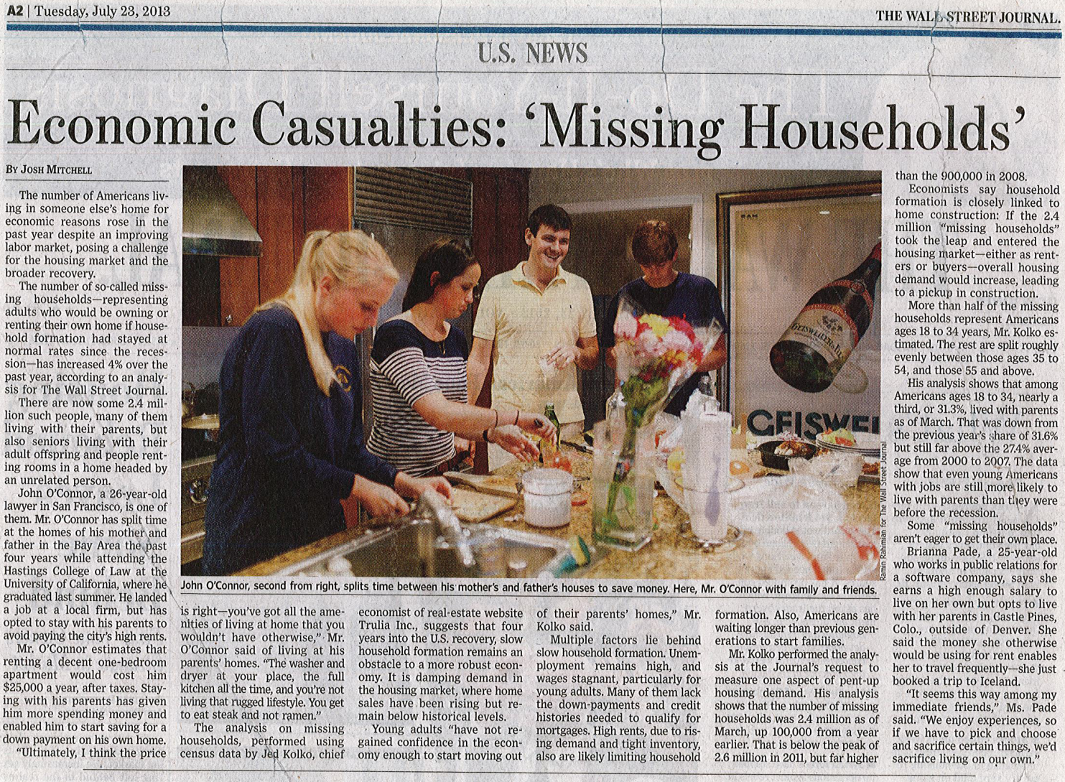
THE 2020 CENSUS: Obtaining an Accurate Population Count.

Slide 25
Master Address Database
FCC recognizes importance of GIS for accurate and accessible geospatial data in supporting the nation’s public safety system – specifically . . .
NextGen911
Accurate and up-to-date situs addresses are essential for emergency response; call handling, routing, service delivery, & location validation.

Slide 26
Going FORWARD . . .
An economically stronger North Carolina will result from increased GIS/IT collaboration
Responding to the marketplace, GIS is moving from product to services via multiple layers of data; from static data to real-time integration.
“Imagery Only” is becoming obsolete; imagery must be accompanied by and communicate meaningful data.

Slide 27
Contacts/Resources
Stan Duncan Henderson County 828-697-4876 stan.duncan@hendersoncountync.org
Tim Johnson CGIA 919-754-6588 tim.johnson@nc.gov
www.ncgicc.org
www.nconemap.com

