Slide 1
Wireless/Cell Towers Centrally Assessed by NCDOR
Michael Connolly, NCDOR

Slide 2
Changes for 2015

Slide 3
Greg Wood – PSC Manager
Retired – January 2015

Slide 4
Bill Wilkes – Asst Director
Retired July 2015

Slide 5
Centrally Assessed for 2015

Slide 6
Wireless Humor

Slide 7
HB 1050 (2014 Session)
Law Changes

Slide 8
HB 1050 (2014 Session)
New law that makes certain property owned by wireless and tower companies to now be centrally assessed by the NC Department of Revenue.
All together 11 statutes had to be added/removed or rewritten.

Slide 9
Statute Changes
NCGS 105-333(9a) – Defines a Mobile Telecommunication Company.
NCGS 105-333(14) – Added Mobile Telecommunication Company to the Public Service Company definition.
Also removed language that specified that a Mobile Telecommunication Company was not a PSC.

Slide 10
Statute Changes - Cont
NCGS 105-333(17a) – Defines tangible personal property of a Mobile Telecommunications Company.
This includes all tangible personal property as well as cellular towers, cellular equipment, cellular equipment shelters and site improvements.
NCGS 105-333(17b) – Defines tangible personal property of a Tower Aggregator Company.
This includes cellular towers, cellular equipment, cellular equipment shelters and site improvements.

Slide 11
Statute Changes - Cont
NCGS 105-333(18) – Removed the definition of a Telegraph Company.
NCGS 105-333(19) – Defines a Telephone Company and makes note that a Telecommunications Company is not a Telephone Company.
NCGS 105-333(22) – Defines a Tower Aggregator Company.

Slide 12
Statute Changes - Cont
NCGS 105-335(c)(4) – As of January 1 – The NCDOR shall appraise the TPP of the Mobile Telecommunication Company at its true value .
NCGS 105-335(c)(5) – As of January 1 – The NCDOR shall appraise the TPP of the Tower Aggregator Company at its true value .

Slide 13
Statute Changes - Cont
NCGS 105-336(c) – Defines how to appraise a Mobile Telecommunication Companies.
Essentially we are appraising using the Cost Index Depreciation Schedules created by the NCDOR.
No Income Approach.
NCGS 105-336(d)(5) – Defines how to appraise a Tower Aggregator Company.
Appraisal is to be based on tower type and height.
Using Marshal & Swift as our guide.

Slide 14
NCGS 105-336(d)(5)
… In determining the true value of a tower of a tower aggregator company or a mobile telecommunications company, the Department of Revenue shall consider what it would cost to replace or reproduce the tower, based on tower height and type, as determined by a nationally recognized cost service commonly utilized by appraisers. For all property, an appropriate deduction shall be made for all forms of depreciation, including physical deterioration, functional obsolescence, and external or economic obsolescence."

Slide 15
2015 Stats – Wireless & Tower Values
40 New Companies Added
$224,105,242 Tower Value
$1,774,601,330 Wireless Value
$1,998,706,572 Grand Total of Value

Slide 16
Tower Companies

Slide 17
Cell Tower Sites
You (the County) will still appraise the Cell Tower Sites (land only).
NCDOR will assess the Tower, Fencing, Shelters and any other improvements.

Slide 18
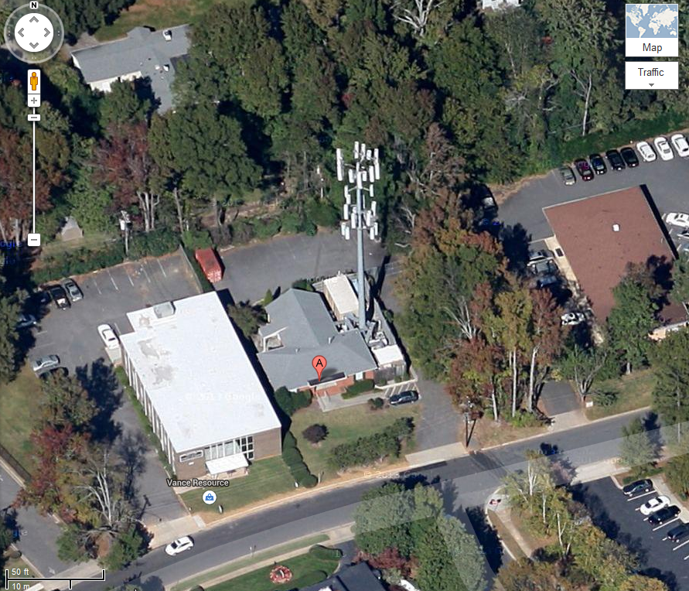
129 Greenwich Road, Charlotte, NC

Slide 19
Cell Tower Appraisal
Replacement Cost New will be determined by utilizing Marshall & Swift ranges of Cost Per Foot by Tower Type.
Depreciation will be determined by year of construction trended by B25 schedule from the NC Cost Index & Depreciation Schedules.
Shelters / Fencing will be appraised using the B25 schedule as well.

Slide 20
Monopole Tower

Slide 21
Guyed Tower

Slide 22
Self Supporting Tower

Slide 23
Marshall & Swift
Tower Type | Tower Height Min | Tower Height Max | Low Range | High Range | Cost Per Foot
SELF SUPPORT | 0 | 50 | 13,071 | 20,950 | $ 340.21
SELF SUPPORT | 51 | 75 | 26,512 | 39,861 | $ 442.49
SELF SUPPORT | 76 | 100 | 41,993 | 61,414 | $ 517.03
SELF SUPPORT | 101 | 150 | 82,271 | 111,240 | $ 645.04
SELF SUPPORT | 151 | 200 | 112,167 | 126,999 | $ 597.92
SELF SUPPORT | 201 | 225 | 119,583 | 133,488 | $ 562.38
SELF SUPPORT | 226 | 250 | 128,853 | 147,393 | $ 552.49
SELF SUPPORT | 251 | 300 | 137,196 | 166,860 | $ 506.76
SELF SUPPORT | 301 | 350 | 157,590 | 192,816 | $ 500.58
SELF SUPPORT | 351 | 400 | 176,130 | 217,845 | $ 492.47
GUYED | 0 | 400 | 190 | 315 | $ 252.61
MONOPOLE | 0 | 50 | 13,071 | 20,950 | $ 379.61
MONOPOLE | 51 | 75 | 26,512 | 39,861 | $ 486.98
MONOPOLE | 76 | 100 | 41,993 | 61,414 | $ 565.59
MONOPOLE | 101 | 150 | 82,271 | 111,240 | $ 693.32
MONOPOLE | 151 | 200 | 112,167 | 126,999 | $ 616.46
MONOPOLE | 201 | 225 | 119,583 | 133,488 | $ 577.83
MONOPOLE | 226 | 250 | 128,853 | 147,393 | $ 571.03
MONOPOLE | 251 | 300 | 137,196 | 166,860 | $ 531.48
MONOPOLE | 301 | 350 | 157,590 | 192,816 | $ 525.74
MONOPOLE | 351 | 400 | 176,130 | 217,845 | $ 518.54

Slide 24
Example of Tower Calculation
Per Marshall & Swift / DOR Trend Schedules
A Monopole Tower that is 130 feet tall constructed in 2003 would have a value of $57,684.
$693.32 / Foot (Comes from M&S)
X 130 Feet (Height of Tower)
__________________________
$90,132 Replacement Cost New
$ 90,132 Replacement Cost New
X .64 (B-25 Schedule - 2003)
__________________________
$57,684 RCNLD

Slide 25
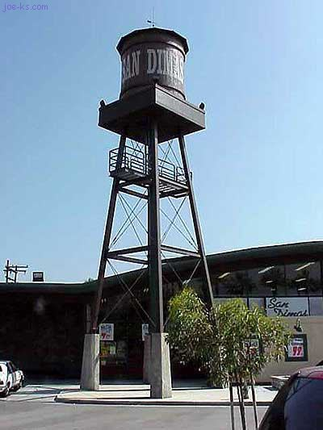
Stealth Towers

Slide 26
Approximate Number of Cell Towers Appraised*
Company Name | # of Towers
American Tower Corp | 935
Crown Castle | 1080
SBA Towers | 455
Sprint | 135
AT&T Mobility | 135
Cellco (Verizon) | 514
T-Mobile | 8
Grand Total | 3262
* There were other tower companies – but these were the large companies

Slide 27
SBA Towers
Name Filed by last year
SBA 2012 TC Assets, LLC | SBA Steel LLC
SBA GC Towers, LLC | SBA Structures, LLC
SBA Infrastructure LLC | SBA Towers II LLC
SBA Monarch Steel, LLC | SBA Towers III LLC
SBA Monarch Towers I, LLC | SBA Towers IV LLC
SBA Monarch Towers III, LLC | SBA Towers V, LLC
SBA Properties, LLC | SBA Towers VI, LLC
SBA Sites, LLC | SBA Towers VII, LLC
SBA Steel II, LLC | SBA Towers, LLC
18 Different Names Filed Under Last Year

Slide 28
Crown Castle
Name Filed by last year
Crown Atlantic Company, LLC | Global Signal Acquisitions LLC
Crown Castle GT Company, LLC | Pinnacle Towers Acquisition LLC
Crown Castle South, LLC | Pinnacle Towers Asset Holding LLC
Crown Castle Towers 05 LLC | Pinnacle Towers LLC
Crown Castle Towers 06-02 LLC | Radio Station WGLD LLC
Crown Communication, Inc.
11 Different Names Filed Under Last Year

Slide 29
American Tower Corp
Name Filed Under Last Year
American Towers, Inc | GTP Towers I, LLC
GLOBAL TOWER ASSETS III, LLC | GTP Towers II, LLC
GTP Acquisition Partners I, LLC | GTP Towers V, LLC
GTP Acquisition Partners II, L | GTP Towers VIII, LLC
GTP Infrastructure I, LLC | SpectraSite Communications, Inc
GTP Infrastructure II, LLC
11 Different Names Filed Under Last Year

Slide 30
Wireless Companies

Slide 31
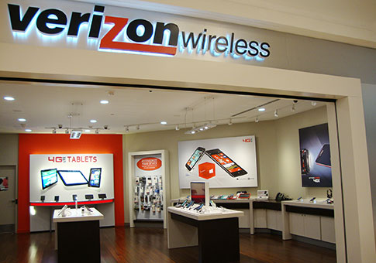
Real Property vs. Business Personal Property
Real Property – County Appraised
BPP – State Appraised

Slide 32
Wireless Companies
The County will still appraise all REAL PROPERTY owned or leased by the Wireless Companies.
NCDOR will appraise all tangible personal property owned or leased by the Wireless Company.

Slide 33
Wireless Company Appraisal
NCDOR will assess the Wireless Companies utilizing the trend schedules for Cellular Equipment per the NC Cost Index & Depreciation Schedules.
In theory – If we had appraised these companies in 2014, our 2014 value should have matched your 2014 value.

Slide 34
Wireless Company (Towers)
Towers –
Towers owned or leased by Wireless Companies will be treated the same as Towers owned or leased by Tower Companies.

Slide 35
Other Types of Properties
Motor Vehicles – All motor vehicles for Wireless or Tower Companies will continue to be assessed by the counties and utilize the Tag and Tax system.
Leasehold Improvements – Will be assessed by the NCDOR.
For Example – Upfitting at a Mall location for Verizon Wireless would be filed with our office.

Slide 36
Medium Cellular Company -11,000 assets
Physical Address | Type of Property Asset | NC Schedule | % Good Factor | Orig Cost | Year of Acquisition | Value | County | Taxing District
4400 Sunset Rd | Antennas | B-10 | 0.82 | 3,854 | 2013 | 3,160 | Mecklenburg | Mecklenburg, Charlotte
700 S. Poplar | Comm Equip | U6 | 0.51 | 6,207 | 2013 | 3,166 | Mecklenburg | Mecklenburg, Charlotte, Special District 1, Special District 2
2550 Distribuibution Center Dr | Comm Equip | U6 | 0.51 | 6,279 | 2013 | 3,202 | Mecklenburg | Mecklenburg, Charlotte
15316 Seigel street | Comp - BTS | U6 | 0.68 | 4,710 | 2014 | 3,203 | Mecklenburg | Mecklenburg, Charlotte
13544 Mallard Creek Rd | Comm Equip | U6 | 0.51 | 6,305 | 2013 | 3,215 | Mecklenburg | Fire (MCH), Mecklenburg, Police
333 E. Trade St | Comp - BTS | U6 | 0.51 | 6,361 | 2013 | 3,244 | Mecklenburg | Mecklenburg, Charlotte, Special District 1, Special District 2
5405 Northstream Dr | Comm Equip | U6 | 0.51 | 6,366 | 2013 | 3,246 | Mecklenburg | Mecklenburg, Charlotte
6946 Fairview Rd | Comp - BTS | U6 | 0.51 | 6,410 | 2013 | 3,269 | Mecklenburg | Mecklenburg,Charlotte
2619 West Blvd. | Comm Equip | U6 | 0.51 | 6,410 | 2013 | 3,269 | Mecklenburg | Mecklenburg, Charlotte
2415 South Allen Rd | Comm Equip | U6 | 0.51 | 6,436 | 2013 | 3,282 | Mecklenburg | Mecklenburg, Charlotte
9526 Shopton Rd West | Power Eqp | B10 | 0.82 | 4,016 | 2013 | 3,293 | Mecklenburg | Mecklenburg, Charlotte
2715 North Tryon Street | Comp - BTS | U6 | 0.51 | 6,520 | 2013 | 3,325 | Mecklenburg | Mecklenburg,Charlotte
6915 EndhAven Lane | Comm Equip | U6 | 0.51 | 6,535 | 2013 | 3,333 | Mecklenburg | Mecklenburg, Charlotte
5630 Susan Dr | Comm Equip | U6 | 0.51 | 6,553 | 2013 | 3,342 | Mecklenburg | Mecklenburg,Charlotte
13605 Zoar Rd | Comm Equip | U6 | 0.51 | 6,585 | 2013 | 3,359 | Mecklenburg | Mecklenburg, Fire (MCH), Police
12300 Pump Station Rd | Comm Equip | U6 | 0.51 | 6,645 | 2013 | 3,389 | Mecklenburg | Mecklenburg, Charlotte
5700 Westpark Dr | HVAC Equip | B-10 | 0.82 | 4,144 | 2013 | 3,398 | Mecklenburg | Mecklenburg, Charlotte
7300 Robinson Church Rd | Comm Equip | U6 | 0.51 | 6,664 | 2013 | 3,399 | Mecklenburg | Mecklenburg, Charlotte
7000 Old Providence Rd | Antennas | B-10 | 0.82 | 4,190 | 2013 | 3,435 | Mecklenburg | Mecklenburg, Charlotte
422 Pecan Ave | Comm Equip | U6 | 0.51 | 6,749 | 2013 | 3,442 | Mecklenburg | Mecklenburg, Charlotte
15178 Beatties Ford Rd | Comm Equip | U6 | 0.51 | 6,749 | 2013 | 3,442 | Mecklenburg | Mecklenburg, Huntersville
1729 Echo Forest Dr | Comm Equip | U6 | 0.51 | 6,749 | 2013 | 3,442 | Mecklenburg | Mecklenburg, Charlotte
9318 Walkers Ferry Rd | Comm Equip | U6 | 0.51 | 6,749 | 2013 | 3,442 | Mecklenburg | Mecklenburg,Fire(MCH),Police
700 East Independence Blvd | Comm Equip | U6 | 0.51 | 6,749 | 2013 | 3,442 | Mecklenburg | Mecklenburg, Charlotte

Slide 37
Districts | Values
Fire (MCH), Mecklenburg, Police | 3,215
Mecklenburg, Charlotte | 49,937
Mecklenburg, Charlotte, Special District 1, Special District 2 | 6,410
Mecklenburg, Fire (MCH), Police | 3,359
Mecklenburg, Huntersville | 3,442
Mecklenburg,Charlotte | 9,936
Mecklenburg,Fire(MCH),Police | 3,442
Grand Total | 79,741

Slide 38
District | Value
Charlotte | 66,283
Fire MCH | 10,016
Huntersville | 3,442
Special District 1 | 6,410
Special District 2 | 6,410
Police | 10,016

Slide 39
Wireless Company Names
AT&T Mobility –
AT&T Mobility & Cricket Communications
Cellco Partnership –
Alltel Comm LLC, Alltel Comm of NC LP, Alltel Comm of Nebraska Inc, Alltel of Asheville, Cellco Partnership
Spok Inc –
FKA – USA Mobility
Sprint –
SprintCom Inc, Airgate PSC Inc, Nextel
T-Mobile –
T-Mobile

Slide 40
2014 vs. 2015
Comparing tower Values
&
Wireless Values
from Last Year to This year

Slide 41
Wireless Value Comparisons (14 vs 15)
Company | 2014 Value | 2015 Value | Change in Value
AT&T Mobility* | 574,232,353 | 619,509,313 | 45,276,960
T-Mobile | 82,834,377 | 92,133,259 | 9,298,882
Verizon | 539,035,202 | 539,865,284 | 830,082
* AT&T Mobility includes both Tower & Wireless Values

Slide 42
When does all of this start?
HB1050 took affect on January 1, 2015.
Any previous audits are still valid for tax years prior to 2015.

Slide 43
Looking Forward to 2016
What we learned in 2015

Slide 44
Taxing District Issues
The Companies don’t know which districts they are located within.
Sometimes they don’t even know the address.
So how do we assign this value to the correct taxing district?????

Slide 45
Taxing District Issues – Mike’s Vision
Companies will send you their assets by address.
Counties will need to assign the proper taxing district to the address.
Taxing Districts will have to follow a very strict formatting specification.

Slide 46
Wireless Companies
Type of Property | County Assessed | NCDOR Assessed
Cell Tower
Cell Tower Concrete, Fencing, Shelter, and other Improvements at site.
Motor Vehicles
Tangible Personal Property – Computers, F&F, M&E.
Leasehold Improvements (Upfits at a Mall for example)
Real Property

Slide 47
Tower Companies
Type of Property | County Assessed | NCDOR Assessed
Cell Tower
Cell Tower Concrete, Fencing, Shelter, and other Improvements at site.
Motor Vehicles
Tangible Personal Property – Computers, F&F, M&E, etc. located at the Tower Site.
Real Property

Slide 48
Landline Companies
Type of Property | County Assessed | NCDOR Assessed
Cell Tower
Cell Tower Concrete, Fencing, Shelter, and other Improvements at site.
Motor Vehicles
Tangible Personal Property
Leasehold Improvements (Upfits at a Mall for example)
Real Property

Slide 49
Cell Towers
Can you find the Cell Tower?

Slide 50
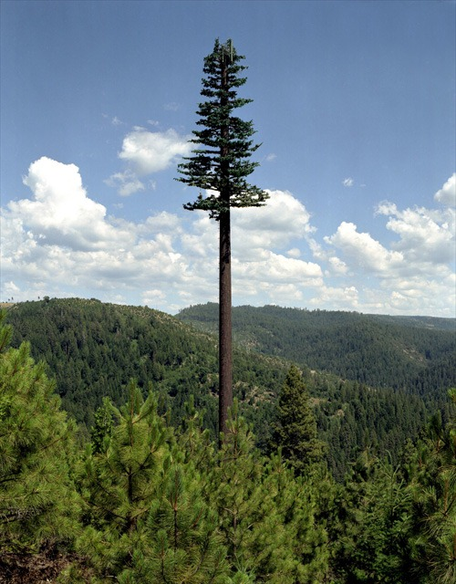

Slide 51
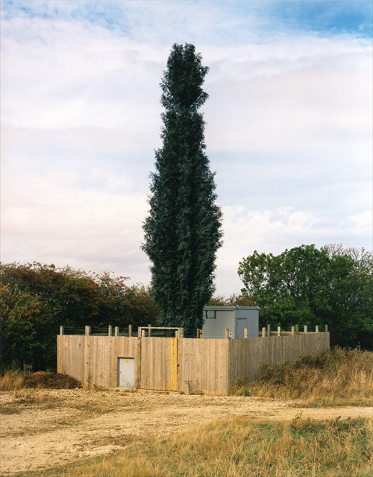

Slide 53
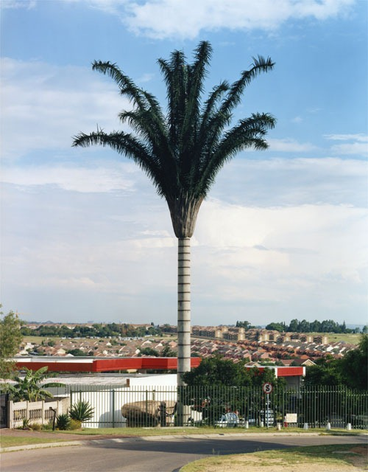

Slide 54
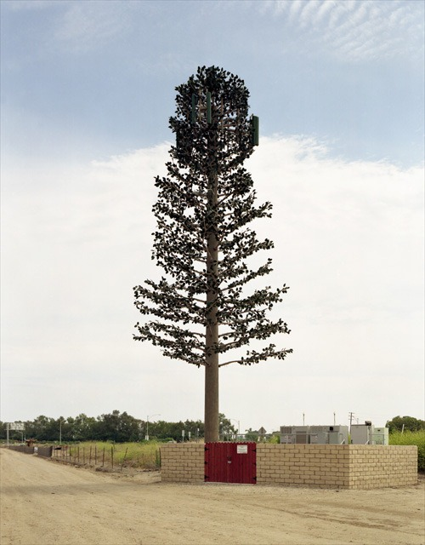

Slide 55
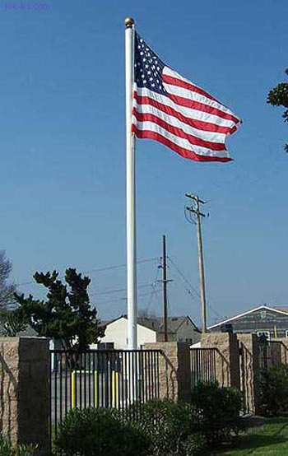

Slide 56
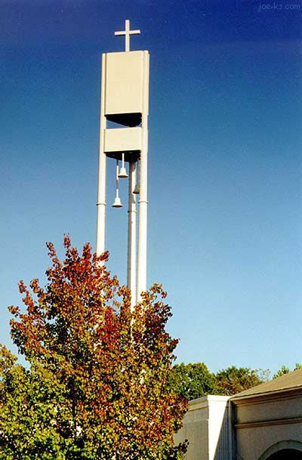

Slide 57
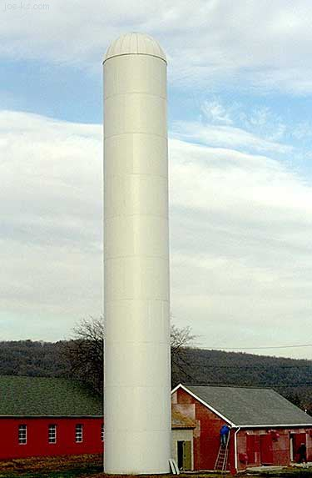

Slide 58
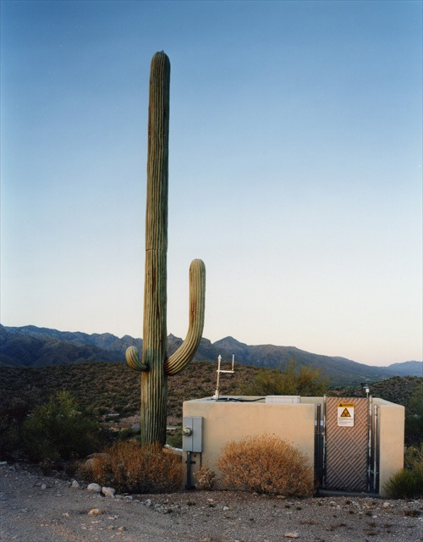

Slide 59
Questions?

