Slide 1
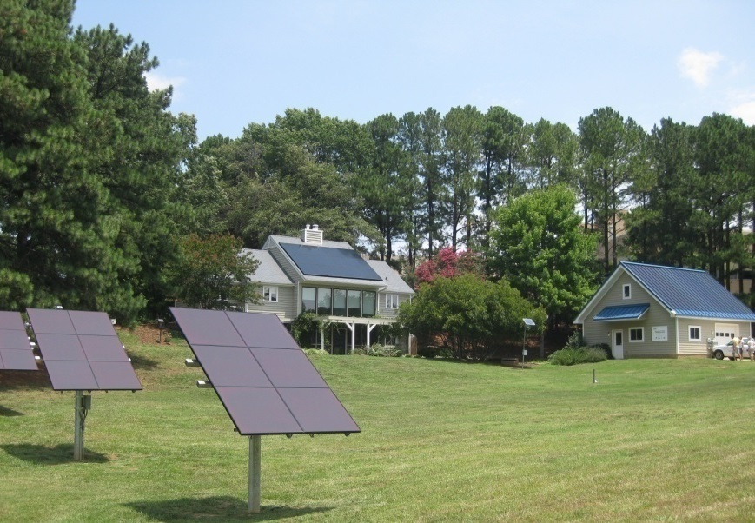
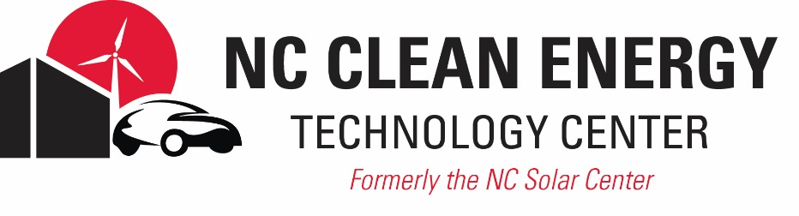

Life of Solar
Tommy_Cleveland@ncsu.edu

Slide 2
N.C. Clean Energy Technology Center (formerly the NC Solar Center) Overview
Created in 1988 as a resource for renewable energy programs and information, training, technical assistance and applied research
Operated by the College of Engineering at N.C. State University
Funded by the N.C. Department of Natural Resources (DENR), federal and state grants, and fee-for-service
Major Program Areas:
Renewable Energy
Clean Power & Efficiency
Clean Transportation
Economic Development
Energy Policy
Workforce Development
Education & Outreach

Slide 3
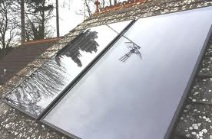
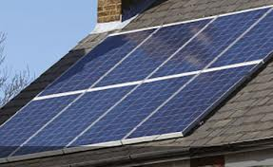
“Solar Panels”
Thermal
Photovoltaic (PV)
Heats water instead of creating electricity
Slightly thicker panels than PV
Converts sunlight into electricity
Most new systems are PV

Slide 4
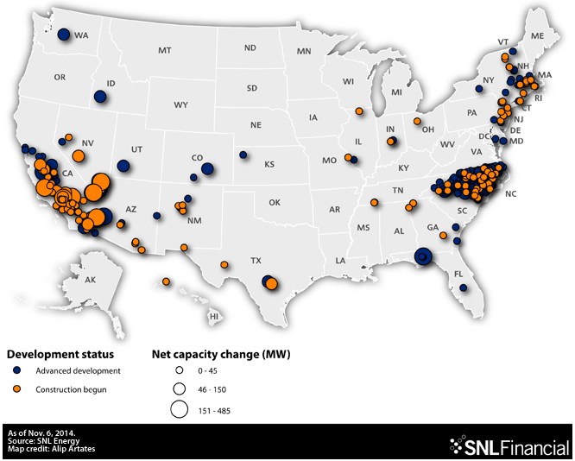
Notes:
Solar in NC is growing strong.

Slide 5
US Solar Market
4.8% of US Capacity
Source: SEIA/GTM “Solar Market Insight”
Notes:
Scaling up to national level, NC currently ranks fourth in the nation in terms of cumulative installed solar capacity of 1,000 MW of solar installations, behind only California, Arizona, and New Jersey. At present, the state accounts for almost 5% of all the solar installed in the U.S.

Slide 6
NC Solar Market
Source: SEIA/GTM “Solar Market Insight”
Notes:
North Carolina current has a strong solar market, with 400 MW of installed PV capacity in 2014 alone. As you can see in the chart here, much of this growth is being driven by utility-scale solar installations. Non-residential systems (including those installed on businesses, non-profits, houses of worship, schools, etc) make up a much smaller amount of the state’s solar capacity, with residential systems practically nonexistent by comparison.
And this is the motivation for today’s workshop. Install PV capacity is expected to continue growing in the near term, with approximately 800 MW expected to be installed across the state in 2015. The vast majority of which (720 MW) will be from utility-scale systems. Since we know more large-scale solar is coming, it is becoming even more important for local governments – such as the ones you all represent – to establish policies and plans throughout your community and state.

Slide 7
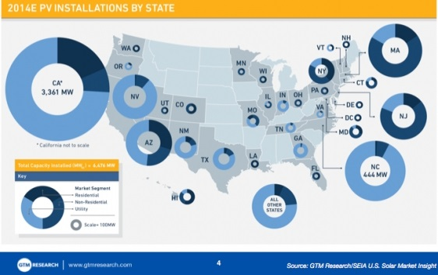
Notes:
The US market, 50 markets, NC example

Slide 8
The Cost of Solar PV
33% drop in price
2010 - 2013
Tracking the Sun VII: The Installed Cost of Photovoltaics in the US from 1998-2013 (LBNL)
Notes:
While part of the answer to this question can be found in the supportive policies the country once passed to incentivize investment in solar, another large part of the answer can be found by examining the cost of solar energy. Here in the U.S., the cost of solar has fallen dramatically over the past several years. Fifteen years ago, a residential solar energy system would run you about $12/ watt. By the end of 2013, this cost was less than $5/ watt, with leading market research suggesting costs are already less than $4/W. Since 2010, the cost of solar has declined by one-third, and we expect this trend to continue throughout the rest of the decade.
One of the main goals for the SunShot Initiative is to reduce costs, down to $1.50/W for residential users by the year 2020.

Slide 9
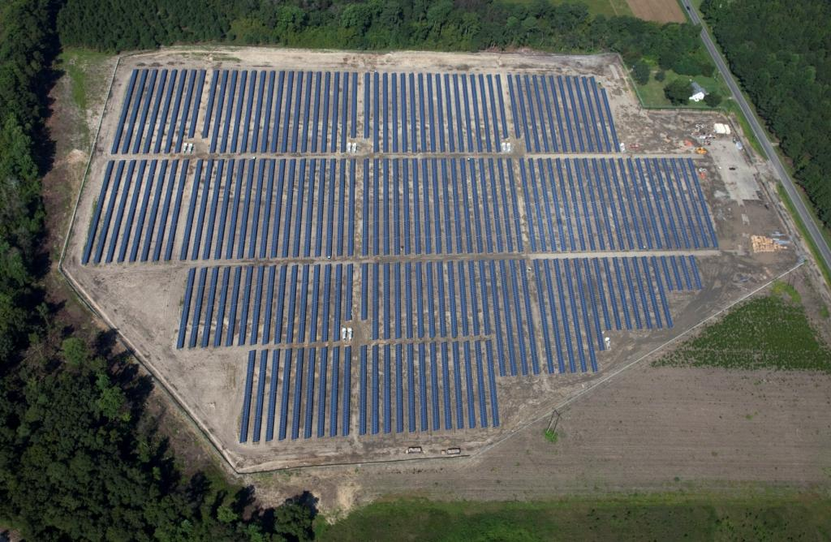

Slide 10
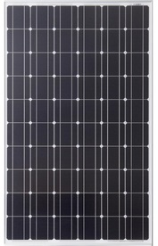
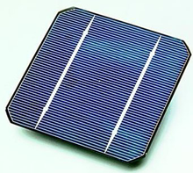
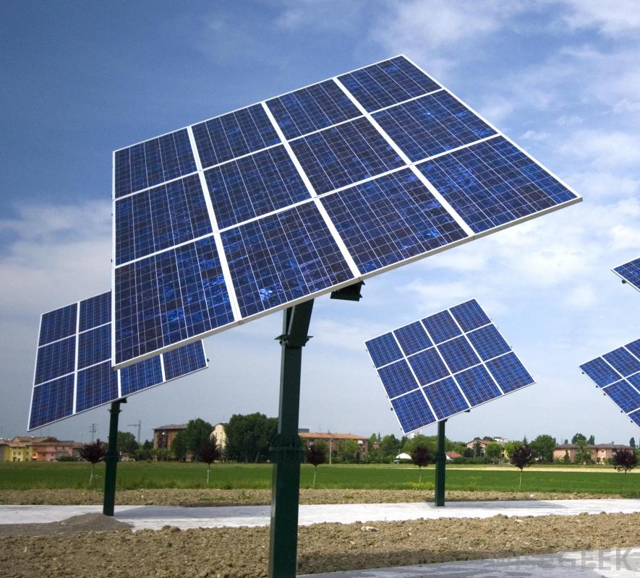
PV System Components: from Cells to Arrays
PV Module
PV Panel
PV Array
Sub-array or string
PV Cell
PV Module
PV Panel
PV Array
Today’s modules are 14% - 21% efficient at converting solar energy into DC electricity

Slide 11
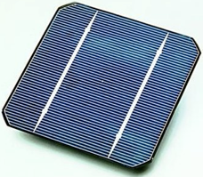
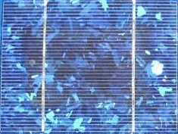

Cell Type Comparison
Mono-crystalline
Multi-crystalline
Thin Film
Cadmium Telluride or
CIGs

Slide 12
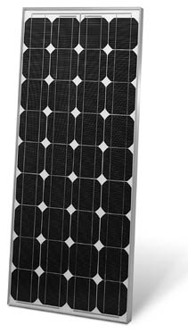
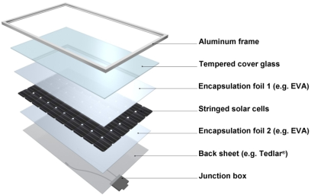
Crystalline Silicon PV Modules
Mono- or poly-crystalline silicon cells (60 year old technology)
Tempered glass front with polymer back in aluminum frame
Guaranteed to produce at least 85% of nameplate power in 25 years
Notes:
High efficiencies currently available
Two general types, mono crystalline (each cell is a thin slice of a single silicon crystal) and poly crystalline (each cell is made up of many moderate sized silicon crystals). Polycrystalline is less efficient, but cheaper to manufacture.

Slide 13
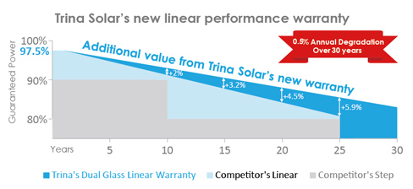
25-30 Module Power Warranty

Slide 14
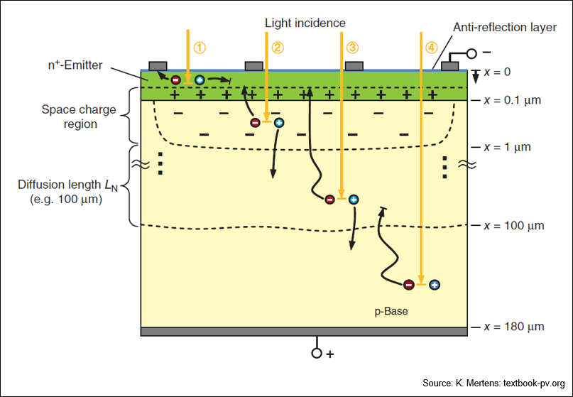
Notes:
15-20% efficiency, progressing up
46% multijunction

Slide 15
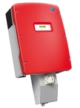
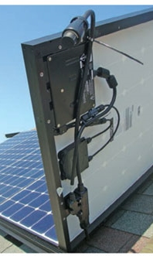
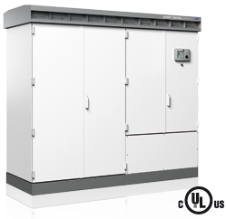
Solar Inverters
Grid Syncing
Failsafe Safeties
200 W to 1MW
96%+ efficiencies
10 to 25 year warranties

Slide 17
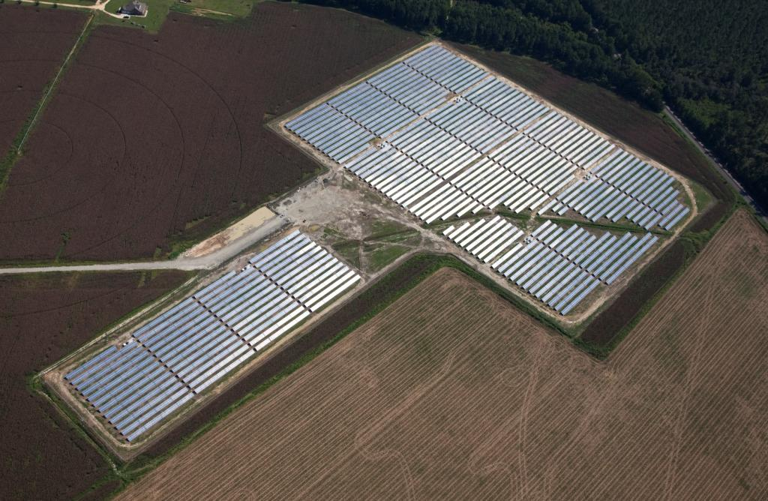

Slide 18
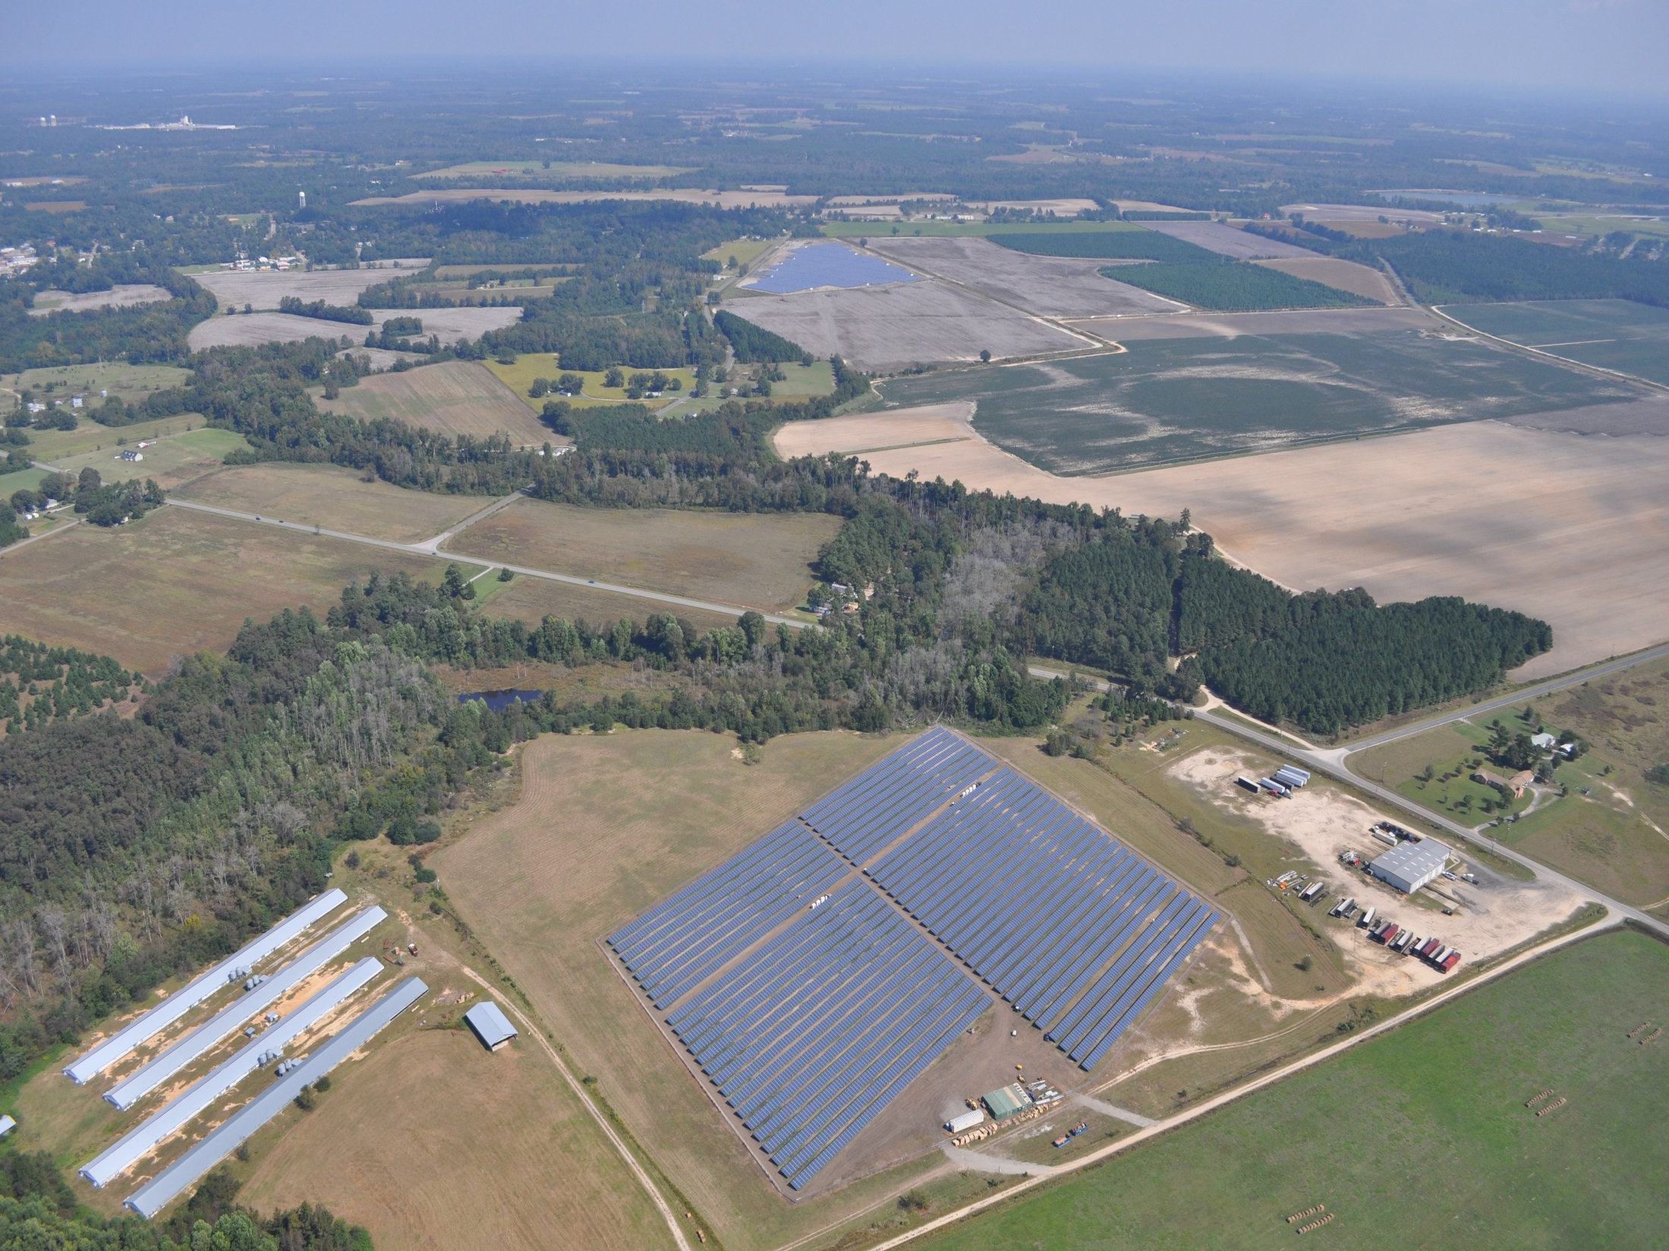
Notes:
Tax Base for Counties

Slide 19
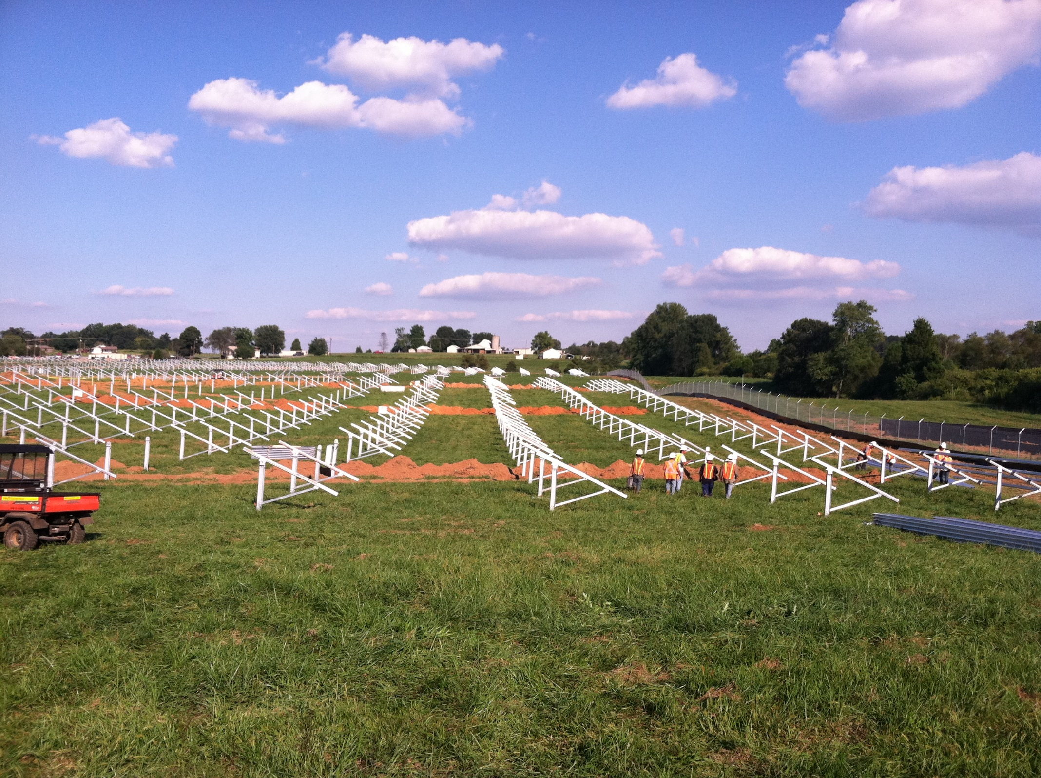

Slide 20
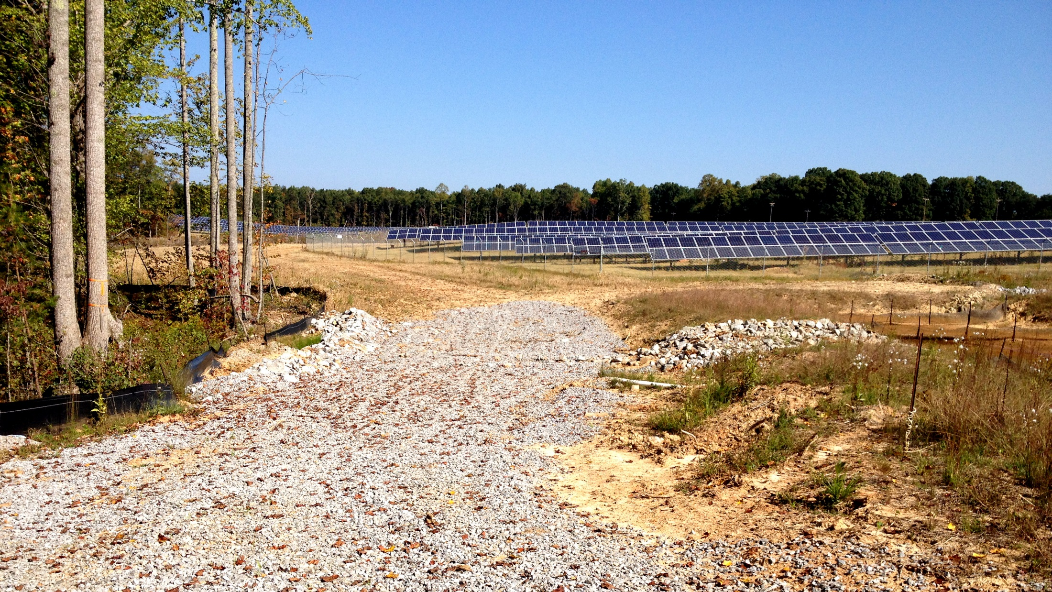

Slide 21
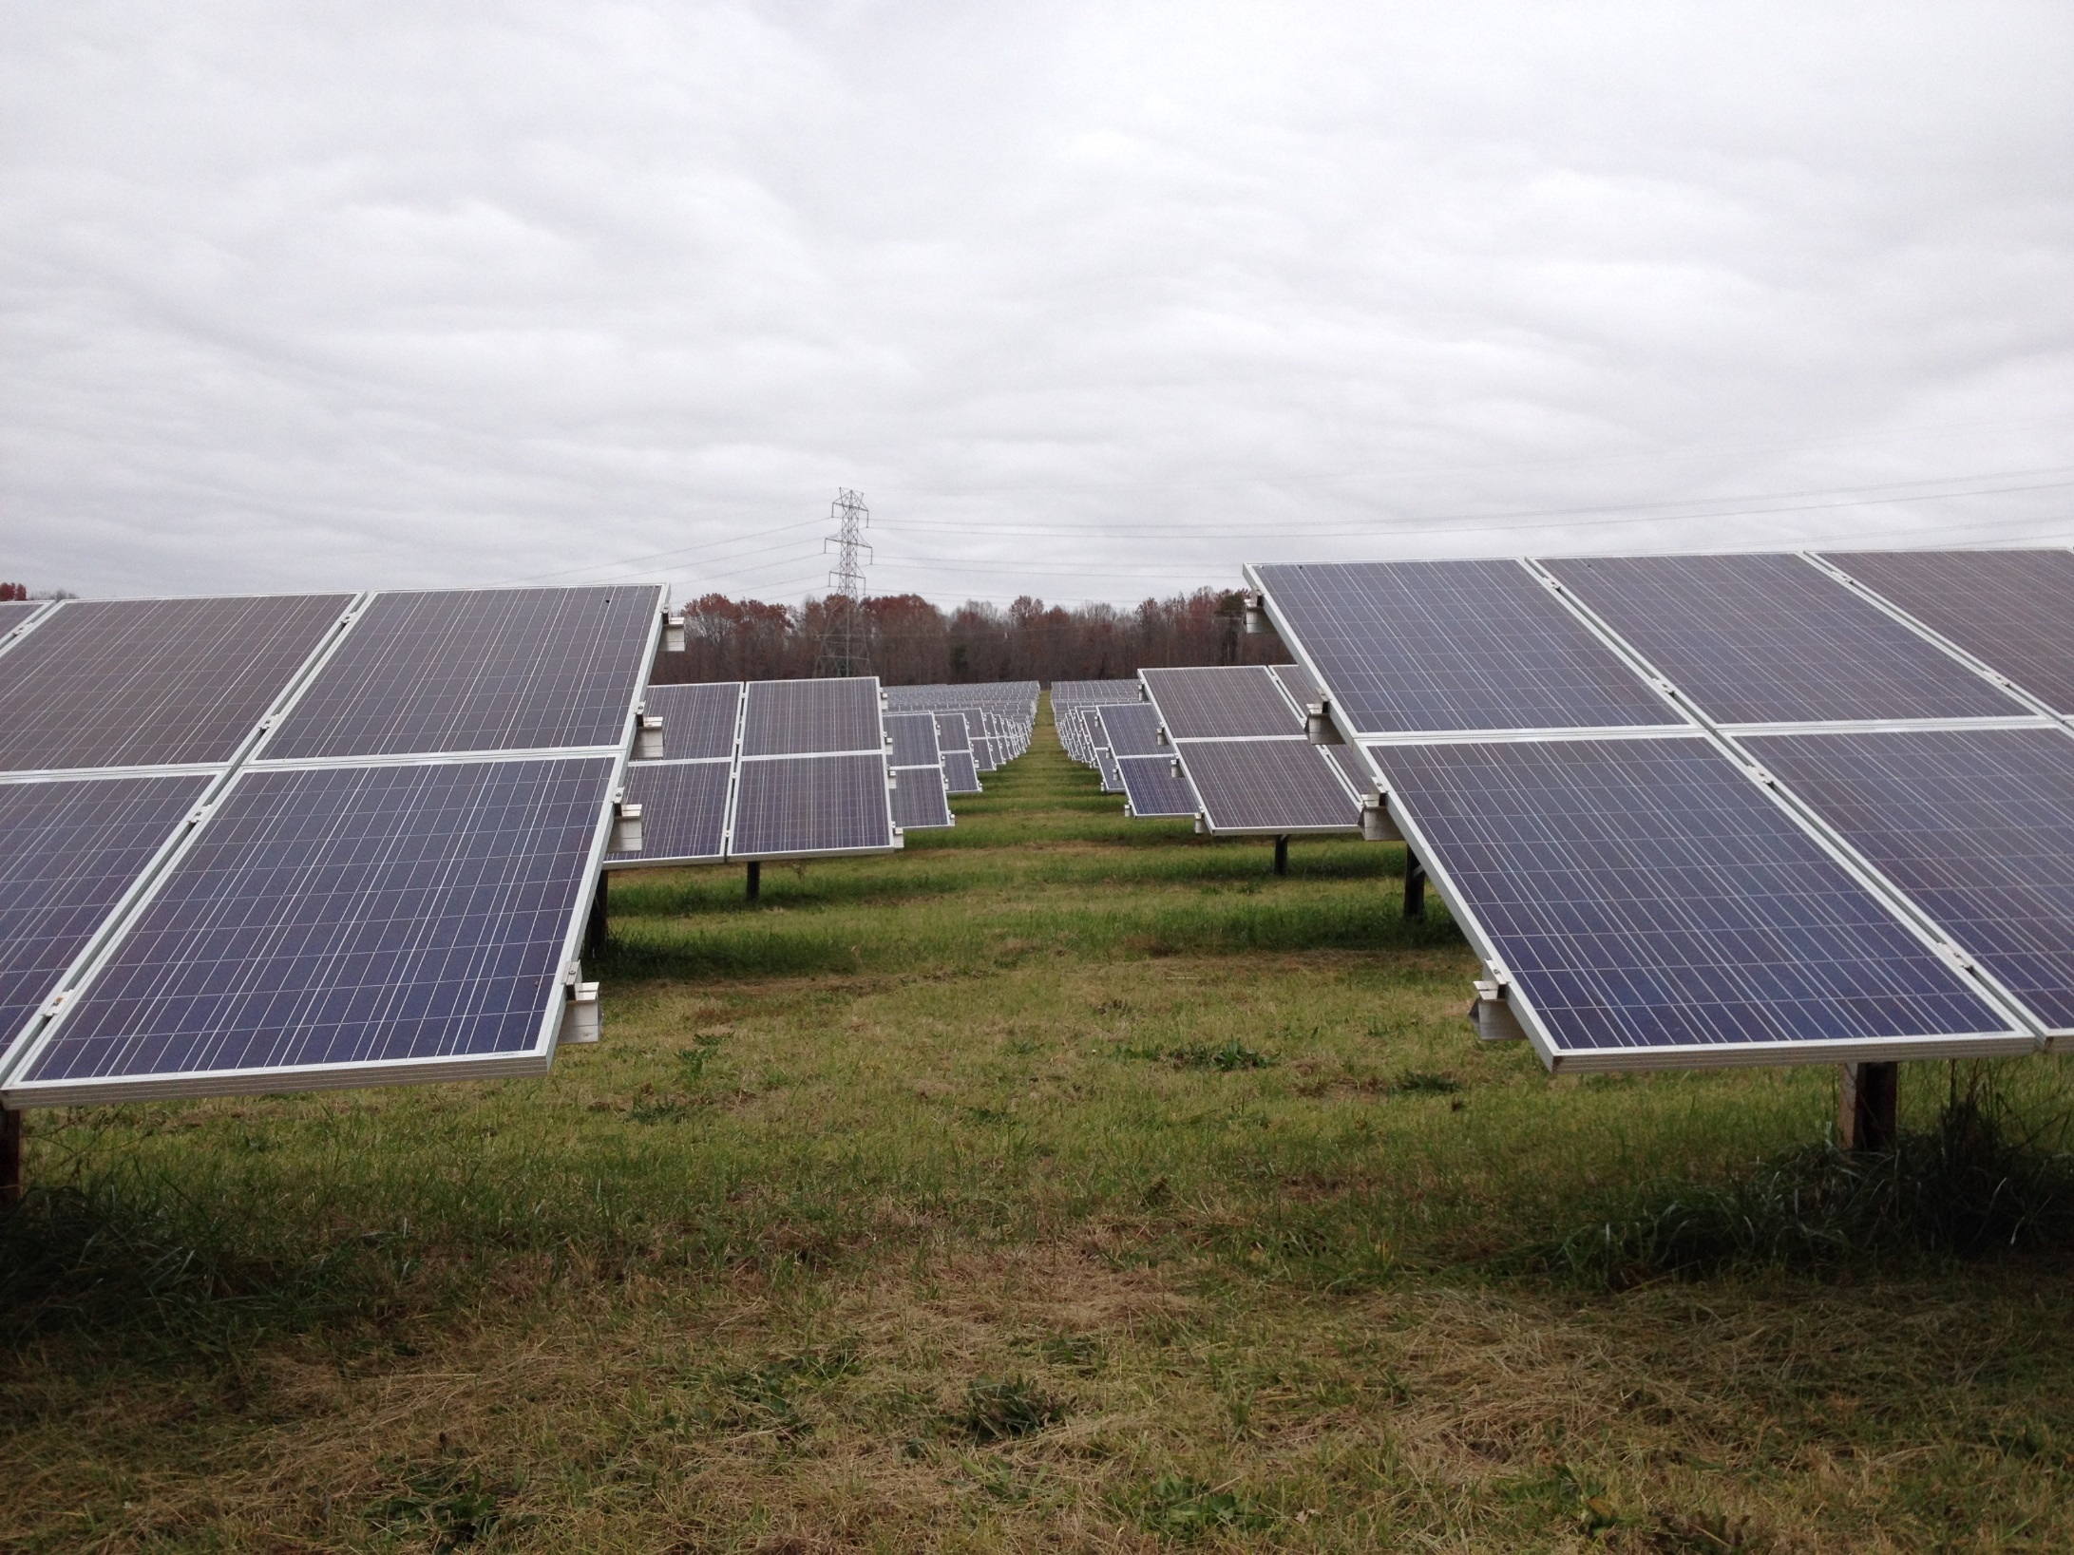
Notes:
Income for land owners Two Lines Farm

Slide 22
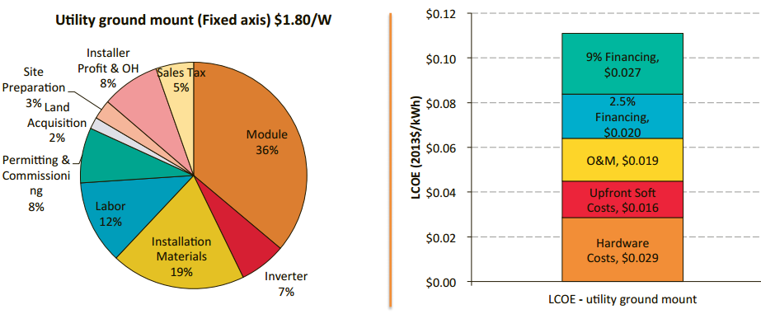


Sources of Utility-Scale PV Costs – LCOE vs. Upfront Costs
Notes:
SunShot $1.00/W goal
There are significant amount of hardware and business operations that contribute to the upfront cost of utility-scale PV
However, equally important to the competitiveness of PV is the cost of financing these systems
A required 9% rate of return represents 42% of the PV system’s LCOE
Reducing the financing costs to inflation would be the equivalent of cutting all hardware costs!
Talk through improvements – higher efficiency, longer life, faster install, less Si

Slide 23
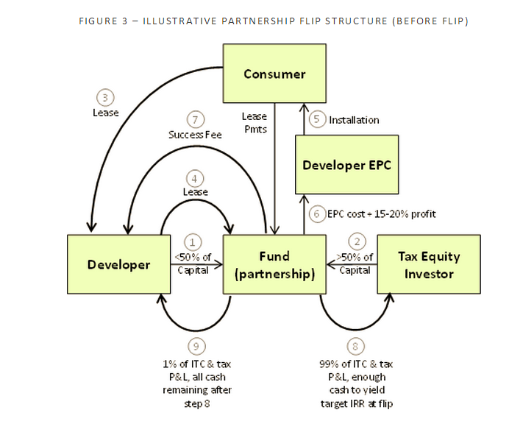

Slide 24
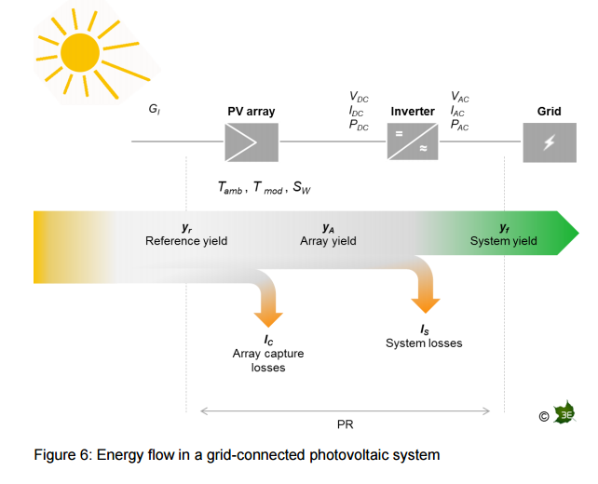

Slide 25
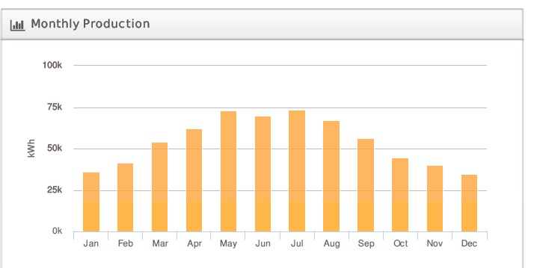

Slide 26
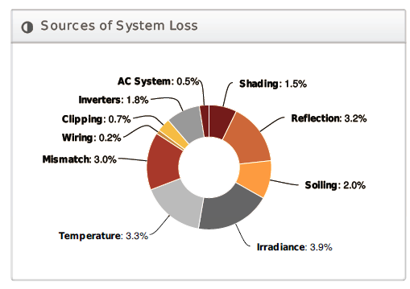

Slide 27
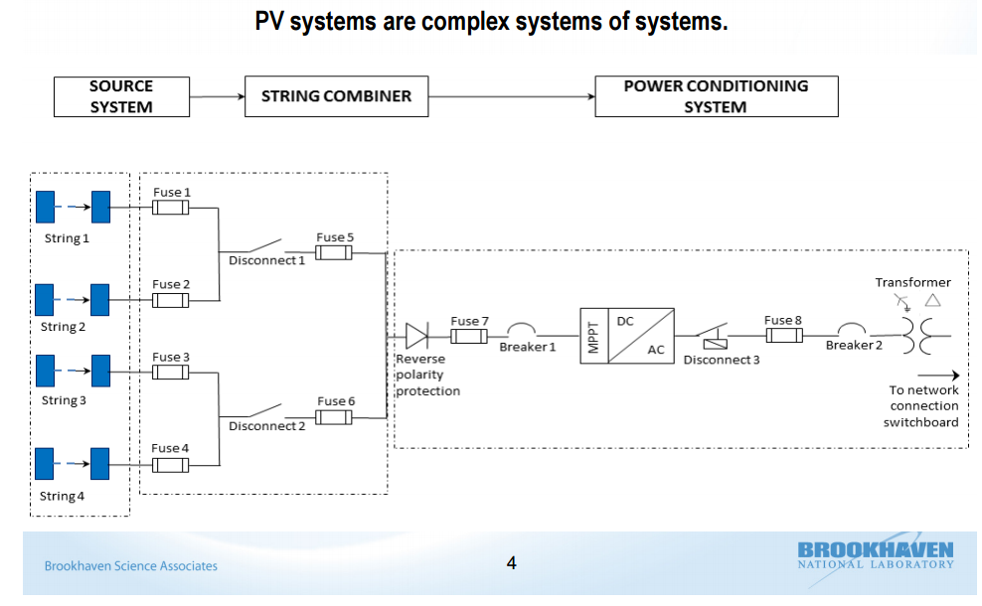
PV Systems are complex system of systems

Slide 28
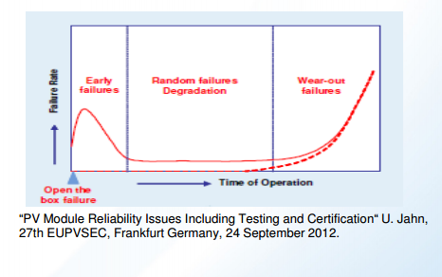
(Very Shallow) Bathtub Failures

Slide 29
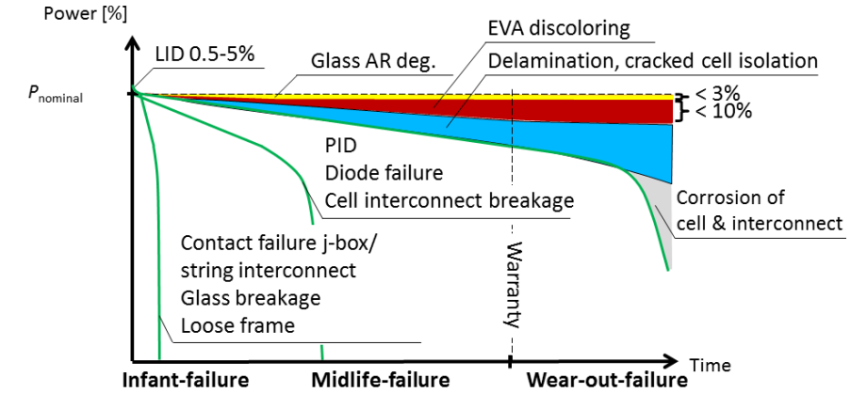
Module Degradation and Failures

Slide 30
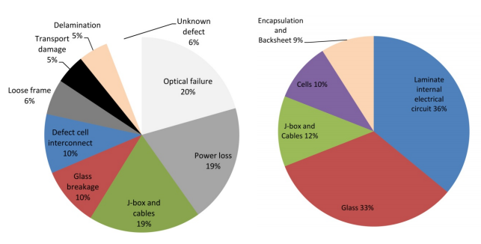
Module Failure rates due to customer complaints in the first two years after delivery
Module Failure rates due to customer complaints in the first two years after delivery
Notes:
Fig. 3.2: Failure rates due to customer complaints in the first two years after delivery. The rate is given relative to the total number of failures. The PV modules are delivered by a German distributor in the years 2006-2010 [redrawn from Richter11]. The statistic is based on a total volume of approximately 2 million delivered PV modules. Categories not found in other module failure statistics are drawn in grey scale.
Fig. 3.3: Field study of PV module failures found for various PV modules of 21 manufactures installed in the field for 8 years [redrawn from DeGraaff11]. The rate is given relative to the total number of failures. Approximately 2% of the entire fleet are predicted to fail after 11-12 years (do not meet the manufacturer's warranty).

Slide 31
Sources of under-performance
Shading
Soiling
Module mismatch
Module failures/degradation
Potential-induced degradation (PID)
Inverter failures
Fuse/breaker
Temperature impacts
Out of inverter voltage range
Clipping by inverter
Animals, extreme weather, lightning

