Slide 1
Cyber Theft – The Hidden Crime
Robert W. Carruth, CSP, ARM-P
Risk Control Manager
NCACC Risk Management Services

Slide 2
What This is All About:
Understanding Data Security in the Cyber-World
Reduce the Likelihood of a Data Breach
Prepare to Respond for WHEN it Happens
Insure Adequate Resources are Available

Slide 3
Memory Lane….

Slide 4
Now the World Has Access
Digital Age
Time & Space are Eliminated
How are Digital Networks and Data Secured
Same Basic Principals as Paper Data
Now The World Has Access

Slide 5
The Modern Computing Environment
Server
Desktop
Laptop
Tablet
Smartphone
Printer
Alarm Systems
VPN
Control Systems

Slide 6
But It’s Still the Same Data

Slide 7
So…
Its About Protecting the Data
Security Principles Remain the Same
Theft is Easier
Lots of Data = Lots of Value

Slide 8
In Other Words….
Anywhere personal information is collected and managed.

Slide 9
Types of Cyber Events
Inadvertent Disclosure
Loss of Device
Virus/Malware “Infection”
Disaster or Hardware Malfunction
Malicious Attack

Slide 10
Results of Cyber Attack
Compromise/Loss of Data
Destruction of Software
Denial of Service
“Snowball” Event
Credibility of Government is Damaged
Slowing of Automation of Processes

Slide 11
Target Breach
Over 70 Million Affected
Credit/Debit Card Data Compromised
Used a “Ram Scraper” to Collect Data
Malware was installed in transaction process
Origin was traced to HVAC Contractor using a Smart-Phone

Slide 12
OPM Breach
June 4, 2014
Over 4 Million Records Compromised
One of Several Cyber Events over 2 Year Period
Agency was Fully Compliant with Federal Guidelines

Slide 13
Lessons Learned – OPM Breach
Critical Infrastructure will be Attacked.
Used to compromise government personnel.
Conduct of reconnaissance and enumeration.
Compliance-based security strategies don’t work.
In-depth audits won’t help, either.
Given today’s operational realities, governments must rethink security standards.
Source: 12 Lessons For Security & Risk Pros From The
US OPM Breach, Forrester Research.

Slide 14
98% of All Data Breaches
Human Error
Insider Misuse
Malware & Viruses
Physical Theft & Loss

Slide 15
Sensitive Data
Social Security Numbers
Banking/Credit Card Data
Health Records
Personnel Records
Other Personal Identifying Information
“Harm” Threshold
Confidential Operations Documents

Slide 16
Vulnerable Areas
Board Clerk
Register of Deeds
Tax Administrator
Utilities
Human Services/Transportation
Health/EMS
Human Resources

Slide 17
Recommended Actions
Appoint a Chief Data Officer or Champion
Protect Data as Social Responsibility
Monitor for Data Access and Exfiltration
Use Encryption as Much as Possible
Develop Plans for How Data is Secured

Slide 18
Recommended Actions
Provide Employee-Centric Data Protection
Use Software to Monitor Behavior
Develop & Enforce Password Protocols
Routinely Purge Authorized User Lists
Monitor the Global Cyber Environment
Source: 12 Lessons For Security & Risk Pros From The
US OPM Breach, Forrester Research.

Slide 19
Tax Administrator
Maintains County’s Tax Records
Assesses New & Existing Property
Distributes Tax Notices
Receives Payments from Public

Slide 20
What Do I Need to Do?
Screen Records for Private Data
Segregate & Secure Consolidated Lists or Databases
Maintain Physical Security over Field Equipment
Protect & Secure Received Property Data
Review Release of Delinquent Tax Listings
Ensure Secure Credit/Debit Card Transactions

Slide 21
The Cyber Pyramid
Human Interface
Data Storage
Systems Security

Slide 22
System Security
Keep Systems Updated – Antivirus & Firewall
Address Access by Contractors & Visitors
Map Your System – Chart Data Flow
Monitor Systems Activity 24/7
Separate Network Servers
Back-up Data Daily Offsite

Slide 23
Data Storage
Use Vendor for Credit Card Payments
Compartment Sensitive Data
Get Rid of What you Don’t Need
Identify What Data is Actually Needed
Move Archives out of Network
Purge Users Periodically
Limit Storage on Mobile Devices
Limit Access to Sensitive Data

Slide 24
User Interface
Establish Social Networking Policy
Control Internet Access
Practice Good Physical Security
Limit Contractor Exposure
Have a Response Plan & Practice It
Educate Your Employees
Purge Users Periodically
Have a good Password Policy
Screen Before Posting or Releasing

Slide 25
New Concepts
The “Data Champion”
ID Protection as an Employee Benefit
External Response Contractor

Slide 26
Incident Preparedness and Response

Slide 27
Incident Key Elements
Response Team
Financial Planning
Response Plan

Slide 28
Response Team
Think Commandos Not Battalions
Ability to move quickly
Integral positions
Administration
Entity Attorney
IT
Department Heads where Data is stored
Ability to reach out to Board and additional staff as needed

Slide 29
Response Team
Data Breach Expertise
Internal?
External?
Multi-jurisdictional Regulatory Experience
Type of Data Influence
PII
PCI
PHI

Slide 30
Financial Planning
What is my potential exposure?
Investigation expenses
Notification and assistance expenses
Regulatory expenses
Liability claims and defense cost
Potential exposure dependent on type of information compromised
Various information (PII, PCI, PHI) - fund to greatest exposure
Fund for single or multiple events?

Slide 31
Financial Planning
Internal Funding
General funds
Separate claims fund
Incorporate in Risk Management fund
External Funding – Insurance
Confirm coverage for main loss exposures
Expert assistance?
Risk Control?
Deductibles and potential exclusions

Slide 32
Financial Planning
Cost Example – 1000 records compromised
PII: $735,745 $736 per record
PCI: $682,575 $683 per record
PHI: $1,017,615 $1,018 per record
Includes forensics, notifications, regulatory, liability claims and defense

Slide 33
Response Plan
Flexibility: Remember Commandos!
Don’t Assume! Investigate to uncover the cause of the breach. Did an actual legal breach occur?
Expert takes point
Communications
Internal
External: Designate a spokesperson(s)
Acknowledgement
Action Plan
Empathy

Slide 34
Response Plan
Monitor action plan and make adjustments as needed
Wrap-up Review
Lessons learned
System or operational changes
Tie back to proactive risk control

Slide 35
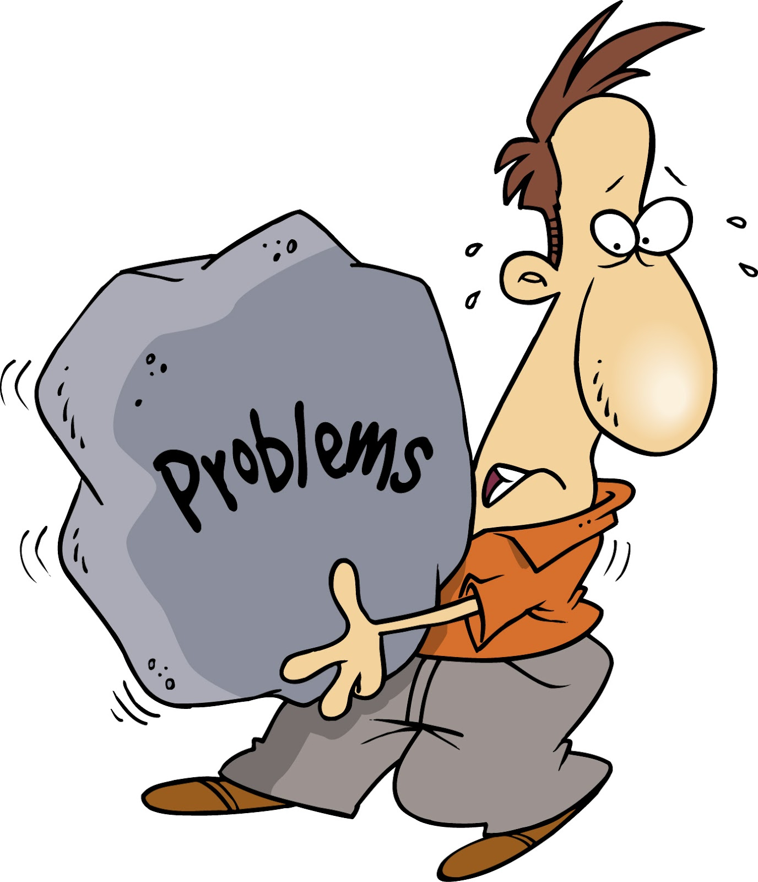
Actual Cyber Event
True story illustration

Slide 36
Questions? Comments?
Bob Carruth: bob.carruth@ncacc.org

