Slide 1
North Carolina Railroad Company
A Presentation to the
North Carolina Department of Revenue
2015 Advanced Real Property Seminar
September 30, 2015
-----------
Railroad Right-of-Way
Issues
Chuck Burnell, V.P. – Real Estate
North Carolina Railroad Company

Slide 2
North Carolina Railroad Company
NCRR’s Mission
To develop the unique North Carolina Railroad assets for the good of the people of North Carolinas.
Develop: Enhancements to assets through partner relationships and capital investments
Unique: Oldest private entity owned by North Carolina managing the corridor specified for railroad
Assets: The 317-mile corridor and other properties under our stewardship
Good: Economic and public enhancements
People: We balance agendas to ensure that all decisions are made in the best interests of the citizens of North Carolina
2

Slide 3
NCRR Facts
NCRR chartered in 1849 to transform the “Rip Van Winkle State”
223-mile railroad was North Carolina’s longest railroad (Charlotte to Goldsboro)
Immediately North Carolina’s largest business corporation 75% State funded at inception
Various operators until leased to Southern Railway in 1895
3

Slide 4
NCRR Facts
NCRR chartered in 1849 to transform the “Rip Van Winkle State”
223-mile railroad was North Carolina’s longest railroad (Charlotte to Goldsboro)
Immediately North Carolina’s largest business corporation 75% State funded at inception
Various operators until leased to Southern Railway in 1895
Atlantic & North Carolina Railroad (A&NCRR) chartered in 1854
96-mile railroad from Goldsboro to Morehead City
Various operators until leased to Southern Railway in 1930s
4

Slide 5
NCRR Facts
NCRR chartered in 1849 to transform the “Rip Van Winkle State”
223-mile railroad was North Carolina’s longest railroad (Charlotte to Goldsboro)
Immediately North Carolina’s largest business corporation 75% State funded at inception
Various operators until leased to Southern Railway in 1895
Atlantic & North Carolina Railroad (A&NCRR) chartered in 1854
96-mile railroad from Goldsboro to Morehead City
Various operators until leased to Southern Railway in 1930s
NCRR and A&NCRR merged in 1989
317 miles (200’ wide) from Morehead City to Charlotte
5

Slide 6
NCRR Facts
NCRR chartered in 1849 to transform the “Rip Van Winkle State”
223-mile railroad was North Carolina’s longest railroad (Charlotte to Goldsboro)
Immediately North Carolina’s largest business corporation 75% State funded at inception
Various operators until leased to Southern Railway in 1895
Atlantic & North Carolina Railroad (A&NCRR) chartered in 1854
96-mile railroad from Goldsboro to Morehead City
Various operators until leased to Southern Railway in 1930s
NCRR and A&NCRR merged in 1989
317 miles (200’ wide) from Morehead City to Charlotte
NCRR becomes a private company in 1998
State of North Carolina purchases remaining voting stock
6

Slide 7
NCRR Facts
NCRR chartered in 1849 to transform the “Rip Van Winkle State”
223-mile railroad was North Carolina’s longest railroad (Charlotte to Goldsboro)
Immediately North Carolina’s largest business corporation 75% State funded at inception
Various operators until leased to Southern Railway in 1895
Atlantic & North Carolina Railroad (A&NCRR) chartered in 1854
96-mile railroad from Goldsboro to Morehead City
Various operators until leased to Southern Railway in 1930s
NCRR and A&NCRR merged in 1989
317 miles (200’ wide) from Morehead City to Charlotte
NCRR becomes a private company in 1998
State of North Carolina purchases remaining voting stock
In 1999, NCRR
Negotiated new agreement with Norfolk Southern (Southern Railway)
Retained authority over the real estate to manage the rail corridor
7

Slide 8
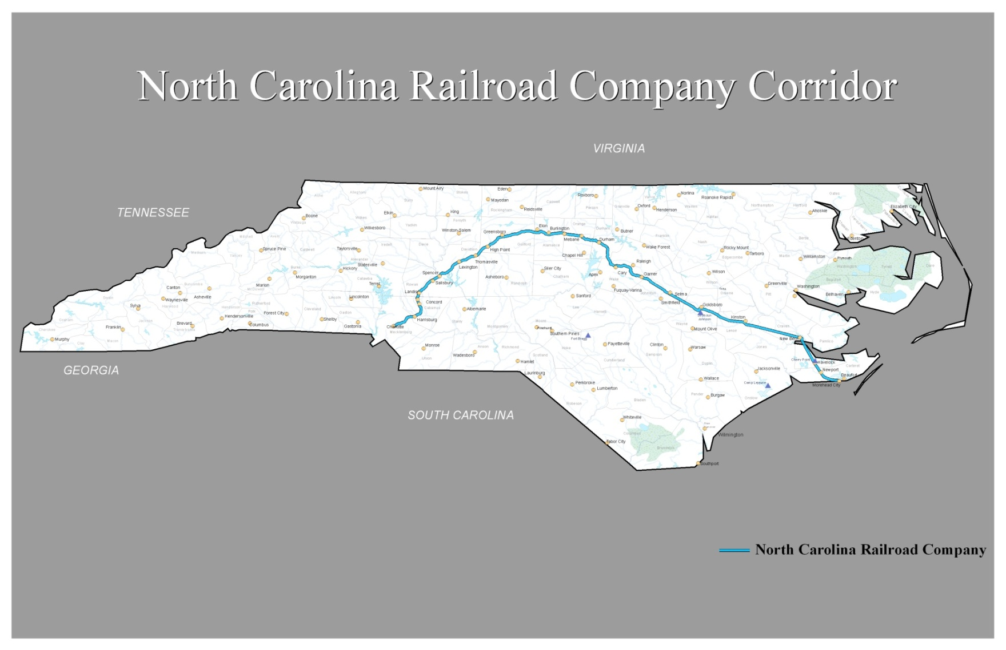
NCRR Route Map
8
Notes:
NCRR was established by the state in order to bring people and goods into the state. Runs through cities: New Bern, Kinston, Goldsboro, Selma, Raleigh, Durham, Burlington, Greensboro, Lexington, Salisbury, Concord, Charlotte.

Slide 9
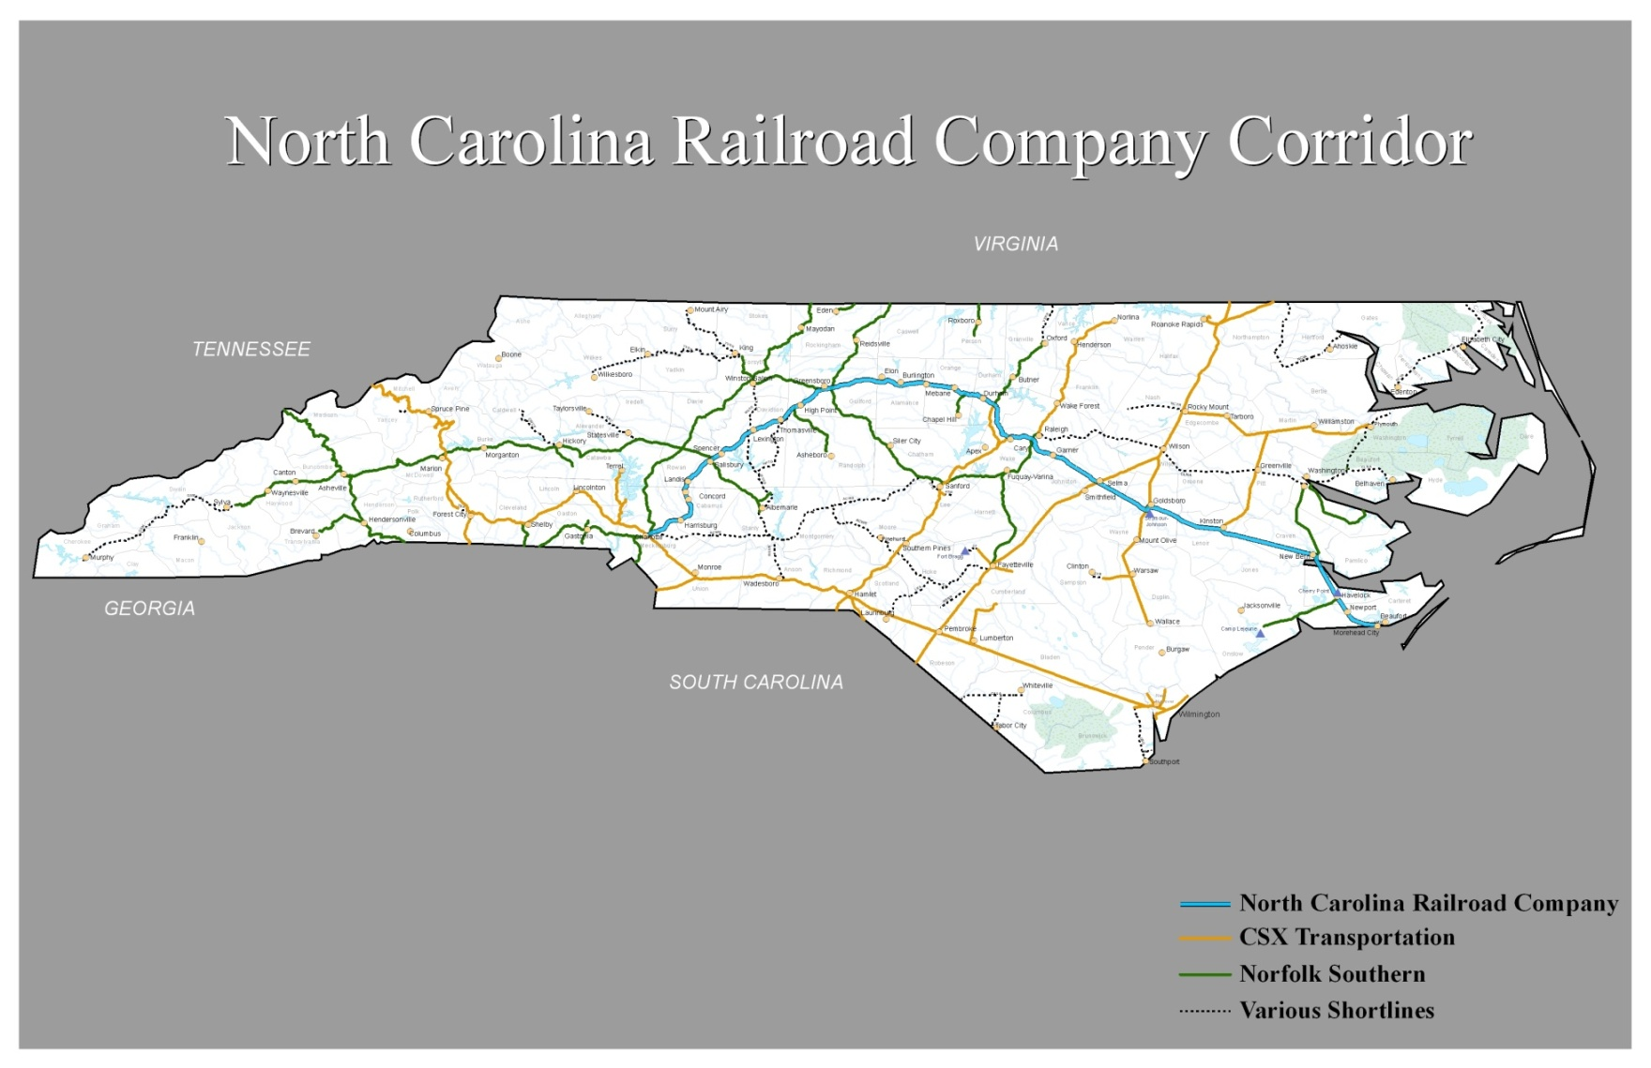
NCRR Route Map
9
Notes:
NCRR was established by the state in order to bring people and goods into the state. Runs through cities: New Bern, Kinston, Goldsboro, Selma, Raleigh, Durham, Burlington, Greensboro, Lexington, Salisbury, Concord, Charlotte.

Slide 10
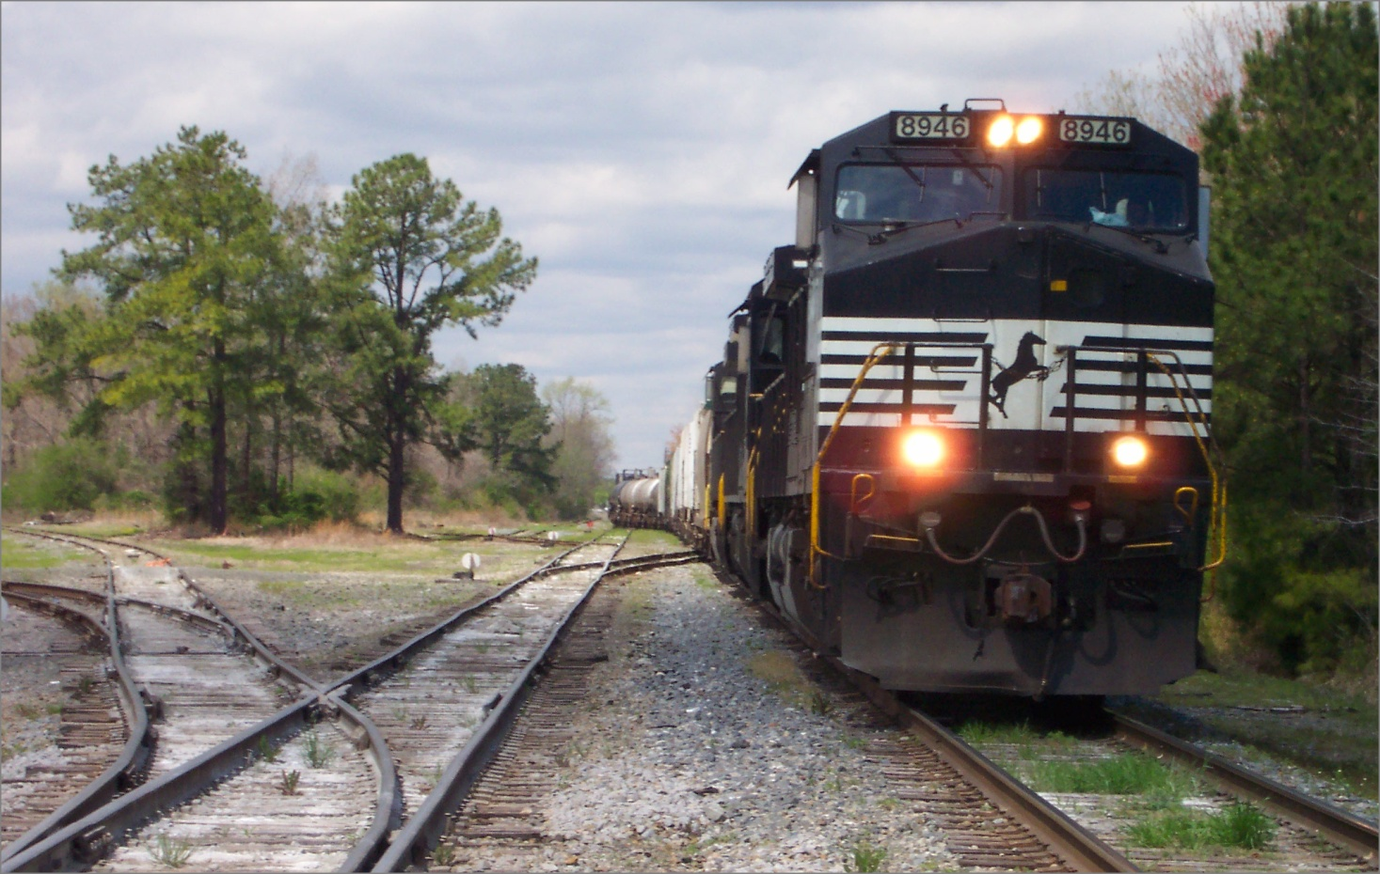
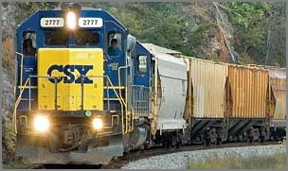
NCRR Transportation Corridor
Corridor Operators on the NCRR Corridor
10

Slide 11
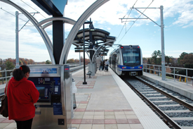
NCRR Transportation Corridor
Corridor Operators on the NCRR Corridor
11

Slide 12
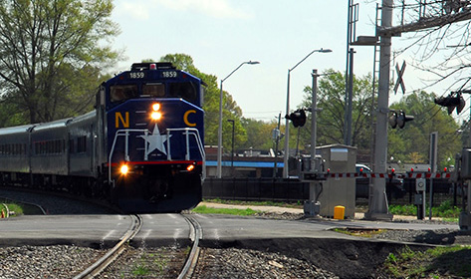
NCRR Transportation Corridor
Corridor Operators on the NCRR Corridor
12

Slide 13
NCRR Corridor & Third Parties
How does a Railroad Right-of-Way impact use of land by Third Parties adjoining the Railroad Right-of-way?
13

Slide 14
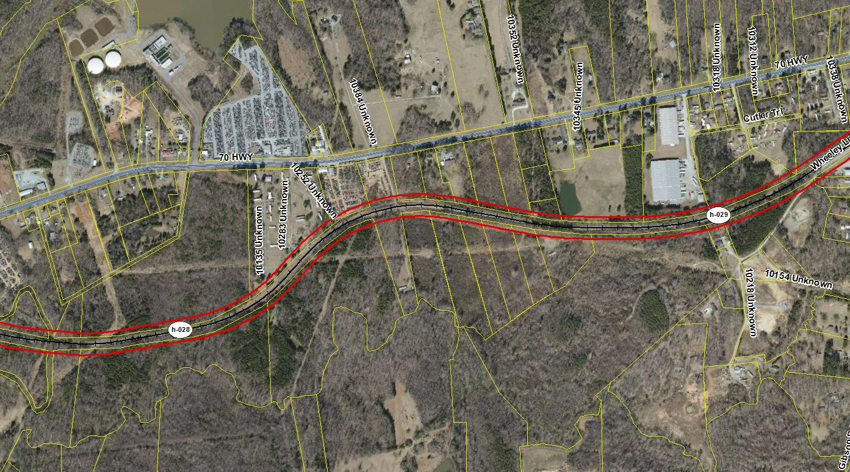
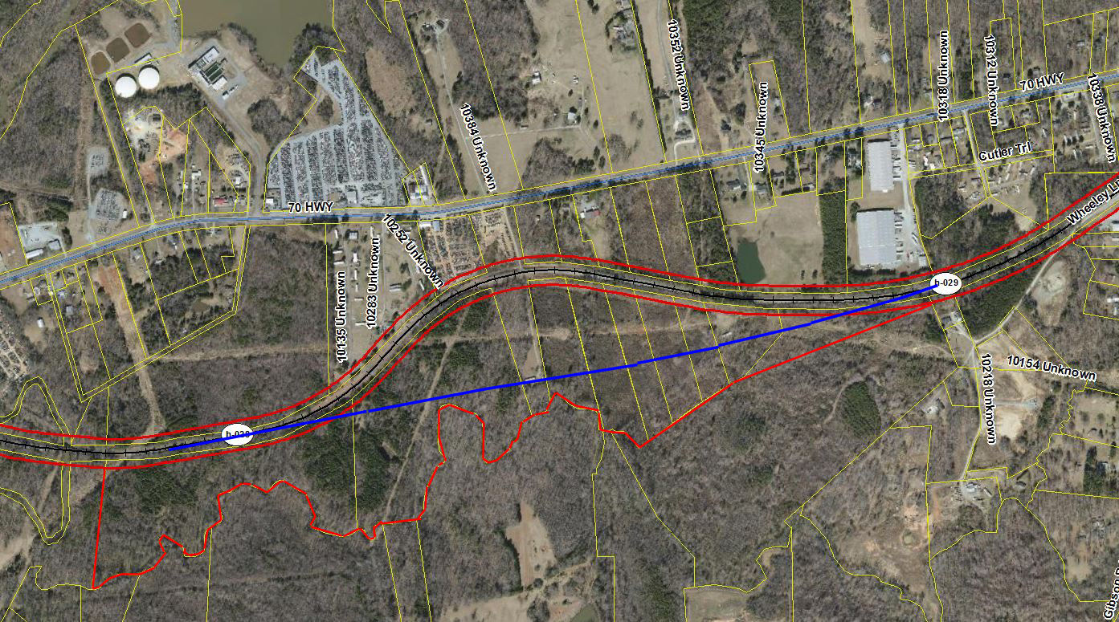
NCRR Corridor & Third Parties
How does a Railroad Right-of-Way impact use of land by Third Parties adjoining the Railroad Right-of-way?
Why are Railroad Rights-of-Way located where they are?
14

Slide 15
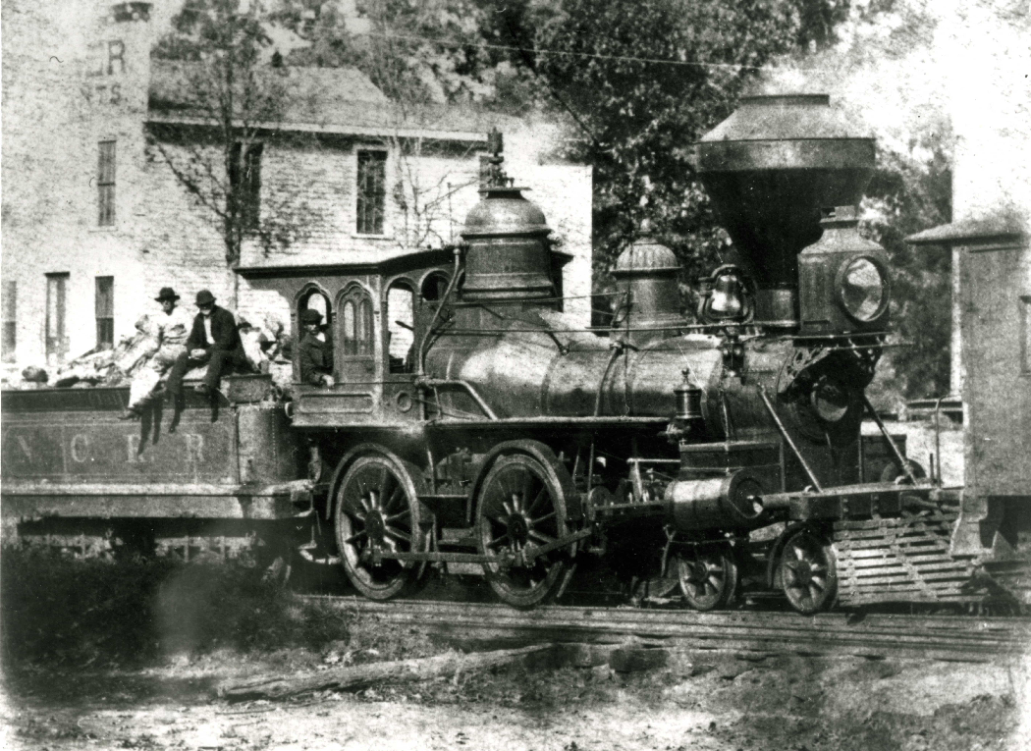
NCRR Corridor & Third Parties
How does a Railroad Right-of-Way impact use of land by Third Parties adjoining the Railroad Right-of-way?
Why are Railroad Rights-of-Way located where they are?
Why does Railroad Rights-of-Way vary in width?
15

Slide 16
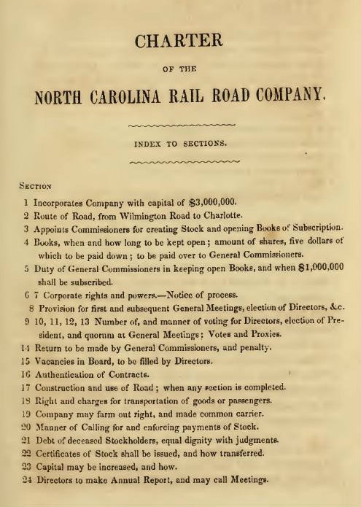
NCRR Corridor & Third Parties
How does a Railroad Right-of-Way impact use of land by Third Parties adjoining the Railroad Right-of-way?
Why are Railroad Rights-of-Way located where they are?
Why does Railroad Rights-of-Way vary in width?
How did NCRR acquire the Rail Corridor?
16

Slide 17
NCRR Corridor Ownership
How did NCRR acquire the Rail Corridor?
Prescribed in 1849 (NCRR) / 1852 (A&NCRR) Charters
17

Slide 18
NCRR Corridor Ownership
How did NCRR acquire the Rail Corridor?
Prescribed in 1849 (NCRR) / 1852 (A&NCRR) Charters
State Grant where no previous grant was issued:
"That all lands not heretofore granted to any person nor appropriated by law to the use of the State, within one hundred feet of the centre of said road which may be constructed by the said company, shall vest in the company as soon as the line of the road is definitely laid out through it, and any grant of said land thereafter shall be void." (Section 30)
18

Slide 19
NCRR Corridor Ownership
How did NCRR acquire the Rail Corridor?
Prescribed in 1849 (NCRR) / 1852 (A&NCRR) Charters
State Grant where no previous grant was issued.
Landowner agreed to convey:
"...company may purchase, have and hold, in fee, or for a term of years, any land ... which may be necessary for the said road, or the appurtenances thereof...for effecting transportation thereon...." (Section 25)
19

Slide 20
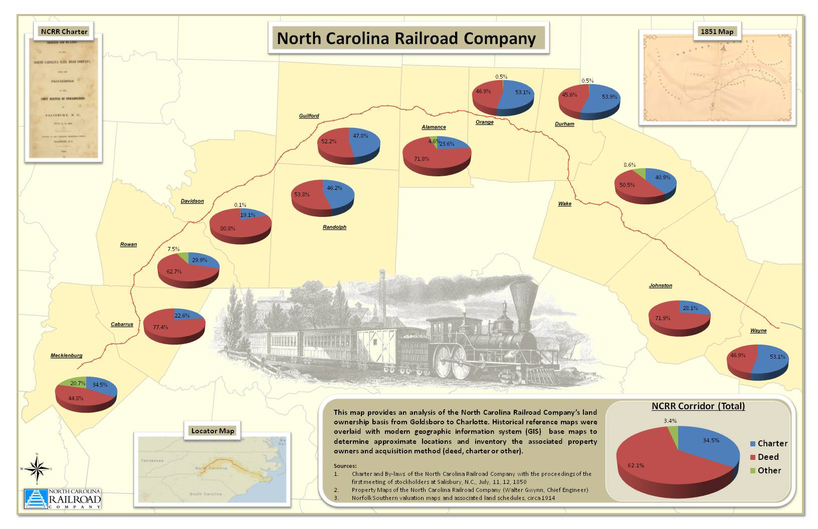
NCRR Corridor Ownership
How did NCRR acquire the Rail Corridor?
20

Slide 21
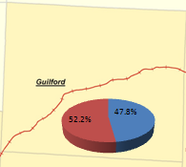
NCRR Corridor Ownership
How did NCRR acquire the Rail Corridor?
21

Slide 22
NCRR Corridor Ownership
How did NCRR acquire the Rail Corridor?
Prescribed in 1849 (NCRR) / 1852 (A&NCRR) Charters
State Grant where no previous grant was issued.
Landowner agreed to convey.
If Landowner did not (or could not) agree to convey, NCRR authorized to condemn (landowner retained right of reverter, a future right):
22

Slide 23
NCRR Corridor Ownership
How did NCRR acquire the Rail Corridor?
"...when land or right of way may be required...and for the want of agreement as to the value thereof, or from any other cause...the same may be taken at a valuation to be made by five commissioners...to be appointed by any court of record…the said commissioners shall take into consideration the loss or damage which may accrue to the owner or owners in consequence of the land or the right-of-way being surrendered, and the benefit and advantage he, she or they may receive from the erection or establishment of the railroad...provided…any person…dissatisfied with the valuation…may have an appeal to the Superior Court…
23

Slide 24
NCRR Corridor Ownership
How did NCRR acquire the Rail Corridor?
(t)he proceedings of the said commissioners, accompanied with a full description of the said land…shall be returned…to the court from which the commission issued, there to remain a matter of record…(a)nd the lands or right of way so valued...shall vest in the said company so long as the same shall be used for the purposes of said rail road…” (Section 27); and
24

Slide 25
NCRR Corridor Ownership
How did NCRR acquire the Rail Corridor?
“That the right of said company to condemn lands ... shall extend to the condemning one hundred feet on each side of the main track of the road, measuring from the centre of the same... and the company shall also have power to condemn any appropriate lands in like manner...for the constructing and building of depots, shops, warehouses [etc]...not exceeding two acres in any one lot or station.” (Section 28)
25

Slide 26
NCRR Corridor Ownership
How did NCRR acquire the Rail Corridor?
Prescribed in 1849 (NCRR) / 1852 (A&NCRR) Charters
State Grant where no previous grant was issued.
Landowner agreed to convey.
If Landowner did not (or could not) agree to convey, authorized to condemn (landowner retains reversion):
4. If Landowner made a claim for compensation (appealed the report of the commissioners), no reverter rights exist:
26

Slide 27
NCRR Corridor Ownership
How did NCRR acquire the Rail Corridor?
"...in the absence of any contract ... signed by the owner...which may be confirmed by the owner thereof, it shall be presumed that the land upon which the said road or any of its branches may be constructed, together with the space of one hundred feet on each side of the centre of the said road, has been granted to the said company by the owner or owners thereof...the said company shall have good right and title thereto, and shall have, hold and enjoy the same as long as the same be used for the purposes of said road, and no longer, unless the person ... owning the said land...shall apply for an assessment of the value of said lands…within two years next after that part of the road…was finished." (Section 29)
27

Slide 28
NCRR Corridor Ownership
How did NCRR acquire the Rail Corridor?
To Summarize, ownership may be by:
State Grant
Written Document:
Warranty Deed
Deed in Lieu of Condemnation (may be Fee Simple Determinable)
Deed of Easement
3. Proceedings of Condemnation (Fee Simple Determinable)
4. Proceedings for Assessment of Value (post-construction).
28

Slide 29
NCRR Corridor & Third Parties
How does a Railroad Right-of-Way impact use of land by Third Parties adjoining the Railroad Right-of-way?
Why are Railroad Rights-of-Way located where they are?
Why does Railroad Rights-of-Way vary in width?
How did NCRR acquire the Rail Corridor?
What is “Fee Simple Determinable”?
29

Slide 30
NCRR Corridor & Third Parties
How does a Railroad Right-of-Way impact use of land by Third Parties adjoining the Railroad Right-of-way?
Why are Railroad Rights-of-Way located where they are?
Why does Railroad Rights-of-Way vary in width?
How did NCRR acquire the Rail Corridor?
What is “Fee Simple Determinable”?
A fee simple determinable is an estate that will end automatically when the stated event or condition occurs. The interest will revert to the grantor or the heirs of the grantor. A life estate is an example of a fee simple determinable. Ownership transfers to the remainderman when the life estate holder dies.
30

Slide 31
NCRR Corridor & Third Parties
How does a Railroad Right-of-Way impact use of land by Third Parties adjoining the Railroad Right-of-way?
Why are Railroad Rights-of-Way located where they are?
Why does Railroad Rights-of-Way vary in width?
How did NCRR acquire the Rail Corridor?
What is “Fee Simple Determinable”?
What is the “red flag” that a present-day conveyance of land adjacent to the Railroad Right-of-Way includes a portion of the Railroad Right-of-Way?
31

Slide 32
NCRR Corridor & Third Parties
How does a Railroad Right-of-Way impact use of land by Third Parties adjoining the Railroad Right-of-way?
Why are Railroad Rights-of-Way located where they are?
Why does Railroad Rights-of-Way vary in width?
How did NCRR acquire the Rail Corridor?
What is “Fee Simple Determinable”?
What is the “red flag” that a present-day conveyance of land adjacent to the Railroad Right-of-Way includes a portion of the Railroad Right-of-Way?
Deed includes reservation: “Subject to the rights of the railroad”. Research is needed to understand the nature of the rights owned by the railroad.
32

Slide 33
NCRR Corridor & Third Parties
How does a Railroad Right-of-Way impact use of land by Third Parties adjoining the Railroad Right-of-way?
What is transferred from Seller to Buyer when the Railroad Right-of-Way is included within the metes and bounds description of a deed?
On the NCRR, it is highly likely that they have no current ownership, but only a future right is transferred that is dependent on NCRR no longer using Railroad Right-of-Way for railroad purposes.
33

Slide 34
NCRR Corridor & Third Parties
How does a Railroad Right-of-Way impact use of land by Third Parties adjoining the Railroad Right-of-way?
What is transferred from Seller to Buyer when the Railroad Right-of-Way is included within the metes and bounds description of a deed?
On the NCRR, it is highly likely that they have no current ownership, but only a future right is transferred that is dependent on NCRR no longer using Railroad Right-of-Way for railroad purposes.
The possibility of reverter (a future right) is created by the Fee Simple Determinate and is transferred to the Buyer.
34

Slide 35
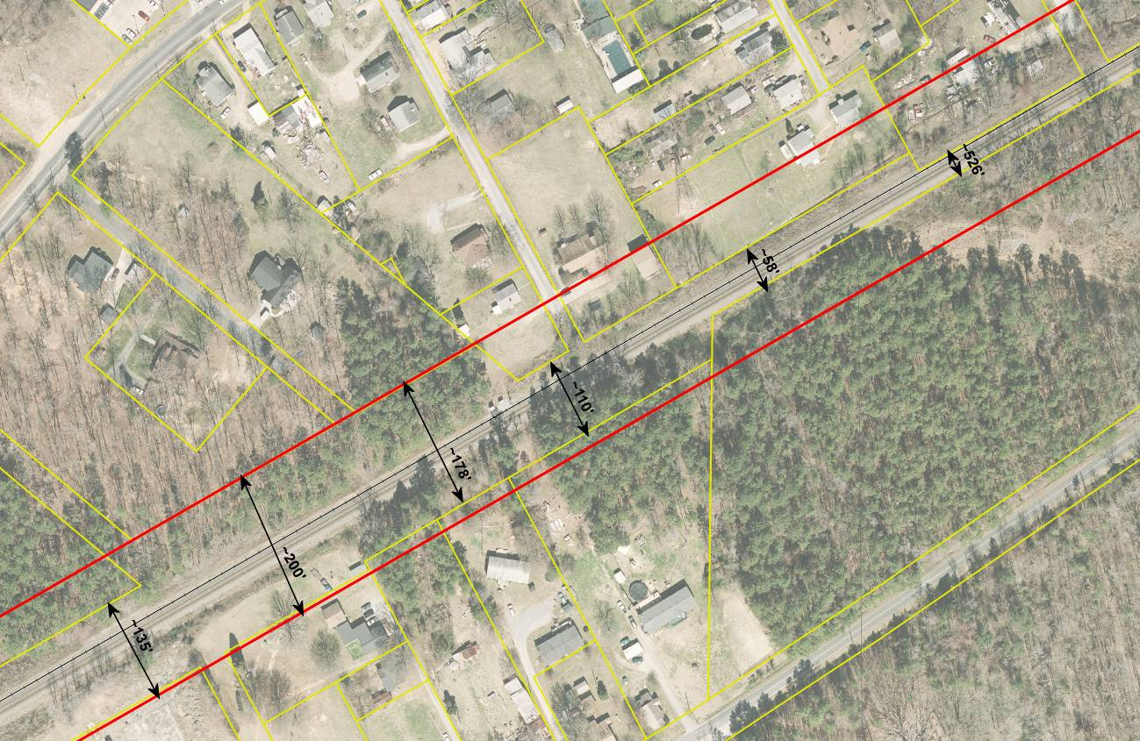
NCRR Corridor & Third Parties
35

Slide 36
NCRR Corridor & Third Parties
How does a Railroad Right-of-Way impact use of land by Third Parties adjoining the Railroad Right-of-way?
What is transferred from Seller to Buyer when the Railroad Right-of-Way is included within the metes and bounds description of a deed?
What are the unintended consequences to adjacent landowners of not properly documenting a fee simple determinant in the public records?
36

Slide 37
NCRR Corridor & Third Parties
What are the unintended consequences to adjacent landowners of not properly documenting a fee simple determinant in the public records?
Structures and Improvements located within the Railroad Right-of-Way can be removed by the Railroad without compensation on short notice.
37

Slide 38
NCRR Corridor & Third Parties
What are the unintended consequences to adjacent landowners of not properly documenting a fee simple determinant in the public records?
Structures and Improvements located within the Railroad Right-of-Way can be removed by the Railroad without compensation on short notice.
An improvement thought to be an appurtenance to the property, such as driveway access, could be removed by the Railroad without compensation on short notice.
38

Slide 39
NCRR Corridor & Third Parties
What are the unintended consequences to adjacent landowners of not properly documenting a fee simple determinant in the public records?
Structures and Improvements located within the Railroad Right-of-Way can be removed by the Railroad without compensation on short notice.
An improvement thought to be an appurtenance to the property, such as driveway access, could be removed by the Railroad without compensation on short notice.
An improved piece of land that includes Railroad Right of Way could be unacceptable collateral for a long term mortgage.
39

Slide 40
NCRR Corridor & Third Parties
What are the unintended consequences to adjacent landowners of not properly documenting a fee simple determinant in the public records?
Structures and Improvements located within the Railroad Right-of-Way can be removed by the Railroad without compensation on short notice.
An improvement thought to be an appurtenance to the property, such as driveway access, could be removed by the Railroad without compensation on short notice.
An improved piece of land that includes Railroad Right of Way could be unacceptable collateral for a long term mortgage.
Taxes are assessed on a landowner that does not own the land, resulting in double taxation (see § 105-333(17) System Property).
40

Slide 41
NCRR Corridor & Third Parties
What are the unintended consequences to adjacent landowners of not properly documenting a fee simple determinant in the public records?
Loss of use of wells & septic tanks.
41

Slide 42
NCRR Corridor & Third Parties
What are the unintended consequences to adjacent landowners of not properly documenting a fee simple determinant in the public records?
Loss of use of wells & septic tanks.
Structures on Railroad Right of Way without an agreement with the railroad are personal property.
42

Slide 43
NCRR Corridor & Third Parties
What are the unintended consequences to adjacent landowners of not properly documenting a fee simple determinant in the public records?
Loss of use of wells & septic tanks
Structures on Railroad Right of Way without an agreement with the railroad are personal property.
If a landowner has an agreement with Railroad, the improvements may be based on a “leasehold” (but typically do not revert to the railroad and typically must be removed upon termination of the agreement).
43

Slide 44
NCRR Corridor & Third Parties
What are the unintended consequences to adjacent landowners of not properly documenting a fee simple determinant in the public records?
Loss of use of wells & septic tanks
Structures on Railroad Right of Way without an agreement with the railroad are personal property.
If a landowner has an agreement with Railroad, the improvements may be based on a “leasehold” (but typically do not revert to the railroad and typically must be removed upon termination of the agreement).
Use of the Railroad Right-of-Way by an adjoining landowner does not ripen into ownership by adverse possession as Railroads are exempt (NCGS § 1-44).
44

Slide 45
NCRR Corridor & Third Parties
How could County officials mitigate these unintended consequences?
45

Slide 46
NCRR Corridor & Third Parties
How could County officials mitigate these unintended consequences?
Assess value on only the improvements owned by Third Parties (as either personal property or leasehold real property) within the Railroad Right-of-Way, but not the land.
46

Slide 47
NCRR Corridor & Third Parties
How could County officials mitigate these unintended consequences?
Assess value on only the improvements owned by Third Parties (as either personal property or leasehold real property) within the Railroad Right-of-Way, but not the land.
Clearly document the land areas assessed (gross deeded acreage vs. net owned acreage) on tax card.
47

Slide 48
NCRR Corridor & Third Parties
How could County officials mitigate these unintended consequences?
Assess value on only the improvements owned by Third Parties (as either personal property or leasehold real property) within the Railroad Right-of-Way, but not the land.
Clearly document the land areas assessed (gross deeded acreage vs. net owned acreage) on tax card.
Do not issue permits for new structures, improvements, wells or septic tanks to be located in Railroad Rights-of-Way unless documented by an agreement with the Railroad.
48

Slide 49
Questions / Comments
Thank you for the Opportunity to Address the
North Carolina Department of Revenue
2015 Advanced Real Property Seminar
www.ncrr.com
©COPYRIGHT, 2015 by North Carolina Railroad Company. All rights reserved.
DISCLAIMER: This Presentation has been prepared by the North Carolina Railroad Company. It is designed to provide accurate information regarding the subject matter covered to the best of North Carolina Railroad Company’s professional skills and is provided with the understanding that North Carolina Railroad Company is not engaged in rendering legal, surveying or other professional advice. Under no circumstances shall the North Carolina Railroad Company be liable for any actions taken or omissions made from reliance on any information contained herein, nor shall the North Carolina Railroad Company be liable for any other consequences from any such reliance. Copying, distributing, re-creating, or any other unauthorized use of the content in these slides without the express written consent of the North Carolina Railroad Company is strictly prohibited.

