Slide 1
Tony Simpson, lgd - director
2019 Advanced Seminars – Legislative Update and Other Topics

Slide 2
Legislative Update
What has passed
H 492 Builder’s Inventory
Changed annual application to one-time application.

Slide 3
What didn’t or hasn’t passed yet
Changes to Veterans and Homestead Exclusions
H 695 – Increase exclusion amount
H 945 – Increase exclusion amount and expand
S 657 – Increase exclusion amounts and expand

Slide 4
What didn’t or hasn’t passed yet
H 692 – Changes to Circuit Breaker
Increases CB from 150% to 200%
Changes to age requirements

Slide 5
What didn’t or hasn’t passed yet
S 416 – Adding new exemption
Exempting 25% of fire fighters home value

Slide 6
What didn’t or hasn’t passed yet
S 578 – Exempting 80% of tangible personal property owned by a qualifying farmer

Slide 7
What didn’t or hasn’t passed yet
Present Use Value
S 663
H 855
H 970
Various changes from ownership requirements to acreage requirements

Slide 8
Doug Huffman Real Property manager
2019 Advanced Seminars

Slide 9
Real Property Section
Daily
Assist property owners and counties with property tax questions, statutory compliance, PTC appeals and calendars, etc.
Annually
Updating of Manuals and Forms
PUV Manual
PUV Course Material
Elderly/Disabled Income Limits (AV-9)
BoER Charges to County Boards and Staff
Tax Association Meetings

Slide 10
Real Property Section
Annually
Low Income Housing Tax Credit List of Qualifying Properties (LIHTC)
UVAB
Cash Rent Studies
Prepare and Distribute UVAB manual for County SOV
Reappraisal Standards
Notices/Request Sent
Random Sample
Sales Ratio Requirements for Standards
Reappraisal Plans

Slide 11
Real Property Section
Annually
Courses and Workshops
Tax Administration in NC
PUV Workshop
BoER Charges to County Boards and Staff
Tax Association Meetings
Various Other Groups on Request

Slide 12
Major Projects or Milestones
Completed
Assessor’s Initiative Waiting on Finalization and Approval of Assessor’s Handbook.
Future
Updating and Creation of Exemption and Exclusion Manual and Workshop
Manual to be completed soon
Reappraisal Workshop
Currently Working on this Project
Wish to Form Joint Committee
Interested in assisting or have suggestions????

Slide 13
Tina stone personal Property manager
2019 Advanced Seminars

Slide 14
Personal Property Section
Tina Stone, PPS, AAS,- Manager
Dave Duty
Travis Isaacs, PPS
Robin Rogers
Chelsie Cornelius, PPS
Guadalupe Salazar

Slide 15
Personal Property
Responsible for applying tax laws and regulations and resolving controversial issues that relate to the taxation of all Personal Property in North Carolina.
Include, but are not limited to, appraisal, assessment and collection problems.
Conduct research on proposed legislation and prepares or reviews all critiques, drafts, findings, and recommendations for the implementation of laws as they relate to the taxation of property Personal Property.
Provide assistance and direction to taxpayers, attorneys, accountants, county tax personnel, and other staff of the Department of Revenue.

Slide 16
Administration of personal property tax, legislative involvement
Review appeals and meet with taxpayers and counties
Prepare appraisal manuals and guides
Manage statewide vehicle system (Tag & Tax) & VTS Budget
Statewide Education and Training program

Slide 17
PP Section Responsibilities
NCDOR State BPP Listing Form
NCDOR Cost & Depreciation Tables
NCDOR Personal Property Course
Personal Property Appeals- BPP, Boats, MH, Vehicles, Penalty, etc
County Visits
Participate in Task Force Studies

Slide 18
Major Projects
Rewrite NCDOR PP Course
Rewrite Tax Admin Course
Valuation of Mobile Homes One Day workshop
Tag & Tax Hardware Upgrade
Others

Slide 19
George Hermane
2019 Advanced Seminars
Public Service Companies
& Information Unit

Slide 20
Public Service Companies
Annual appraisal of Public Service Companies
Total appraised value of 36.8 billion for the 2019/2020 Fiscal Year
Continuing Improvement Process

Slide 21
Public Service Companies
New Public Service Utility Analyst

Slide 22
Information Unit
Collection of data regarding local values and levies
Data reported on TR Reports is used for:
Distribution of sales tax to counties and municipalities
Statistical Reports – Values, Levies, Tax Rates, Local Tax
Policy making – General Assembly (PUV reporting)
Other programs - School funding, Tourism, etc.
TR Form Changes
NCVTS Reporting- Motor Vehicle Values & Levies

Slide 23
Mike Connolly Assistant Director
2019 Advanced Seminars

Slide 24
Certified Public Manager (CPM)
18 Month Program
Approximately 30 people across state agencies annually participate
Finishes with a project to benefit the Agency
Must have buy-in from Director (Tony Simpson)
Must develop a team to complete the project
Must have baseline data (potentially be able to show the benefit of the project)

Slide 25
CPM Project
How do we better prepare first-time assessors?

Slide 26
CPM Team
Tabitha Ashe – Jackson County new assessor
Chelsie Cornelius
George Hermane
Doug Huffman
Tina Stone
Wanda Whisnant

Slide 27
Baseline Data
Notes:
This showed us that almost half of our assessors have less than 6 year’s experience. 18 of them have served less than 2 years. Since this data has been published we have had at least 1 more, and there is currently 4 vacant assessor positions. Gaston, Pamlico, Harnett, Gates.

Slide 28
Baseline Data
Notes:
This shows that a large part of our assessors are coming in to the office with very little experience prior to taking their role.

Slide 29
Baseline Data
Likert Questions (1-5, with 5 Being the Highest) | Ranking (Assessors with less than 2 Years Experience) | Ranking (Assessors with more than 8 Years Experience)
Rank your knowledge of overseeing a reappraisal | 2.83 | 3.86
Rank you knowledge of Present-Use-Value | 2.83 | 3.72
Rank your knowledge of exemptions and exclusions | 3.17 | 3.97
Rank your knowledge of dealing with personal property | 2.94 | 3.94
Rank your knowledge of appraisals of vehicles and the VTS | 2.61 | 3.28
Notes:
This shows the level of confidence in overseeing the tax office increase by close to (1) base point for those with 8 or more years experience versus those with less than 2 years.

Slide 30
Big Question
Is there a better way to prepare the first time assessors so that they have the knowledge/confidence of a veteran assessor without having to serve for 8 -10+ years?
Can we speed up the learning curve?
Hopefully the first time assessor initiative will help…

Slide 31
CPM Plan
Develop an Assessor Handbook
(Done but going through final peer review)
Develop a Mentoring/Coaching team
(SOP’s are done, getting with the NCAAO Executive Board at the Fall Conference to discuss)
Develop an annual reception for First-Time Assessors at the DOR headquarter or some other location
(Looking to have the first one in December in Raleigh)

Slide 32
Assessor Handbook
It will be …
It will not be …
A quick reference guide
A digital document
For all assessors and appraisers
A replacement for the Machinery Act
A legal document

Slide 33
Mentor/Coach Team
Goal is to create a team of mentors
Still in the planning phase of this
Partner up with SOG and NCCCA

Slide 35
Assessor Handbook
Chapter 1 – Government Structure and Laws
Chapter 2 – Roles and Responsibilities of the Assessor
Chapter 3 – Tax Year
Chapter 4 – Property Appraisal and Assessment
Chapter 5 – Real Property
Chapter 6 – Land Records and GIS
Chapter 7 – Personal Property
Chapter 8 – Vehicle Tax System

Slide 36
Assessor Handbook
Chapter 9 – Discovered Property
Chapter 10 – Administrative Processes
Chapter 11 – Appeals
Chapter 12 – Refunds and Releases
Chapter 13 – Compliance Program
Chapter 14 – Collections
Chapter 15 – Education
Chapter 16 – Managing the Tax Office
Chapter 17 – Additional Resources

Slide 37
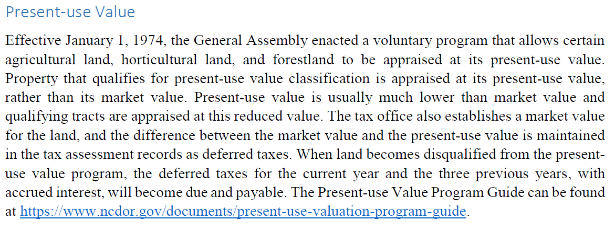
Assessor Handbook Snippet

Slide 38
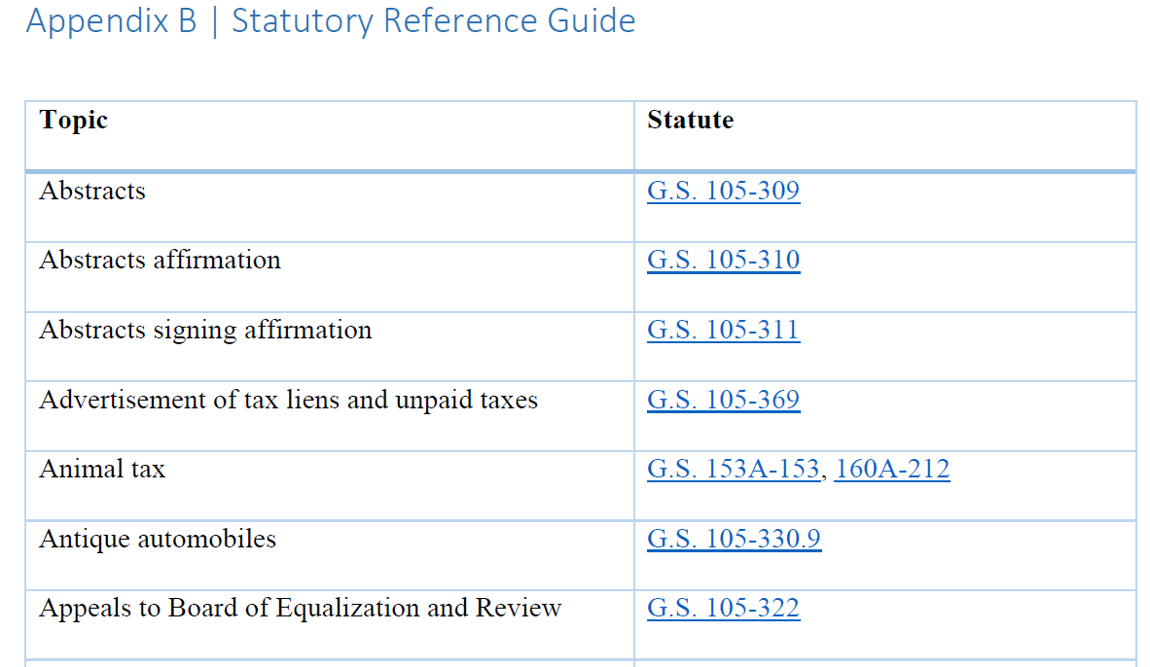
Assessor Handbook Snippet

