Slide 1

Timber Markets in North Carolina
Rajan Parajuli, Ph.D.
Assistant Professor & Extension Specialist
Department of Forestry and Environmental Resources
NORTH CAROLINA STATE UNIVERSITY

Slide 2
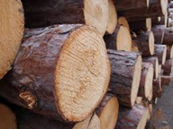
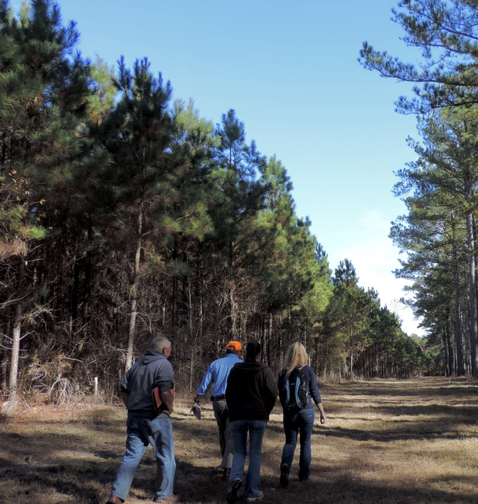
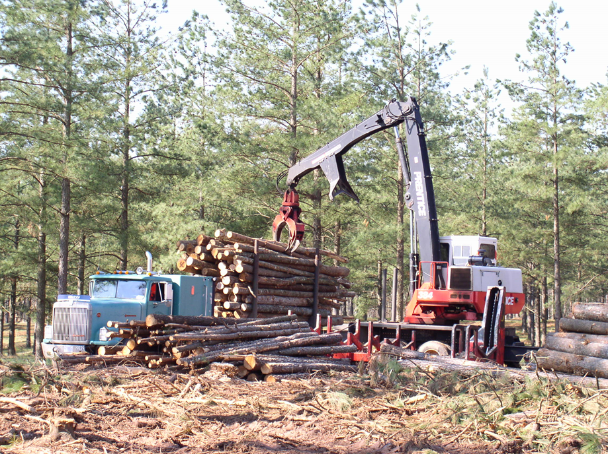
Outline
Forest resources in North Carolina
Economic contribution of the NC forest sector
Timber price trends
SRTS projections

Slide 3
Forest Resources in North Carolina
In 2018,
Total timberland area: 18.1 million acres
Loblolly pine: 4.95 million acres (~27%)
Only 17% of timberland is artificially regenerated.
Source: USDA FS FIA

Slide 5
Forest Resources in North Carolina
86% of timberland is privately-owned
Source: USDA FS FIA

Slide 6
Forest Resources in North Carolina
Net Merchantable volume: 42.25 billion cubic feet
 | Softwoods | Hardwoods | Total
Average annual net growth volume (million cu ft) | 918.5 | 752.5 | 1,670.96
Average annual removals (million cu ft) | 571.7 | 319.1 | 890.7
Growth to Drain Ratio | 1.61 | 2.36 | 1.88
Annual harvest is less than annual growth
Source: USDA FS FIA

Slide 7
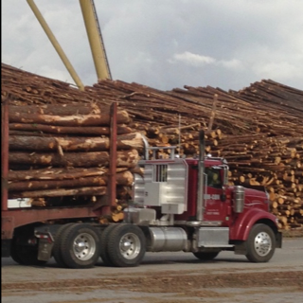
Timber Harvest Receipts in 2017
$467 million -stumpage value of timber harvest
$915 million the delivered value to mills.

Slide 8
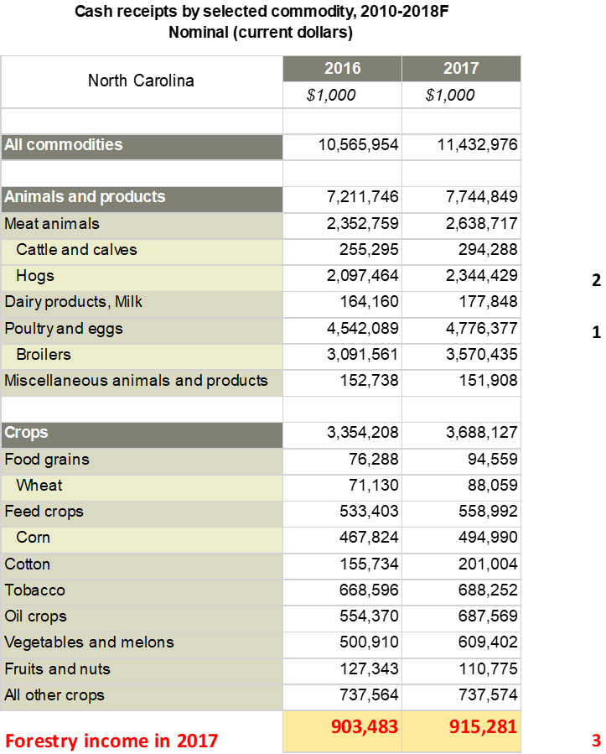
Timber Harvest Receipts in 2017
Timber was the largest among crops, and just behind Hogs and Broilers in NC.
USDA ERS

Slide 9
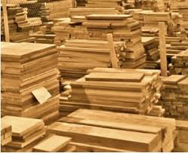
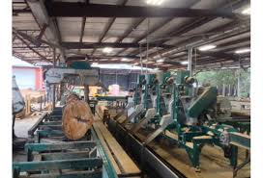
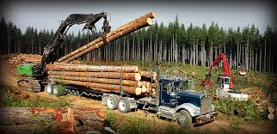
Economic Contribution of the NC Forest Sector in 2017
Including forestry, logging, and sawmills, furniture:
151,000 full- and part-time jobs
$8.2 billion in payrolls.
$32.75 billion in industry output

Slide 10
NC Forest Sector in 2017
 | Employment (jobs) |  | Labor Income (million $) | Gross State Product (million $) | Industry Output (million $)
Total Contribution
Forestry operations | 523 |  | 24.36 | 54.65 | 71.07
Logging | 8,113 |  | 363.54 | 458.08 | 710.16
Primary solid wood mills | 19,361 |  | 1,069.12 | 1,708.49 | 4,633.68
Secondary solid wood mills | 73,139 |  | 3,635.66 | 5,349.23 | 12,797.91
Primary paper and paperboard mills | 16,503 |  | 1,081.26 | 1,873.66 | 5,206.47
Secondary paper and paperboard mills | 33,343 |  | 2,007.03 | 3,298.76 | 9,331.54
Total | 150,983 |  | 8,180.96 | 12,742.87 | 32,750.83
Change in Total Contribution from 2016
Forestry operations | -3.8% | -12.3% |  | 62.5% | 23.4%
Logging | -2.0% | -10.7% |  | -9.2% | -19.4%
Primary solid wood mills | 3.4% | 8.1% |  | 1.2% | 5.2%
Secondary solid wood mills | -0.1% | 4.1% |  | 0.2% | -0.9%
Primary paper and paperboard mills | -1.2% | 2.4% |  | -0.2% | -2.0%
Secondary paper and paperboard mills | 2.9% | 6.7% |  | 4.4% | 1.8%
Total | 0.8% | 4.2% |  | 1.1% | 0.0%
Values, based on multi-industry contribution analysis, are reported in 2017 dollars

Slide 11
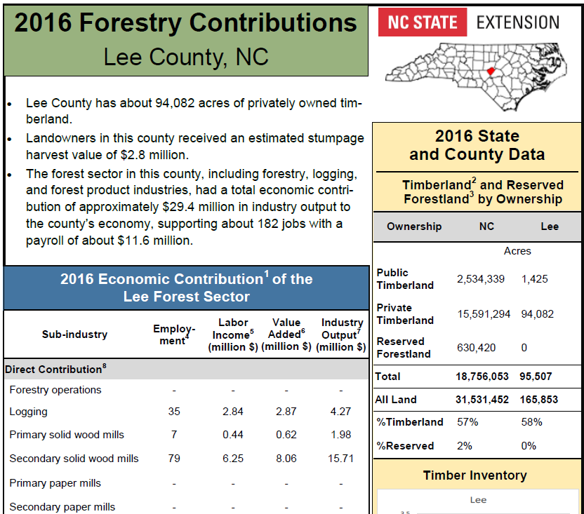
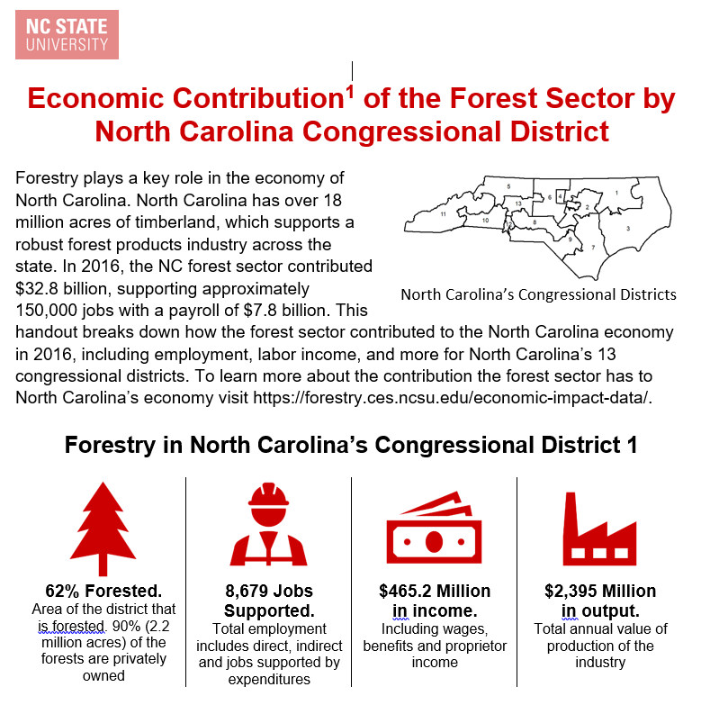
Forestry Contribution Reports
For all 100 counties in NC
For 13 Congressional districts
Available at: https://forestry.ces.ncsu.edu/economic-impact-data/

Slide 12
Forestry Contribution Reports

Slide 13
Forestry Contribution Reports
For 13 Congressional districts

Slide 14
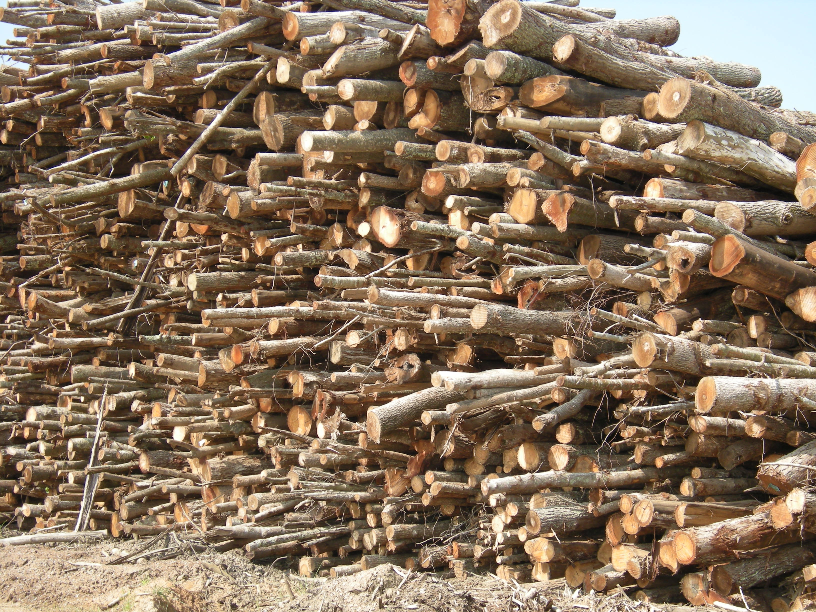

Slide 15
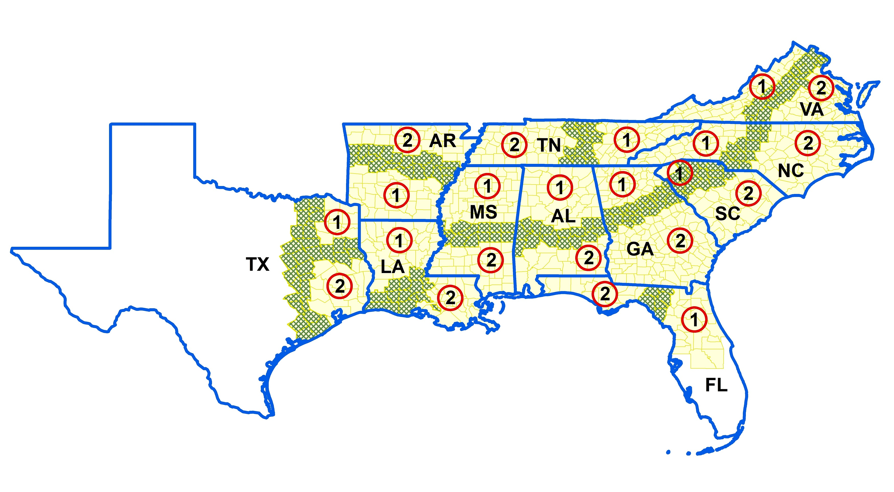
Pine Prices (Source: TMS)
Prices in eastern NC are consistently higher than south-wide average
Notes:
Let’s look at the long-term price trend in Eastern NC compared to the southwide prices.

Slide 16
Pine Prices (Source: TMS)
Pine Pulpwood
Average prices in eastern NC are consistently higher than south-wide average
Notes:
Let’s look at the long-term price trend in Eastern NC compared to the southwide prices.

Slide 17
Pine Pulpwood Market in Eastern NC
Notes:
Estimated elasticity values for softwood pulpwood stumpage. Both demand for and supply of pulpwood stumpage are inelastic. Only an outlier is Polyakov et al. 2005 in the Alabama pulpwood market. Supply inventory elasticity is estimated to be around 1, i.e. unit elastic.

Slide 18
Unique Eastern NC Pulpwood Market
Fluff mill impact faded away?
Notes:
Estimated elasticity values for softwood pulpwood stumpage. Both demand for and supply of pulpwood stumpage are inelastic. Only an outlier is Polyakov et al. 2005 in the Alabama pulpwood market. Supply inventory elasticity is estimated to be around 1, i.e. unit elastic.

Slide 19
Hardwood Prices (Source: TMS)
Hardwood prices are not so good compared to the southwide average.
Pulpwood prices in Eastern NC are even lower than Western NC.
Hardwood Pulpwood
Hardwood Sawtimber

Slide 20
Hardwood Prices (Source: TMS)
Hardwood Pulpwood

Slide 21
Timber Markets in the U.S. South
South-Wide Regional Timber Price Trends, 2005-2018 (Timber-Mart South 2019)
Pine sawtimber prices have dropped almost 40%

Slide 22
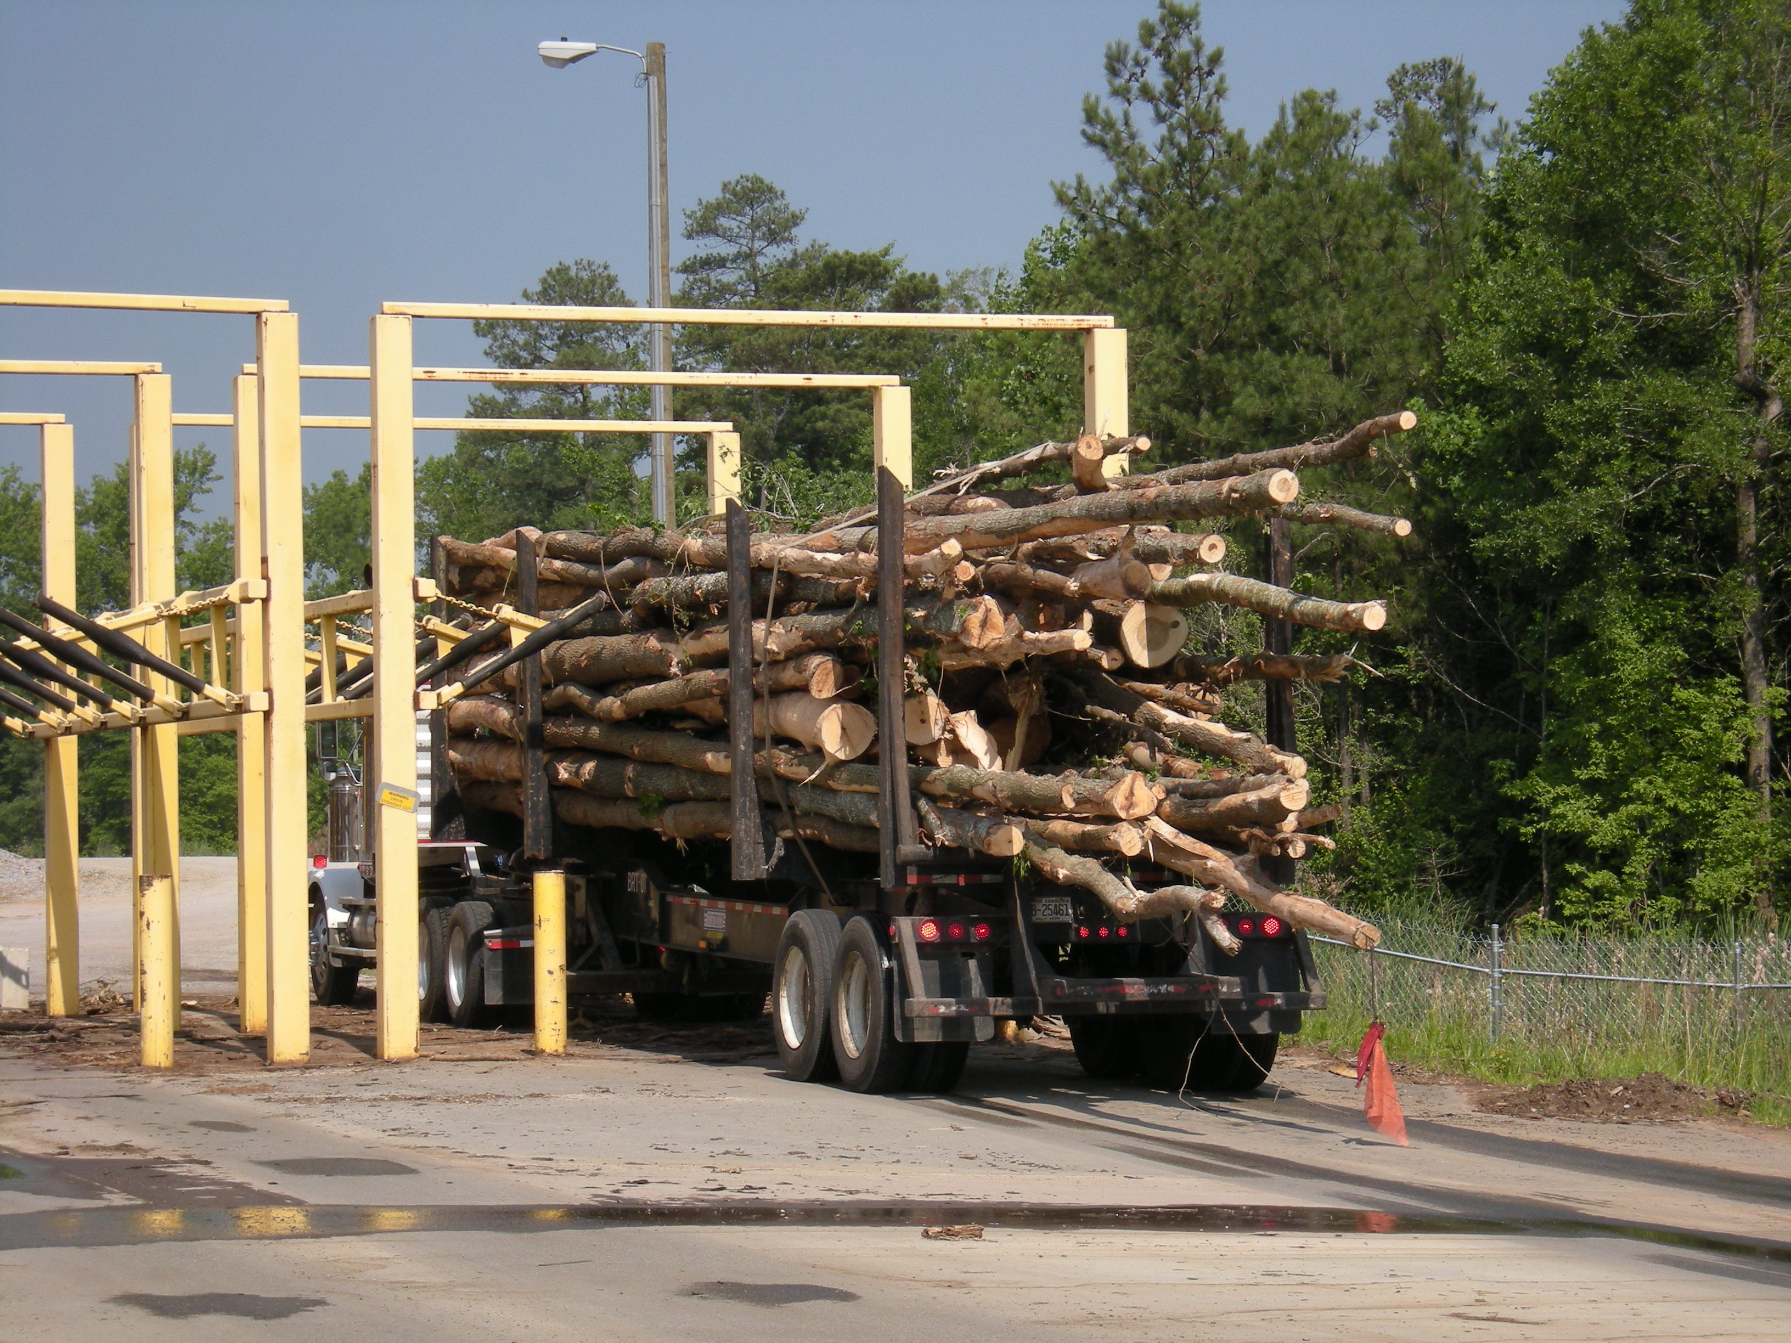

Slide 23
SRTS Projections: NC-Wide
PINE TIMBER MARKETS IN NC
Notes:
Estimated elasticity values for softwood pulpwood stumpage. Both demand for and supply of pulpwood stumpage are inelastic. Only an outlier is Polyakov et al. 2005 in the Alabama pulpwood market. Supply inventory elasticity is estimated to be around 1, i.e. unit elastic.

Slide 24
SRTS Projections: NC-Wide
HARDWOOD TIMBER MARKETS IN NC
Notes:
Estimated elasticity values for softwood pulpwood stumpage. Both demand for and supply of pulpwood stumpage are inelastic. Only an outlier is Polyakov et al. 2005 in the Alabama pulpwood market. Supply inventory elasticity is estimated to be around 1, i.e. unit elastic.

Slide 25
Major Price Driving Factors in Timber Markets
Competition---buyers’ competition to take wood
Inventory
Seasonality and weather—Extreme weather events
Tract size
Tree size and quality
Source: Forest2Market

Slide 26
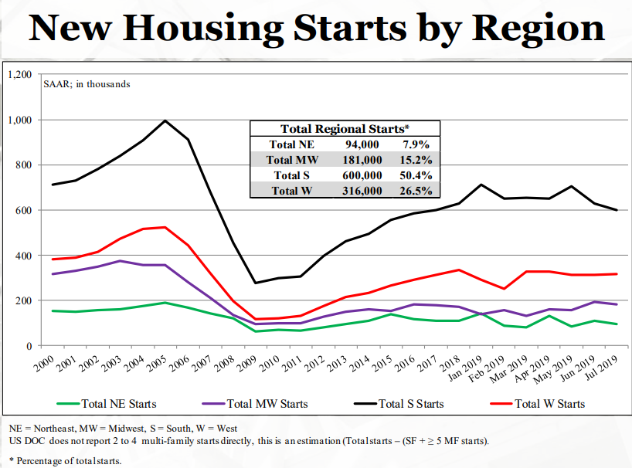

Slide 27
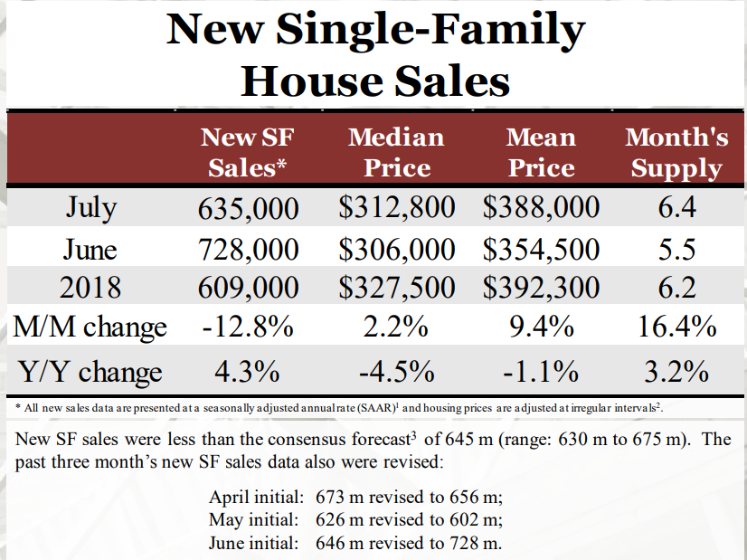

Slide 28
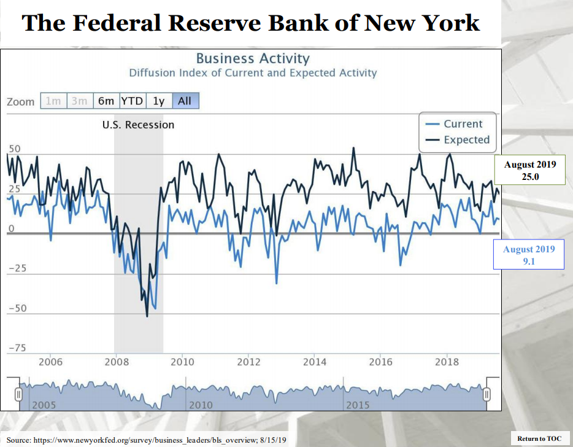

Slide 29
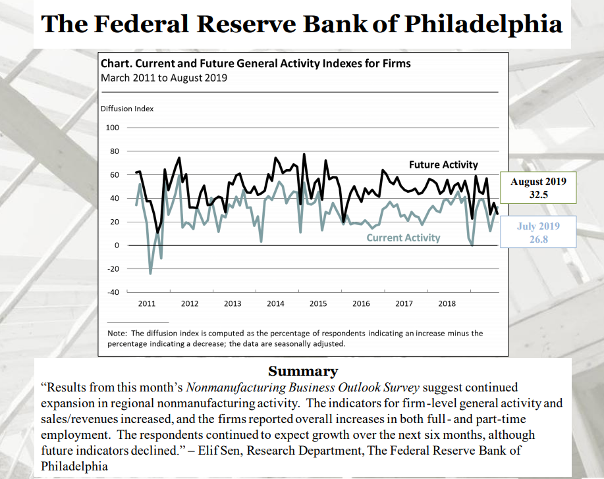

Slide 30
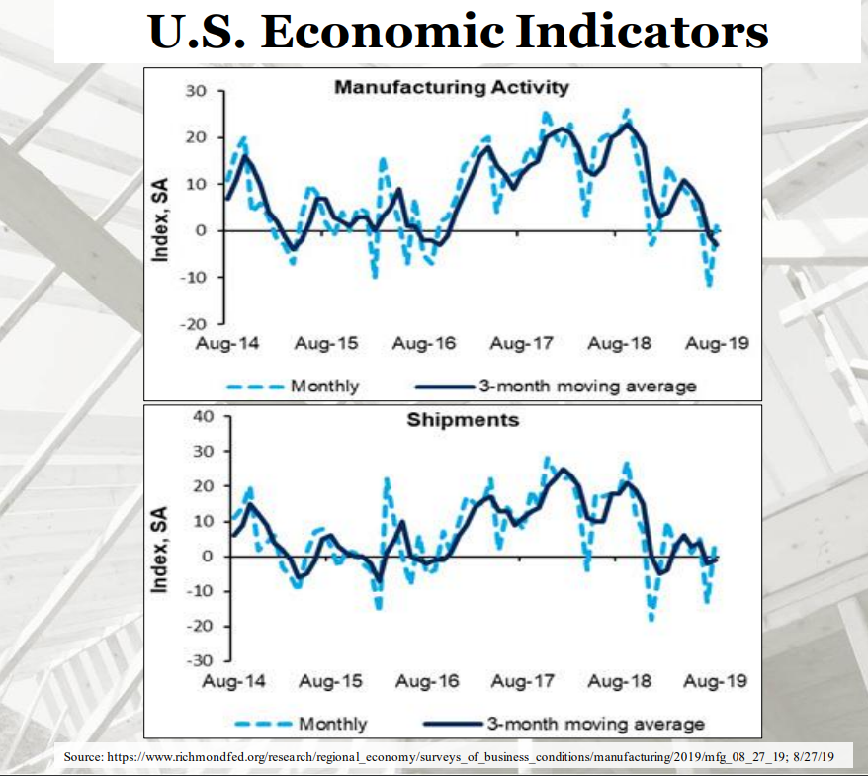

Slide 31
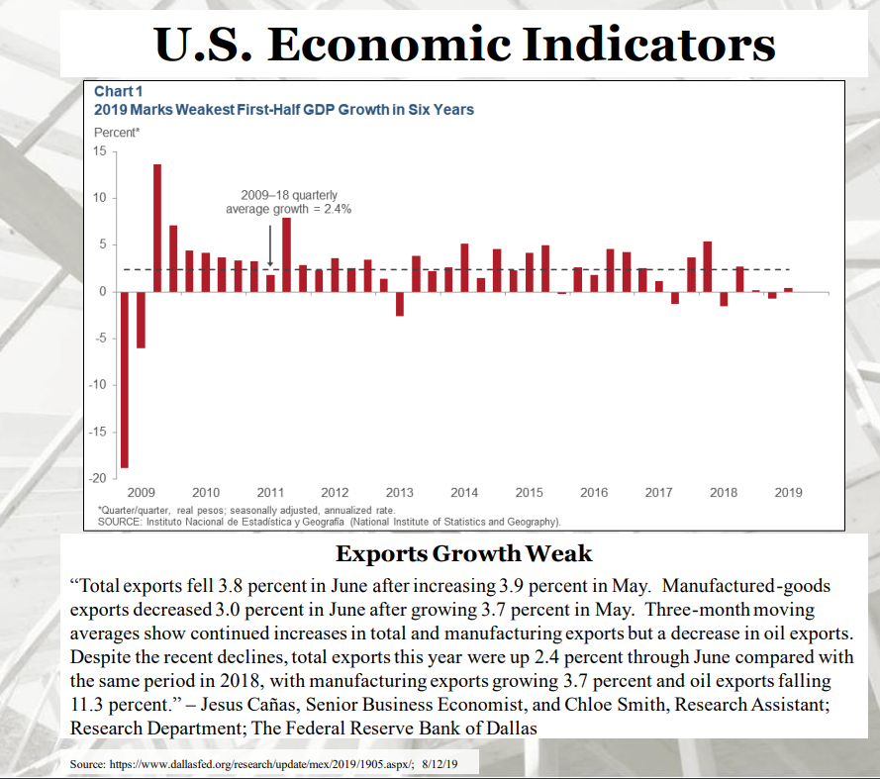

Slide 32
THANKS!!!!!!!!!!!
QUESTIONS????

Slide 33
Thank you
Rajan Parajuli, 919-513-2579, rparaju@ncsu.edu
Mark Megalos 919 513-1202, mamegalo@ncsu.edu
Colby Lambert, 919-814-6041, cslamber@ncsu.edu
Extension Forestry https://forestry.ces.ncsu.edu

