Slide 1
Re-combination of Map Parcels
NC Association of Assessing Officers – 9-20-2019
North Carolina
Land Records Management Program
North Carolina Department
of the Secretary of State
North Carolina Department of
the Secretary of State
Elaine F. Marshall, Secretary of State
Presented by: John B. Bridgers Jbridgers@sosnc.gov
Land Records Consultant (919) 814-5456

Slide 2
In North Carolina
Closing costs are among the lowest in the entire country. (47th)
Title Insurance rates in North Carolina are significantly cheaper than in other states.
In large part, because of the integrity and accuracy of the land records across the state.
Title searches are relatively easy
Few title insurance claims are actually filed
Even fewer paid

Slide 3
While the tax office is NOT
The “Title Police,”
G.S. 105-302(a) says, “Taxable real property is to be listed in the name of the owner. . . “
If the land records are not diligently maintained,
A whole host of problems can appear.

Slide 4
Is it the fault of the tax office
When there are title problems?
ABSOLUTELY NOT!
But who gets convicted
in the
“Court of Public Opinion,”
when title problems
show up in the tax bills?

Slide 5
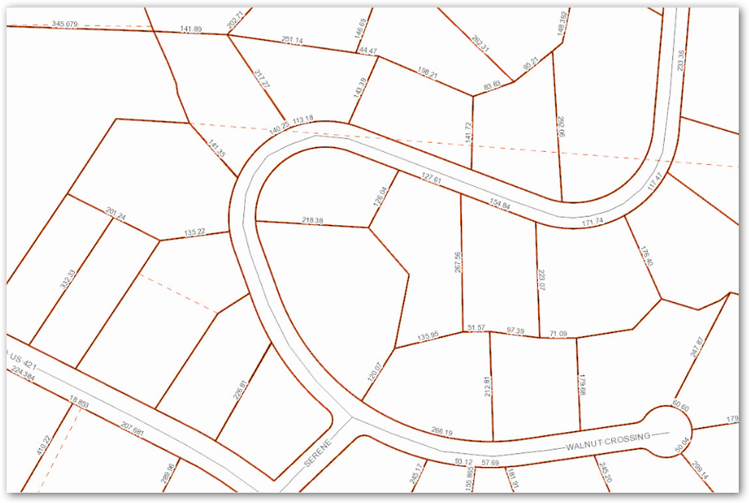
Basically, if your tax maps aren’t correct,
Ain’t Nothing Right!

Slide 6
But,
Why
Are
We
Really
Here

Slide 7
In a word

Slide 8
Specifically - Ad Valorem taxes
“Ad Valorem” – Latin for “According to value”

Slide 9
North Carolina Constitution:
Article V – Finance
Section 2. State and local taxation.
(1) Power of taxation. The power of taxation shall be exercised in a just and equitable manner . . .

Slide 10
§ 105-273. Definitions.
(1) Abstract – The document on which the property of a taxpayer is listed.
(2) Appraisal. - The true value of property or the process by which true value is ascertained.
(3) Assessment. – The tax value of property or the process by which the assessment is determined.
(9) Listing – An abstract, when used as a noun.

Slide 11
§ 105-296. Powers and duties of assessor
The assessor shall have general charge of:
the listing,
appraisal,
and assessment
of all property in the county
in accordance with the provisions of law.
And he shall exercise all powers not inconsistent with the Constitution or the laws of this state.
So, just what does this mean?

Slide 12
§ 105-296. Powers and duties of assessor
Means:
All property inside the county boundary is “fair-game” to be
- examined, (listed)
- valued, (appraised)
- and taxed (assessed)
– except for those special classes set aside by the Constitution or the General Assembly

Slide 13
§ 105-296. Powers and duties of assessor
But, it also means –
Because an assessor has the duty to list, appraise, and assess all the property in their county,
That -
The assessor from a neighboring county does not have the authority to list, appraise, and assess property in your county.

Slide 14
§ 105-296. Powers and duties of assessor
If your county “swaps” the parcels that straddle the county line, with an adjoining county,
The two counties are not following the General Statute of assessing all the property in the county.

Slide 15
Deeds get recorded in the county cadastre.
Exactly what is the county cadastre?
The county cadastre is:
the “OFFICIAL LIST” of
property owners and descriptions of their property located in the register of deeds office and the clerk of courts office.
How many have ever actually looked at or seen the county cadastre?

Slide 16
The County Cadastre

Slide 17
In pre-remote access deeds-online-availability days, this is what it looked like in the deed vault.

Slide 18
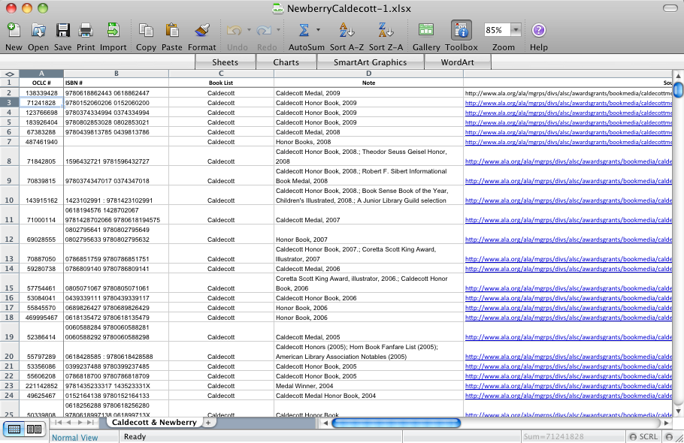
Why do we need this “official list” of owners and descriptions of their property?

Slide 19
Government entities need to
know who to contact for:
1. any unpaid taxes.
2. eminent domain

Slide 20
Cadastral Maps – i.e. Tax Maps
Maps of the official documents in the County Cadastre
“Document-Driven System “
Any document not recorded in the
Register of Deeds Office or the Clerk of Courts Office
is outside of, or not in the OFFICIAL LIST
of owners and descriptions
i.e. - the County Cadastre

Slide 21
So, In the Tax Office,
In connection with real estate,
Just what are we taxing?
Parcels
And any appurtenance attached thereto.

Slide 22
What is a Parcel?
§ 47-30(f)(11)(c)(1) defines a parcel as:
“an area of land in a single, legal description or legally recorded subdivision that has been or may be legally conveyed to a new owner in its existing configuration.”

Slide 23
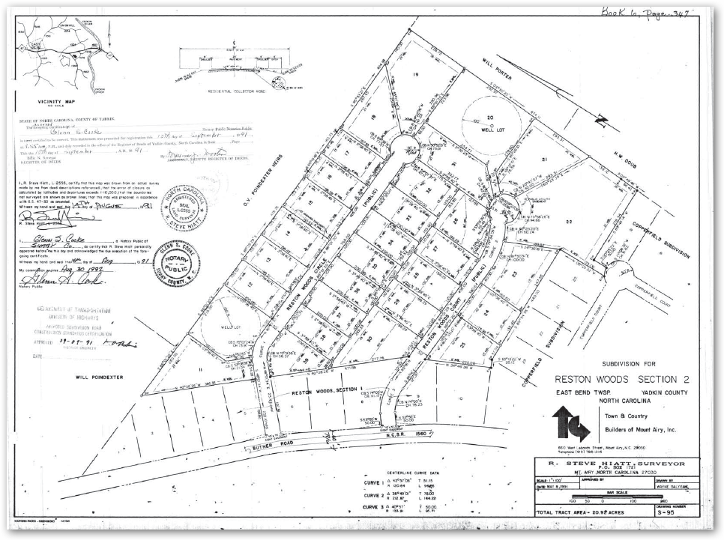
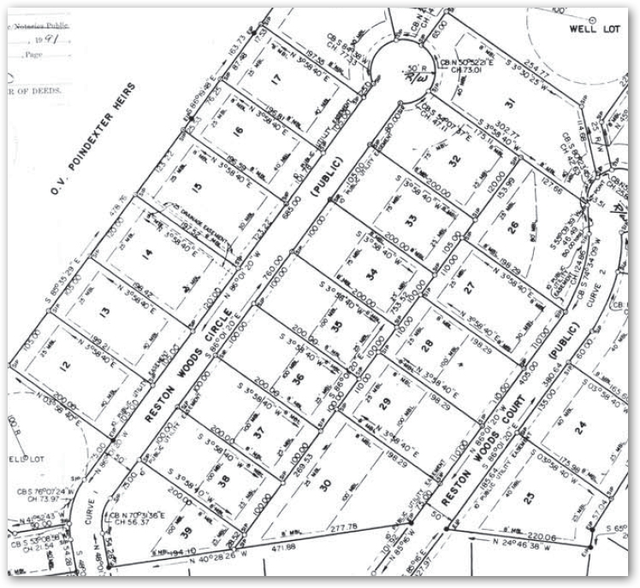
Justin Case purchased:
Lot 16, in 1995, for $15,000.
In 2000, Terry Dactel purchased two lots, 29 & 33 for $20,000 each. The two lots were conveyed to Terry in the same deed.
17
16
In 1998, he purchased lot 17 for $18,000.
33
Countywide re-appraisal:
2001 – lots valued at $20,000
2005 – lots valued at $25,000
2009 – lots valued at $20,000
2002 – lots valued at $21,000
2006 – lots valued at $25,000
29
Let’s assume that each of these lots are ¾ acre
2010 – lots valued at $20,000

Slide 24
17
Following the 2010 – re-appraisal, the county commissioners decided to go back to an 8-year re-appraisal cycle.
16
33
What is the total value on which Justin is being assessed taxes?
With the 2018 county re-appraisal, it was determined the lots were selling at $75,000.
29
Each lot in the subdivision was appraised and assessed at $75,000.
What about Terry?

Slide 25
17
Justin comes into the tax office and says,
“I want to combine my two lots for tax purposes.“
16
33
What is he really and truly saying?
When he says, “. . . for tax purposes. . .”
Most likely, what he is really means is,
“I want to lower my tax bill; but I still
want to be able to sell the lots
individually just in case I get a chance
to sell one of them.“
29

Slide 26
17
Suppose the mapper simply merges the two lots into a single parcel without some muniment recorded in the register of deeds.
Depending on the county’s Schedule of Values, Justin’s tax value on the new combined lot may be $80,000, or $85,000.
17
16
16
Do the tax maps or the CAMA records have any bearing on the legal status of real property?
Does Justin’s tax parcel now match the definition of a parcel as given in GS 47-30(f)(11)(c)(1)?
34
How many lots Justin
legally own?
Is Justin’s property being assessed “at value?”
How much can he sell each lot?
29
What is the total tax value of Terry Dactel’s two lots?
Are they being treated in a just and equitable manner as directed by the Constitution of North Carolina?

Slide 27
Suppose, a couple of years later, Justin gets a chance to sell one of the lots but; the county zoning had changed the minimum lot size to one acre.
When Justin goes to the Planning & Zoning Office to see about splitting the lots back to individual lots, what are they most likely going to do?
17
17
16
Chances are, they’re going to simply look at the tax maps and do no more research on his parcels.
16
33
Without requiring him to record an affidavit of combination, he could claim that he never intended for the tax office to combine the two lots.
If Justin had been required to record an affidavit of combination then he cannot come back and claim that he never intended for the tax office to combine the parcels.
His intent is in the public record and there can be no argument of his intent was.
29
Requiring an affidavit of combination is just a cleaner way to handle the combination in the tax records.
It also gives a single “reference” in the chain of title that allows the records in the CAMA system to follow the county cadastre as a document-driven system and matches the statutory definition of a parcel.

Slide 28
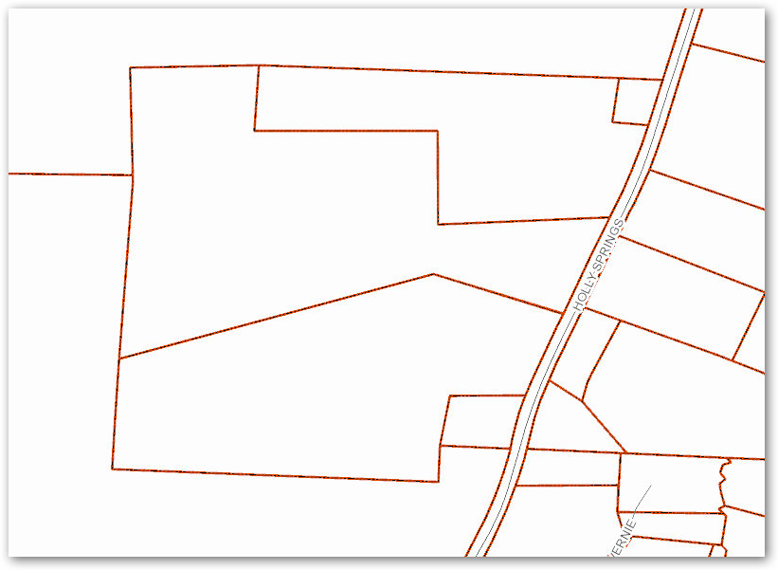
In 1982, Cora Nona Cobb purchased
Parcel 3265
In 1984, Cora Nona Cobb purchased
Parcel 2495
3265
1982 deed
2495
1984 deed

Slide 29
In 1985, Cora wanted to get Farm Use (PUV) on her land and needed a ten-acre tract in order to qualify.
She asked the county to combine the two parcels
3265
1982 deed
2495
1984 deed

Slide 30
How are deed references usually arranged on the property record card?
What happens if the attorney or paralegal doing a title search is not paying close attention to the property record card?
3265
1982 deed
2495
1984 deed
In 2015, Cora deeded one acre to
her grandson, Willie Gettit.

Slide 31
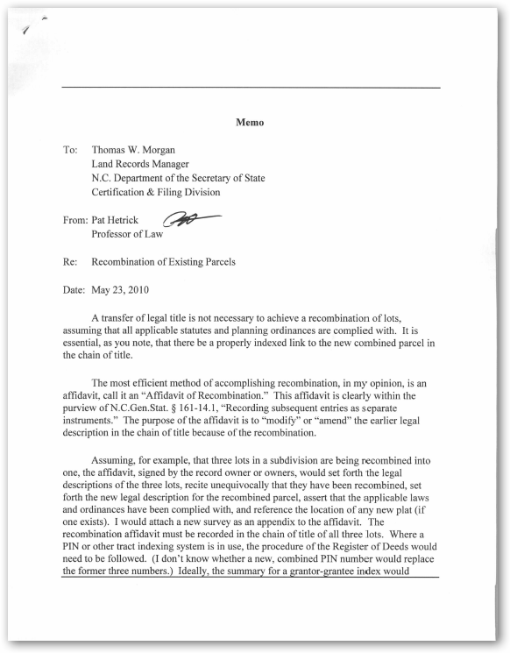
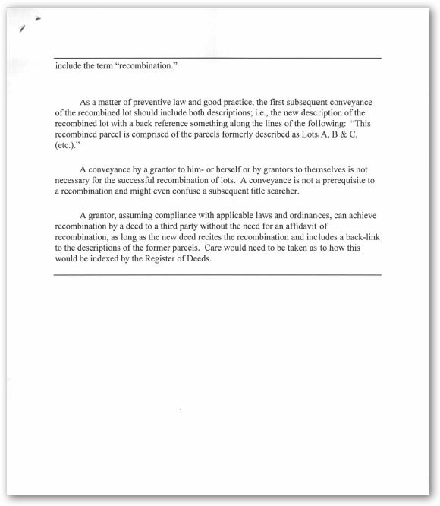

Slide 32
§ GS 161-14.1 Recording subsequent entries as separate instruments
(Paraphrased)
“(3) Subsequent instrument – Any instrument presented for registration that it is intended or purports to:
Modify,
Amend,
Supplement …
… A previously registered instrument.”

Slide 33
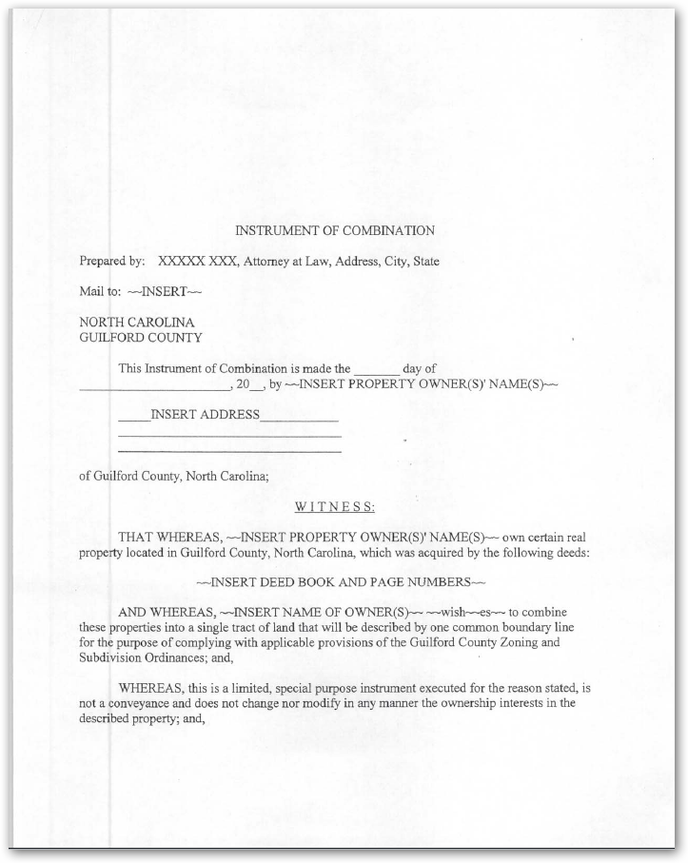

Slide 34
G.S. 47-30(g) Recording of Plat
“. . . Reference in any instrument hereafter executed to the record of any plat herein authorized shall have the same effect as if the description of the lands were set out in the instrument.”

Slide 35
Because of this statute - G.S. 47-30(g)
“Lot 55 as shown on plat recorded in Book of Maps 2015, Page 865.
But the statute also says,
“Reference in any instrument shall have the same effect. . .”
It does not say, “The recording of a plat shall have the same effect. . . “
Deed descriptions can simply be:

Slide 36
What about splitting parcels per a recorded plat?
Every recorded plat must have a surveyor’s certification on what kind of plat it is under GS 47-30(f)(11)
If the (f)(11) statement is:
“a. That the survey creates a subdivision of land within the area of a county or municipality that has an ordinance that regulates parcels of land.”
Then the subdivision parcels should be created.

Slide 37
When an owner has gone through the subdivision planning process
And then records a plat,
He is publically saying, “I am making a change to the use of this parcel of land.”
Under USPAP guidelines, that change should be recognized in the tax values
Which is done through the creation of the individual parcels shown on the plat.

Slide 38
Any other statement for the
For the 47-30(f)(11) statement
i.e. (b), (c), (d), or (e)
Should be evaluated on a case by case basis
As to whether or not the split should be created in the CAMA system.

Slide 39
Basically:
Plats split.
Plats don’t combine.

Slide 40
Any questions, so far?

Slide 41
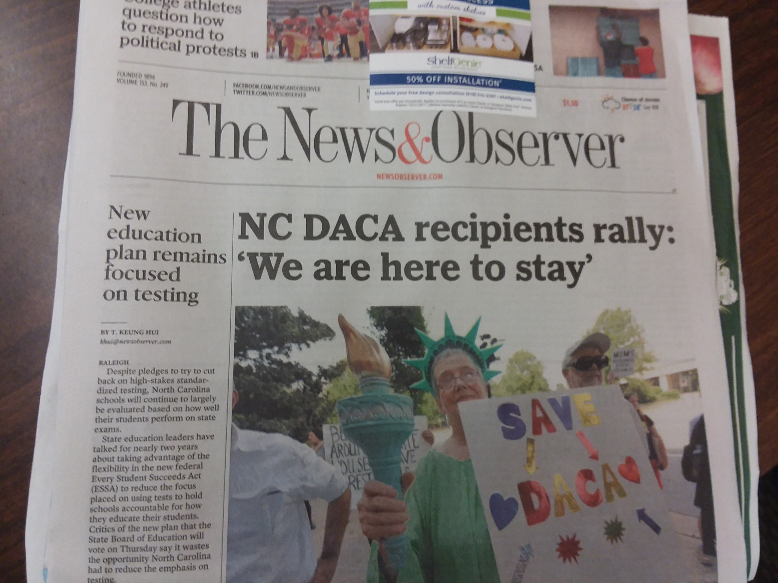
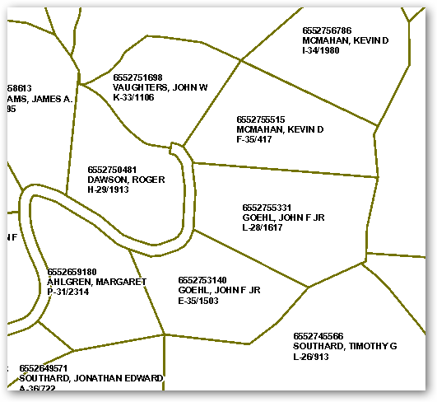
Real-life Parcels on Display

Slide 42
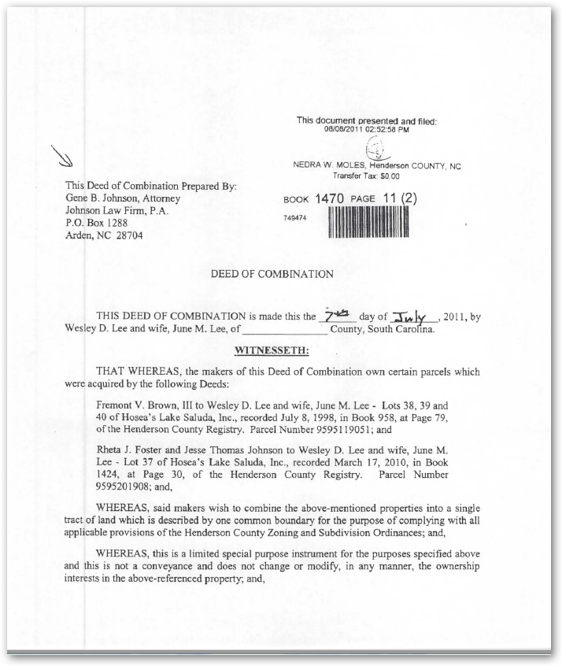
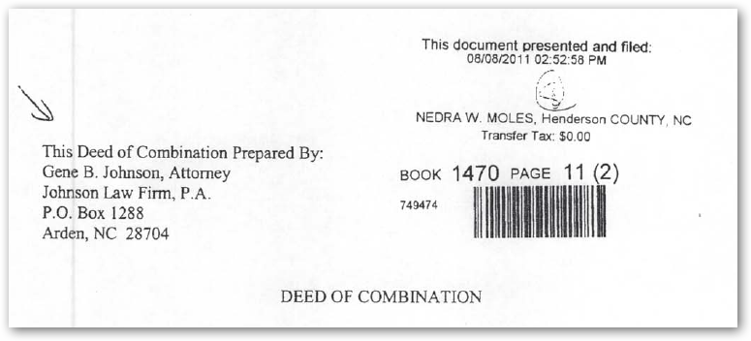

Slide 43
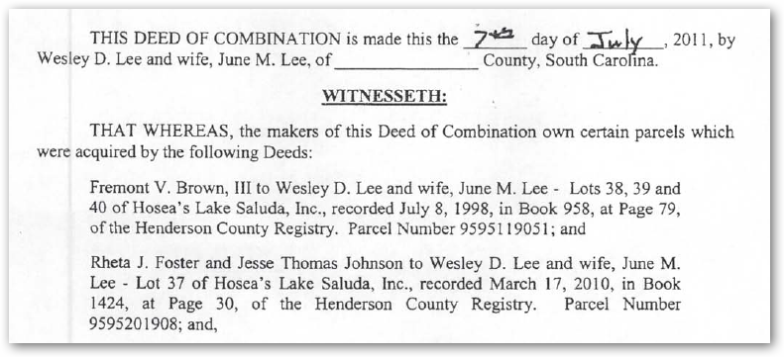

Slide 44
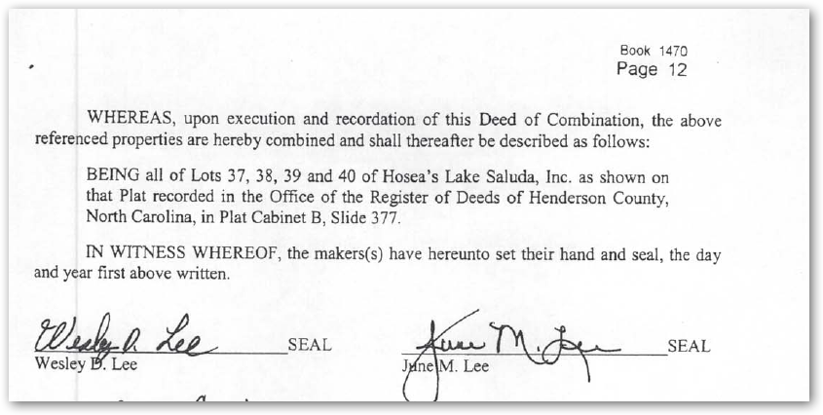

Slide 45
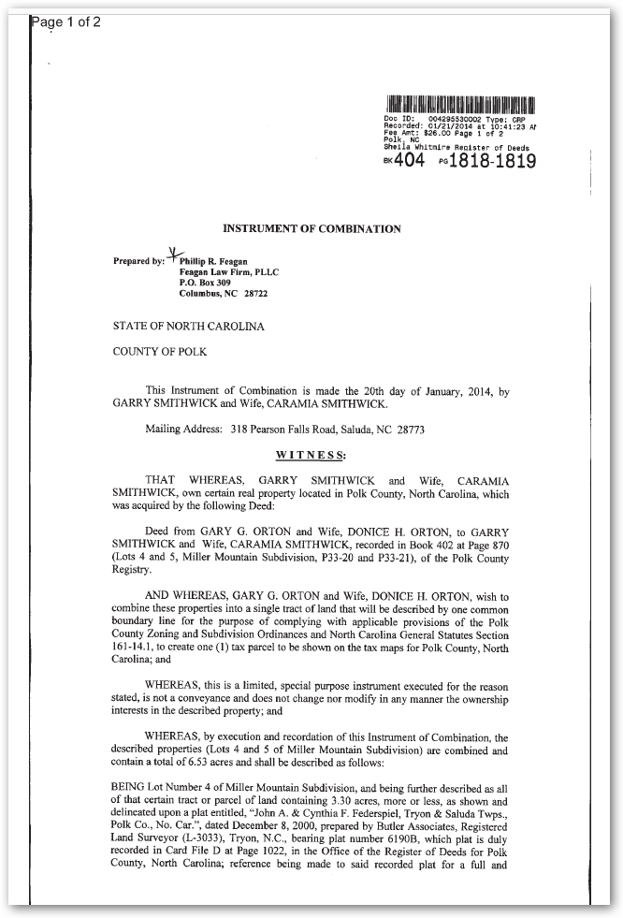
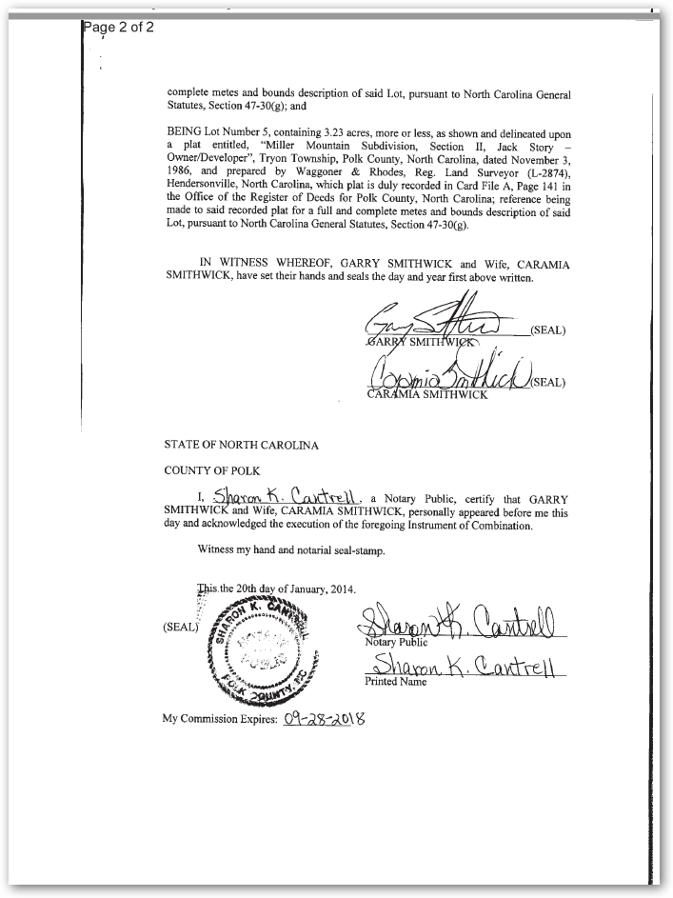
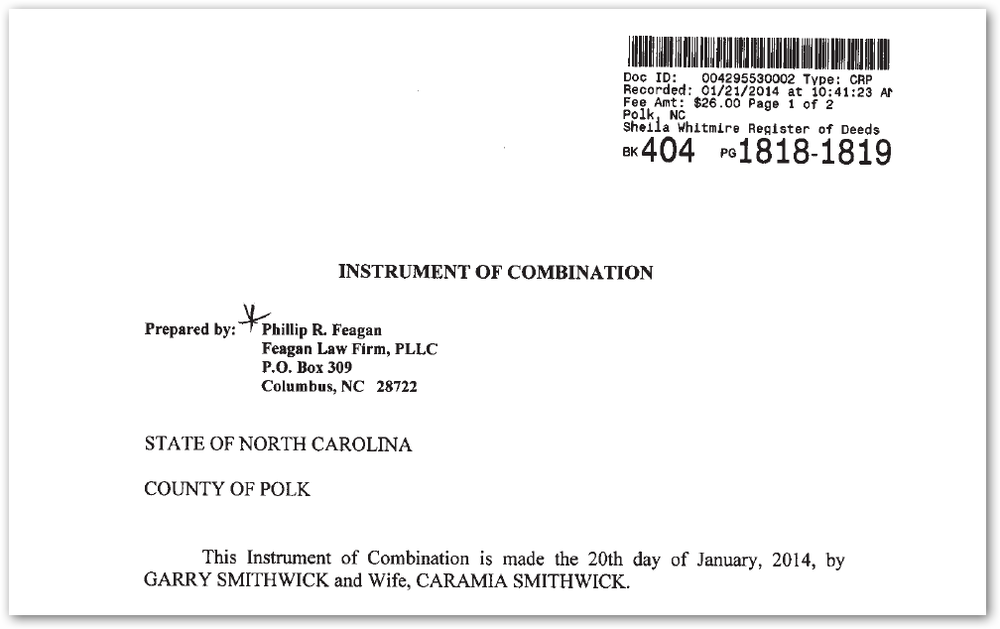

Slide 46
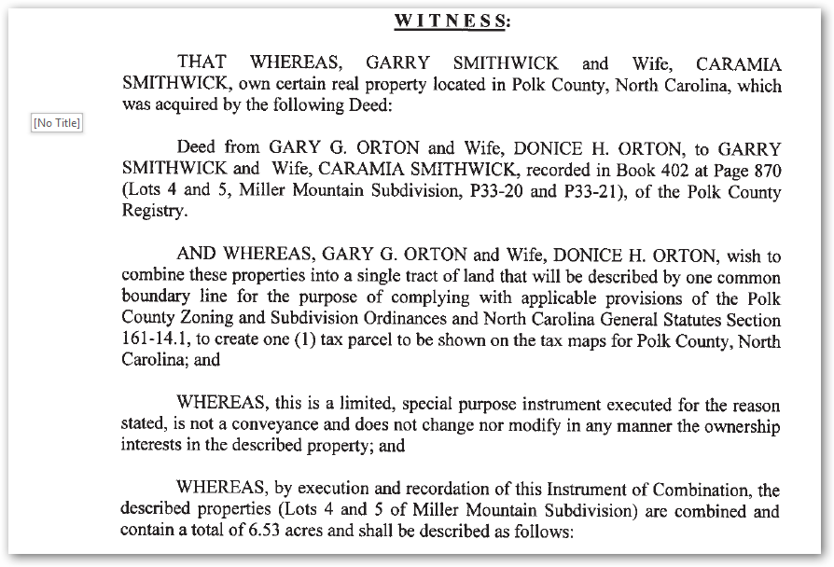

Slide 47
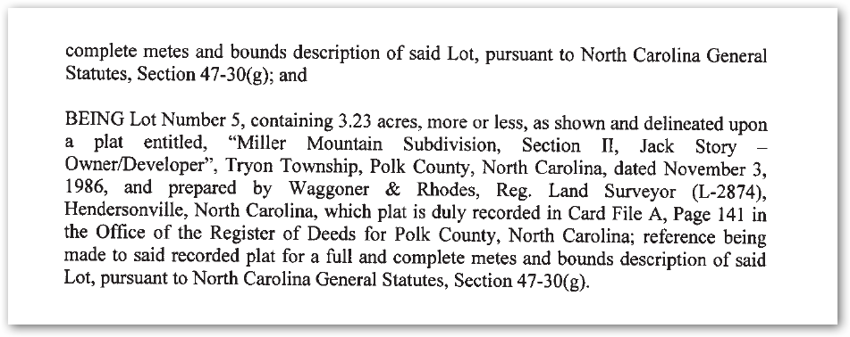

Slide 48
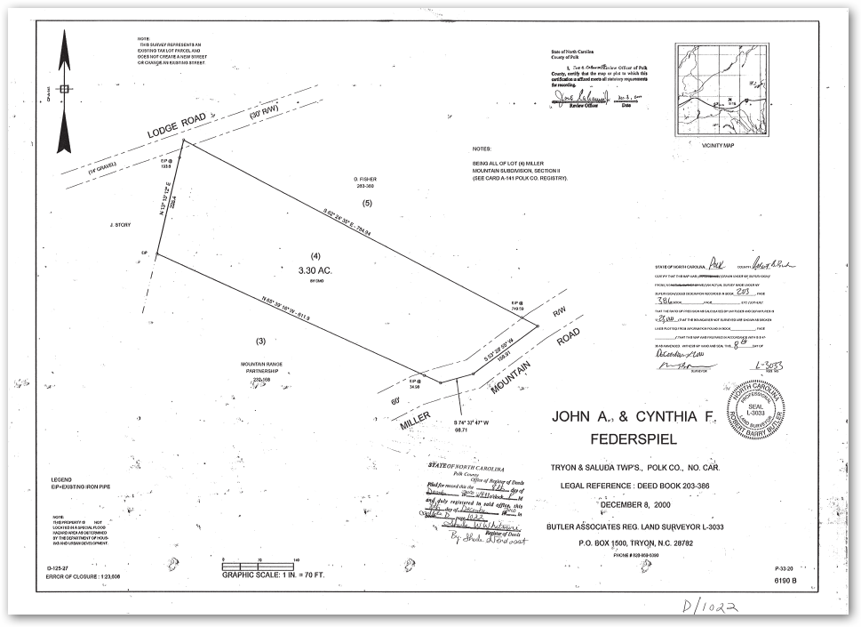
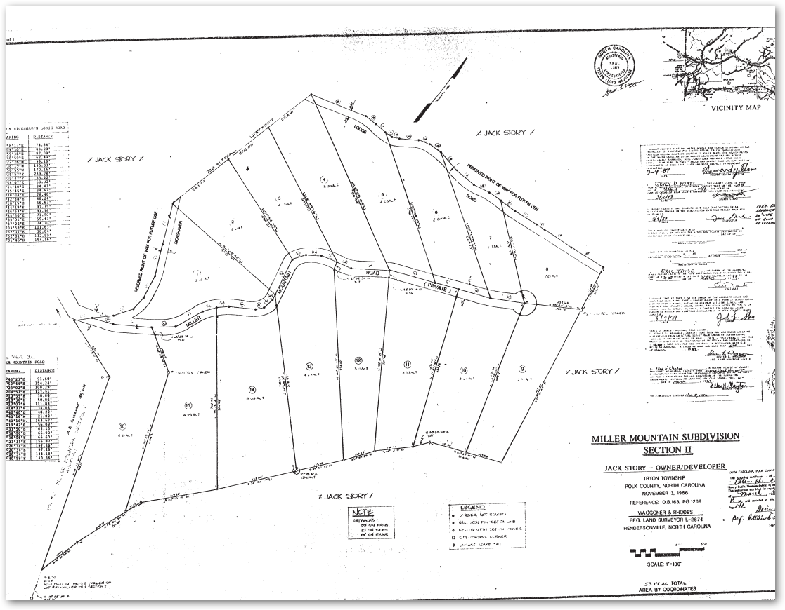

Slide 49
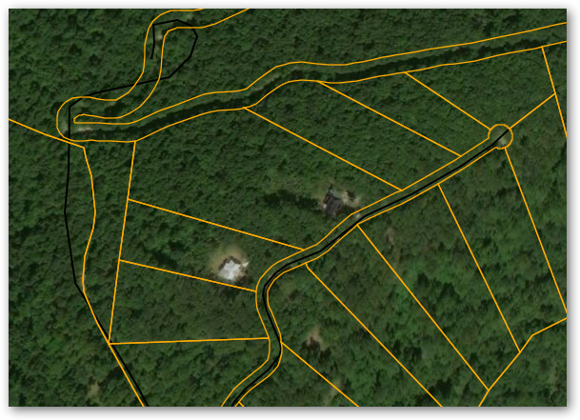

Slide 50
Statute of Frauds
§ 22-2. Contract for sale of land; leases.
All contracts to sell or convey any land,
or any interest in
or concerning them
must be in writing and must be signed
by the person with that authority. (paraphrased)
(29 Charles II, c. 3, ss. 1, 2, 3; 1819, c. 1016, P.R.; 1844, c. 44; R.C., c. 50, s. 11; 1868, c. 156, ss. 2, 33; Code, ss. 1554, 1743; Rev., s. 976; C.S., s. 988.)

Slide 51
§ 47-14. Register of deeds to verify the presence of proof or acknowledgement.
(d) Scope – Registration of an instrument pursuant to this section is not effective with regard to parties who have not executed the instrument or whose execution has not been duly proved or acknowledged.

Slide 52
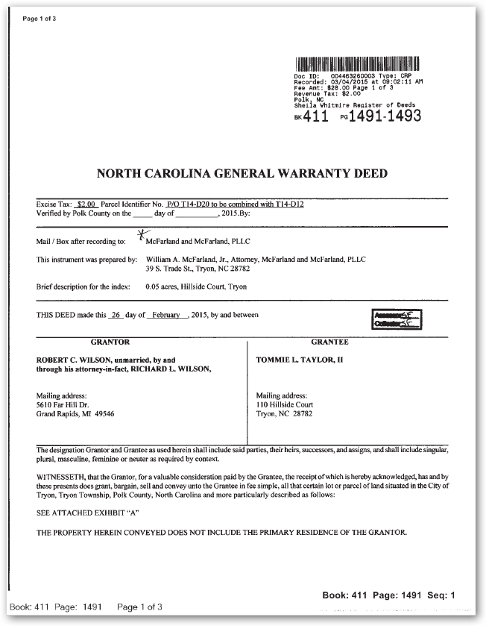
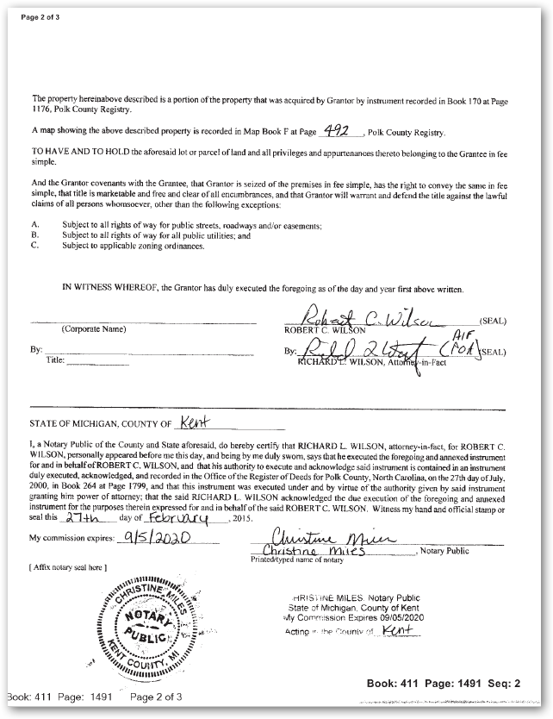
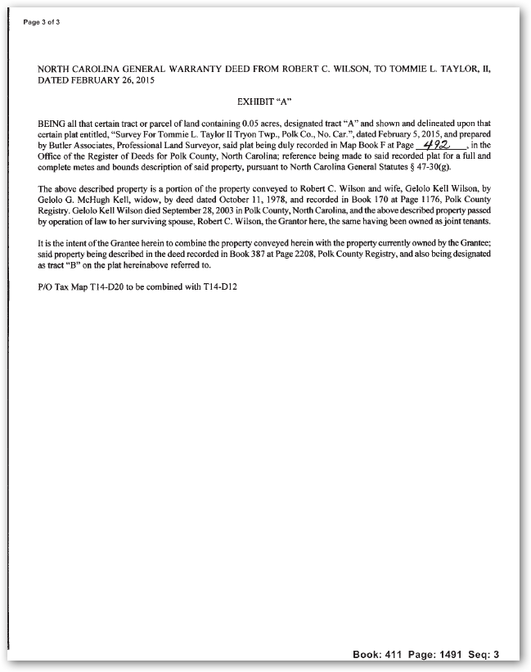
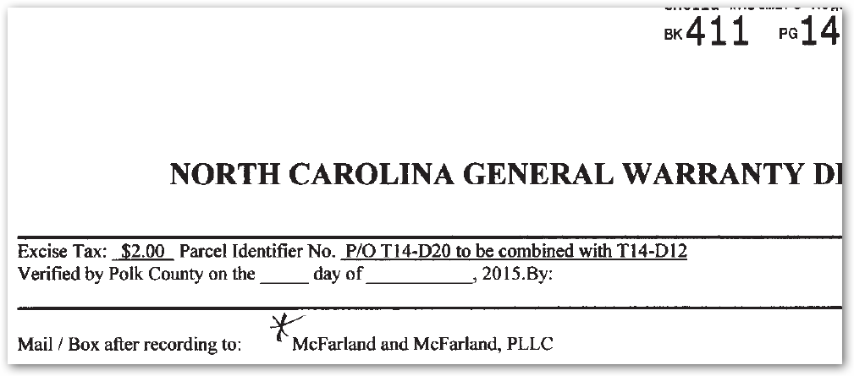

Slide 53
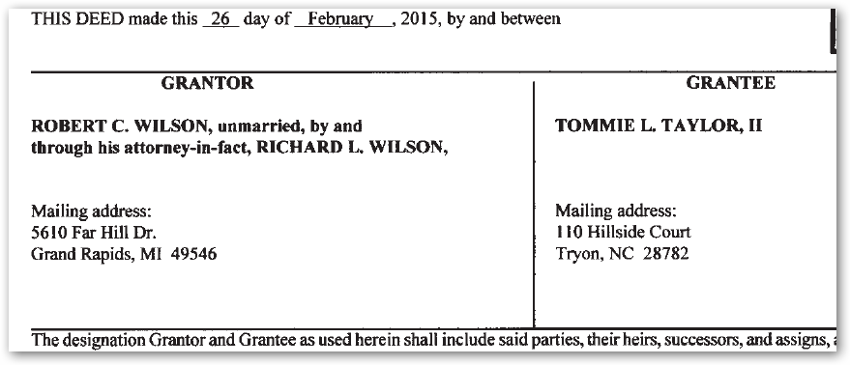

Slide 54
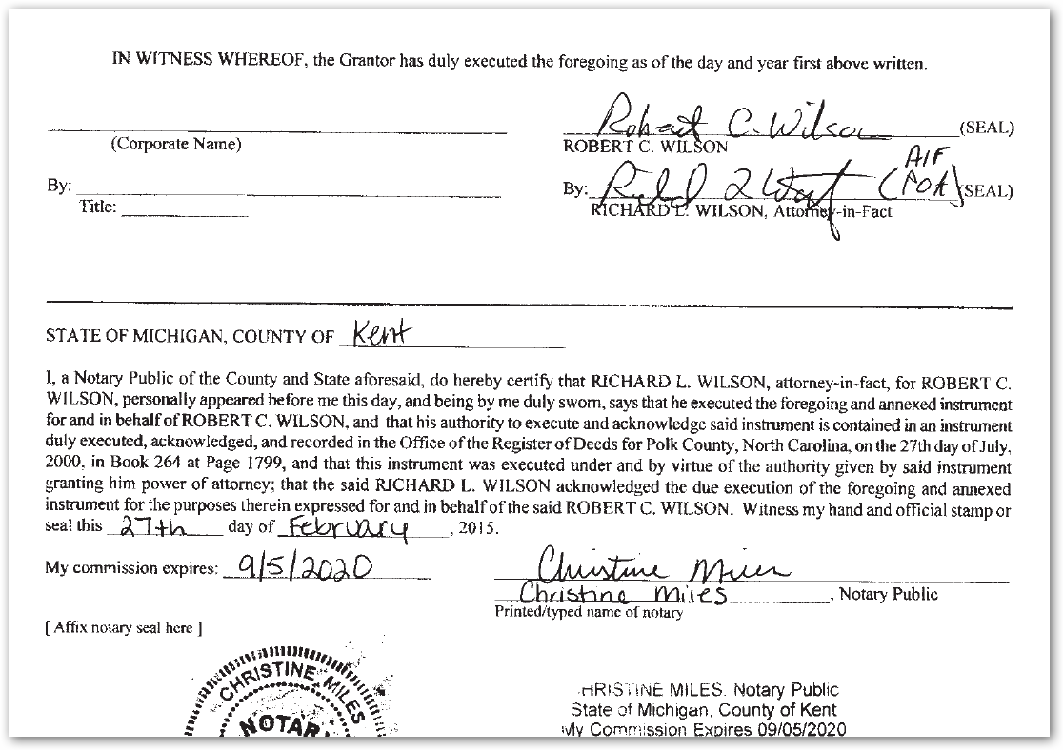
As the Grantee,
Tommie Taylor didn’t signed the document.

Slide 55
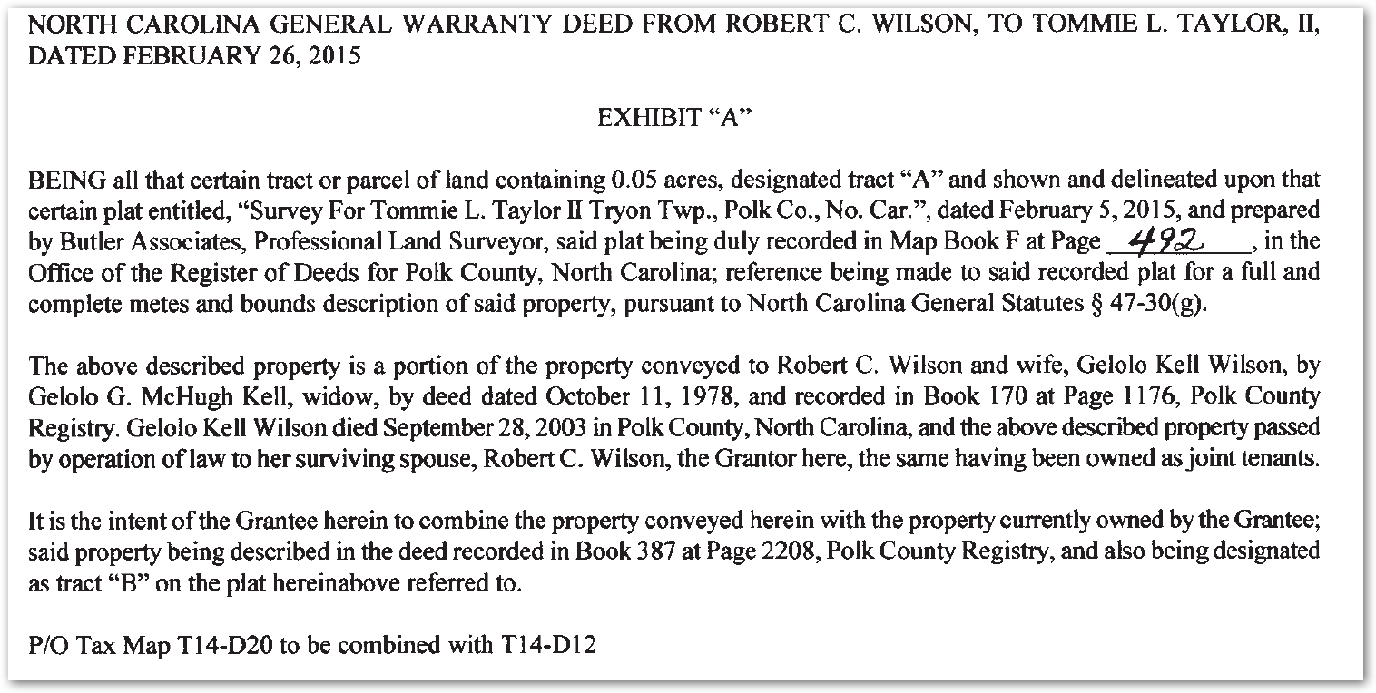

Slide 56
Does this statement by the Grantor combine the this piece of land being conveyed by the Grantor with the land the Grantee already has?

Slide 57
Question: What about having
The owner
Sign a letter of intent
With the letter
Being kept on file in:
The land records office,
The tax office, or
the planning and zoning office?

Slide 58
What happens when
A deed of trust gets recorded before the deed is recorded?
The “borrower” is not bound by the deed of trust because they did not own the property at the time the deed of trust was recorded, even if it was recorded just moments before the deed.

Slide 59
If something as important
As a deed of trust
that IS recorded in the register of deeds office,
but just out of proper sequence,
is of no value
Simply because of order in which the documents were recorded,

Slide 60
Then,
How could any document
sitting in a file folder in the
tax office, planning and zoning office,
or the land records office and
never have darkened the door of the Register of Deeds office
have any impact on the parcels in county?
The answer is:
It wouldn’t!

Slide 61
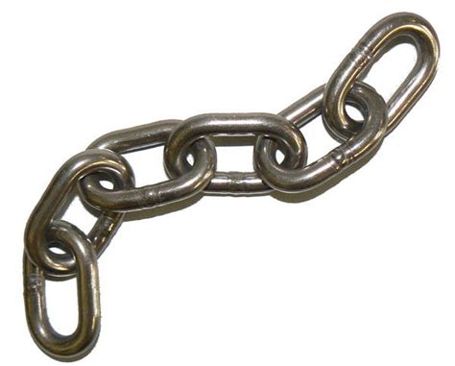
A “Letter of Intent”
Kept on file in any office other than being recorded in the Register of Deeds office is not in the county cadastre and not in the chain of title.
A prudent searcher does not have to go outside the chain of title.

Slide 62
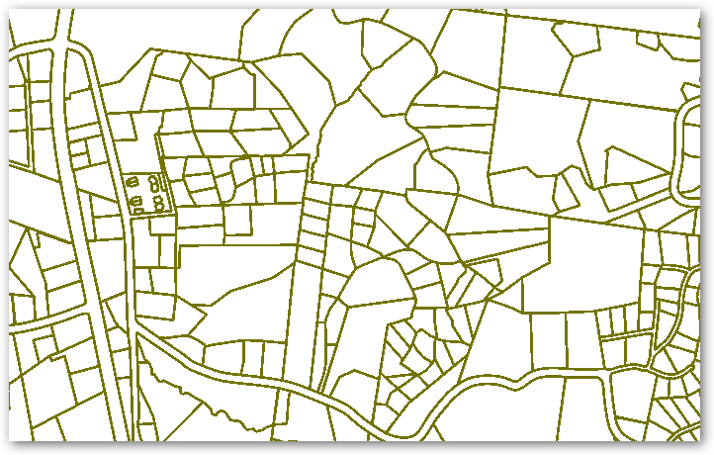
More Real-life Parcels on Display

Slide 63
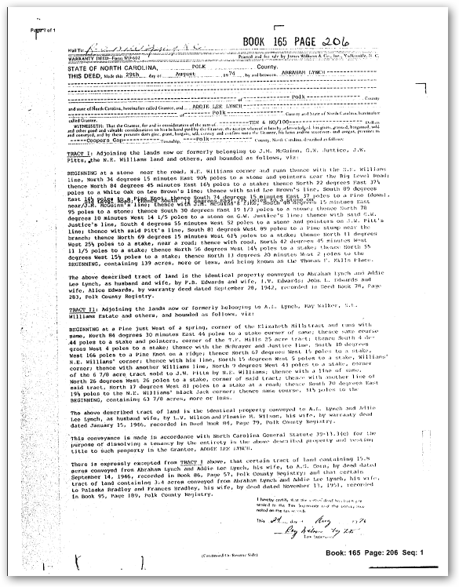
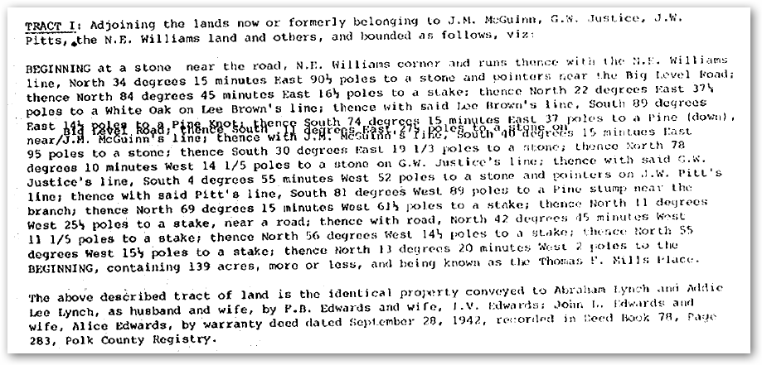
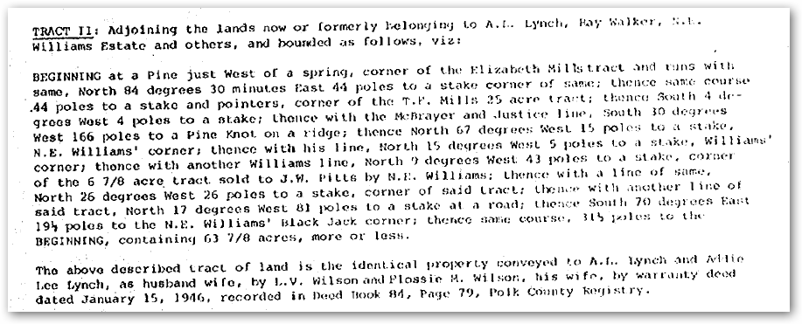
1974 deed

Slide 64
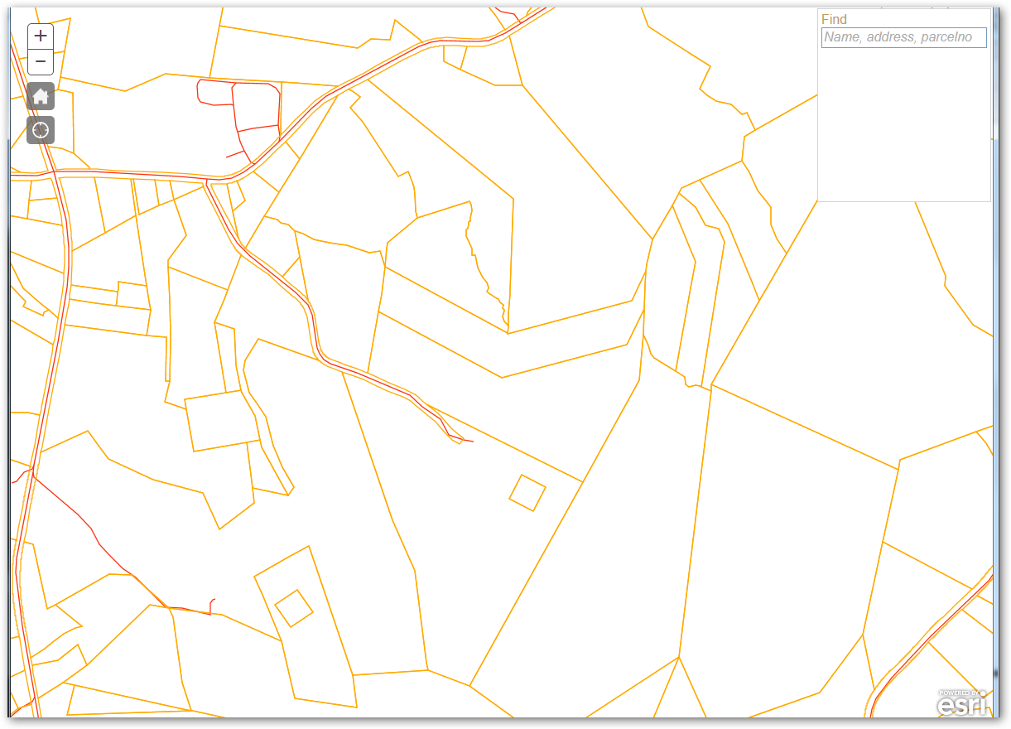
Area of interest
Area described by 1974 deed

Slide 65
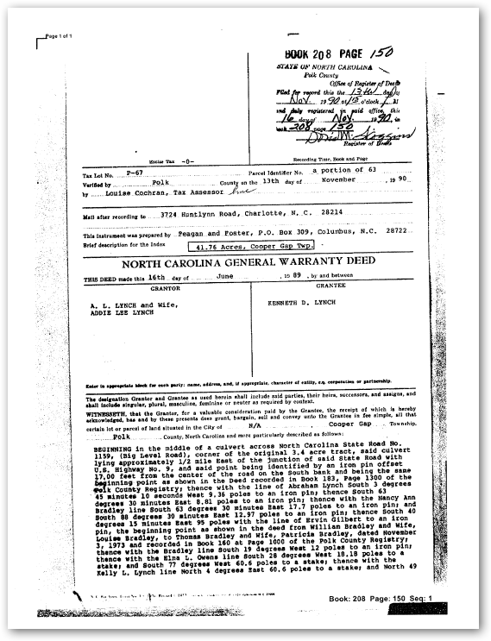
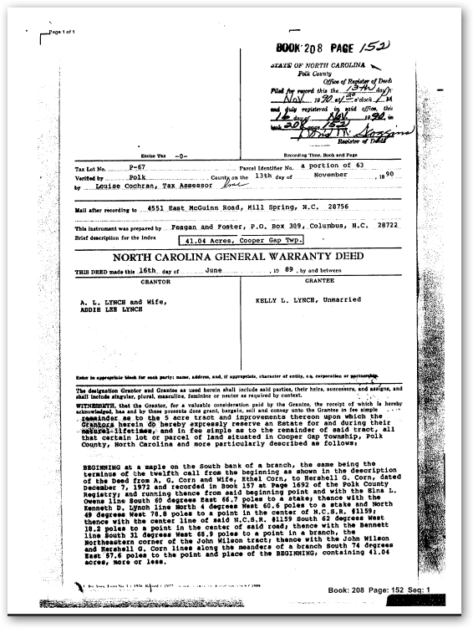
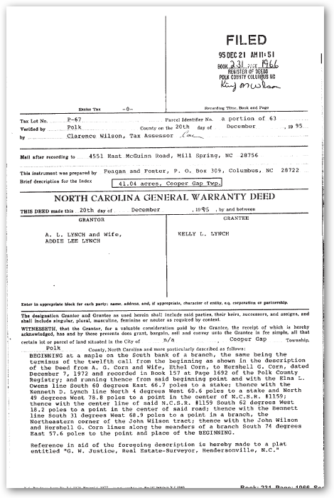
In 1990, A. L. and Addie Lynch deeded a tract to
Kenneth Lynch (DB – 208-150), and a tract to
Kelly Lynch (DB 208-152.)
Kelly’s tract had a life estate on it which was
released, in 1995 (DB 231-1966.)

Slide 66
P67-63
DB 231 / 1966
Kelly’s
P67-109
DB 208/150
Kenneth’s

Slide 67
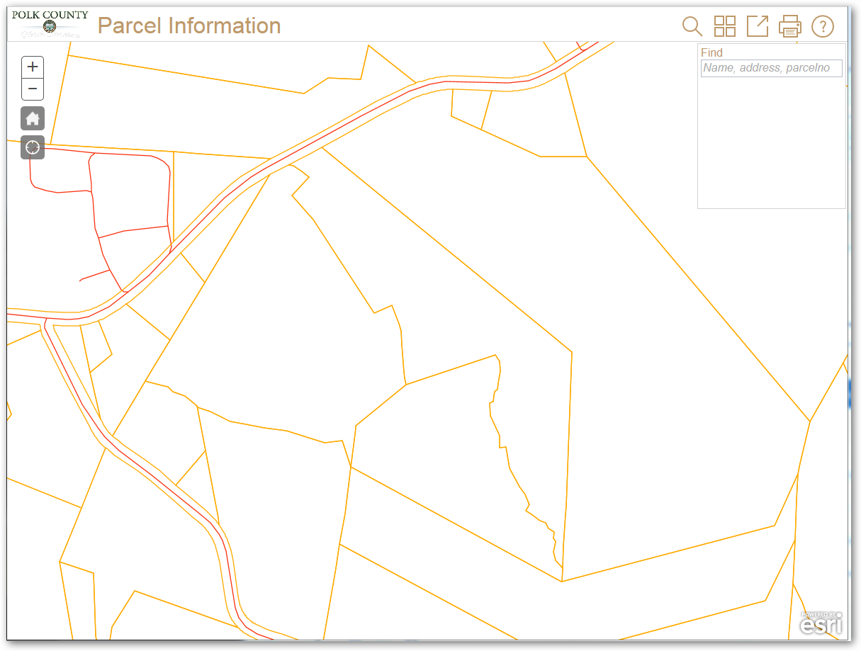
Kelly’s
P67-63
Kenneth’s
P67-109

Slide 68
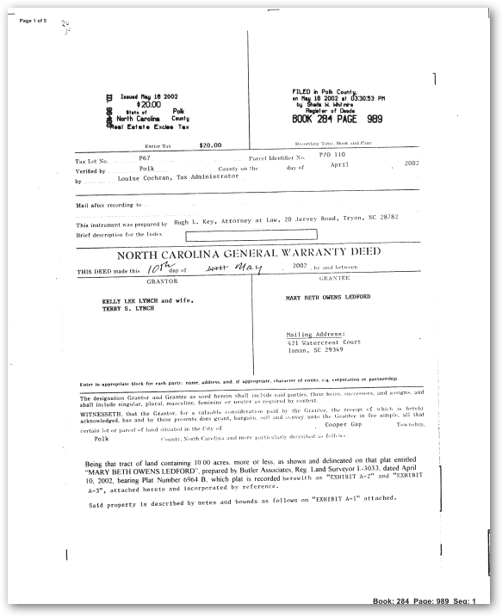
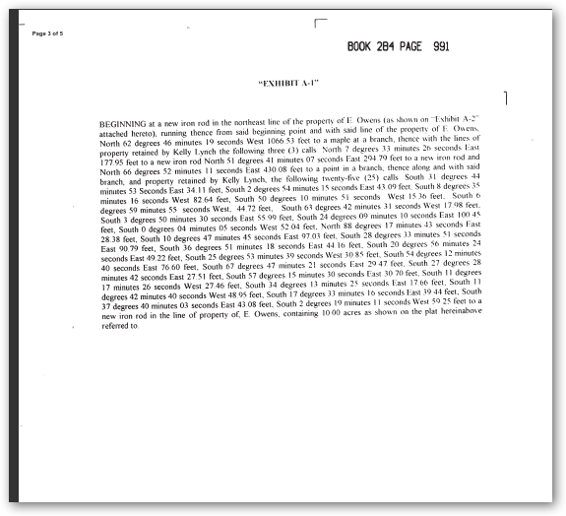
In 2002, Kelly Lee Lynch and wife Tammy S. Lynch deeded 10 acres to Mary Beth Owens Ledford

Slide 69
Kelly’s
Kenneth’s
Mary Beth Ledford
P67-138 (db 284 – 989)

Slide 70
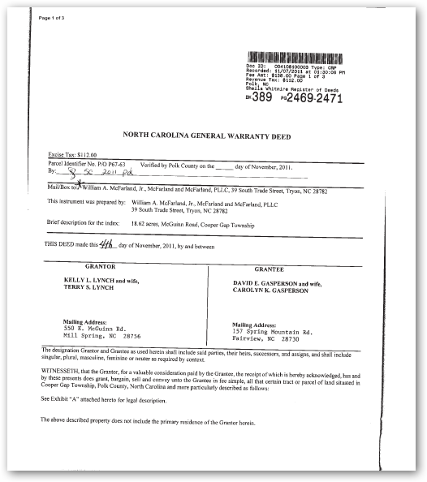
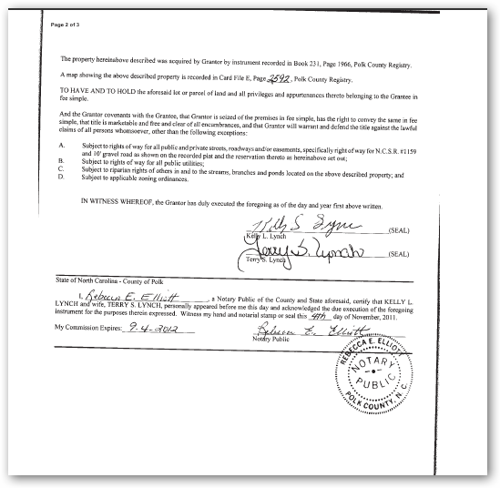
In 2011, Kelly and his wife deeded David Gasperson and his wife 18.62 acres as shown on plat recorded in plat book E-2592

Slide 71
Kelly’s
Kenneth’s
David Gasperson
P67-164
(DB 389-2469)
Mary Beth Ledford
P67-138 (db 284-989)
Tax Maps as of 2012

Slide 72
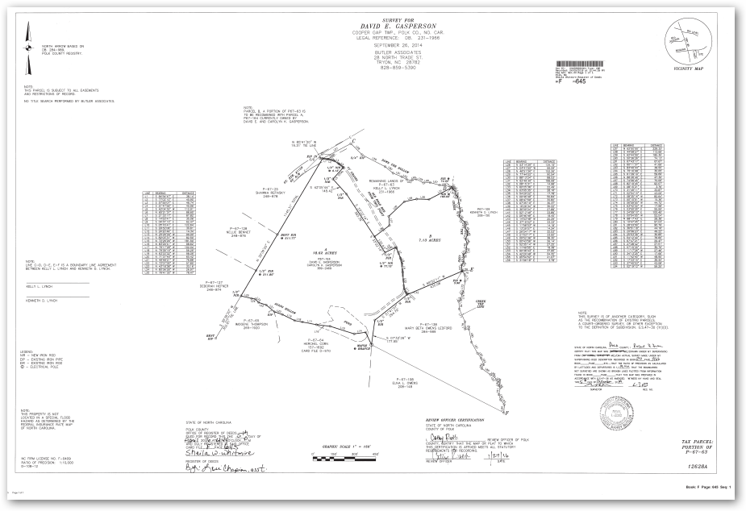
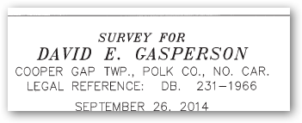
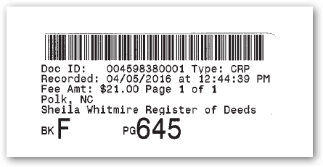
7.13 acres
18.62 acres
Mary Beth Ledford
David Gasperson
10.00 acres
Plat recorded in April 2016.

Slide 73
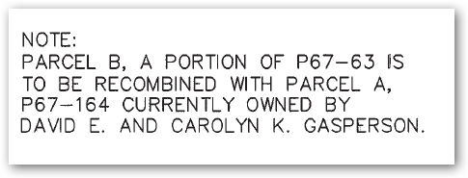
A
7.13 acres
18.62 acres
B

Slide 74
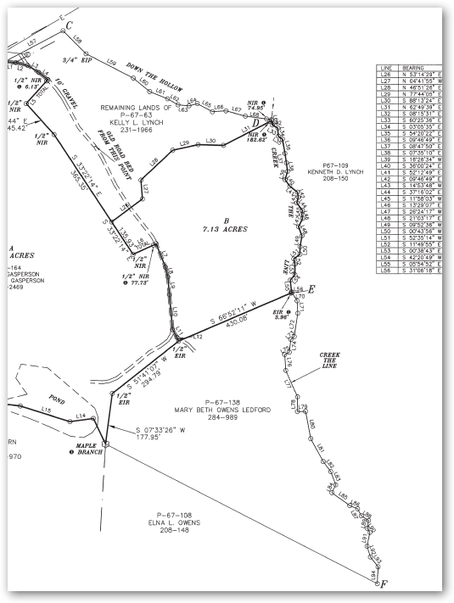
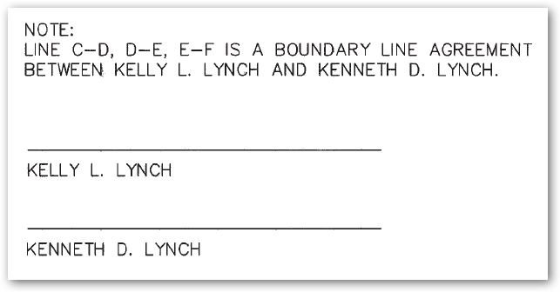
C
D
A
7.13 acres
B
E
18.62 acres
F

Slide 75
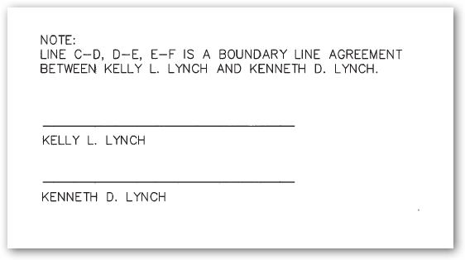
Even if both Kelly and Kenneth
Had signed the plat
And even if the signatures were notarized,
The plat still would not have changed the boundary between the two parcels.
Plats don’t convey
title!
And what about their wives?

Slide 76
A true boundary line agreement should only be used when the exact location of the boundary is uncertain.
When the boundary is known and the adjoining owners wish to change the boundary, that is a split. They need to exchange deeds transferring title of the property effected.
At the very minimum, there needs to be a document, other than just a plat, signed by both brothers and their wives and recorded in the register of deeds that each of the landowners agrees that the other person owns the land across the line.

Slide 77
Gasperson
P67-164
(DB 389-2469)
April 2016, Kelly Lynch and his wife deeded 7.13 acres to David Gasperson and his wife in db 418-1392 based on the plat F-645

Slide 78
Gasperson
(DB 389-2469)
Gasperson
(DB 418-1392)
David Gasperson and wife recorded an affidavit of recombination in DB 418-1400.

Slide 79
Kelly Lynch
Without exchange of deeds, Kenneth still owns these areas.
Kenneth Lynch
Gasperson
Anybody see a problem here?
Without exchange of deeds, Kelly still owns this area.

Slide 80
Still More Real-life Parcels on Display

Slide 81
Deed: 804 / 716 recorded 7-15-1992

Slide 82
Deed: 804 / 716 recorded 7-15-1992

Slide 83
Property of Michael Grooms & Kathy Riggin, JTROS
1.94 acres
DB: 804 / 716
7612-93-1412
7612-93-9200

Slide 84
Deed: 1010 / 689
recorded 8-5-1998

Slide 85
Deed: 1010 / 689
recorded 8-5-1998

Slide 86
Property of Michael Grooms & Kathy Riggin, JTROS
1.94 acres
DB: 804 / 716
What’s the difference between:
Estate by the entirety &
Joint tenancy with rights of survivorship?
7612-93-1412
7612-93-9200
Michael Grooms etux.
Kathy Riggin Grooms
0.04 acre
Db: 1010 / 689

Slide 87
In 1998, the county merged the two deed descriptions into a single parcel.
At some point, the county merged the two into a single parcel.
Grooms & Riggin property
Db: 804 / 716
7612-93-1412
7612-93-9200
Grooms’ property
Db: 1010 / 689

Slide 88
7612-93-1412
7612-93-9200
In 2013, the Grooms’ executed a deed of trust based on the description from DB 804 / 716

Slide 89
The county still had the single tax parcel.
7612-93-1412
7612-93-9200

Slide 90
Deed of Trust: 1993 / 603
Recorded: June 11, 2013
This is the original deed for 1.94 acres.

Slide 91
Trustee’s Deed: 2194 / 886
Recorded: June 7, 2017

Slide 92
The county still had the single tax parcel,
7612-93-1412
7612-93-9200
Until the bank foreclosed on the Deed of Trust and the Trustee’s Deed was recorded in DB 2191 / 886, creating two parcels.
until the bank foreclosed on the Deed of Trust and recorded the Trustee’s Deed in DB 2191 / 886, creating two parcels.

Slide 93
The problem really occurred because the bank missed the second deed.
But, if the county had required the recording of an affidavit or instrument of combination before merging the two,
The bank would have included the 0.04 acre tract in the deed of trust, in 2013;
And the 0.04 acre tract would not have become an orphaned parcel with the foreclosure, in 2017.

Slide 94
Where do we go from here?
The Land Records Management Division does not recommend counties go through their parcels to split out the parcels that were combined without some document being filed in the register of deeds.

Slide 95
A more practical approach
Is to be cognizant that a document recorded in the register of deeds office is needed to make changes to the tax parcels.
The existing parcels that are already combined when they really should not have been,
Can be corrected whenever they are transferred to a new owner.

Slide 96
Is anything wrong with this map?
Soooooooo, in conclusion

Slide 97
Is anything wrong with this map?
This is Mississippi, not Alabama
Map of Recombination
Just because a map shows something to be a certain way, doesn’t make it so!

Slide 98
Any Questions?
Contact info:
John Bridgers
919-814-5456
jbridgers@sosnc.gov

