Slide 1
Municipal Annexations and the County Tax Office
North Carolina Secretary of State
Elaine F. Marshall, Secretary
Land Records Management Program
Presenter: John B. Bridgers
jbridgers@sosnc.gov
919-814-5456

Slide 2
Disclaimer!
The following presentation is for 2019 Advanced Real Property Seminar.
It is intended to provide assistance dealing with municipal annexations.
Neither this document nor this presentation is to be considered a legal opinion or legal advice.
I, John Bridgers, am not an attorney and cannot give anyone legal advice.
Anyone needing a legal opinion should consult with an attorney.

Slide 3
Are there problems with Municipal annexations?

Slide 4
NC Constitution – Article VII General Assembly to provide for local government.
General Assembly shall provide for:
The organization
Government
And fixing of boundaries of:
Counties
Cities and towns,
And other governmental subdivisions
And

Slide 5
NC Constitution – Article VII (continued)
Except as prohibited by this Constitution,
May give such powers and duties to:
Counties,
Cities and towns,
And other governmental subdivisions
As it may deem advisable.

Slide 6
Prior to 1947,
The North Carolina General Assembly
Voted on each and every
Annexation
and
De-annexation

Slide 7
Population examples:
YEAR | Asheville | Charlotte | Fayetteville | Greensboro | Raleigh | Winston - Salem
1870 1,400 4,473 4,660 497 7,790 443
Today like: Pine Bluff Valdese Granite Falls Aurora Brevard Elk Park
1890 10,235 11,557 4,222 3,317 12,678 10,729
Today like: Mount Airy Lincolnton Pittsboro Lillington Davidson Belmont
1920 28,504 46,338 8,877 19,861 24,418 48,395
Like today: Sanford Apex Clinton Boone Shelby Kannapolis
1940 51,310 100,899 17,428 59,319 46,879 79,815
Like today: Burlington High Point Lenoir Chapel Hill Wilson Jacksonville
2018 (est.) 92,452 872,498 209,468 294,722 479,332 246,328

Slide 8
In 1947:
Under the authority of the Constitution,
To relieve pressure of having to vote
on each and every annexation,
the General Assembly passed
a series of statutes
allowing towns and cities
the freedom to annex territory
without having to go to the Legislature.

Slide 9
While the General Assembly
Delegated authority to annex property to towns,
It has not relinquished its Constitutional authority to:
Annex property to a municipality
Form a municipality
Dissolve a municipality
De-annex property from a town

Slide 10
Nor did the General Assembly delegate the authority to de-annex property.
Only the General Assembly can de-annex property from a town.
Property is either annexed or it is not annexed
Towns cannot have a “do over.”
Annexation is a legislative process
Contingencies and conditions
cannot be placed on the annexation by the town.

Slide 11
What do annexations effect?
Do citizens ever gotten “excited” about any of these?
Annexations can and do effect:
Voter Districts
Property Taxes
School Districts
Fire Districts and fire insurance rates
Police Districts
Annexations also effect:
Sales tax receipts
State Board Assessed tax receipts

Slide 12
§ 160A-58.61
Whenever the limits of a municipality are enlarged
It shall be the duty of the mayor
To cause an accurate map
Together with the ordinance duly certified
To be recorded in the register of deeds
In the county or counties
And with the Secretary of State.

Slide 13
Why require a map?

Slide 14
The general public can’t read and understand a written legal description.
BEGINNING at an existing iron pin in the center of Pine Bluff Road, corner of Mamie Honeycutt (said iron pin being S. 16-57-20W. 129.34 feet from a p.k. nail in the center of the intersection of Pine Bluff Road and N.C. Highway 24-27)(said p.k. nail being N. 48-50-07 W. 43.24 feet from N.C.G.S. Monument Reed Mine); and runs thence with the center of Pine Bluff Road, S. 14-07-19 W. 241.83 feet to a p.k. nail, corner of Leith Morrison; thence with three lines of Morrison as follows: 1st, N. 73-27-58 W. 210.11 feet to an old pipe; 2nd, S.13-42-58 W. 210.43 feet to an old iron pipe in the center of a gravel drive; and 3rd, S. 73-35-13 E. 210.04 feet to a nail in the center of Pine Bluff Road; thence with the center of Pine Bluff Road five lines as follows: 1st, S. 7-37-33 W. 82.01 feet to a p.k. nail; 2nd, S. 5-15-36 W 97.73 feet to a nail; 3rd, S. 3-12-15 W. 114.02 feet to a nail; 4th, S. 1-29-36 W. 212.03 feet to a nail; and 5th, S. 0-42-42 W. 312.32 to an existing iron pin in the center of said Road, corner of Estelle Lee Estate; . . .

Slide 15
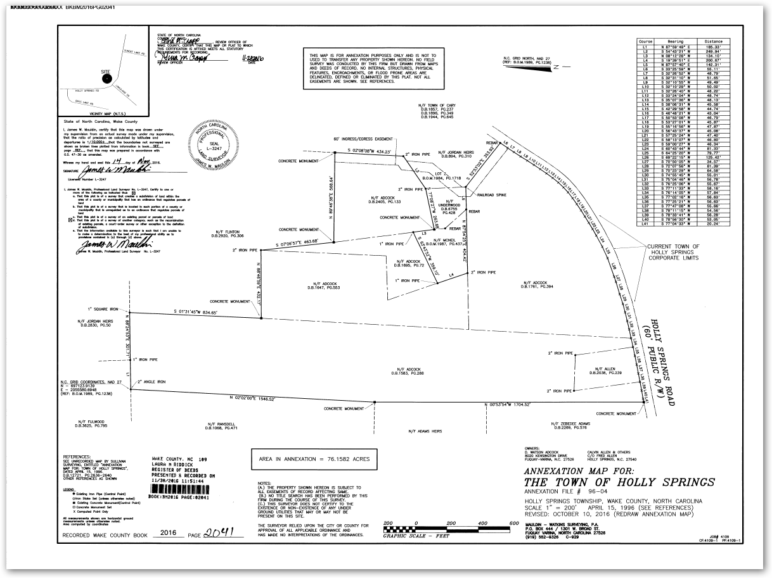
Maps provide a graphic representation of the area so someone can see exactly what is being annexed.

Slide 16
The statutes specifically stipulate an accurate map is to be recorded.
What is an accurate map?
An accurate map provides the ability to definitively locate a point from the map to a point on the ground.

Slide 17
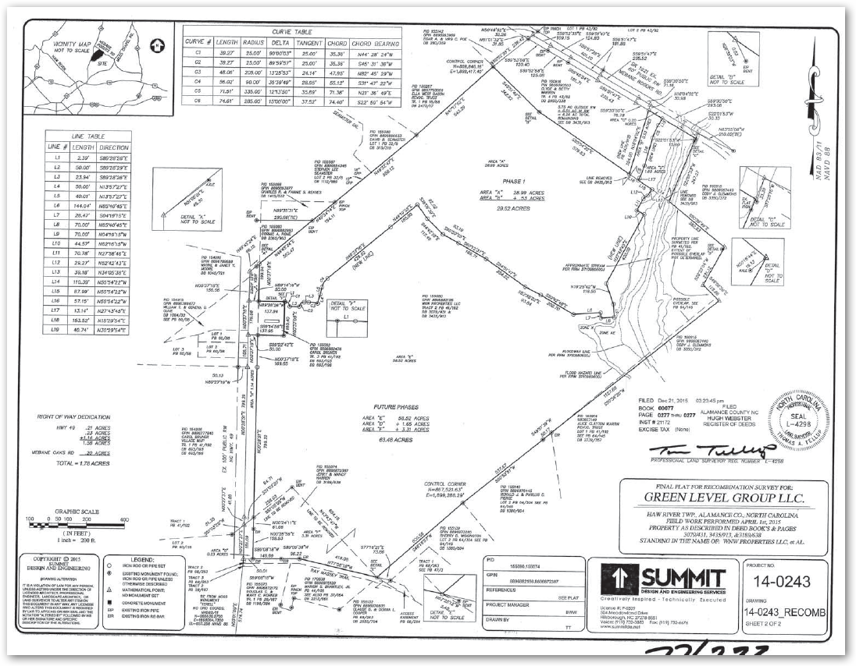
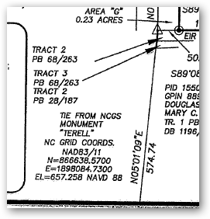
An accurate map is a survey.

Slide 18
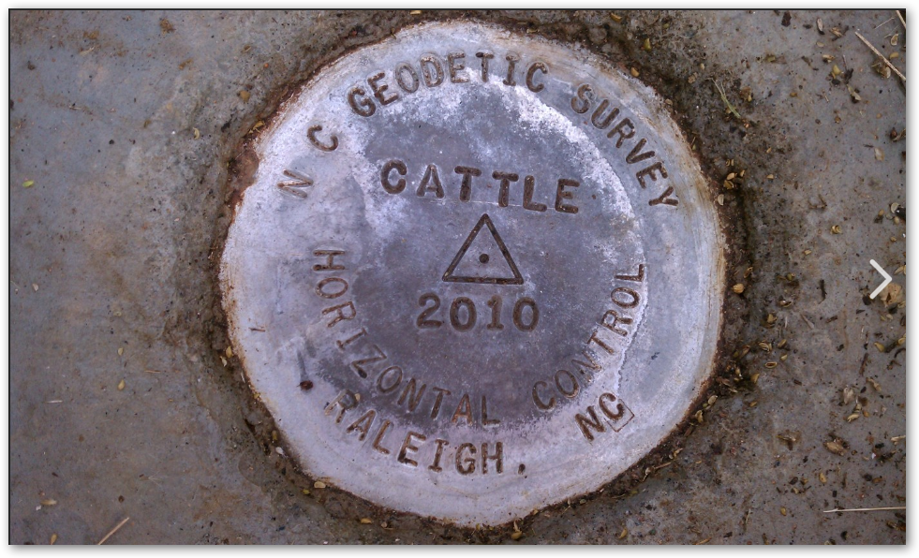
NCGS Monument - North Carolina Geodetic Survey Monument
They are markers that have been specifically measured for latitude and longitude by the NC Geodetic Survey.
Across North Carolina, there are some 30,000 survey monuments.
If a survey is within 2,000 feet of a monument, surveyors are required to tie their survey to the monument.

Slide 19
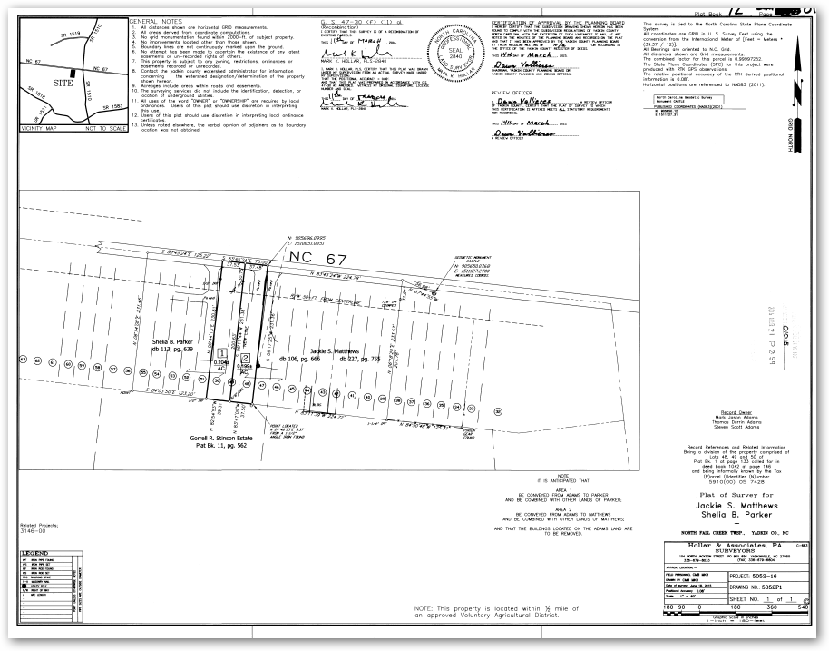
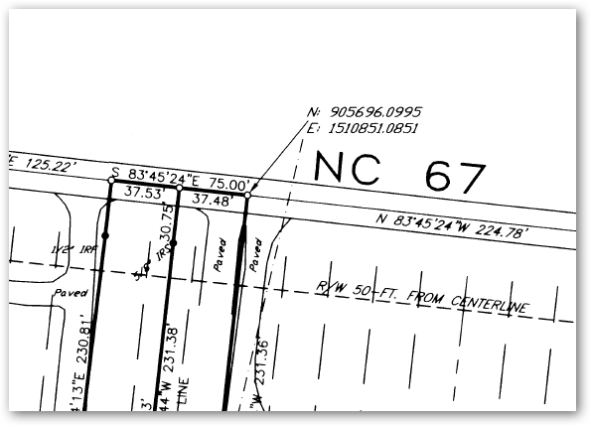
Even if there is not a geodetic survey monument within 2,000 feet, surveyors will sometimes include the State Plain coordinates of a point to give a precise location of a point or corner.

Slide 20
Surveys have a stated level of precision or accuracy.
GIS maps do not.
GIS property maps are inventory maps of the county cadastre for use by the county tax office and, by definition, are not accurate maps.

Slide 21
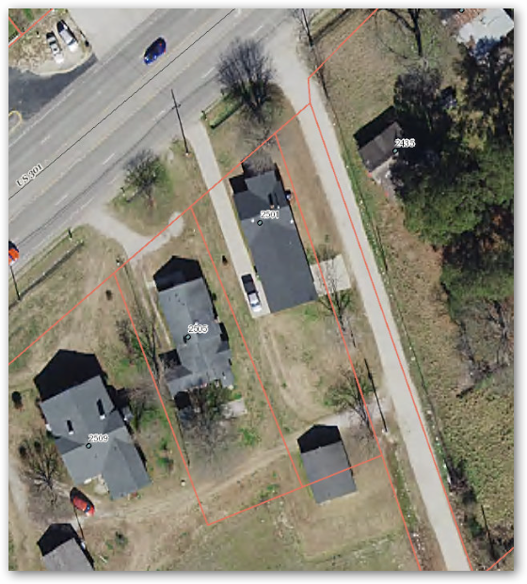
A GIS map can be off as much as 15 or 20 feet.

Slide 22
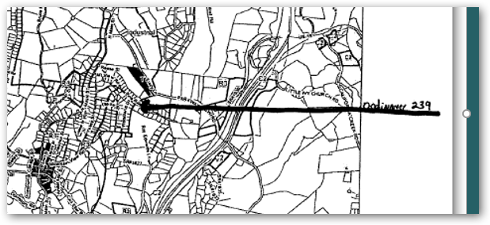
Actual map submitted as an accurate map
From this map, can you tell what is being annexed?
An illegible map
is useless!

Slide 23
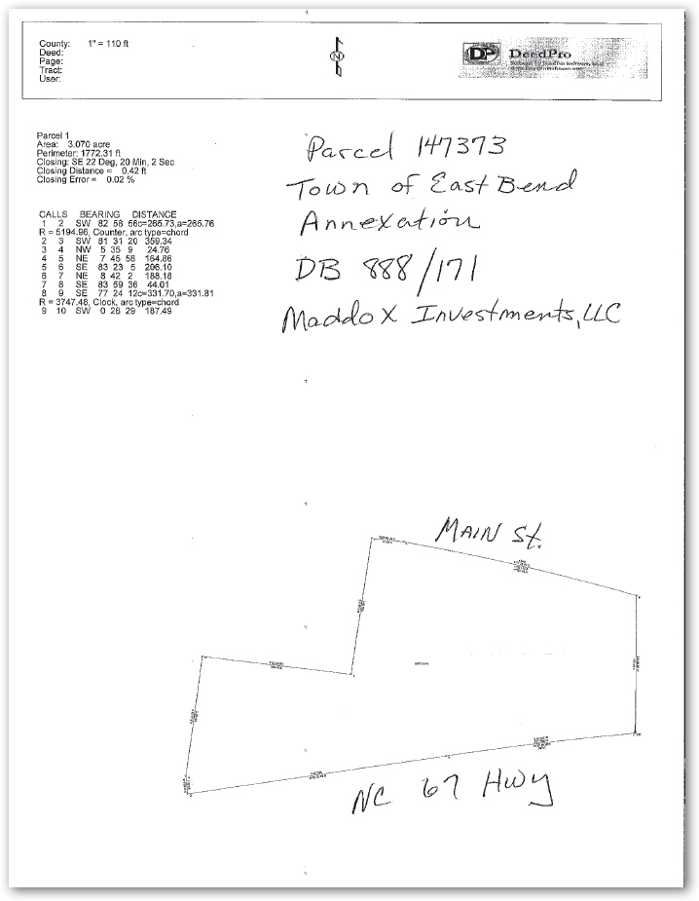
Another example of a submitted “map.”
This isn’t even a map!

Slide 24
Still another example.
Just what is getting annexed?
This GIS map submitted shows the whole parcel highlighted

Slide 25
When the written description from the annexation ordinance is plotted, it looks more like this, half the parcel indicated on the map.

Slide 26
As it turned out, the reason half the parcel was annexed was because the other half had previously been annexed.
The town did not have a survey of the area being annexed so they used the county GIS.
City Limits

Slide 27
How many counties
struggle with
how to deal
with parcels
that are
in and out
of the city limits?

Slide 28
(b) In fixing new municipal boundaries . . . a municipal governing board
§ 160A-58.54. Character of area to be annexed.
Shall comply with all the following:
(1) Use recorded property lines and streets as boundaries.
(2) Use whole parcels of property in that if any portion of that parcel is included, the entire parcel of real property as recorded in the deed transferring title shall be included.

Slide 29
Because GS 160A-58.54(b)
Stipulates municipalities must comply with the statute and the statute says . . .
(2) Use whole parcels of property in that if any portion of that parcel is included, the entire parcel of real property as recorded in the deed transferring title shall be included.
The county, in my opinion, would be in its rights to create an individual tax parcel when a portion of a parcel that is annexed.

Slide 30
Mapping of annexations

Slide 31
BEGINNING at an existing iron pin in the center of Pine Bluff Road, corner of Mamie Honeycutt (said iron pin being S. 16-57-20W. 129.34 feet from a p.k. nail in the center of the intersection of Pine Bluff Road and N.C. Highway 24-27)(said p.k. nail being N. 48-50-07 W. 43.24 feet from N.C.G.S. Monument Reed Mine); and runs thence with the center of Pine Bluff Road, S. 14-07-19 W. 241.83 feet to a p.k. nail, corner of Leith Morrison; thence with three lines of Morrison as follows: 1st, N. 73-27-58 W. 210.11 feet to an old pipe; 2nd, S.13-42-58 W. 210.43 feet to an old iron pipe in the center of a gravel drive; and 3rd, S. 73-35-13 E. 210.04 feet to a nail in the center of Pine Bluff Road; thence with the center of Pine Bluff Road five lines as follows: 1st, S. 7-37-33 W. 82.01 feet to a p.k. nail; 2nd, S. 5-15-36 W 97.73 feet to a nail; 3rd, S. 3-12-15 W. 114.02 feet to a nail; 4th, S. 1-29-36 W. 212.03 feet to a nail; and 5th, S. 0-42-42 W. 312.32 to an existing iron pin in the center of said Road, corner of Estelle Lee Estate; . . .

Slide 32
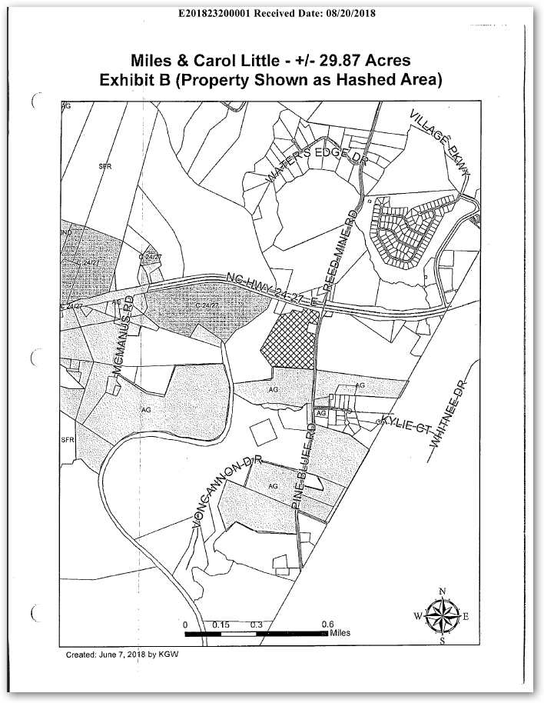
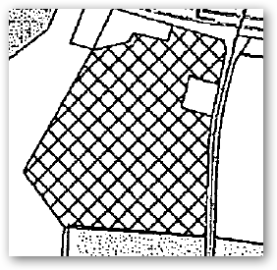
Pine Bluff Road

Slide 33
When the description is plotted over the map, there is a discrepancy.
How should the annexation be mapped in the county GIS?
Pine Bluff Road
According to the ordinance?
Or according to the submitted map?

Slide 34
Town of Yadkinville
Original description of Yadkinville
Since Yadkinville was incorporated in 1857, multiple annexations have been done.
There is no way to tell, by looking at the map, when any one of those annexations was done or how much area was annexed in a particular annexation.

Slide 35
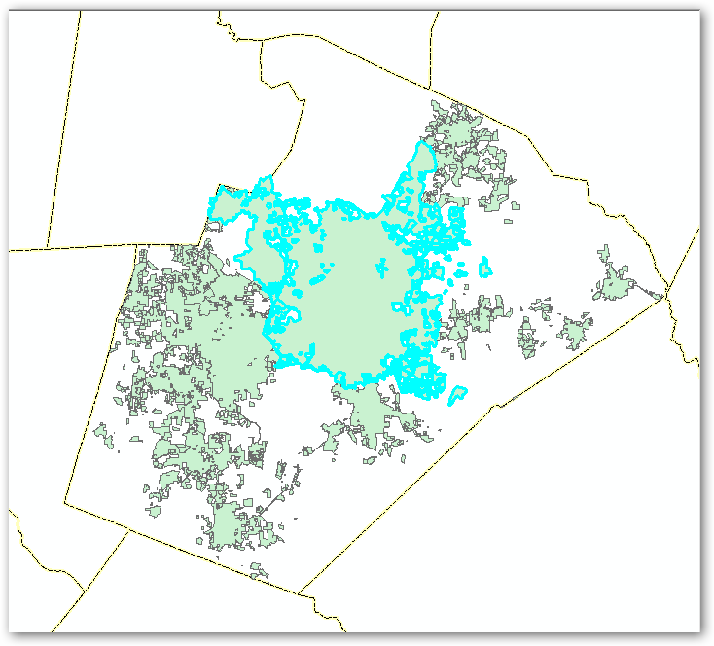
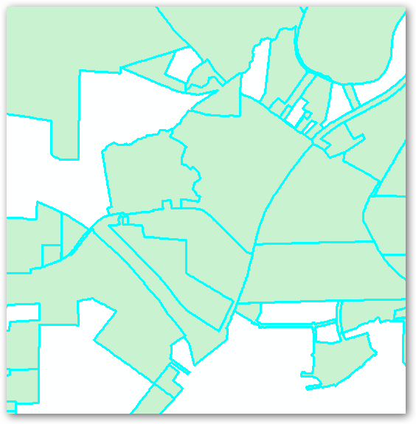
Wake County
Enables the displaying of the growth of the town over time.
Annexations are mapped with individual polygons for each annexation.
Allows for the querying for the specific annexation ordinance information.

Slide 36
In conclusion:
The Land Records Management Division of the NC Department of the Secretary of State recommends:
1. Annexations be mapped according to the description in the ordinance not according to the map provided.
2. Annexations be mapped as individual polygons rather than merged into a single polygon for the entire town.

Slide 37
Questions

